Slide 1
Machine Learning I
Lab 1 Review

Slide 2
What are we going to do?
There are two sections in this lab. On section one, you will work on the provided data set using the taught technique. For the second part you should apply the techniques on News popularity data set.
We will apply decision tree and random forest on three datasets
We will evaluate decision tree for both regression and classification problem

Slide 3
Method 1- Decision Tree
Download “credit.csv” from Moodle
Prepare the dataset
Implement the decision tree
Evaluate the result

Slide 4
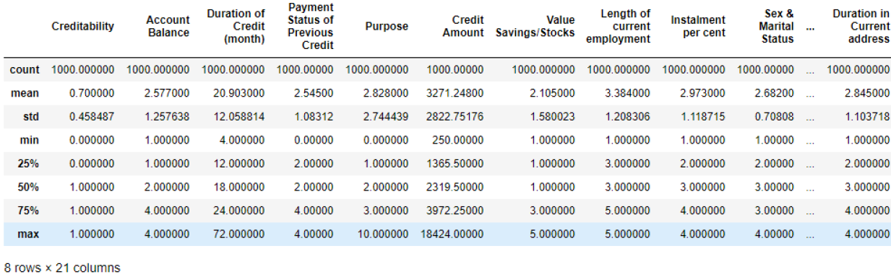
Data collection
import pandas as pd
# import the csv file
input_file = "address/to/file/credit.csv"
credit = pd.read_csv(input_file)
credit.describe()

Slide 5
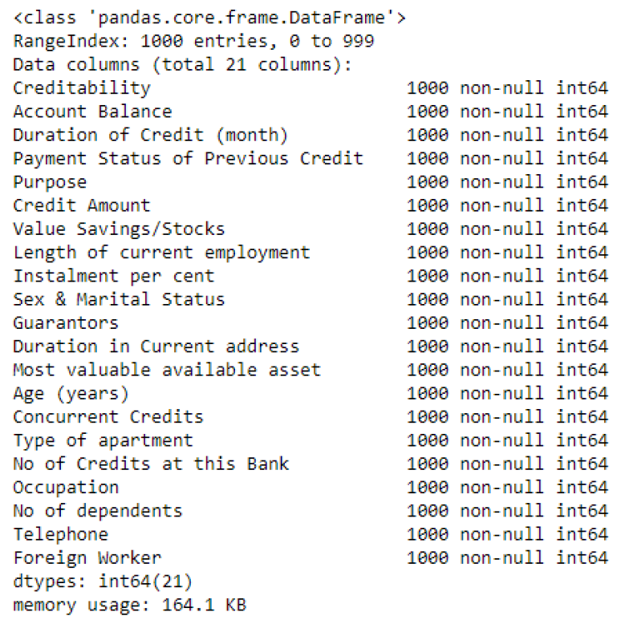
Exploring the data
credit.info()
What is target variable?
target = credit['creditability']

Slide 6
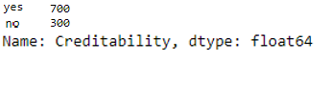
Exploring the data
One issue with using the decision tree in Python is with categorical data. There is a one additional step of pre-processing when you want to use decision tree for categorical data in python.
Check the output and see the difference.
target.value_counts()

Slide 7
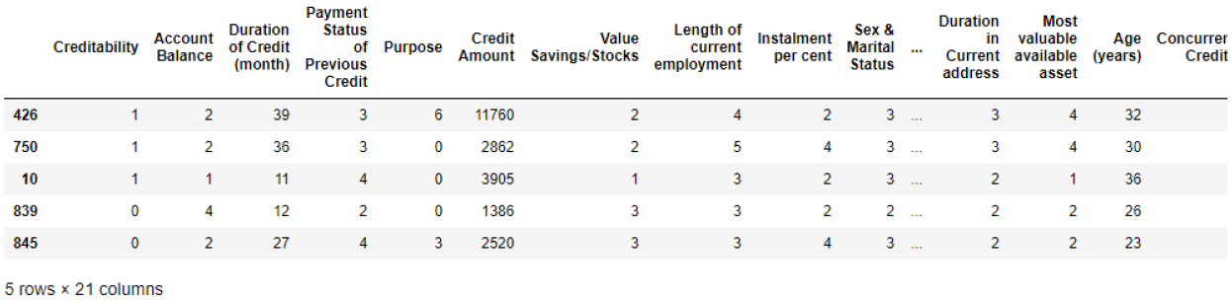
Splitting data- Method 1
In order to develop the tree-based classification model you need to split the data into training and test records.
# Generate random numbers
import random
random.seed(12345)
indx = random.sample(range(0, 1000), 1000)
credit_rand = credit.iloc[indx]
target_rand = target.iloc[indx]
credit_rand.head(5)

Slide 8


Splitting data- Method 1
Run this command and compare the results:
Generally we use 75% to 90% for training and the rest for testing
A good Randomization should show close percentages between splits
credit_rand.describe()
credit_train = credit_rand.iloc[0:700]
credit_test = credit_rand.iloc[7000:1000]
target_train = target_rand.iloc[0:700]
target_test = target_rand.iloc[700:1000]
target_train.value_counts()/700
target_test.value_counts()/300

Slide 9
Splitting data- Method 2
We can use following code to split data
# Method 2 of splitting the model
from sklearn.model_selection import train_test_split
y = target
X = credit.drop(['Creditability'], axis=1)
X_train, X_test, y_train, y_test = train_test_split(X, y, test_size=0.30, random_state=52)

Slide 10
Training the model
Train the model:
# Design decision tree
from sklearn import tree
from sklearn.tree import DecisionTreeClassifier
model = tree.DecisionTreeClassifier()
model = model.fit(X_train, y_train)

Slide 11
Visualize the model
Visualize the model
from IPython.display import SVG
from graphviz import Source
from IPython.display import display
graph = Source(tree.export_graphviz(model, out_file=None
, feature_names=X.columns, class_names=['default', 'no default']
, filled = True))
display(SVG(graph.pipe(format='svg')))

Slide 12
Model Evaluation
Train the model:
Q1- If you see the accuracy 0f 100%, what does it mean? Does this mean that we design a perfect model? This is some thing that needs more discussion. Write a few sentences about accuracy of 100%.
from sklearn.metrics import confusion_matrix
from sklearn.metrics import accuracy_score
y_predict = model.predict(X_test)
confusion_matrix(y_test, y_predict)
accuracy_score(y_test, y_predict)*100

Slide 13

Part 2- Random forest
Let’s use the same dataset but this time for random forest. Use the similar strategy described in course to see the accuracy.
Q2 – What are the three most important features in this model.
Now, Change the random seed to 23458 and find the new accuracy of random forest.
X_train, X_test, y_train, y_test = train_test_split(X, y, test_size=0.30, random_state=52)
clf = RandomForestClassifier()
clf.fit(X_train, y_train)
y_predict = clf.predict(X_test)
print(confusion_matrix(y_test, y_predict))
print(accuracy_score(y_test, y_predict)*100)

Slide 14
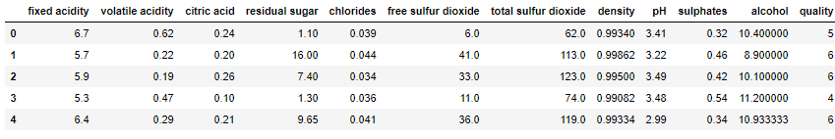
Part 3- Decision tree and regression
Load the withewines dataset
input_file = "address/to/file/whitewines.csv"
wine = pd.read_csv(input_file)
wine.head(5)

Slide 15
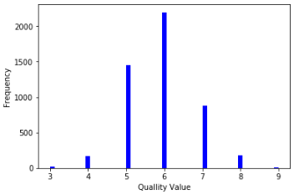
Pre-processing
Load the withewines dataset
# Plot the target variable
import matplotlib.pyplot as plt
# An "interface" to matplotlib.axes.Axes.hist() method
n, bins, patches = plt.hist(x=wine['quality'], bins='auto', color='b', )
plt.xlabel('Quallity Value')
plt.ylabel('Frequency')
plt.show()

Slide 16
Splitting data and train the model
Split data to 60% for training and 40% to testing use the seed of 12345
And start to train the model similar to a regular decision tree
X = wine.drop(['quality'], axis=1)
y = wine['quality']
X_train, X_test, y_train, y_test = train_test_split(X, y, test_size=0.40, random_state=1234)
model = tree.DecisionTreeClassifier()
model = model.fit(X_train, y_train)

Slide 17
What is going inside the model?
We can use following codes to see inside the model
from sklearn.tree import export_graphviz
export_graphviz(model, out_file ='tree.dot', feature_names =X.columns)
digraph Tree {
node [shape=box] ;
0 [label="alcohol <= 10.75\ngini = 0.674\nsamples = 2938\nvalue = [14, 104, 890, 1322, 502, 104, 2]"] ;
1 [label="volatile acidity <= 0.287\ngini = 0.622\nsamples = 1780\nvalue = [10, 83, 757, 774, 131, 24, 1]"] ;
0 -> 1 [labeldistance=2.5, labelangle=45, headlabel="True"] ;
2 [label="volatile acidity <= 0.227\ngini = 0.618\nsamples = 1088\nvalue = [8, 32, 339, 568, 116, 24, 1]"] ;
1 -> 2 ;
3 [label="alcohol <= 8.75\ngini = 0.59\nsamples = 533\nvalue = [3, 14, 113, 313, 73, 17, 0]"] ;
2 -> 3 ;
4 [label="sulphates <= 0.425\ngini = 0.667\nsamples = 21\nvalue = [1, 0, 6, 3, 10, 1, 0]"] ;
3 -> 4 ;

Slide 18
Evaluate the model
Now evaluate the model but remember that this is the regression.
Q3- What is your interpretation about this amount of RMSE?
The value will be 0.84. Is this a good value?
np.corrcoef(y_test,y_predict)
from sklearn.metrics import mean_squared_error
RMSE = mean_squared_error(y_predict, y_test)**0.5
RMSE

Slide 19
News Popularity
The News data set is the Online News Popularity data set from the University of California - Irvine Machine Learning Data Repository
In addition two Journals:
“Predicting and Evaluating the Popularity of Online News” by He Ren and Quan Yang,
“A Proactive Intelligent Decision Support System for Predicting the Popularity of Online News” by Kelwin Fernandes,
The URL for the data set description is:
http://archive.ics.uci.edu/ml/datasets/Online+News+Popularity#

Slide 20
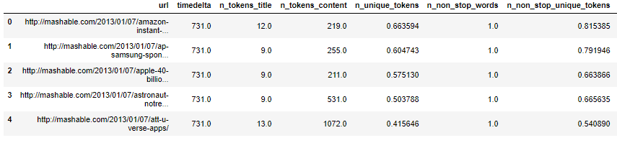
Load and start pre-processing
This is the dataset:
We want to make this problem a classification one. One approach is to make any piece of article more than 1400 likes as a favorite one

Slide 21
Code for making the target
Based on our criteria:
Q4- Try decision tree and random forest and evaluate the model.
# handle goal attrubte to binary
popular = news.shares >= 1400
unpopular = news.shares < 1400
news.loc[popular,'shares'] = 1
news.loc[unpopular,'shares'] = 0

