Slide 1
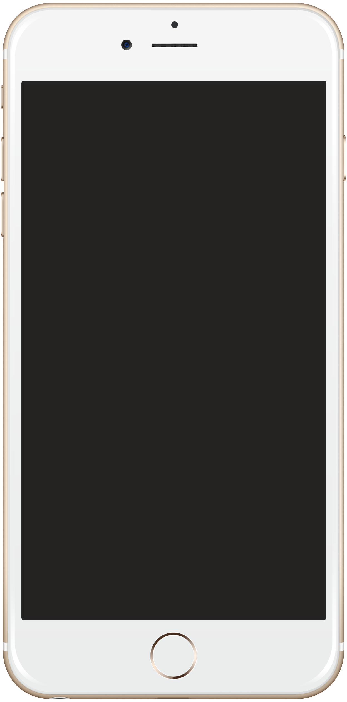
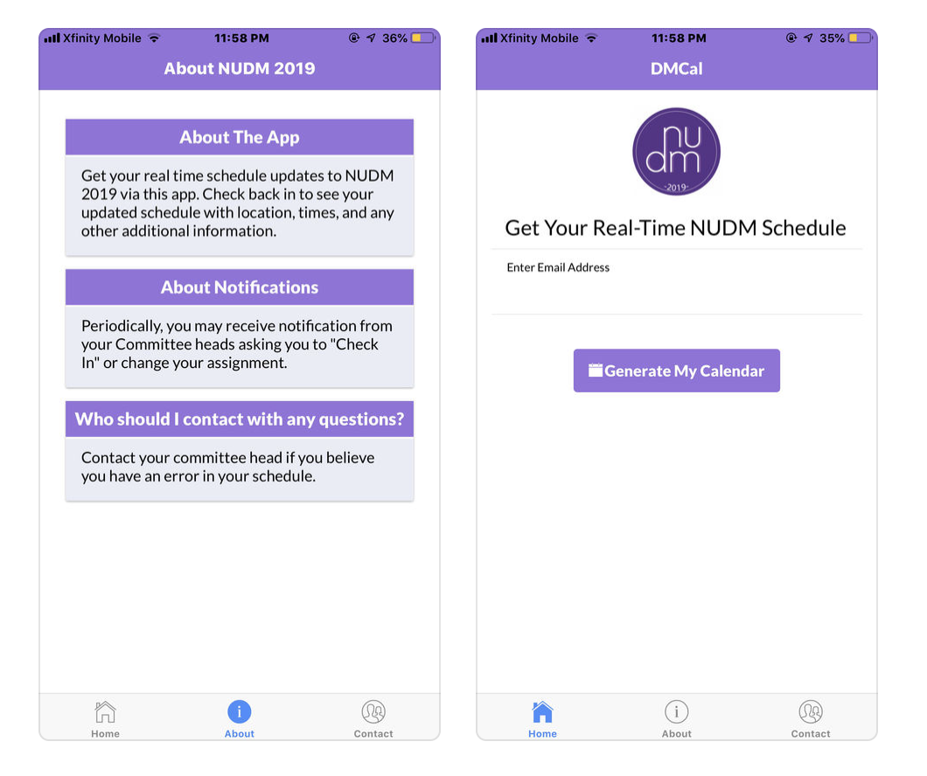
NUDM Committee Member
Mobile application for Northwestern University Dance Marathon 2019, one of the largest independent student-run philanthropies in the country.
App generates live schedules for committee members.
App sends two types of notifications: committee member reminders to complete tasks and custom notifications from executive co-chairs.

