Slide 1

BE1002:
Flask and Web Servers
05 October 2023
Raffles Hall Developers AY23/24

Slide 2
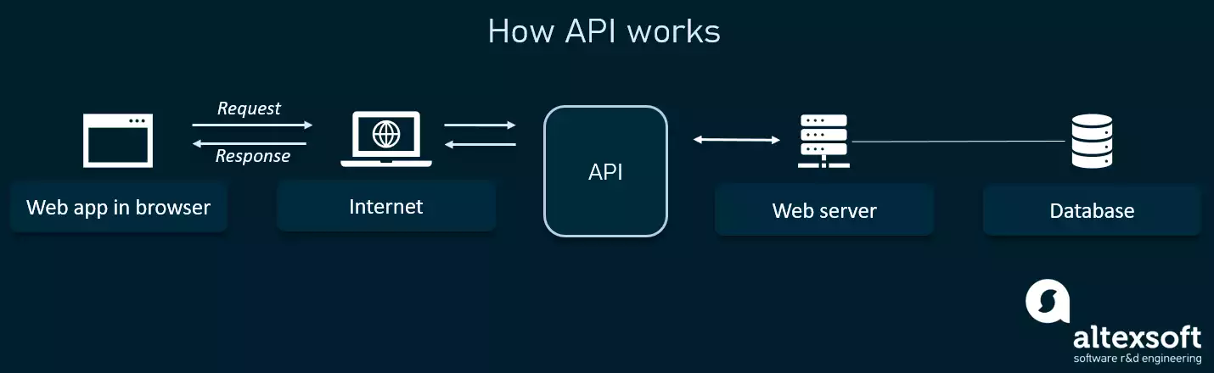
Server Basics - Like really basic
Raffles Hall Developers AY23/24
Notes:
So in our context, web app is our rhapp, when u click a button for e.g. gym, it sends a request to the internet then to the API. API will tell the web server what to do, like what information to take from the db. And return back the other way to show up on the web app, which my example clicking on the gym button, it will then bring u to gym page.

Slide 3
API
Implement a server that only handles request for data.
Typically JSON format for data.
Rendering and Updating: Done with React (Frontend)
JSON:
{
“KEY”: “VALUE”
}
Raffles Hall Developers AY23/24

Slide 4
API
Very importantly, APIs are organised around endpoints.
Raffles Hall Developers AY23/24
Notes:
Know your HTTPS methods

Slide 5
API
Format: {baseURL}/A/B/C/D
{baseURL} : rhapp.lol
Example: rhapp.lol/gym
Static vs Variable endpoint:
Static: specific item/categories (e.g. gym)
Variable: Used to specify specific items/identifiers → usually passed in as a variable (e.g. bookings/{userID} // GET bookings/A1234567B - retrieve booking with the userID: A1234567B)
Raffles Hall Developers AY23/24

Slide 6
API
Internal Naming Conventions
Static Endpoint: >1 item → use plural form e.g. /bookings/
Base Endpoint: Specify all the categories → e.g. DELETE /bookings, POST /bookings, GET /bookings
Use methods to describe verbs; use endpoints to describe noun
→ ✅ DELETE /student/{studentID}
→ ❌ DELETE /delete-student/{studentID}
Structure the endpoints hierarchically if possible {language}/topics/{topicName}/{articleID}
→ e.g. EN/topics/Software-Engineering/How-To-Survive
Raffles Hall Developers AY23/24

Slide 7
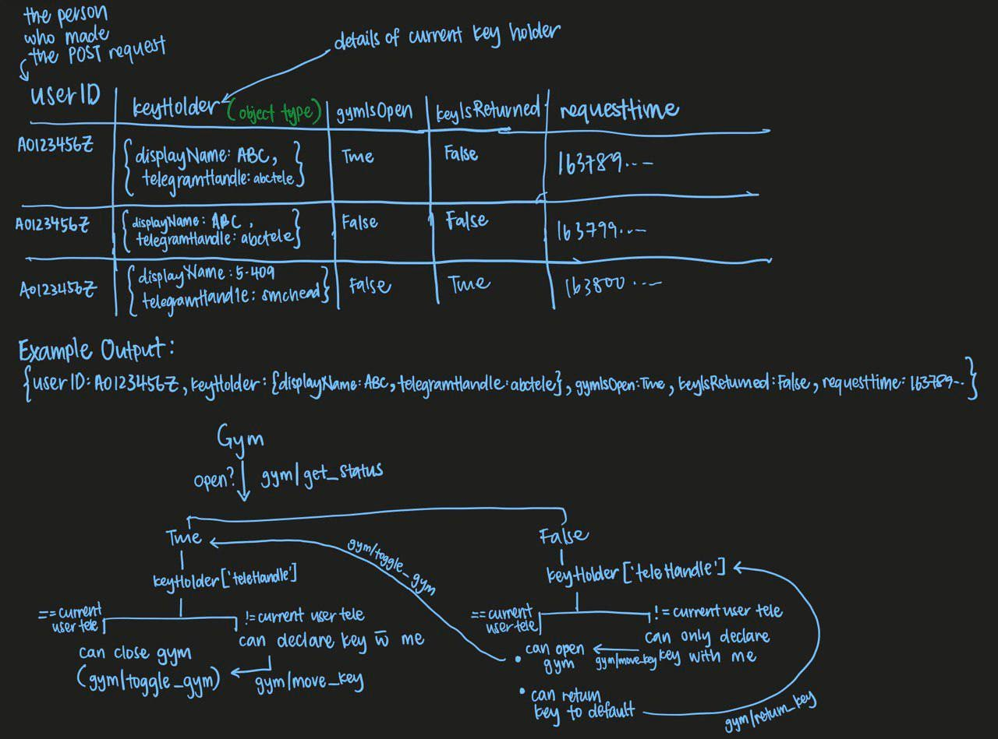
How to Plan (?)
Raffles Hall Developers AY23/24

Slide 8
Code Time
Raffles Hall Developers AY23/24

