Slide 1

INTRO TO JAVASCRIPT AND TYPESCRIPT
ENTER
Notes:
DO YOU KNOW THAT you can actually click on the buttons on the slides?? Try them out!

Slide 2



LESSON SUMMARY
Introduction to JavaScript
Javascript Live Demo
Introduction to Typescript
Typescript Live Demo
Assignment
JS
TS
Assignment
Notes:
DO YOU KNOW THAT you can actually click on the buttons on the slides?? Try them out!

Slide 3
Part 1
Introduction to Javascript
JS
TS
Assignment

Slide 4
JavaScript
Programming Language of the Web
Web Dev Libraries
High-level, easy to learn
Weakly Typed
JS
TS
Assignment

Slide 5
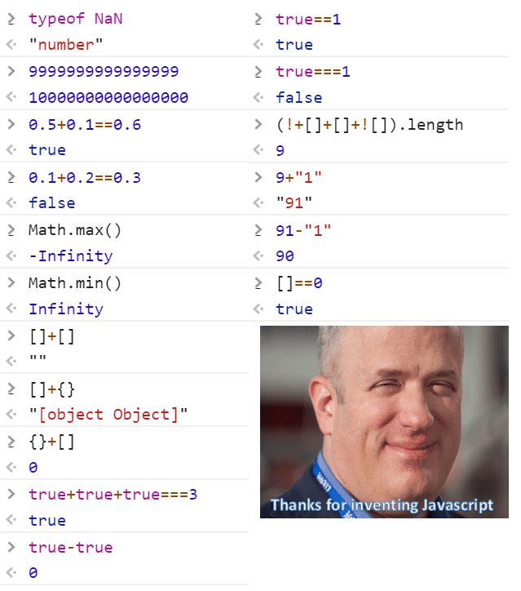
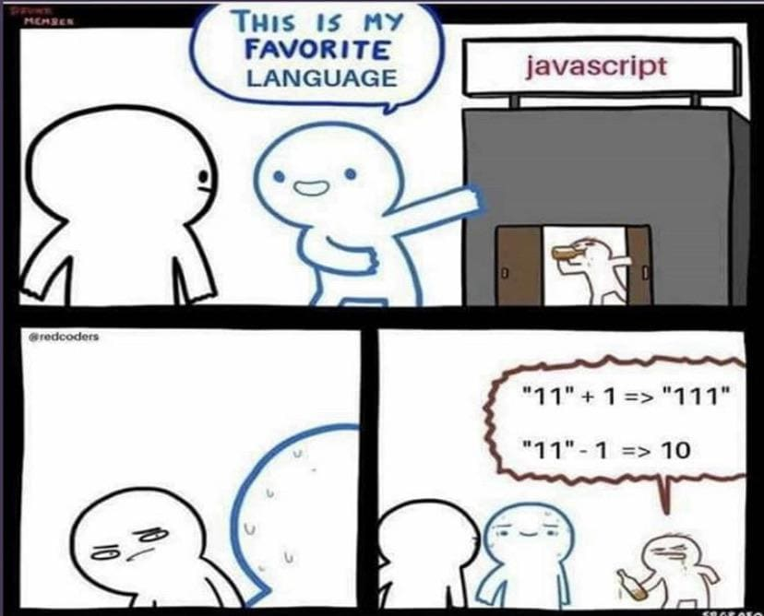
JS
TS
Assignment
Notes:
Demo ('b' + 'a' + + +'a' + 'a').toLowerCase() on F12

Slide 6
Lesson Content: Javascript
Declaring Variables
Types of primitive data
Javascript Fundamentals
Ternary Operators
Switch
Loops
Functions
JS
TS
Assignment
Notes:
Open a website and show how Javascript is embedded in the website

Slide 7
Javascript DEMO
www.programiz.com/javascript/online-compiler/
JS
TS
Assignment

Slide 8
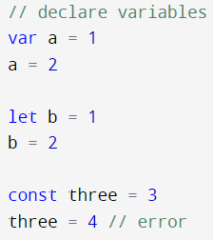
Declaring variables
There are three ways to declare variables!
Var = global
Let = not global
Const = not modifiable
Type of data is auto-determined
JS
TS
Assignment
Notes:
// declare variables
var a = 1
a = 2
let b = 1
b = 2
const three = 3
three = 4 // error

Slide 9
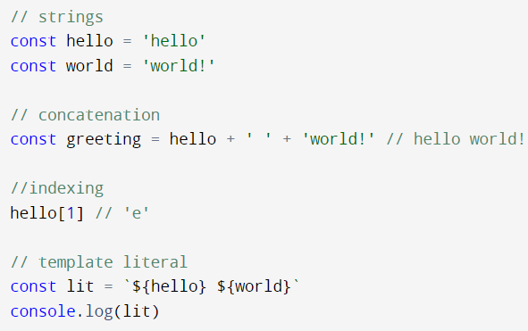
String Declaration & Concatenation
JS
TS
Assignment
Notes:
// strings
const hello = 'hello'
const world = 'world!'
// concatenation
const greeting = hello + ' ' + 'world!' // hello world!
//indexing
hello[1] // 'e'
// template literal
const lit = `${hello} ${world}`
console.log(lit)

Slide 10
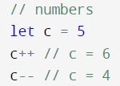
Numbers
JS
TS
Assignment
Notes:
// numbers
let c = 5
c++ // c = 6
c-- / c = 4

Slide 11
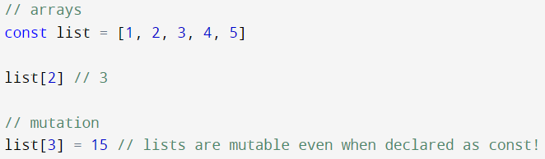
Arrays!
JS
TS
Assignment
Arrays
Collection of items
Can be referred to via their index
Modifiable even if they are declared as constant!
Notes:
// arrays
const list = [1, 2, 3, 4, 5]
list[2] // 3
// mutation
list[3] = 15 // lists are mutable even when declared as const!
console.log(list)

Slide 12
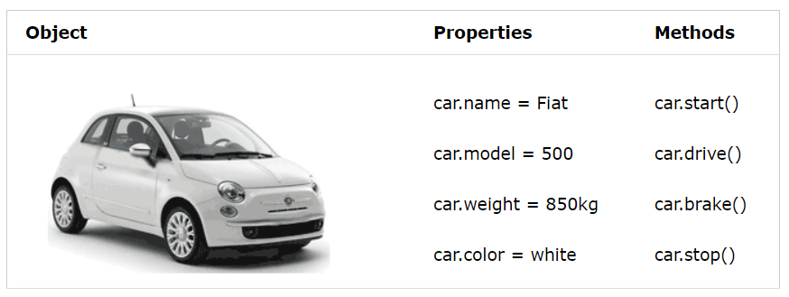
Objects
In real life, a car is an object. A car has properties like weight and color, and methods like start and stop.
JS
TS
Assignment
All cars have the same properties, but the property values differ from car to car.

Slide 13
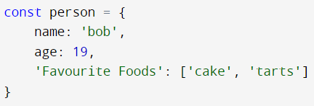
Object Declaration
JS
TS
Assignment
Object declaration contains:
Name of object
Properties of object
Key and value pairs
Notes:
const person = {
name: 'bob',
age: 19,
'Favourite Foods': ['cake', 'tarts']
}

Slide 14
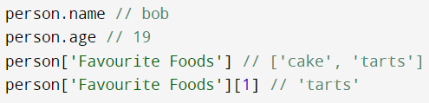
Object Referencing
JS
TS
Assignment
This is how you reference object properties!
Notes:
person.name // bob
person.age // 19
person['Favourite Foods'] // ['cake', 'tarts']
person['Favourite Foods'][1] // 'tarts'

Slide 15
Exercise 1
Declare an object named Student with:
Properties include:
Name (your name, a string)
Block Number
Favourite Food (one string)
CCAs (an array!)
JS
TS
Assignment
Notes:
person.name // bob
person.age // 19
person['Favourite Foods'] // ['cake', 'tarts']
person['Favourite Foods'][1] // 'tarts'

Slide 16
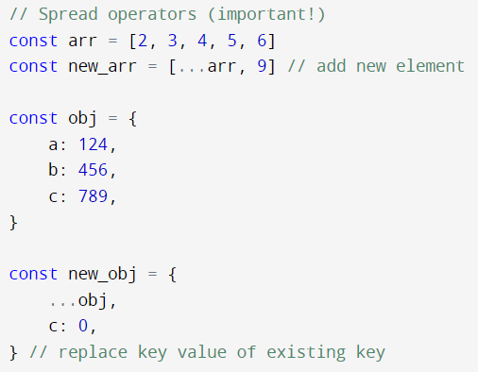
Spread operators
Spread operators quickly copy all or part of an existing array/object into another array/object.
JS
TS
Assignment
Notes:
person.name // bob
person.age // 19
person['Favourite Foods'] // ['cake', 'tarts']
person['Favourite Foods'][1] // 'tarts'

Slide 17
Exercise 2
For the object from Exercise 1:
Declare a new object Student2, where all properties remain the same as Student, except that Favourite Food changes (switch it out with your other favourite food!)
JS
TS
Assignment
Notes:
person.name // bob
person.age // 19
person['Favourite Foods'] // ['cake', 'tarts']
person['Favourite Foods'][1] // 'tarts'

Slide 18
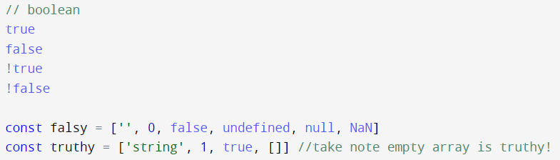
Boolean Values (falsy/truthy)
JS
TS
Non-boolean values are evaluated to either True or False in a boolean context.
Truthy values are values that evaluate to True in a boolean context.
Falsy values are values that evaluate to False in a boolean context.
Assignment
Notes:
// boolean
true
false
!true
!false
const falsy = ['', 0, false, undefined, null, NaN]
const truthy = ['string', 1, true, []] //take note empty array is truthy!

Slide 19
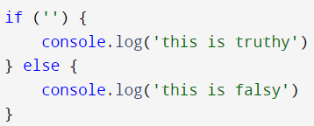
Boolean Values (falsy/truthy)
JS
TS
Assignment
Notes:
if ('') {
console.log('this is truthy')
} else {
console.log('this is falsy')
}

Slide 20
Javascript
Fundanmentals
JS
TS
Assignment

Slide 21
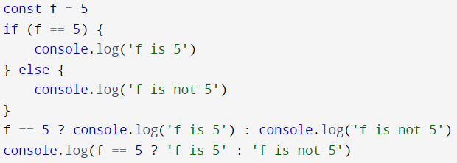
Ternary operators
JS
TS
Assignment
Ternary operators (? and :) can make if-else statements much more concise.
Notes:
const f = 5
if (f == 5) {
console.log('f is 5')
} else {
console.log('f is not 5')
}
f == 5 ? console.log('f is 5') : console.log('f is not 5')
console.log(f == 5 ? 'f is 5' : 'f is not 5')

Slide 22
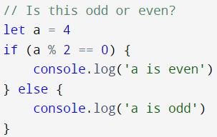
Exercise 3
JS
TS
Assignment
Rewrite this using ternary operators.
Notes:
// Is this odd or even?
let a = 4
if (a % 2 == 0) {
console.log('a is even')
} else {
console.log('a is odd')
}

Slide 23
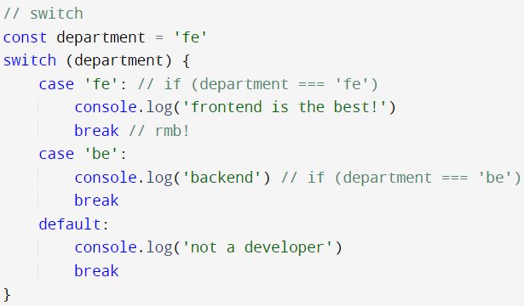
Switch
JS
TS
Assignment
Perform different actions based on different conditions
Note: the next case will be executed even if the evaluation does not match the case if break is omitted!
Notes:
const department = 'fe'
switch (department) {
case 'fe': // if (department === 'fe')
console.log('frontend is the best!')
break // rmb!
case 'be':
console.log('backend') // if (department === 'be')
break
default:
console.log('not a developer')
break
}

Slide 24
Exercise 4
JS
Write a code that outputs "I am coming!" if the var free is true, and outputs "I cannot make it" if the var free is false, using switch. (default: output “I’m not sure”)
TS
Assignment
Notes:
// Write a code that outputs "I am coming!" if the var free is true, and outputs "I cannot make it" if the var free is false, using switch.

Slide 25
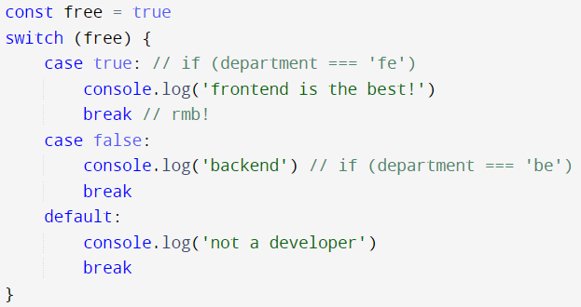
Exercise 4 Solution
JS
TS
Assignment
Notes:
const free = true
switch (free) {
case true: // if (department === 'fe')
console.log('frontend is the best!')
break // rmb!
case false:
console.log('backend') // if (department === 'be')
break
default:
console.log('not a developer')
break
}

Slide 26
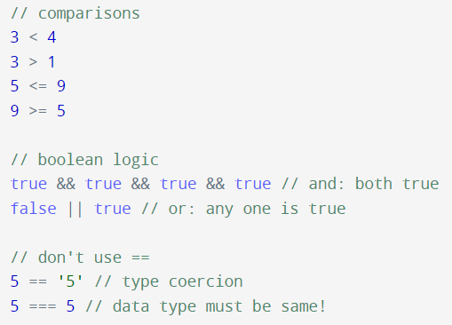
Comparison
JS
TS
Assignment
Notes:
// comparisons
3 < 4
3 > 1
5 <= 9
9 >= 5
// boolean logic
true && true && true && true // and: both true
false || true // or: any one is true
// don't use ==
5 == '5' // type coercion
5 === 5 // data type must be same!

Slide 27
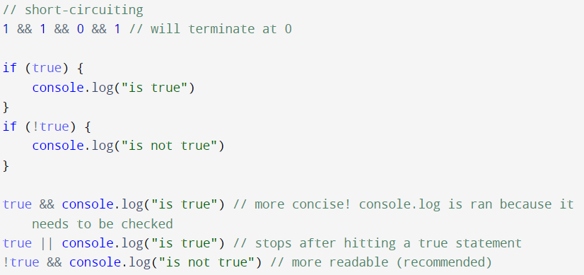
Short-circuiting
JS
Javascript evaluates an expression from left to right with || and && operators.
If the condition is met and the rest of the conditions won’t affect the already evaluated result, the expression will short-circuit and return that result (value).
Used to make if-else statements more concise
TS
Assignment
Notes:
// comparisons
3 < 4
3 > 1
5 <= 9
9 >= 5
// boolean logic
true && true && true && true // and: both true
false || true // or: any one is true
// don't use ==
5 == '5' // type coercion
5 === 5 // data type must be same!

Slide 28
Short-circuiting
JS
TS
Assignment
Notes:
// short-circuiting
1 && 1 && 0 && 1 // will terminate at 0
if (true) {
console.log("is true")
}
if (!true) {
console.log("is not true")
}
true && console.log("is true") // more concise! console.log is ran because it needs to be checked
true || console.log("is true") // stops after hitting a true statement
!true && console.log("is not true") // more readable (recommended)

Slide 29
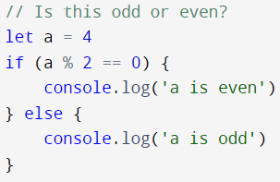
Exercise 5
JS
TS
Assignment
Use short-circuit to rewrite this code block.
Notes:
// Is this odd or even?
let a = 4
if (a % 2 == 0) {
console.log('a is even')
} else {
console.log('a is odd')
}

Slide 30

Exercise 5 Solution
JS
TS
Assignment
Notes:
let a = 4
a % 2 === 0 && console.log('a is even')
a % 2 !== 0 && console.log('a is odd')

Slide 31
Loops
JS
TS
Assignment
Notes:
// while loop
let count = 0
while (count < 10) {
console.log(count)
count++
}
// do while loop
let ct2 = 0
do {
console.log(ct2)
ct2++
} while (ct2 < 10)
// for loop
for (let i = 0; i < 10; i++) {
console.log(i)
}

Slide 32
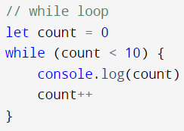
While loop
JS
TS
Assignment
While loop checks for condition first, and repeats the loop if condition is satisfied.

Slide 33
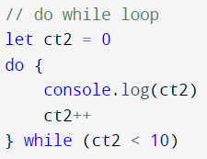
Do While loop
JS
TS
Assignment
Do while loop executes the loop first, then checks for condition - the loop is repeated if condition is satisfied.

Slide 34
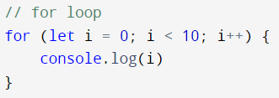
For loop
JS
TS
Assignment
For loop repeats the loop for a fixed number of times.

Slide 35
Functions
JS
TS
Assignment
Notes:
// while loop
let count = 0
while (count < 10) {
console.log(count)
count++
}
// do while loop
let ct2 = 0
do {
console.log(ct2)
ct2++
} while (ct2 < 10)
// for loop
for (let i = 0; i < 10; i++) {
console.log(i)
}

Slide 36
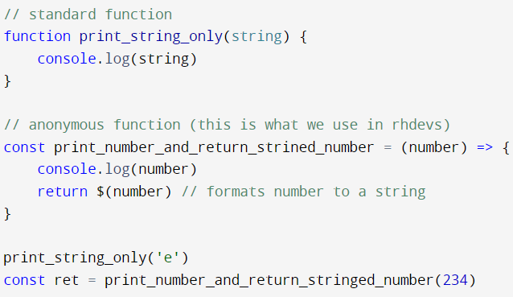
Standard Function
JS
TS
Assignment
Notes:
// standard function
function print_string_only(string) {
console.log(string)
}
// anonymous function (this is what we use in rhdevs)
const print_number_and_return_strined_number = (number) => {
console.log(number)
return $(number) // formats number to a string
}
print_string_only('e')
const ret = print_number_and_return_stringed_number(234)

Slide 37
Anonymous Function
JS
TS
Assignment
Stored as variable instead, can be used as arguments!

Slide 38
Lesson Content: Javascript
To recap, we have learnt:
Declaring Variables
Types of primitive data
Javascript Fundamentals
Ternary Operators
Switch
Loops
Functions
JS
TS
Assignment
Notes:
Open a website and show how Javascript is embedded in the website

Slide 39
Part 2
Introduction to Typescript
JS
TS
Assignment

Slide 40
TypeScript
Syntactic superset of JavaScript
JS is loosely-typed -> hard to tell datatype
TS specifies datatypes and raises errors when types don’t match in code
Type checking done in compile time —> possible for variable to be assigned the wrong datatype value in runtime! (e.g. API response data)
JS
TS
Assignment
Notes:
Open a website and show how Javascript is embedded in the website

Slide 41
Some Conventions and Good practices
Do not use var
Use === instead of ==
camelCase for variable names, PascalCase for type alias, UPPER_CASE for global constants
Emphasis on READABILITY; DRY/KISS principle
Read our style guide here!
JS
TS
Assignment
Notes:
https://www.notion.so/heads-of-rhdevs/WIP-RHDevs-Frontend-Code-Style-Guide-b5f294c047f14f78b370031afb2c73c5

Slide 42
Lesson Content: Typescript
Declaring Variables
Types aliases
Union Types
Map & Reduce
JS
TS
Assignment
Notes:
Open a website and show how Javascript is embedded in the website

Slide 43
Typescript DEMO
typescriptland.org/play
JS
TS
Assignment

Slide 44

Declaring variables
JS
TS
Variables have fixed type which cannot be changed after declaration, and the type can be declared.
Assignment
Notes:
let str = 'use let instead!' // local variable
str = 3 // invalid!
let str: string = 'use let instead!' // local variable
str = "me"

Slide 45
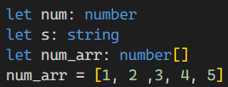
Examples
JS
TS
Assignment
Notes:
let num: number
let s: string
let num_arr: number[]
num_arr = [1, 2 ,3, 4, 5]

Slide 46

Type aliases
JS
TS
Type Aliases allow defining types with a custom name (an Alias).
Assignment
Notes:
// type aliases
type NumberArray = number[]
const number_array: NumberArray = [2, 3, 4, 5]

Slide 47
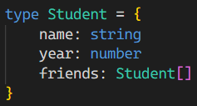
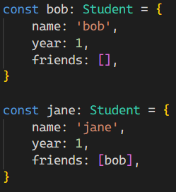
Object Type Declaration
JS
TS
Assignment
Declare custom types for objects to make sure all your objects have the correct properties!
Notes:
type Student = {
name: string
year: number
friends: Student[]
}
const bob: Student = {
name: 'bob',
year: 1,
friends: [],
}
const jane: Student = {
name: 'jane',
year: 1,
friends: [bob],
}

Slide 48

Union Types
JS
TS
Assignment
A union type a value that can be one of several types.
Use this if your variable can have several possible types.
Notes:
let string_or_number: string | number
string_or_number = 7
string_or_number = '7'
// notice how they're both valid!

Slide 49
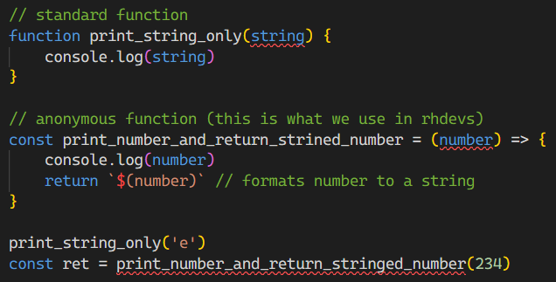
Functions
JS
TS
Assignment
Notice how they’re invalid - need to add type to parameters!
Notes:
// standard function
function print_string_only(string) {
console.log(string)
}
// anonymous function (this is what we use in rhdevs)
const print_number_and_return_strined_number = (number) => {
console.log(number)
return $(number) // formats number to a string
}
print_string_only('e')
const ret = print_number_and_return_stringed_number(234)

Slide 50
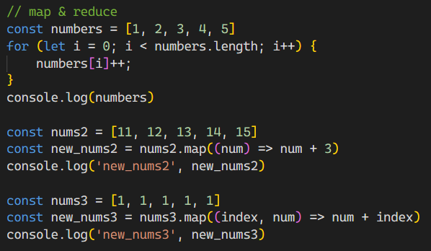
Map
JS
TS
This code increments all numbers in “numbers” by 1. It works, but can we be more efficient?
Assignment
Notes:
// map & reduce
const numbers = [1, 2, 3, 4, 5]
for (let i = 0; i < numbers.length; i++) {
numbers[i]++;
}
console.log(numbers)

Slide 51
Map
JS
TS
map takes in a one-parameter function and modifies each element using the function.
Assignment
Notes:
const nums2 = [11, 12, 13, 14, 15]
const new_nums2 = nums2.map((num) => num + 3)
console.log('new_nums2', new_nums2)

Slide 52
Map
JS
TS
map can take in index as well! (making it a 2 parameter function)
Assignment
Notes:
const nums3 = [1, 1, 1, 1, 1]
const new_nums3 = nums3.map((index, num) => num + index)
console.log('new_nums3', new_nums3)

Slide 53

Exercise 7
JS
TS
Assignment
Fill in the code such that new_nums will square all the elements in nums
Notes:
const nums = [1, 2, 3, 4, 5]
const new_nums = /* ??? */
console.log('new_nums', new_nums)

Slide 54

Exercise 7 Solution
JS
TS
Assignment
Notes:
const nums = [1, 2, 3, 4, 5]
const new_nums = nums.map((num) => num * num)
console.log('new_nums', new_nums)

Slide 55
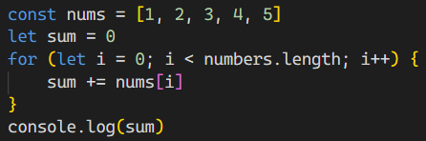
Reduce
JS
TS
This function goes through all elements and combines all of them into a sum.
This works, but it can be more efficient…
Assignment
Notes:
const nums = [1, 2, 3, 4, 5]
let sum = 0
for (let i = 0; i < numbers.length; i++) {
sum += nums[i]
}
console.log(sum)

Slide 56

Reduce
JS
TS
reduce apply a function against two values of the array as to reduce it to a single value.
Assignment
Notes:
const reduce_this = [1, 2, 3, 4, 5]
const reduced = reduce_this.reduce((val1, val2) => val1 + val2)
console.log('reduced', reduced)

Slide 57
Exercise 8
JS
TS
Assignment
Fill in the code such that new_nums is the product of all the elements in the array.
Notes:
const nums = [1, 2, 3, 4, 5]
const product = /* ??? */
console.log('product', product)

Slide 58

Exercise 8 solution
JS
TS
Assignment
Notes:
const nums = [1, 2, 3, 4, 5]
const product = nums.reduce((val1, val2) => val1 * val2)
console.log('product', product)

Slide 59
Assignment!
JS
TS
Assignment

Slide 60
Assignment #1
Assignment file - assignment.js
‘Translate’ a JS code to TS
Convert syntax to follow best practices
Follow instructions and hints in the comments
Assignment #1 Repo
JS
TS
Assignment
Notes:
Assignment #1 Repo - https://github.com/rhdevs/fe-training-mission-1-submission-AY23-24

Slide 61
Assignment #1 - Submission Instructions
Clone Assignment #1 Repo and find assignment.js
Copy and rename file to <your name>.ts
Follow instructions on file to convert it to valid Typescript (you can use an online compiler to help you with this!)
Follow instructions on Assignment #1 Repo README to PR your file (PR must be approved)
JS
TS
Assignment
Notes:
Assignment #1 Repo - https://github.com/rhdevs/fe-training-mission-1-submission-AY23-24
Online compiler - https://www.typescriptlang.org/play

Slide 62
Useful Links
playcode.io
TS Compiler
JS
Nice JS/React online interpreter/compiler
Useful TypeScript online compiler
TS
Assignment
FreeCodeCamp
Google
For learning HTML/CSS/JS/React
(some contents are applicable)
Your best friend

Slide 63
THANKS!
RH
Devs
Do you have any questions?
Front
Slides by Low Wei Sheng
Front-End Lead, AY23/24
Raffles Hall Developers
End
Please keep this slide for attribution

