Slide 1
BE1001: Python Basics
🐍
14 September 2023
Raffles Hall Developers AY23/24

Slide 2
Agenda
Introduction
Variables
Loops and Conditionals
Types and Casting
Functions
Data Structures: List and Dictionaries
Error Handling
Debugging
Raffles Hall Developers AY23/24

Slide 3
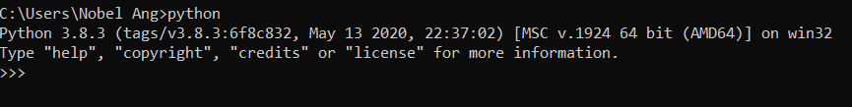
Introduction
Download Python (no shit bruh): https://www.python.org/downloads/
For Windows:
Select “Add to PATH when installing”
Raffles Hall Developers AY23/24

Slide 4
Variables
Storing information → Store the value 4 into x;
x = 4
x + 3 #7
Raffles Hall Developers AY23/24

Slide 5
Variables
For Python, you do not need to declare the class and you can re-assign any value to any variable
x = 4
x = "test123"
x = 1.1111111
print(x)
Raffles Hall Developers AY23/24

Slide 6
Arithmetic Operation on Numbers
Operators | Operation | Example
** | Exponent | 2 ** 3 = 8
% | Modulus/Remainder | 22 % 8 = 6
// | Floor Division | 22 // 8 = 2
/ | Division | 22 / 8 = 2.75
* | Multiplication | 3 * 3 = 9
- | Subtraction | 5 - 2 = 3
+ | Addition | 2 + 2 = 4
Raffles Hall Developers AY23/24

Slide 7
Logical Operators
Operators | Operation | Example
and | AND | a and b
or | OR | a or b
not | NOT | not (a and b)
== | Equality | 4 == “4” #false
<, >, <=, >= | Comparison | 4 < 5 #true
Raffles Hall Developers AY23/24

Slide 8
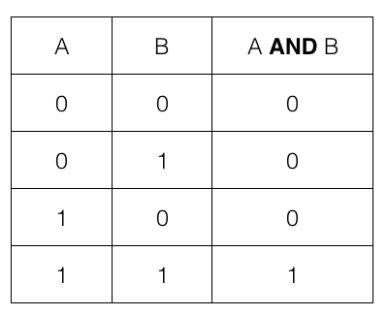
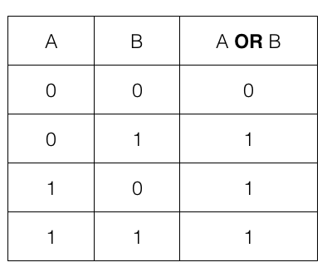
Logical Operators
Raffles Hall Developers AY23/24

Slide 9
Data Types
Integer: A number without decimal point → 4
Float: A floating point number → 4.0, 4.5
String: A series of characters, surrounded by single or double quotation → “Hello world”
Boolean: True/False
Normally, operations will automatically change (or cast) data types when needed
For instance, "Hello" + 4 automatically changes 4 from an `int` to a `String`. A String Concat is performed "Hello4"
However, sometimes (eg. DB operations) specific data types are required. Here we will use casting. For instance, to cast String "4" to int 4, use the int() function
→ int(“4”) == 4
Raffles Hall Developers AY23/24

Slide 10
Loops and Conditionals
if
→ To run code only if a condition is met
if (condition1):
# code
elif (condition2):
# code
else:
# code
Raffles Hall Developers AY23/24

Slide 11
Loops and Conditionals
for loops
→ For loops is to iterate over a sequence. Most commonly used to run code a set number of time
for (i in range(8)):
# code
Raffles Hall Developers AY23/24

Slide 12
Loops and Conditionals
for loops
→ For loops is to iterate over a sequence. Most commonly used to run code a set number of time
for (i in range(8)):
# code
When given a list, for loops gives an alias to each item in the list and loops through them:
for (item in listOfItem):
# item is the item this loop is looking at in this iteration
Raffles Hall Developers AY23/24

Slide 13
Loops and Conditionals
while loops
→ while loops run continuously if a condition is met; e.g. loop until x value exceeds 100
x = 4
while (x <= 100):
x += 4
Raffles Hall Developers AY23/24

Slide 14
Loops and Conditionals
Loop commands
continue → stops the current iteration of the loop and continues the next iteration
for (i in range(3)):
if i === 2:
continue
print("i is not equals to 2")
Raffles Hall Developers AY23/24

Slide 15
Loops and Conditionals
Loop commands
break → stops the loop
while (true):
if (condition):
break
Raffles Hall Developers AY23/24

Slide 16
Functions
Functions are reusable pieces of code group together. Function takes in values and returns a result.
def add(x, y):
return x + y
add(2,3) #5
Raffles Hall Developers AY23/24

Slide 17

Data Structures: List
Lists, also known as arrays, is the most direct way to store a series of data. Both of the following ways of declaration is valid.
fruits = list('apples', 'oranges', 'pears')
fruits = ['apples', 'oranges', 'pears']
Raffles Hall Developers AY23/24

Slide 18
Data Structures: List
Lists, also known as arrays, is the most direct way to store a series of data. Both of the following ways of declaration is valid.
fruits = list('apples', 'oranges', 'pears')
fruits = ['apples', 'oranges', 'pears']
Raffles Hall Developers AY23/24

Slide 19
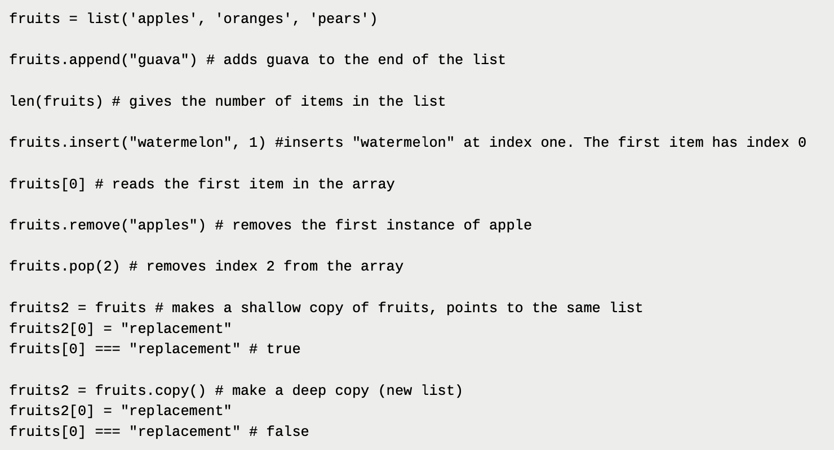
Data Structures: List
Raffles Hall Developers AY23/24

Slide 20
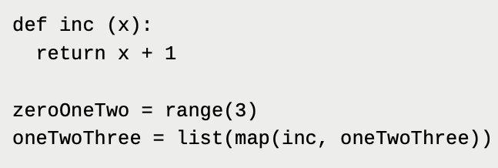
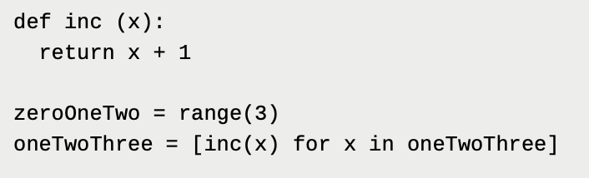
Data Structures: List
List Operations
map → applies a function to all items in a list
Raffles Hall Developers AY23/24

Slide 21
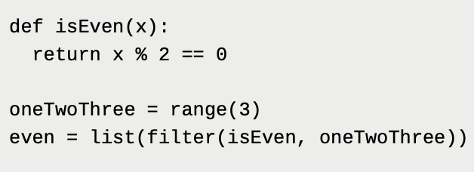
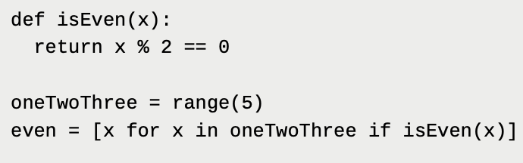
Data Structures: List
List Operations
filter → returns all items that fulfill a given condition in a function
Raffles Hall Developers AY23/24

Slide 22
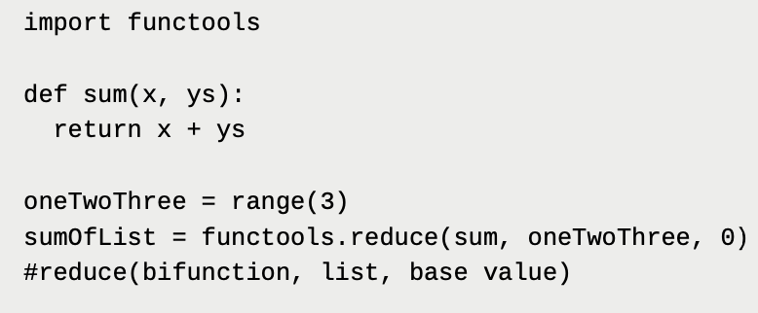
Data Structures: List
List Operations
reduce → produces a result from a list with base value and combination function
x = 0; ys = 0 → 0 + 0 = 0
x = 0; ys = 1 → 0 + 1 = 1
x = 1; ys = 2 → 1 + 2 = 3
Raffles Hall Developers AY23/24

Slide 23
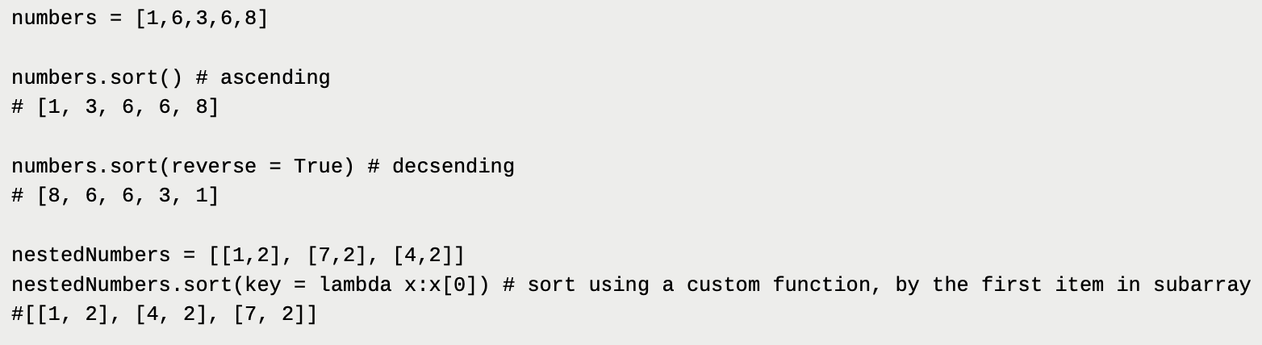
Data Structures: List
List Operations
sort → sort the list of items in order of ascending/descending
Raffles Hall Developers AY23/24

Slide 24
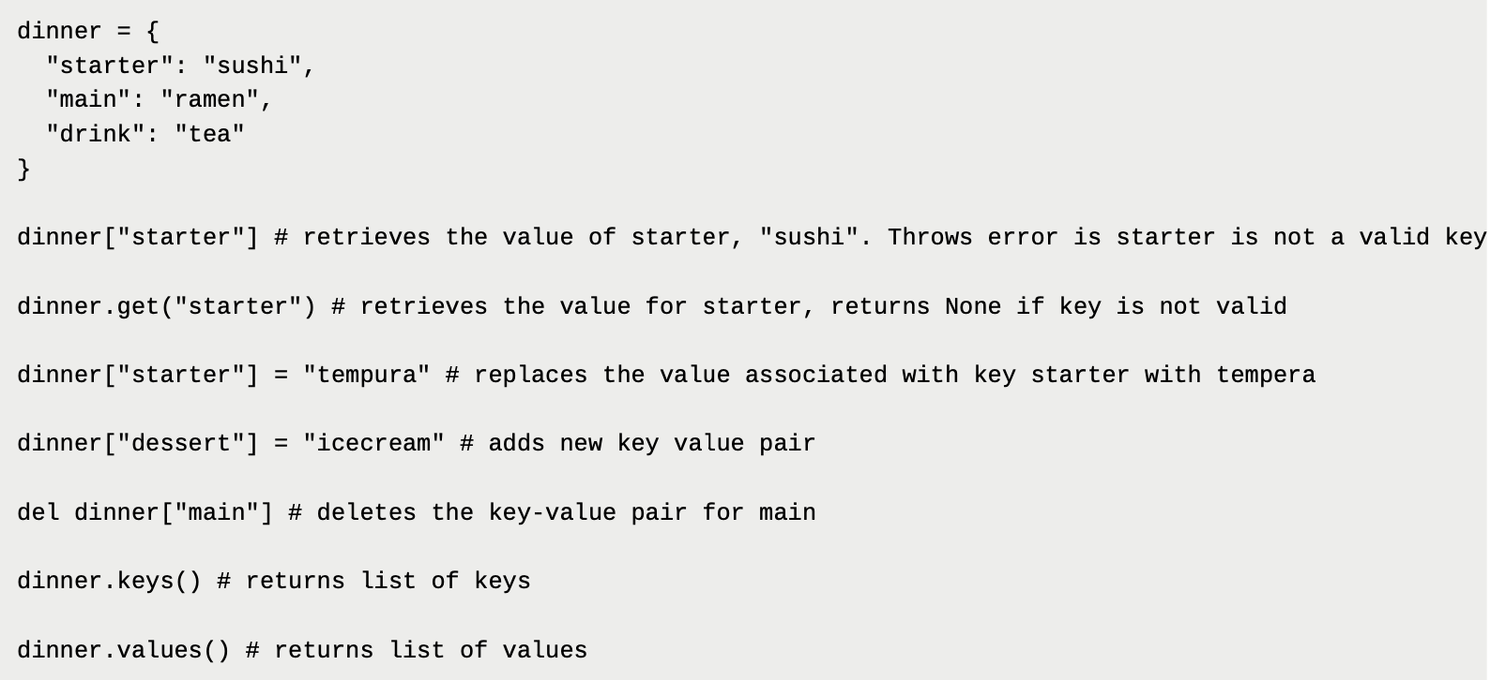
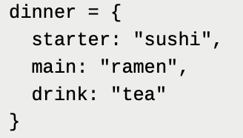
Data Structures: Dictionaries
Dictionary
A series of key-value pairs
Raffles Hall Developers AY23/24

Slide 25
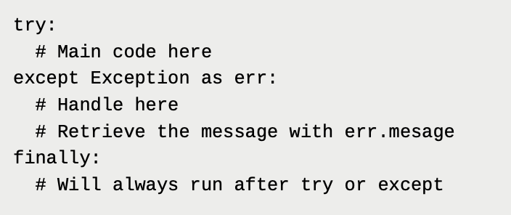
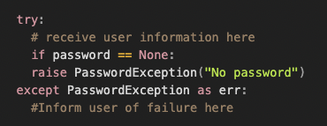
Error Handling
Errors in a programs are shown as exceptions. In most cases, exceptions are with the code and you should fix something.
In some cases, errors are unexpected (e.g reading from a file location that is not valid).
In some other cases, you will want to throw your own exception to show that something is wrong
Raffles Hall Developers AY23/24

Slide 26
Error Handling
Errors in a programs are shown as exceptions. In most cases, exceptions are with the code and you should fix something.
In some cases, errors are unexpected (e.g reading from a file location that is not valid).
In some other cases, you will want to throw your own exception to show that something is wrong
Raffles Hall Developers AY23/24

