Slide 1
A
Shape
속성 : 위치(point), 크기(size)
기능 : draw()
Circle
Triangle
Square

Slide 2
Object
최상위 객체
Animal
class Animal extends Object{
Animal(){
super();
}
}
조상 객체 정보 포함
※ public/protected 변수/메서드만 상속가능
※ static변수/메소드는 상속불가
Cat

Slide 3
Language lan1 = new English();
Language
+int alphabetNumber; (s)+String type;
+displayAlphabet() : void
0x100 Language타입
+int alphabetNumber;
+displayAlphabet() : void
+sayHello() : void
German lan2 = new German();
English
+int alphabetNumber;
+displayAlphabet() : void
+sayHello() : void
German
+int alphabetNumber;
+displayAlphabet() : void
+sayHallo() : void
Korean
+int alphabetNumber;
+displayAlphabet() : void
+sayAnyung() : void
0x200 German타입
+int alphabetNumber;
+displayAlphabet() : void
+sayHallo() : void

Slide 4
Language lan1 = new English();
0x100 Language타입
+int alphabetNumber;
+displayAlphabet() : void
+sayHello() : void
Language
+int alphabetNumber;
+sayHello() : void
German lan2 = new German();
English
+int alphabetNumber;
+sayHello() : void
German
+int alphabetNumber;
+sayHello() : void
Korean
+int alphabetNumber;
+sayHello() : void
0x200 German타입
+int alphabetNumber;
+displayAlphabet() : void
+sayHallo() : void

Slide 5
Language lan1 = new German();
Language
+int alphabetNumber; (s)+String type;
+displayAlphabet() : void
0x100 Language타입
+int alphabetNumber;
+displayAlphabet() : void
+sayHallo() : void
Language영역(blue)
만 사용 가능
German lan2 = new German();
German
+int alphabetNumber;
+displayAlphabet() : void
+sayHallo() : void
0x200 German타입
+int alphabetNumber;
+displayAlphabet() : void
+sayHallo() : void
German영역(red)
모두 사용 가능
Parent p = new Child();
Child c = (Child)new Parent();

Slide 6
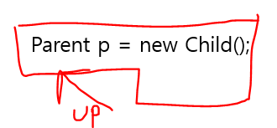
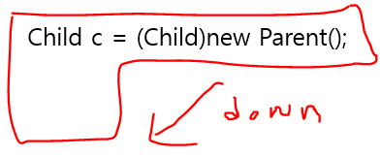
Child c = new Child(); Parent p = new Parent();
Parent p = c; Child c = (Child)p;

