Slide 1
Loading Patran Compatible WARP Result Files in TecPlot
June 18, 2007

Slide 2
Objectives
To plot FE mesh and stress/strain/displacement contours in Tecplot 360, using the patran compatible binary result files generated by the WARP3D analysis

Slide 3
Convert Patran Compatible WARP Results to Tecplot Data
Compile and run FORTRAN script tec_pat.f
Input file:
  “prefix”.crd ➔ defining nodal coordinates
  “prefix”.elm ➔ defining nodal connectivity
  Patran compatible warp result files, wnbs*, wnbe*, wnbd*
Output file:
  disp”stepID”.dat ➔ nodal displacement results
  strs”stepID”.dat ➔ nodal stress results
  strn”stepID”.dat ➔ nodal strain results

Slide 4
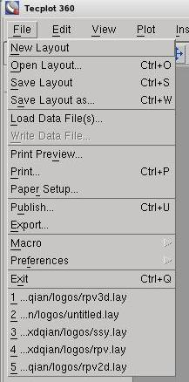
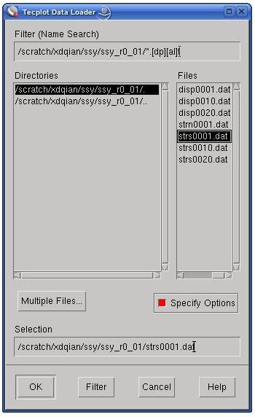
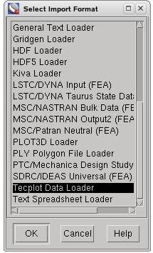
Load Tecplot Data File (1)

Slide 5
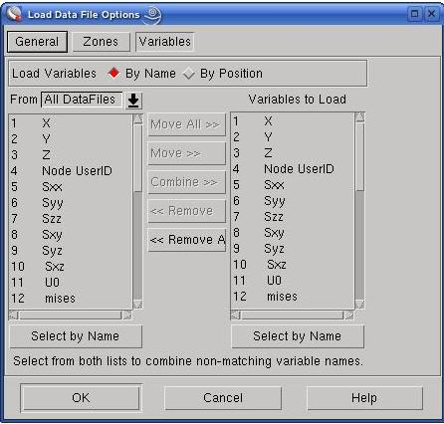
Load Tecplot Data File (2)
Load all 26 stress variables, 22 strain variables, or 3 displacement variables into Tecplot

Slide 6
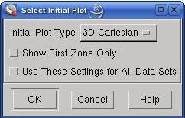
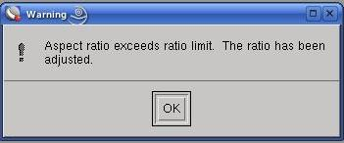
Load Tecplot Data File (3)
Tecplot imposes a default aspect ratio (ratio of the length of the model along one axis over that along another) of 25 for the dimensions of 3-D space. If the aspect ratio is exceeded, tecplot will be automatically adjusted. We can scale it to the real dimensions later.

Slide 7
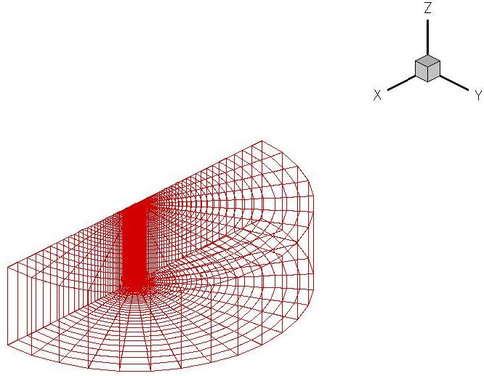
Load Tecplot Data File (4)
Model loaded in Tecplot is NOT to scale!

Slide 8
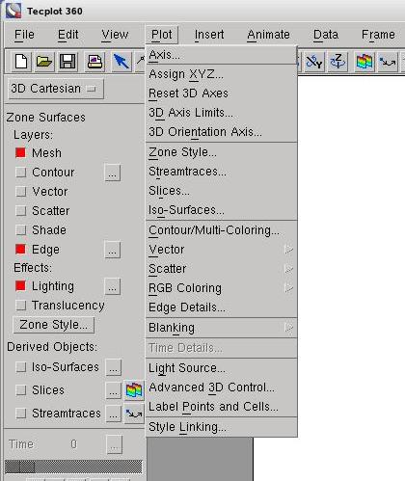
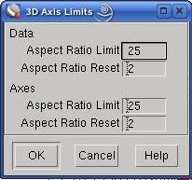
Scale Dimensions of the Model (1)
Change to a large value, e.g. 1000

Slide 9
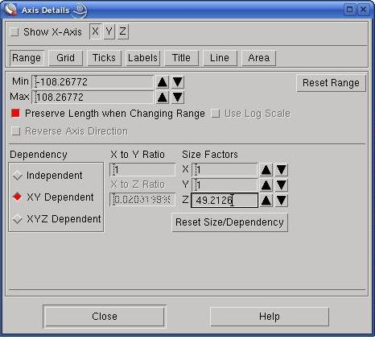
Scale Dimensions of the Model (2)
Change to 1 or select “xyz dependent”

Slide 10
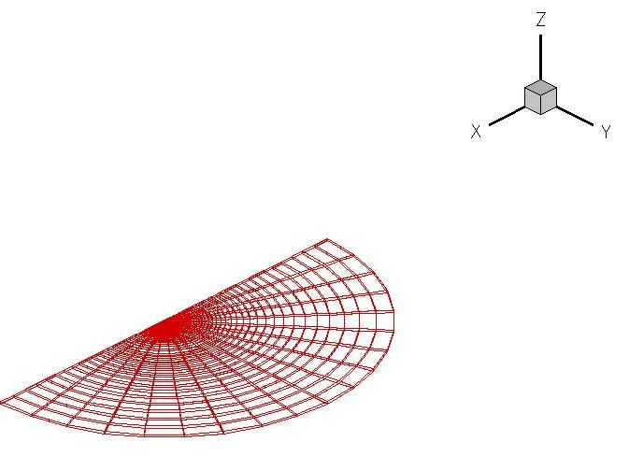
Model Scaled to Physical Dimensions

Slide 11
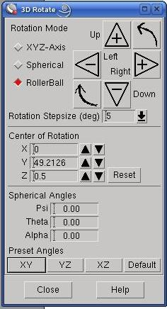
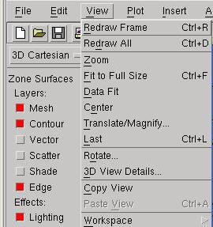
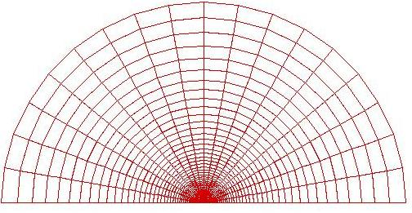
Rotate Views

Slide 12
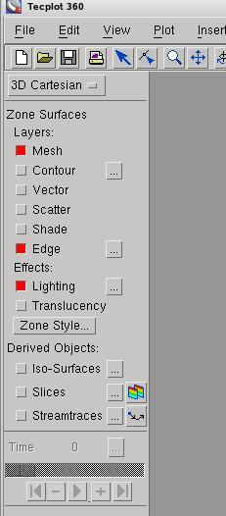
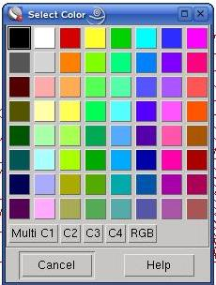
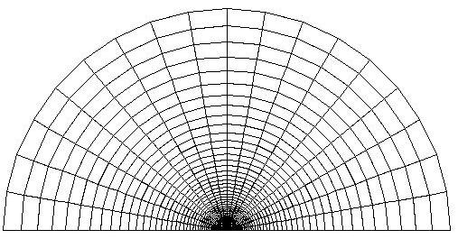
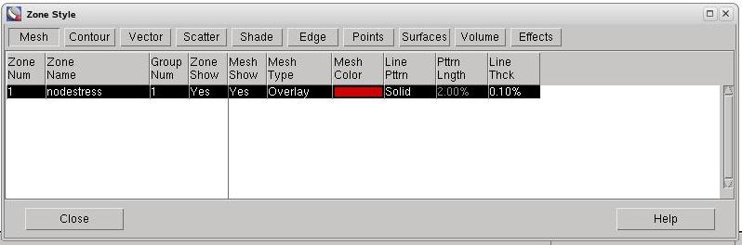
Adjust Mesh Properties

Slide 13
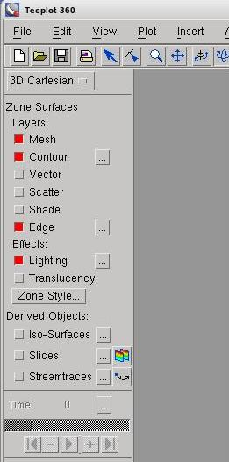
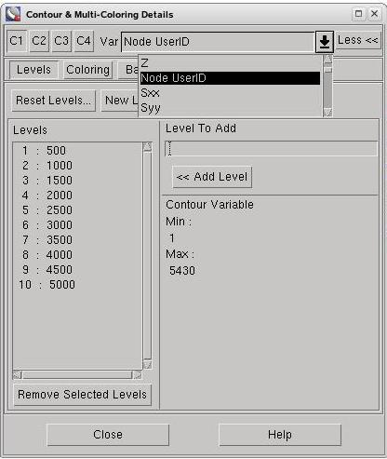
Plotting Contours

Slide 14
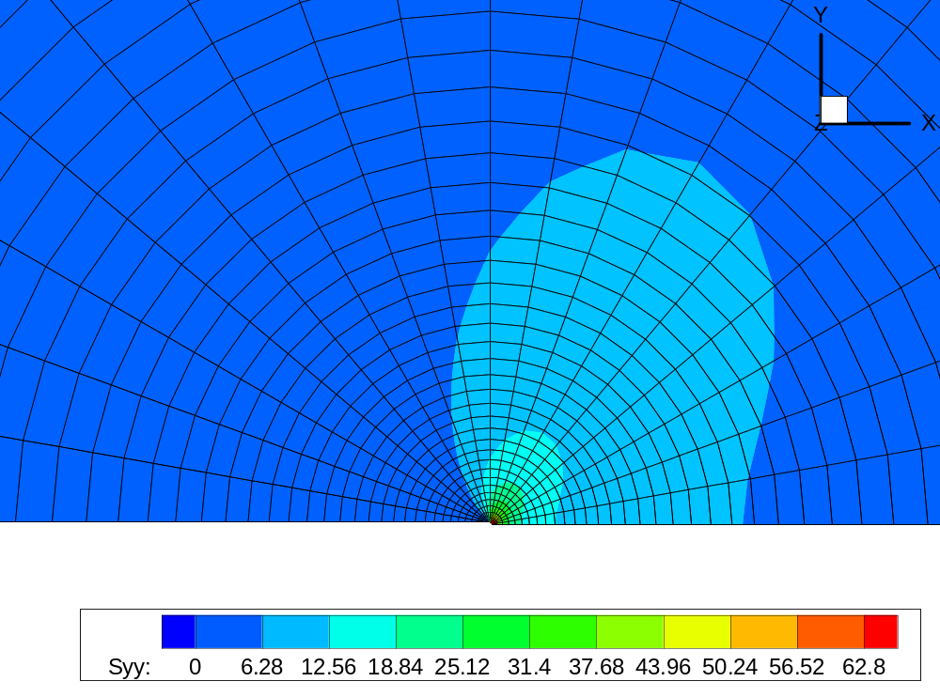
σ_{yy} contours

Slide 15
Data Structure of the Tecplot Data File
Variables="X","Y","Z", "NodeID"
"Sxx","Syy","Szz","Sxy","Syz","Sxz",
"U0","mises", "c1", "c2", "c3", "I1", "I2","I3",
"S1","S2","S3","l1","m1","n1","l2","m2","n2",
"l3","m3","n3","Step ID"
Zone T="nodalstress", N=5430 E=2555
datapacking=point, zonetype=FEBRICK
0.400000E-04 0.00000 0.00000 1 30.8816 114.657
… …
… …
35 37 3 1 36 38 4 2
… …
Define variable names
Define FE data zone
Define variables
Define element connectivity

Slide 16
Defining Variable
Variables="X","Y","Z", "NodeID"
"Sxx","Syy","Szz","Sxy","Syz","Sxz",
"U0","mises", "c1", "c2", "c3", "I1", "I2","I3",
"S1","S2","S3","l1","m1","n1","l2","m2","n2",
"l3","m3","n3","Step ID"
The variable name definition uses the parameter “Variable” followed by the list of the user-defined variable names.
The sequence of the names dictates the sequence for which the numeric values of the variables are defined.
For 3-D FE data, the first three variables MUST define the coordinate values of the FE model.

Slide 17
Defining FE data
Zone T="nodalstress", N=5430 E=2555
datapacking=point, zonetype=FEBRICK
“Zone” initiates the data definition
“T” = Title of the zone
“N” = Number of nodes
“E” = Number of elements
“datapacking” = defining the sequence of the data input, either “point” or “block”, see next slide
“zonetype” = element type, “FEBRICK” for 3-D solid (8-node or 20-node) elements

Slide 18
Defining Variables
0.400000E-04 0.00000 0.00000 1 30.8816 114.657
“X”
“Y”
“Z”
NodeID
Sxx
Syy
The above defines the variables in a “Point” datapacking format.
For “Block” format, the user defines the values of each variable in a “Block” manner, i.e., the user first defines all values of “X”, followed by those for “Y”, and followed by those for “Z”, etc.

Slide 19
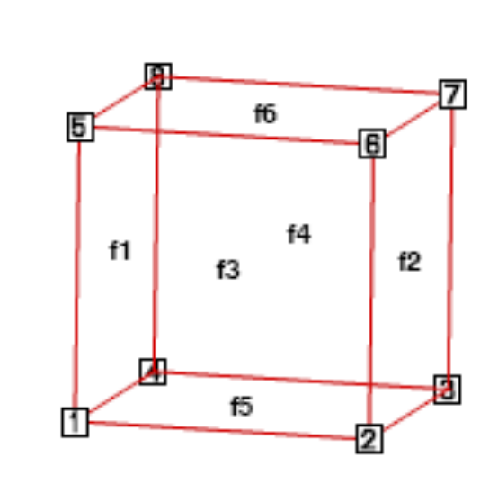
Defining Element Connectivity
35 37 3 1 36 38 4 2
Since NO assembly of stiffness matrix is processed in Tecplot, the user defines only the 8 corner nodes the for a particular element (with 8 or more nodes). The connectivity follows that of the WARP3D as shown in the figure below.

Slide 20
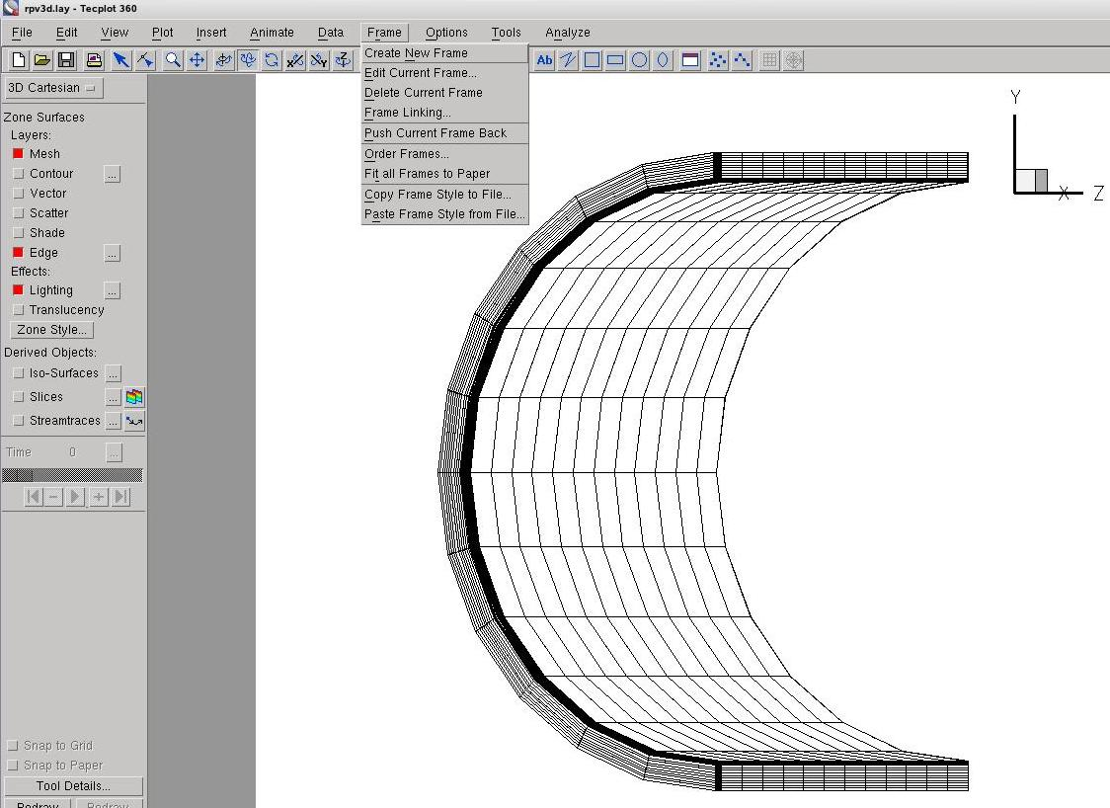
Exporting Tecplot FE Meshes/Contours To Powerpoint (1)
Step 1: zoom to the area of interest
Step 2: Create a frame enclosing the area of interest
Area of interest

Slide 21
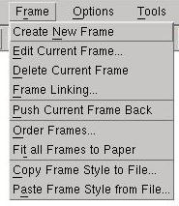
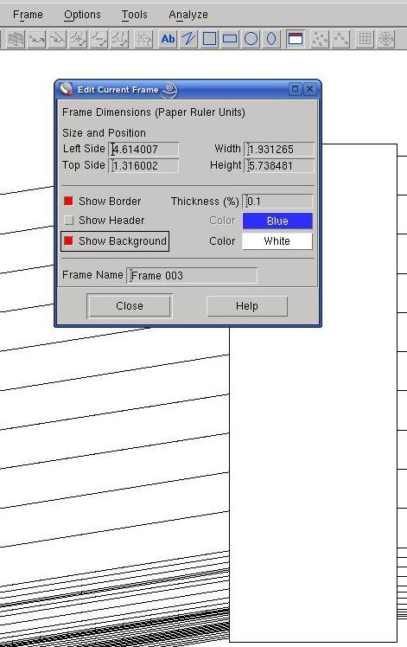
Exporting Tecplot FE Meshes/Contours To Powerpoint (2)
Step 3: Edit the frame properties
“Uncheck” all three options
This is the new frame to export the zoomed view of an FE model

Slide 22
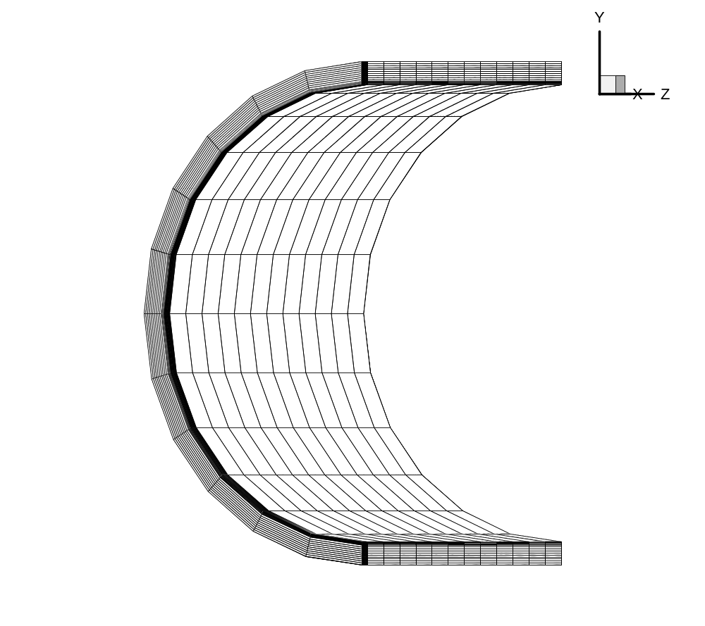
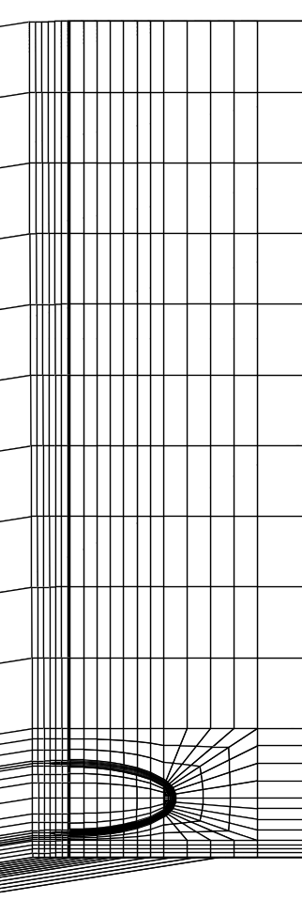
Exported Pictures from Tecplot
Global mesh
Zoomed mesh

Slide 23
Appendix: FORTRAN code for tec_pat.f
c
c this program filters converts the patran compatible WARP result file
c to TECPLOT loadable data file
c
c
implicit integer (a-z)
parameter(n_max=500)
parameter(num_node=95000)
parameter(num_elem=50000)
parameter(maxcols=26)
c
common /text/ textstring
c
double precision ux(num_node), uy(num_node), uz(num_node)
double precision x(3, num_node), elval(maxcols, num_elem)
real xval, yval, zval, pvals(maxcols), rtemp
character*9 ch_disp(n_max), ch_strn(n_max), ch_strs(n_max)
character*12 dispfile(n_max), stressfile(n_max), strainfile(n_max)
character binnam*80, ok*1, cstep*6, yes*6, strsname*80, struc*30,
& strnname*80
character textstring*80, coordinates*30, incidences*30, dispname*12
dimension title(80), ele(20, num_elem)
dimension nstep(n_max), ino(num_node), iel(num_elem),
& lex(num_elem)
c
c
c

Slide 24
c--------------------------------------
c
write(*,*)
write(*,*)' --------------------------------------------------'
write(*,*)'| Program prepares data for Tecplot 360 program |'
write(*,*)'| |'
write(*,*)'| The input files is: web* wnb* |'
write(*,*)'| The output files are: disp*.dat strs*.dat |'
write(*,*)'| and strn*.dat |'
write(*,*)'| |'
write(*,*)'| |'
write(*,*)'| Computational Fracture Mechanics Research Group |'
write(*,*)'| University of Illinois at Urbana-Champaign |'
write(*,*)'| |'
write(*,*)'| Last modification: June 18, 2007 |'
write(*,*)' --------------------------------------------------'
write(*,*)
c
c--------------------------------------
c
write(*,*) 'How many steps at which warp result files exist?'
read(*,*) nn
write(*,*) 'For every ? steps the results were output?'
read(*,*) nk
3 write(*,*) 'nodal stress or strain (s for stress, n for strain)?'
read(*,'(a)') ok
if(ok.ne.'s'.and.ok.ne.'S'.and.ok.ne.'n'
& .and.ok.ne.'N') then
write(*,*) 'please enter "s" for stress or "n" for strain'
go to 3
endif

Slide 25
write(*,*) 'output for nodal displacement, (yes or no)?'
read(*,'(a)') yes
write(*,*) 'Total element number in the model?'
read(*,*) nelem
write(*,*) 'Total node number in the model?'
read(*,*) n_nod
write(*,*) 'prefix of the input file?'
read(*,'(a)') struc
5 write(*,*) '8 or 20 node elements?'
read(*,*) ncon
c
if(ncon.ne.8.and.ncon.ne.20)then
write(*,*) 'please enter 8 or 20!'
go to 5
endif
c
c
do i=1,nn
nstep(i) = nk*i
write(cstep, 100) nstep(i)
ch_disp(i)='wnbd'//cstep(2:6)
dispfile(i)='disp'//cstep(3:6)//'.dat'
stressfile(i)='strs'//cstep(3:6)//'.dat'
strainfile(i)='strn'//cstep(3:6)//'.dat'
ch_strn(i)='wnbe'//cstep(2:6)
ch_strs(i)='wnbs'//cstep(2:6)
enddo
100 format('c',i5.5)
c
c Read in the nodal coordinates and element connectivity
c

Slide 26
textstring=struc//' '
call left_centred(30,irp)
struc=textstring(1:30)
il=1
10 il=il+1
if (il.lt.irp) then
if (struc(il:il).ne.'.') goto 10
il=il-1
endif
c
coordinates = struc(1:il)//'.crd'
incidences = struc(1:il)//'.elm'
c
open(unit=1,file=coordinates,status='old')
do i=1,n_nod
read(1,*) ii, x(1,ii), x(2,ii), x(3,ii)
enddo
close(unit=1)
open(unit=1,file=incidences,status='old')
do i=1,nelem
if(ncon.eq.8)then
read(1,*) ii, ele(1,ii), ele(2,ii), ele(3,ii), ele(4, ii),
& ele(5, ii), ele(6, ii), ele(7, ii), ele(8,ii)
else
read(1,*) ii, ele(1,ii), ele(2,ii), ele(3,ii), ele(4, ii),
& ele(5, ii), ele(6, ii), ele(7, ii), ele(8,ii), ele(9,ii),
& ele(10,ii), ele(11,ii), ele(12,ii), ele(13,ii), ele(14,ii),
& ele(15,ii), ele(16,ii), ele(17,ii), ele(18,ii), ele(19,ii),
& ele(20, ii)
endif
enddo
close(unit=1)
c

Slide 27
c *********************************************************
c * *
c * read displacement binary patran file *
c * *
c *********************************************************
c
if((yes(1:1).eq.'y').or.(yes(1:1).eq.'Y')) then
c
termin=5
termot=6
binfil=10
tec=15
c
write(termot,*) ' '
write(termot,*) ' '
write(termot,*) '>> binary node value processing program'
write(termot,*) ' '
c
do 200 i=1,nn
open(unit=tec,file=dispfile(i),status='unknown')
write(tec,*) 'Variables= "X", "Y","Z", "Node UserID",
&"U", "V", "W","Step ID"'
write(tec,*) 'Zone T="nodaldisp", N=', n_nod,',','E=',nelem,',',
& 'datapacking=point, zonetype=FEBRICK'
binnam = ch_disp(i)
open(unit=binfil,file=binnam,status='old',recl=3000,
& form='unformatted')
write(termot,*) ' '
write(termot,'(a,a,a)') ' > file ', ch_disp(i), ' open ok'
c

Slide 28
c read the binary results file of nodal values.
c read x, y, z components. patran results are single
c precision. read as single and store as double.
c
read(binfil) title, nnode, ii, rtemp, ii, nvals
read(binfil) title
read(binfil) title
c
c read values for each node into a double array
c
write(termot,*) '> reading nodal results file..'
do node = 1,nnode
read(binfil) ii, xval, yval, zval
ux(node) = xval
uy(node) = yval
uz(node) = zval
ino(node) = ii
c
if(ii.ne.node) then
write(*,*) 'error during reading nodal results !!!'
stop
endif
c
c => n_step node-number u1 u2 u3
write(tec,150) x(1,node), x(2,node),x(3,node),
& ino(node), ux(node), uy(node), uz(node),nstep(i)
enddo
150 format(3(2x,g15.6),(2x,i6),3(2x,g15.6),(2x,i6))
do elem=1, nelem
write(tec, 180) (ele(ii,elem), ii=1,8)
enddo
180 format(8(2x,i6))

Slide 29
close(unit=tec)
close(unit=binfil)
write(termot,*) '> writing nodal results to file..'
200 continue
endif
c
c ************************************************************
c * *
c * Read in stress strain binary patran files *
c * *
c ************************************************************
c
write(termot,*) ' '
write(termot,*) ' '
write(termot,*) '>> binary stress/strain processing program'
write(termot,*) ' '
c
if((ok(1:1).eq.'s') .or. (ok(1:1).eq.'S')) then
do 300 i=1,nn
binnam = ch_strs(i)
strsname=stressfile(i)
open(unit=tec,file=strsname,status='unknown')
write(tec,*) 'Variables="X","Y","Z", "NodeID"'
write(tec,*) '"Sxx","Syy","Szz","Sxy","Syz","Sxz",'
write(tec,*) '"U0","mises", "c1", "c2", "c3", "I1", "I2","I3",'
write(tec,*) ' "S1","S2","S3","l1","m1","n1","l2","m2","n2", '
write(tec,*) '"l3","m3","n3","Step ID"'
write(tec,*) 'Zone T="nodalstress", N=', n_nod, 'E=',nelem,
& 'datapacking=point, zonetype=FEBRICK'
write(*,*)'Processing file: ',binnam
open(unit=binfil,file=binnam,status='old',recl=3000,
& form='unformatted')

Slide 30
write(termot,*) ' '
write(termot,'(a,a,a)') ' > file ', ch_strs(i), ' open ok'
c
c read the binary results file of nodal strains/stresses.
c patran results are single precision. read as single and
c store as double.
c
read(binfil) title, nnode, ii, rtemp, ii, nvals
read(binfil) title
read(binfil) title
c
c read values for each node into a double array
c
write(termot,*) '> reading nodal stress/strain file..'
write(termot,*) '> writing nodal stress/strain to file..'
c
c
do node = 1,nnode
read(binfil) ii, (pvals(jj),jj=1,nvals)
ino(node) = ii
if(ii.ne.node) then
write(*,*) 'error during reading nodal results !!!'
stop
endif
c
write(tec,250) x(1,node), x(2,node),x(3,node),
& ino(node),(pvals(jj),jj=1,nvals),nstep(i)
c
enddo
250 format(3(2x,g15.6)(2x,i6),26(2x,g15.6),(2x,i6))
close(unit=binfil)

Slide 31
do elem=1, nelem
write(tec, 280) (ele(ii,elem), ii=1,8)
enddo
280 format(8(2x,i6))
close(unit=tec)
c
300 continue
c
else
c
do 400 i=1,nn
binnam = ch_strn(i)
strnname=strainfile(i)
open(unit=tec,file=strnname,status='unknown')
write(tec,*) 'Variables="X","Y","Z","NodeID",'
write(tec,*) '"Exx","Eyy","Ezz","Exy","Eyz","Exz","Eeff",'
write(tec,*) '"I1", "I2", "I3", "e1", "e2", "e3","l1","m1",'
write(tec,*) '"n1","l2","m2","n2","l3","m3","n3", "STEP ID"'
write(tec,*) 'Zone T="nodestrain", N=',n_nod,'E=',nelem,
& 'datapacking=point, zonetype=FEBRICK'
write(*,*)'Processing file: ',binnam
open(unit=binfil,file=binnam,status='old',recl=3000,
& form='unformatted')
write(termot,*) ' '
write(termot,'(a,a,a)') ' > file ', ch_strn(i), ' open ok'
c
c read the binary results file of nodal strains/stresses.
c patran results are single precision. read as single and
c store as double.
c
read(binfil) title, nnode, ii, rtemp, ii, nvals
read(binfil) title
read(binfil) title

Slide 32
c
c read values for each node into a double array
c
write(termot,*) '> reading nodal stress/strain file..'
write(termot,*) '> writing nodal stress/strain to file..'
c
c
do node = 1,nnode
read(binfil) ii, (pvals(jj),jj=1,nvals)
ino(node) = ii
if(ii.ne.node) then
write(*,*) 'error during reading nodal results !!!'
stop
endif
c
write(tec,350) x(1,node), x(2,node),x(3,node),
& ino(node),(pvals(jj),jj=1,nvals),nstep(i)
c
enddo
350 format(3(2x,g15.6),(2x,i6),22(2x,g15.6),(2x,i6))
close(unit=binfil)
do elem=1, nelem
write(tec, 380) (ele(ii,elem), ii=1,8)
enddo
380 format(8(2x,i6))
close(unit=tec)
c
400 continue
endif
c
stop
end

Slide 33
c
c ********************************************************************
c
c this subroutine rewrites the string from the first non-empty
c letter to the last letter, and also gives the total number of
c letters in the string
c
c ********************************************************************
c----67--1---------2---------3---------4---------5---------6---------7-!
subroutine left_centred(nch,rpo)
implicit none
c
integer nch,rpo,l,r,i
character textstring*80
c
common /text/ textstring
c
l=0
10 l=l+1
if ( textstring(l:l).eq.' ') goto 10
r=l
20 r=r+1
if (r.lt.nch) then
if (textstring(r:r).ne.' ') goto 20
r=r-1
endif
rpo=0
do i=l, r
rpo=rpo+1
textstring(rpo:rpo)=textstring(i:i)
enddo
return
end

