Slide 1
Gesture Recognition
By Pradeep M
Rhea Anand
Vaibhav Jain

Slide 2
Problem Statement
Recognise Gestures for the purpose of media controls on videos and ppts.
The Three Difficulty Levels:
Static Hand Gestures
Dynamic Hand Gestures
Both under Different Lightings (i.e. with shadows etc)

Slide 3
Introduction
This Project aims to assist the user is controlling the flow of powerpoint presentations i.e switching between slides and controlling videos i.e play, pause.
For video controls the user can input static gestures like holding out your hand to play/pause video. This demonstrates the easy case of our project.
For ppt’s the user must input moving hand gestures like moving the hand from left to right for going to next slide, moving the hand from right to left to go to previous slide.

Slide 4
The most difficult part is segregating the hand from the rest of the image. Hence, the hard case of our project is detecting the hand in different lighting (the hand being either the darker or the lighter part of the frame)

Slide 5
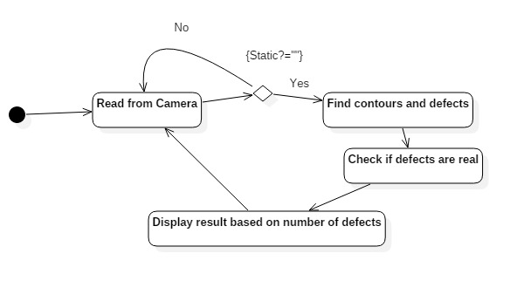
DFD

Slide 6
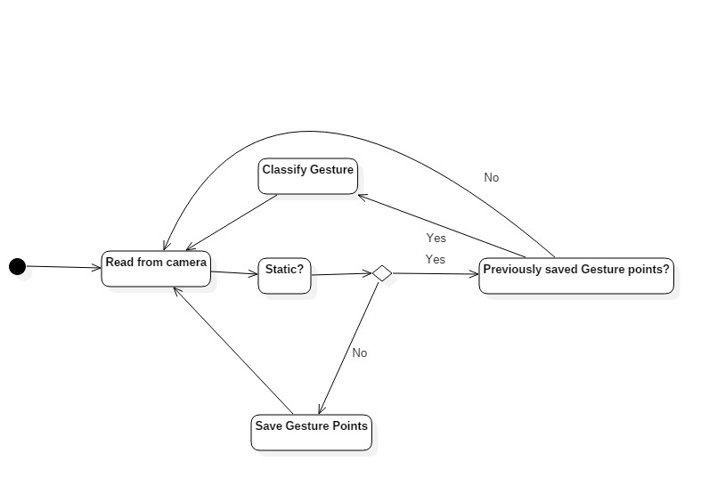
DFD

Slide 7
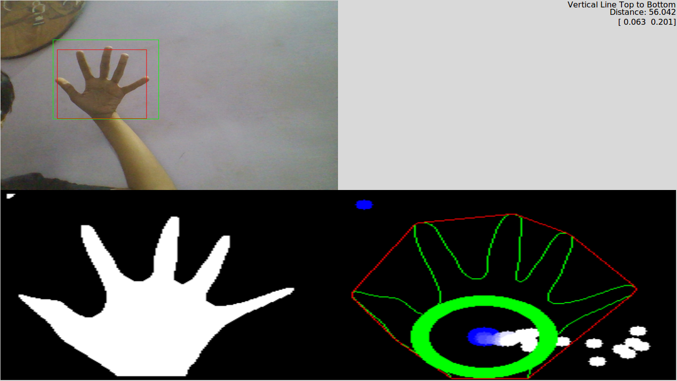
Sample Inputs: Easy Case

Slide 8
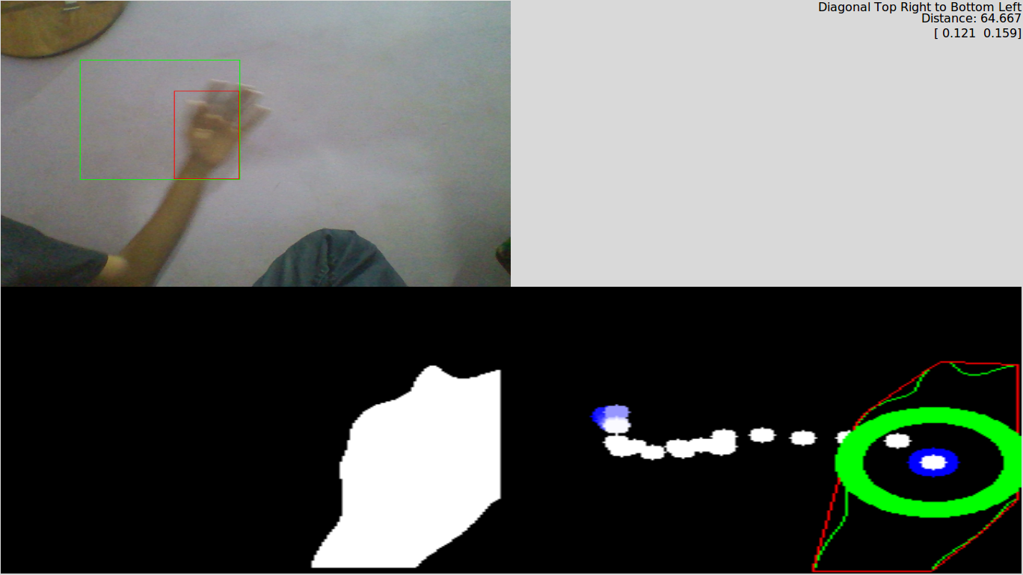
Sample Inputs: Medium Case

Slide 9
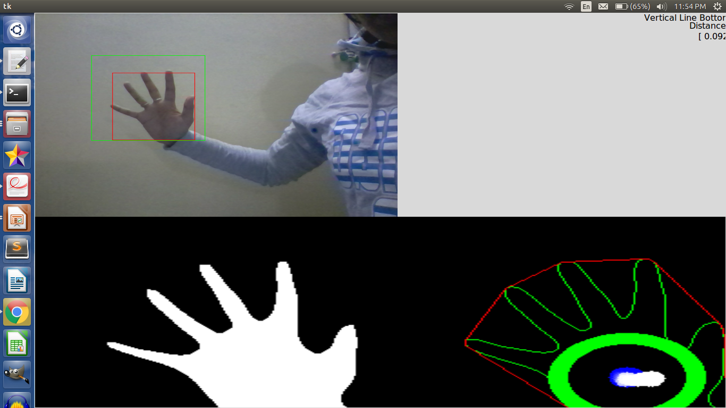
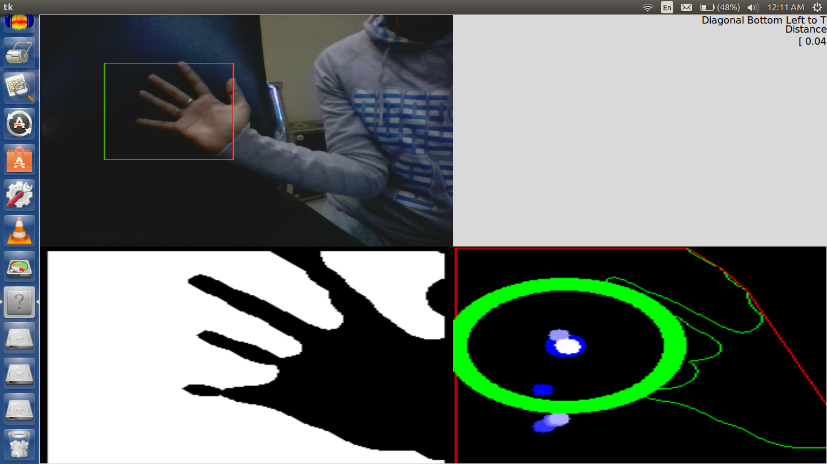
Sample Inputs: Hard Case

Slide 10
Process
Step-1: Read the image
Step -2: Thresholding the image after applying gaussian filter . Here the algorithm used is Otsu’s binarization. It automatically calculates a threshold value from image histogram for a bimodal image.

Slide 11
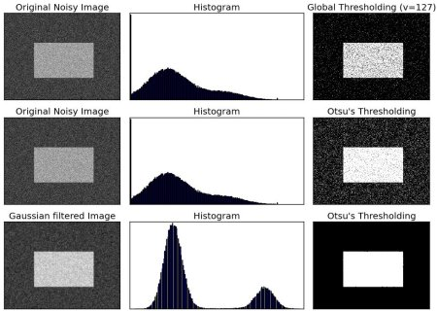

Slide 12
Step-3: Extract hand Contour from the binary image.
Step-4: Find convex hull and convexity defects. Using the opencv convexhull method and convexity Defect method we find the convexities in the hand image. This is useful in static recognition
Step-5: Find hand moment positions. We find this using opencv moments() function. It’s used to determine whether the hand is stationary or moving later in the process.
Step-6: Find the center of the palm. We construct a circle in the palm of the hand using an algorithm similar to the one in the link https://www.youtube.com/watch?v=xML2S6bvMwI. This center is useful in keeping track of the moving hand which is helpful in dynamic gesture recognition.

Slide 13
Step-7: check Can Do Gestures. Before we classify the dynamic gestures we need to check whether the hand has moved sufficient distance or not. Using the center points calculated in the previous step we check whether the hand has moved sufficient distance or not.
Step-8: Determine stationary. In this function we compare the current hand position with the previous hand position using the hand moment data. If it is same for some fixed amount of time we set the stationary parameter to true or else if set the record parameter as true. Both these parameters are useful in the next step.
Step-9: Determine gesture. Based on the parameters computed in the previous step, we perform static gesture recognition or dynamic gesture recognition. For static recognition we use the convexity defects information computed in previous steps to determine the appropriate gesture.

Slide 14
For dynamic gestures we call the method classifyGesture.
ClassifyGesture: Compares the stored gesture points with the saved templates and finds the closest match with minimal error.

Slide 15
Conclusion
This system works quite well and it can be used for doing powerpoint presentations or video controlling saving the hassle for switching the slides manually.
It is a cheap alternative to IR sensor cameras. With improved accuracies we can replace IR sensor cameras for gesture recognition purpose.

Slide 16
Future Work
Our further aims are to improve accuracy of thresholding the image, tracking and classifying the gesture and be able to detect fingers.
Once we have finger detection, it will be possible to recognize more complex gestures. Like Rotatory motion of the finger etc.

