Slide 1
Forests in India : Analytics on Forests of India
N L Ramya : 01FB14ECS124
N Sourabh : 01FB14ECS125
Rhea Anand : 01FB14ECS186
Riya John : 01FB14ECS191

Slide 2
AIM
To relate Forest Cover with various aspects such as Rainfall, Temperature and Air Pollution.
In doing so, we can determine how the various aspects of the environment are interdependent on each other.
We take data from places with different environmental conditions such as hilly regions, coastal areas, plains, plain areas, and so on.
After establishing the pattern, we interpret it and give possible reasons to explain the behaviour.

Slide 3
Data Sets Used
District-wise Population : 2005-2013
District-wise Forest Cover : 2005-2013
District-wise Annual Rainfall: 2004-2013
District-wise Temperature : 2005 – 2013
Latitude-Longitude of Districts of India
Physiographic Divisions of India

Slide 4
Implementation
Visualisation of all the data : Using maps and graphs
We plotted graphs of rainfall/temperature/population with respect to forest cover.
By drawing scatter plots for each region, we determined how the forest cover influences the various environmental factors.
By finding the slope of the graph, we established how the given quantity varies with respect to forest cover. We also find the correlation with respect to forest cover for all of the above factors.
By finding a multiple regression model , we predict the future forest cover for the districts of India.

Slide 5
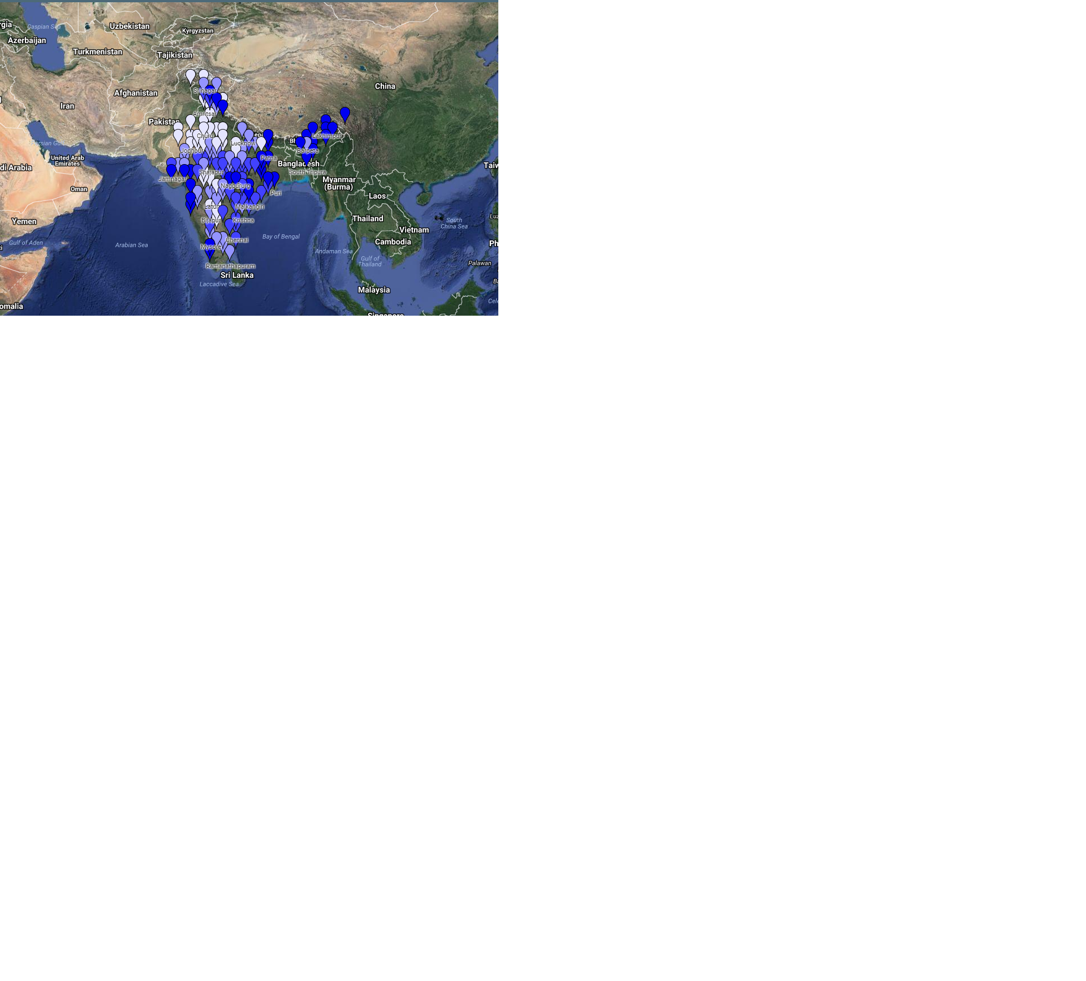
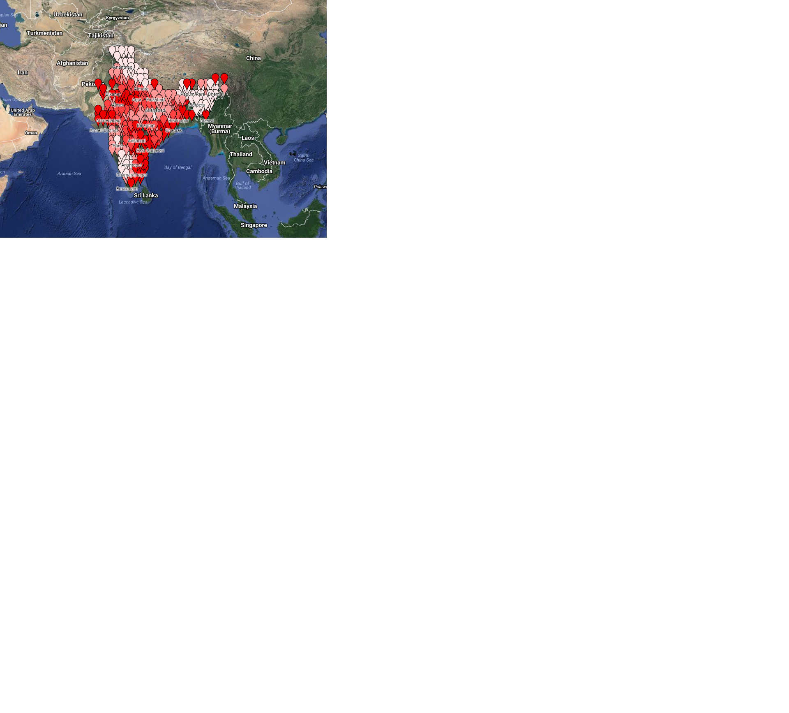
Visualisation

Slide 6
Relationships
The correlation coefficient (Forest vs Rainfall) is around 0.5. This implies that it is not necessarily true that as forest cover increases, rainfall increases too. There is a moderate relationship. We find that around 30 percent of the districts would fit the linear model from the R square value
The correlation coefficient (Forest vs Temperature) is around -0.37. This implies that it is not necessarily true that as forest cover increases, temperature increases too. There is a moderate relationship. We find that around 14 percent of the districts would fit the linear model from the R square value
The correlation coefficient (Population vs Forest) is around -0.1. This implies that it is not necessarily true that as forest cover increases, rainfall increases too. There isn’t a clear relationship.
We hence try to classify the data region wise

Slide 7



















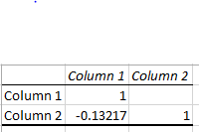

Forest on Rainfall Population on Forest Forest on Temperature
Northern plains
Western plains
Eastern plains
Deccan Plateau
Highlands
Northern Mountains
Coastal
Correlation for 2007

Slide 8
In the Coastal, Deccan plateau, Western and Eastern plains, we find that the rainfall is affected a lot more by the forest cover than in the Northern plains, Northern mountains and Highlands.
The population has affected the forest cover in the Eastern plains and Highlands the most in the years of 2007 – 2013. The Deccan Plateau and the Northern mountains have been affected a little . Coastal, Western plains and Northern plains are not affected much.
The Forest has affected the temperature in the Eastern plains and Coastal regions the most. The Highlands and Western plains have a lesser correlation. The forest cover has a positive correlation with temperature in the Northern plains and Deccan Plateau.

Slide 9
Regression and Prediction : How is Forest affected?
From the regression coefficient, the analysis reveals that increasing population density leads to a decrease in forest cover. Form the analysis on the northern mountains it can be concluded that an increase in population density by 1 unit can lead to decrease in forest-cover by 0.05% and on an average for the entire country it was decrease by 0.001%.
From positive correlation coefficient in most of the districts of India, increase in average rainfall indicates increase in forest-cover. It can be concluded that an increase in rainfall by 1mm across the country will cause 0.011% increase in forest-cover of India.
It is found that there is a varying relationship between forest cover and temperature. In most places of the country increase in temperature indicates decrease in forest cover. However in the Northern Plains, Northern Mountains and Western Plains it indicates increase in forest cover. It was found that forest cover was affected the most by temperature. If there is an increase in temperature by 1 degree Celsius due to global warming and other factors then there is a possibility of 2.43% decrease of forest-cover in the country.
Using multiple regression and modelling, we could estimate the future forest cover in districts of India.

Slide 10
Forests are our lifeline. From our study, we see how the population is adversely affecting the forest area which in turn affects the temperature and Rainfall.
It is important to raise awareness that the change in forest cover is of global concern as forest is a precious natural resource required to sustain life on Earth. Deforestation is a major cause for climate change and increase in global warming. With the world growing at a very high pace, the increasing need for space is turning out to be an area of concern. And this desperate need has led to felling of trees and clearing of forest cover.
It is believed that this project can be useful to protected area managers for forest conservation and thus help in sustainability.

