Slide 1
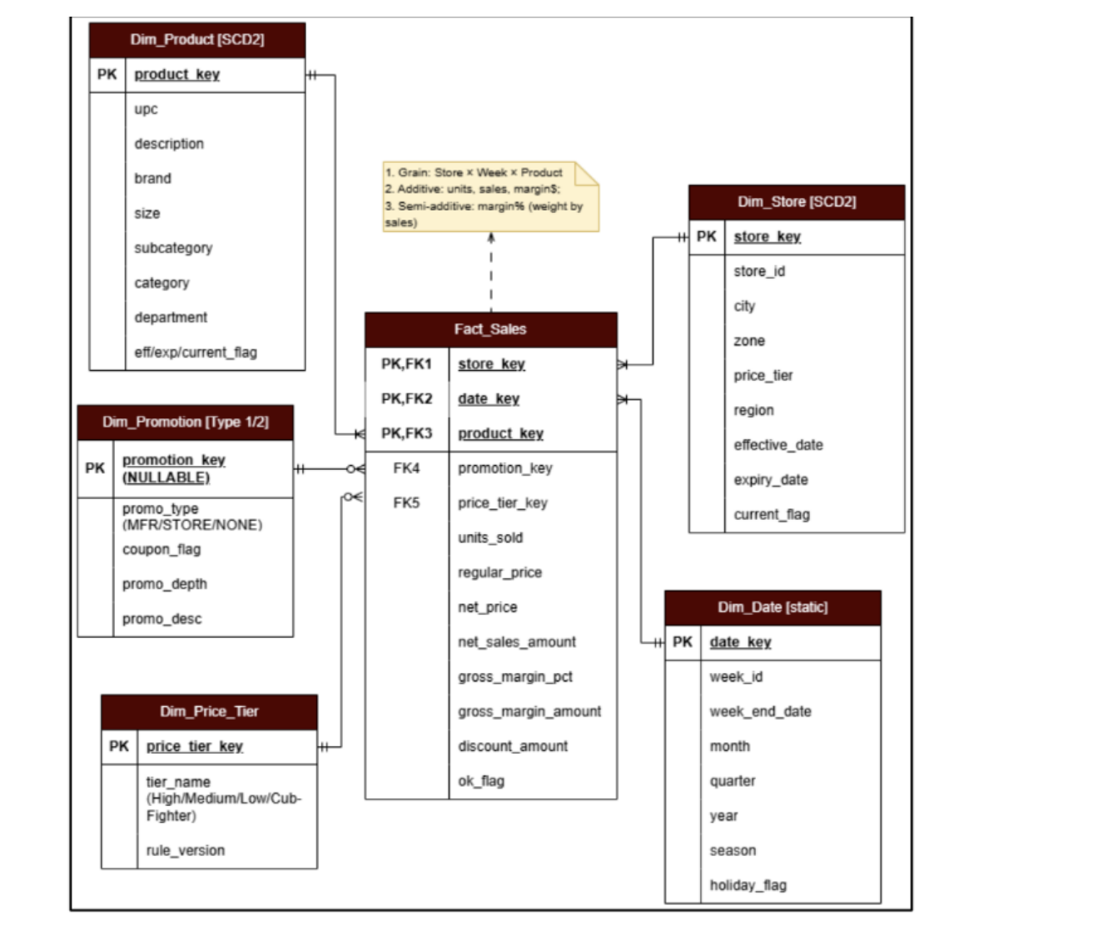
Sales & Margin Mart Schema
Use this to explain the warehouse design: fact table + conformed dimensions.
DFF Retail Data Warehouse & BI Analytics | Asset 01

Slide 2
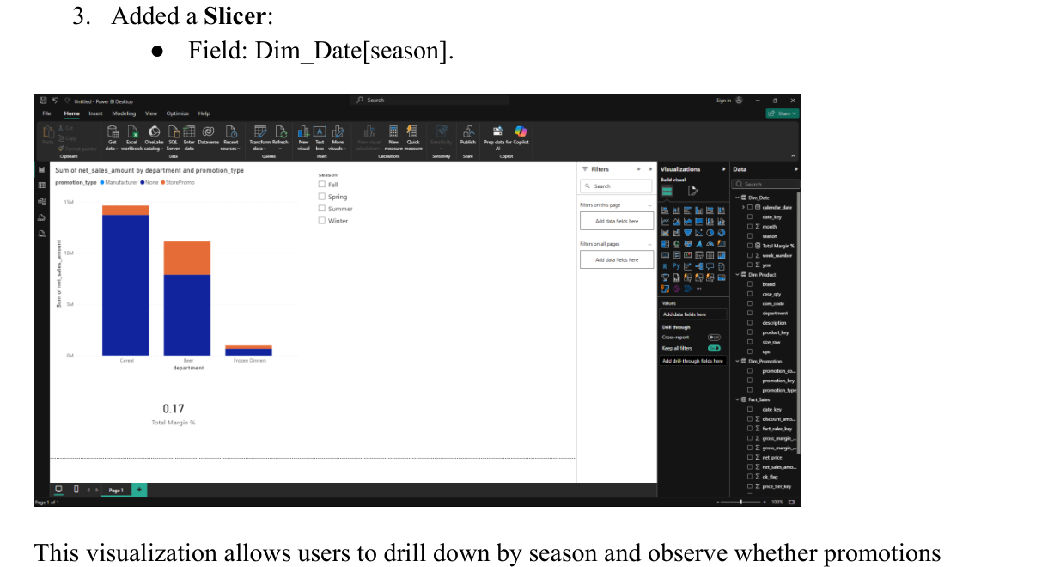
BQ1: Profit Margin by Category & Promotion
Use this to explain category profitability and promotion impact on margins.
DFF Retail Data Warehouse & BI Analytics | Asset 02

Slide 3
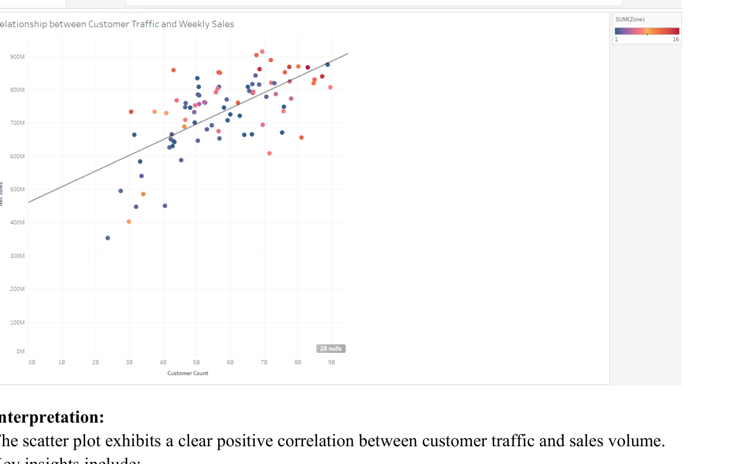
BQ3: Store Traffic vs Weekly Sales
Use this to explain traffic vs conversion diagnosis across stores.
DFF Retail Data Warehouse & BI Analytics | Asset 03

Slide 4
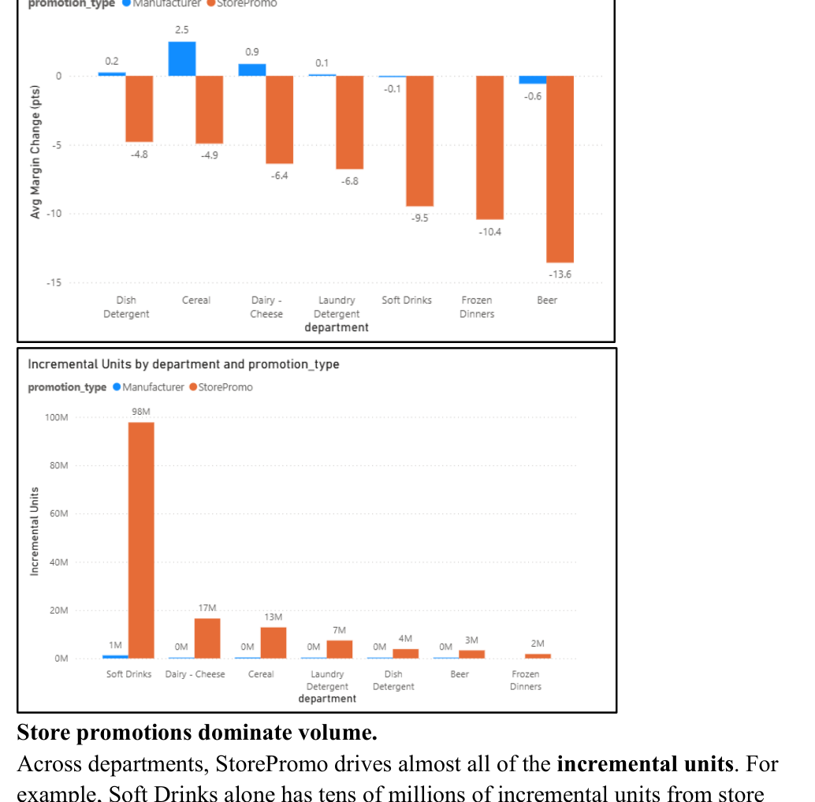
BQ4: Promotion Impact Analysis
Use this to explain lift versus margin tradeoff for promotions.
DFF Retail Data Warehouse & BI Analytics | Asset 04

Slide 5
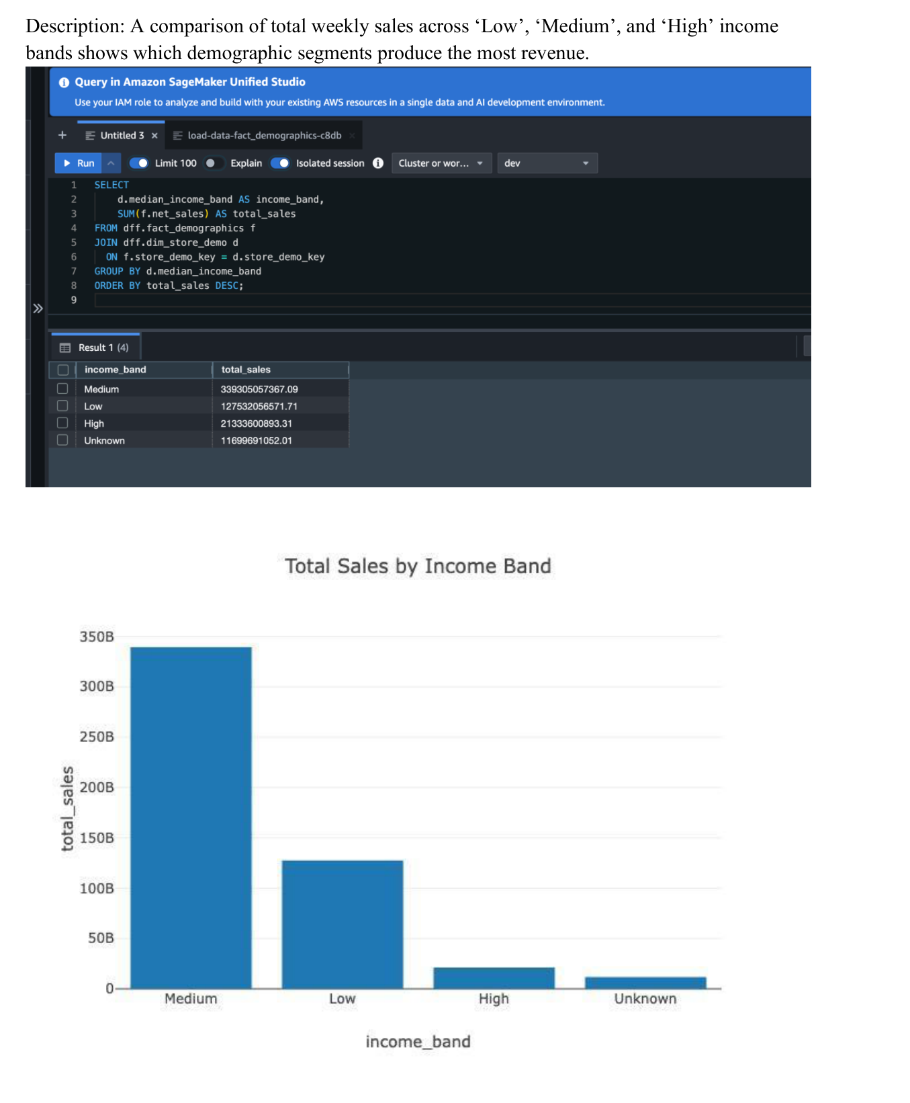
BQ8: Demographic Sales & Coupon Analysis
Use this to explain income/household segmentation from Redshift outputs.
DFF Retail Data Warehouse & BI Analytics | Asset 05

