Slide 1
BP Website Template.
Renard Heath
ITD210 Web Page Design II
Mr. Jared Oliverio
26 Feb 2018

Slide 2
Website Structure
Index.html
About Bayview.html
Specials.html
Social_Media.html
Appointments.html
Links.html

Slide 3

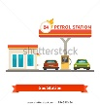

Home Page
BP Project Home Page Details
Logo – BP Logo to left and Station Logo centered above Nav-Bar
Nav Bar – BootStrap Nav Theme used with last nav button being drop down
Page Color Scheme – Will based on BP Corporate colors;
Green = #66CC33
Yellow = #F9E814
White = #FFFFFF
Add Carousel Feature that has shop pictures.
Add Footer with same theme of Nav Bar except no button just contact info with a
<address></address><mailto> element for email</mailto>
Page will be responsive
about
Specials
Social Media
Drop down to: Appointments an Links
CAROUSEL SLIDES OF SHOP Pictures
Bayview BP 8595 Bayview Blvd – Phone # -BayviewBP@gmail.com

Slide 4
About Page
BP Project Home Page Details
Logo – BP Logo to left and Station Logo centered above Nav-Bar
Nav Bar – BootStrap Nav Theme used with last nav button being drop down
Page Color Scheme – Will based on BP Corporate colors;
Green = #66CC33
Yellow = #F9E814
White = #FFFFFF
About the Shop <p></p> using CSS for section style, may use bootstrap for content article section.
Add Aside Feature that has testimonial elements.
Add Footer with same theme of Nav Bar except no button just contact info with a
<address></address><mailto> element for email</mailto>
Page will be responsive
about
Specials
Social Media
Drop down to: Appointments an Links
About the Shop
Testimonial
<blockquote>
<p></p>
<articles>
<p>Mission Statement</p>
<p>Hours of Operation</p>
<p>Services offered</p>
</articles>
Bayview BP 8595 Bayview Blvd – Phone # -BayviewBP@gmail.com

Slide 5
Specials Page
BP Project Home Page Details
Logo – BP Logo to left and Station Logo centered above Nav-Bar
Nav Bar – BootStrap Nav Theme used with last nav button being drop down
Page Color Scheme – Will based on BP Corporate colors;
Green = #66CC33
Yellow = #F9E814
White = #FFFFFF
Add Pricing Table Feature that display shop prices.
Add a drop down feature with links to specials under categories
Add Footer with same theme of Nav Bar except no button just contact info with a
<address></address><mailto> element for email</mailto>
Page will be responsive
about
Specials
Social Media
Drop down to: Appointments an Links
Pricing table
Garage Services
Snacks Offered
State Inspection
<drop down>
Current specials
<drop down>
Current specials
Bayview BP 8595 Bayview Blvd – Phone # -BayviewBP@gmail.com

Slide 6
Social Media Page
BP Project Home Page Details
Logo – BP Logo to left and Station Logo centered above Nav-Bar
Nav Bar – BootStrap Nav Theme used with last nav button being drop down
Page Color Scheme – Will based on BP Corporate colors;
Green = #66CC33
Yellow = #F9E814
White = #FFFFFF
Add Embedded Social Media Widget that user can post directly to Facebook from.
Add Footer with same theme of Nav Bar except no button just contact info with a
<address></address><mailto> element for email</mailto>
Page will be responsive
about
Specials
Social Media
Drop down to: Appointments an Links
Embedded Social Media Widget
Bayview BP 8595 Bayview Blvd – Phone # -BayviewBP@gmail.com

Slide 7
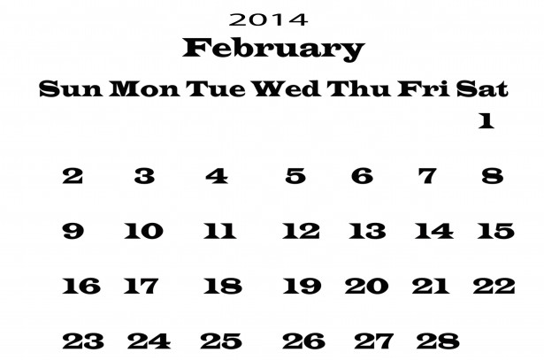
Appointment Page
BP Project Home Page Details
Logo – BP Logo to left and Station Logo centered above Nav-Bar
Nav Bar – BootStrap Nav Theme used with last nav button being drop down
Page Color Scheme – Will based on BP Corporate colors;
Green = #66CC33
Yellow = #F9E814
White = #FFFFFF
Add Calendar Feature that shows days that specials are offered and shows open time slots. Allows instructs customers to call for appointment
Add Footer with same theme of Nav Bar except no button just contact info with a
<address></address><mailto> element for email</mailto>
Page will be responsive
about
Specials
Social Media
Drop down to: Appointments an Links
Bayview BP 8595 Bayview Blvd – Phone # -BayviewBP@gmail.com

Slide 8
Links Page
BP Project Home Page Details
Logo – BP Logo to left and Station Logo centered above Nav-Bar
Nav Bar – BootStrap Nav Theme used with last nav button being drop down
Page Color Scheme – Will based on BP Corporate colors;
Green = #66CC33
Yellow = #F9E814
White = #FFFFFF
<ul> That list all required links to BP Corporate and business partners. </ul>; with Yellow background.
Add Footer with same theme of Nav Bar except no button just contact info with a
<address></address><mailto> element for email</mailto>
Page will be responsive
about
Specials
Social Media
Drop down to: Appointments an Links
Links to:
Corporate BP
Business Partners
Other required linked sites
Bayview BP 8595 Bayview Blvd – Phone # -BayviewBP@gmail.com

