Slide 1
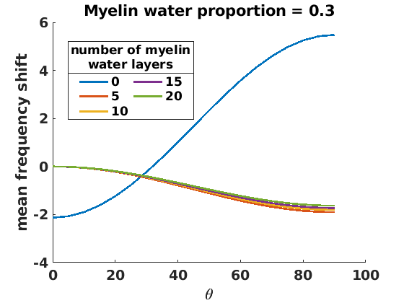
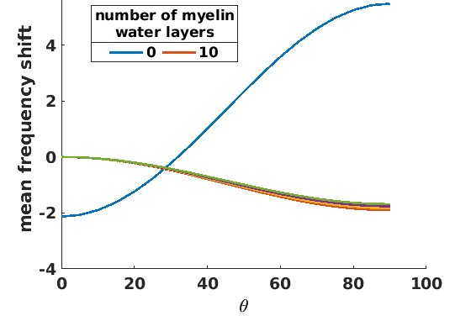
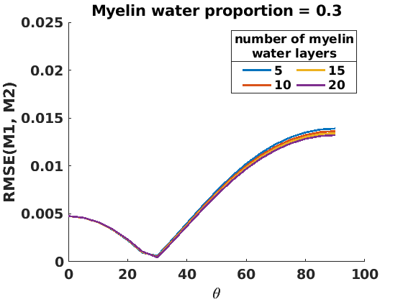
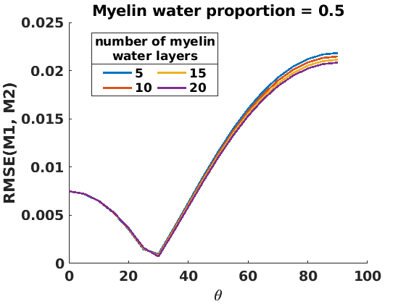
Myelin water volume fraction = 0.3
Myelin water volume fraction = 0.5
Myelin water volume fraction = 0.3
Myelin water volume fraction = 0.5

