Slide 1
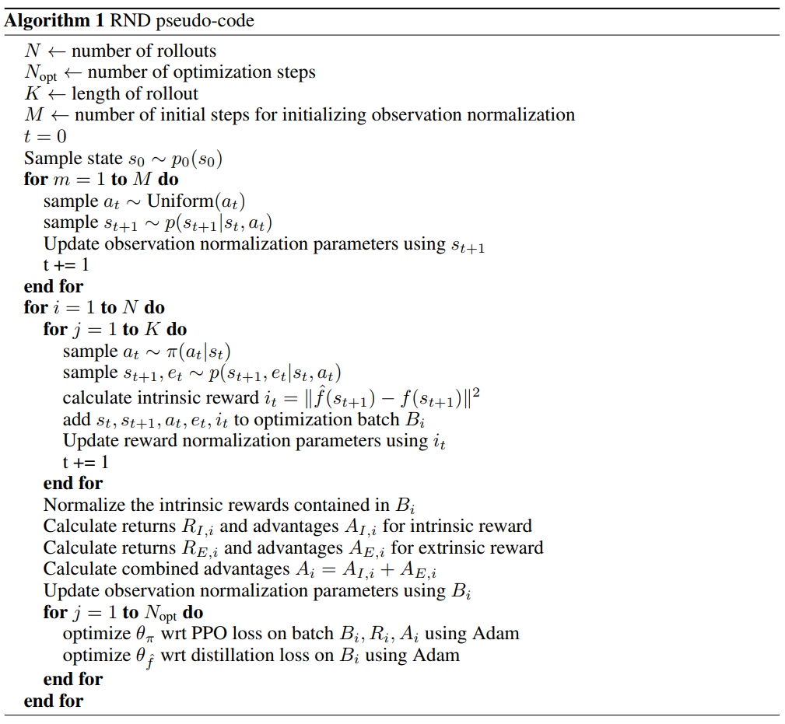
Implemented
Not Implemented
Partially Implemented

