Slide 1
Software I/O Virtualization
Software I/O Virtualization = I/O Device Emulation
Hypervisor는 Emulation을 통해 가상 I/O 장치를 생성하고 가상 머신에게 제공한다.
Full-Virtualiztion / Paravirtualization
VM
VM
Unmodified Device Driver
Modified Device Driver
Hypercall /
Exception
Hypervisor
Exception
Device Emulation
Trap Handler
Device Driver
Device

Slide 2
KVM + QEMU
KVM - CPU Virtualization, Memory Virtualization
QEMU - I/O Full-virtualization
QEMU
Guest Kernel
I/O Emulation
I/O Emulation
Physical Device Driver
Exception
3
9
irqfd
vCPU
7
4
Event Loop
1
8
2
vIRQ
return
6
Linux Kernel
KVM Module
Device Driver
5
Device

Slide 3
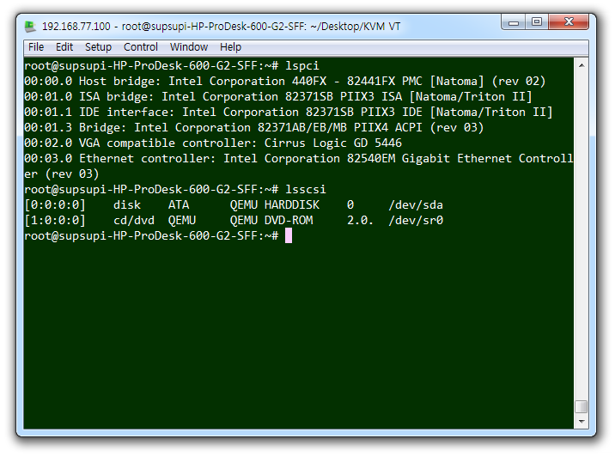
KVM + QEMU
CPU (KVM)
PCI Host bridge
(QEMU)
PCI BUS0
NIC (QEMU)
IDE Controller (QEMU)
IDE Cable
HDD (QEMU)
DVD-ROM
(QEMU)

Slide 4
Virtio Architecture
Paravirtualized device driver.
QEMU
Guest Kernel
Virtio Device Emulator
(Backend)
Virtio Driver
(Frontend)
Virtqueue
vCPU
Event Loop
Shared Memory (Zero-copy)

Slide 5
KVM + QEMU + VirtIO
KVM - CPU Virtualization, Memory Virtualization
QEMU - I/O Full-virtualization + I/O Paravirtualization (VirtIO)
QEMU
Virtqueue
Guest Kernel
1
VirtIO Device Emulation
VirtIO Device Driver
5
Exception
8
irqfd
vCPU
6
Event Loop
2
7
4
vIRQ
3
Linux Kernel
KVM Module
Device Driver
ioeventfd
Device

Slide 6
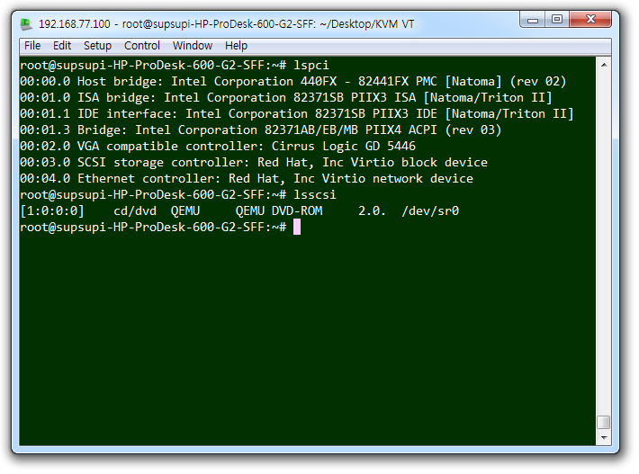
KVM + QEMU + virtio-net + virtio-blk
CPU (KVM)
PCI Host bridge
(QEMU)
PCI BUS0
NIC (virtio-net)
virtio-blk
SCSI Controller
Block

Slide 7
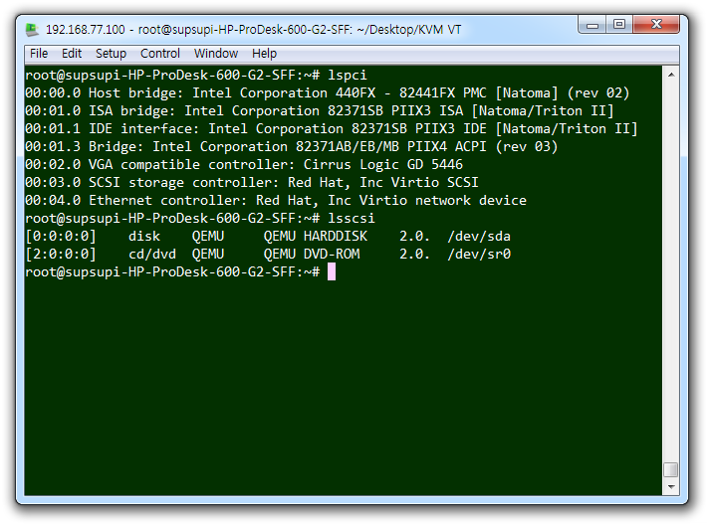
KVM + QEMU + virtio-net + virtio-scsi
CPU (KVM)
PCI Host bridge
(QEMU)
PCI BUS0
NIC (virtio-net)
SCSI Controller (virtio-scsi)
SCSI Cable
HDD (QEMU)

Slide 8
KVM + QEMU + VirtIO + vhost-net
KVM - CPU Virtualization, Memory Virtualization
QEMU - I/O Full-virtualization
vhost-net - virtio network device emulation
QEMU
Guest Kernel
virtio-net Device Driver
1
Exception
8
virtqueue
vCPU
2
7
vIRQ
5
Linux Kernel
KVM Module
vhost-net
3
virtio-net Emulation
ioeventfd
6
irqfd
4
macvtap / macvlan
NIC Device Driver
NIC

Slide 9
KVM + QEMU + VirtIO + vhost-scsi
KVM - CPU Virtualization, Memory Virtualization
QEMU - I/O Full-virtualization
vhost-scsi - virtio scsi controller emulation
QEMU
Guest Kernel
virtio-scsi Device Driver
1
Exception
8
virtqueue
vCPU
2
7
vIRQ
5
Linux Kernel
KVM Module
vhost-scsi
3
virtio-scsi Emulation
ioeventfd
6
irqfd
4
LIO (Linux I/O Target)
Block Device Driver
SCSI, SATA

Slide 10
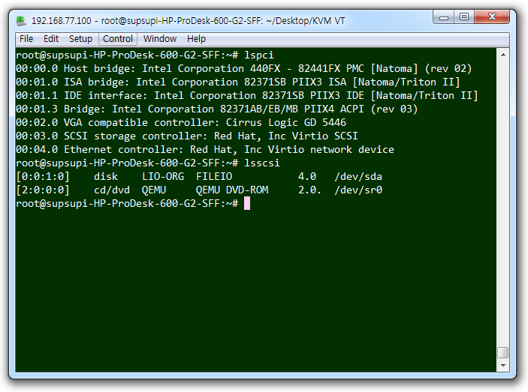
KVM + QEMU + virtio-net + virtio-scsi + vhost-net + vhost-scsi
CPU (KVM)
PCI Host bridge
(QEMU)
PCI BUS0
NIC (virtio-net)
SCSI Controller (virtio-scsi)
SCSI Cable
HDD (LIO)

