Slide 1
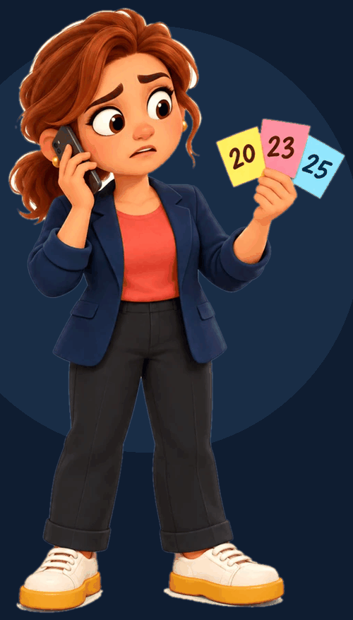
21 October
Lotte is a payroll consultant at SD Worx.
Her client Atlas calls:
“Can we still submit a payroll change?”
Notes:
It's 21 October. Lotte is a payroll consultant at SD Worx. Her client Atlas calls: can we still submit a payroll change?

Slide 2
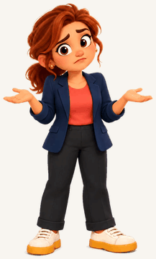
Three answers. None of them is right
20th
Procedure Belgium
General rule
23rd
Atlas meeting
A proposal on the board
25th
Teams chat
A question, no owner
22nd
Roy's agreement
Only in Roy's head
Lotte doesn't lack information. Nothing tells her which version to trust. Today she searches for 20 minutes and pings three colleagues. If she guesses wrong, real people get the wrong salary.
Notes:
The procedure says the 20th. A Teams meeting said the 23rd. Someone in chat says the 25th. None of them is right: the real answer is the 22nd, an exception Roy agreed with Atlas. It was never written down, it only lives in Roy's head. Lotte doesn't lack information, she has too much of it, and nothing tells her which version to trust. If she guesses wrong, real people get the wrong salary.

Slide 3





THE SOLUTION
SDtrust
Teams
Mail
ONE ANSWER
22 October 2026
Confirmed by Roy
Account owner, Atlas
Knowledge you can trust,
without anyone writing it down
CRM
SDtrust reads what your company already writes, decides which version to trust, and shows you why.
Procedures
Sebastien · Roy · Wanne
Tectonic hackathon finals · SD Worx challenge · 20 October 2026
Notes:
That's the problem SD Worx asked us to solve: turn scattered knowledge into something people can trust, without anyone writing documentation. Our answer is SDtrust. It reads what your company already writes in Teams, mail, the CRM and procedures, decides which version to trust, and shows you why.

Slide 4
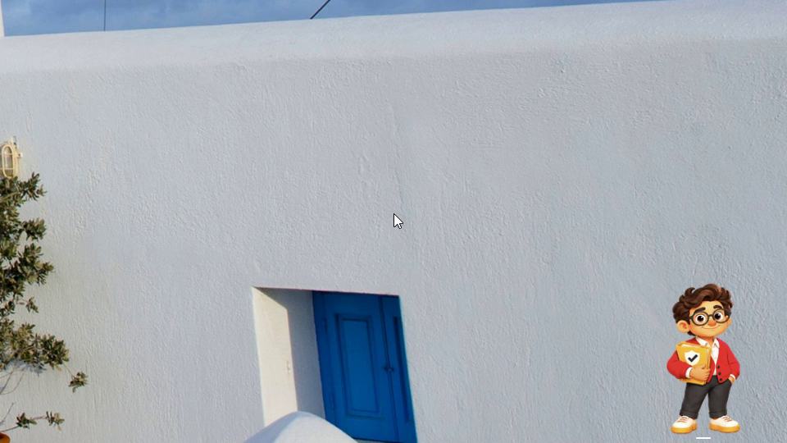
Video 1 · Meet Finn
Notes:
Video 1: Meet Finn. It plays by itself with its own narration; stay quiet and click when it ends.

Slide 5

Video 2 · coming from Sebastien
Replace this box: Insert › Video › This Device, then Playback › Start: Automatically
Video 2 · Clip 2
Notes:
Video 2: Sebastien's clip 2 is not in docs/presentation/video yet. Rebuild the deck once it is pushed.

Slide 6
Video 3 · coming from Sebastien
Replace this box: Insert › Video › This Device, then Playback › Start: Automatically
Video 3 · Clip 3
Notes:
Video 3: Sebastien's clip 3 is not in docs/presentation/video yet. Rebuild the deck once it is pushed.

Slide 7
Video 4 · coming from Sebastien
Replace this box: Insert › Video › This Device, then Playback › Start: Automatically
Video 4 · Clip 4
Notes:
Video 4: Sebastien's clip 4 is not in docs/presentation/video yet. Rebuild the deck once it is pushed.

Slide 8




Finn calls the one person who knows
LIVE TRANSCRIPT
Teams call
Calling Roy…
Connected
Finn
Hi Roy, it's Finn. You own the Atlas account, so you're the one who knows. Until when can Atlas submit payroll changes this October? I can't find anything approved.
R
Finn
SDtrust
Roy
Account owner, Atlas
Roy
Hi Finn! Until the 22nd. I agreed it with Atlas, but I never put it in the CRM.
Why Roy? He is the Atlas account owner in the CRM
Finn
Got it. I'll update the CRM myself, and let Lotte know.
Saved to the CRM by Finn
S35 · Teams call with Roy · 21 October 2026
Roy
Thanks, Finn!
“Atlas may submit payroll changes until 22 October 2026.”
Confirmed by the owner
Belgium · Atlas · October 2026
Trust 15%
94%
Notes:
THE CALL. Roy stands up holding his phone as if he picks up.
On entering: the call rings for 2 seconds, then Finn speaks (audio plays by itself):
FINN: Hi Roy, it's Finn. You own the Atlas account, so you're the one who knows. Until when can Atlas submit payroll changes this October? I can't find anything approved.
CLICK 1, Roy answers live, loud and clear:
ROY: Hi Finn! Until the 22nd. I agreed it with Atlas, but I never put it in the CRM.
CLICK 2, Finn answers (audio):
FINN: Got it. I'll update the CRM myself, and let Lotte know.
CLICK 3, Roy answers live:
ROY: Thanks, Finn!
CLICK 4, the CRM card appears. PRESENTER: Roy never opened the CRM. Finn wrote the agreement there himself, so the next person who asks gets the 22nd straight away.

Slide 9
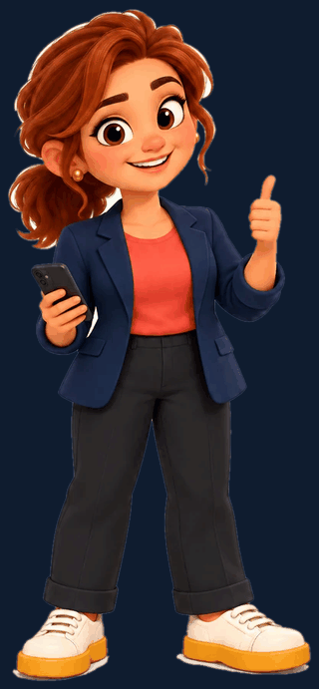

An answer you can trust.
Or an honest “I don't know”,
plus the right colleague.
Zero unnecessary effort.
SDtrust
Notes:
SDtrust: an answer you can trust, or an honest I don't know plus the right colleague. Zero unnecessary effort.

Slide 10
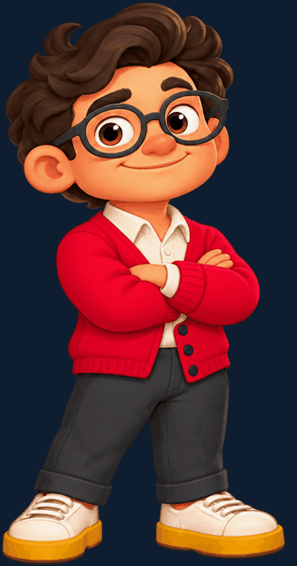
Thank you
Questions? Finn is listening.
Sebastien · Roy · Wanne
Tectonic hackathon finals · SD Worx challenge · 20 October 2026
SDtrust
Notes:
Thank the jury and open for questions.
If asked how trust is scored: four factors. Authority: an approved statement from the owner beats a proposal or a chat message. Scope: valid for this country, client and period. Validity: superseded or expired versions lose. Agreement: conflicting sources lower trust, and when trust is too low Finn asks the owner.
If asked whether this is real: the desktop app, the answer and evidence screens and the trust display are built. Sources and the call are simulated with demo data. Connecting Teams, mail and the CRM is the next step.

