Slide 1
Practicing Intelligence
Third-Party Risk in a Noisy Supply Chain
InfraGard Conference Presentation
Darkweb IQ

Slide 2
Why Third-Party Risk Demands a New Intelligence Standard
Third-party compromise is not new — but the scale and opacity of access paths are growing.
Mass exploitation, infostealer logs, and poor hygiene in MSPs, create invisible exposure.
Most alerts focus on symptoms: malware alert, abnormal log-in, phishing detection, anomalous behavior.
Notes:
When we say intelligence, we don’t mean headlines or feeds. We mean tradecraft and engaging with brokers. We mean operating with intention, discerning what’s real — and helping our partners act with clarity, not urgency
Mass exploitation = widespread use of the same vulnerability or attack path across many victims. Examples:
MOVEit file transfer vulnerability (Cl0p)
ProxyShell/ProxyLogon against Exchange Servers
CVE-2023-34362 (Fortinet) abused by multiple IABs at once
MSP invisible exposure:
RMM credentials harvested from MSP helpdesk staff in stealer logs
Shared AnyDesk, ConnectWise, or TeamViewer credentials reused across client orgs
MSPs retaining remote access even after a service engagement ends

Slide 3
Why Third-Party Risk Demands a New Intelligence Standard
Root posture risk = why the access was possible in the first place:
Overprivileged vendor account
• Unmonitored VPN user
• Password stolen weeks ago and never rotated
Notes:
Few focus on the root risk because of the focus on the symptoms / effects of root risk

Slide 4
What’s Missing from the Cyber Stack
Everyone in this room has a defensive stack.
• MFA, EDR, XDR, GRC, segmentation, phishing simulations.
• These are critical. Keep them. Build on them.
But less are thinking:
• Who’s targeting your credentials right now?
• How is your remote access footprint appearing on stealer logs?
• Is your MSP being used as a brokered foothold?
• What does your organization look like to the access economy?

Slide 5
What’s Missing from the Cyber Stack: Offensive Minded Intelligence
offensive minded intelligence.
not threat feeds or scraping.
We’re talking about offensive collection — human-driven, source-facing, and upstream.
Most threat feeds (e.g., IOC, IP/domain watchlists) offer signals after compromise or attacker staging.
OC feeds like MISP, Anomali, and Recorded Future are useful, but reactive.
Scraping dark web forums = passive and noisy.
value = real access and human-driven intelligence before threat indicators ever emerge

Slide 6
Companion Concept: “What Does an Offensive Mindset Look Like?”
Defensive Posture | Offensive Intelligence Posture
Detect anomalies | Identify compromised access before use
Block threats | Trace how they’re brokered
Monitor traffic | Intercept underground movement
React to incidents | Prevent adversary foothold
Validate claims | Debunk with firsthand proof
Notes:
“Offensive Mindset” language
“Intercept underground movement” = acquiring access from threat actors before it’s sold downstream
“Validate claims” = validating breach/extortion claims circulating in underground chatter or private channels
“Debunk or validate with firsthand proof” = showing the credential never existed, the malware was fake, or the actor was bluffing — because you engaged them or reviewed the actual logs

Slide 7
The Making of the Modern Third-Party Risk Landscape
What we call “third-party risk” today is the byproduct of a decade of scaling that accelerated under pressure of convenience, cost savings, and reliance on third party expertise — NOT intentional security design
“SaaS has become the default… embedding concentration risk into global critical infrastructure.” Patrick Opet, CISO, JPMorgan Chase (May 2025)
the system was architected for efficiency, not resilience.
Notes:
Even JPMorgan — the largest financial institution on earth — is calling out this new reality.
Their CISO’s open letter reads like a warning about what happens when trust boundaries collapse.
“we must reject these integration models without better solutions” - intentional security design, offensive minded approach to bolster an already strong defense

Slide 8
How We Got Here
Reliance Accelerated: “Organizations increasingly rely on third parties… to perform critical functions, provide essential services, and support strategic objectives.” (KPMG, 2021)
Efficiency Over Visibility: Cost savings and specialization drove adoption — but left behind real-time oversight and layered access governance.
Cyber Risk Emerges: “Cybersecurity and data privacy rank among the top third-party risks… requiring continuous monitoring and real-time visibility.”

Slide 9
How We Got Here
Monitoring Gaps Remain: Calls for real-time third-party data reinforce what’s missing in current tooling: the origin layer of compromise — where trust becomes exposure.

Slide 10
Covid 19: The Great Expansion of Access
Remote Work at Scale: In 2020, enterprises moved to remote access overnight — opening ports, extending privileges, and scaling trust faster than oversight.
Access Surged — and So Did Attacks:
RDP attacks grew 768% in 2020, totaling 29 billion attempts (ReliaQuest)
Ransomware attacks spiked 148% in March 2020 alone (VMware)
Threat actors exploited urgency — not technical flaws — as their entry point
Upstream Compromise, Downstream Impact:
In the 2023 MOVEit breach, victims like Shell and the U.S. Dept. of Energy were compromised not directly, but via an exploited vendor platform. (TechCybersecurityNews, Dec 2023)
Notes:
the evolution of third party risk is made up of many causes of different weights, we touched on the natural evolution of software and services etc that increased the risk, however, one factor of outweighed proportions must be acknowledged: COVID 19 and it’s impact on 3rd party risk citations: ReliaQuest observed a 768% growth in RDP attacks throughout 2020, totaling 29 billion attempted attacks, as organizations expanded remote access capabilities
VMware noted a 148% increase in ransomware attacks in March 2020 compared to the previous month, attributing the surge to opportunistic exploitation during the pandemic .
Guidepoint Security reported that ransomware incidents reached a record high in the first quarter of 2025, with over 2,000 victims and 70 active threat groups

Slide 11
Covid 19: The Great Expansion of Access
From Third Party to Threat Actor:
Shared tools became shared exposure. Vendor ecosystems expanded faster than they could be secured.
Today’s Landscape:
By Q1 2025, ransomware reached record highs: 2,000+ victims, 70+ active groups (GuidePoint Security) — many exploiting remote services and credential access.
Notes:
What we saw during COVID wasn’t just a spike in attacks — it was a shift in the playing field. Access became fluid. And the threat followed it.

Slide 12
(citations for prior two slides)
ReliaQuest observed a 768% growth in RDP attacks throughout 2020, totaling 29 billion attempted attacks, as organizations expanded remote access capabilities
VMware noted a 148% increase in ransomware attacks in March 2020 compared to the previous month, attributing the surge to opportunistic exploitation during the pandemic .
Guidepoint Security reported that ransomware incidents reached a record high in the first quarter of 2025, with over 2,000 victims and 70 active threat groups

Slide 13
Challenges in Third Party Risk Management
JP Morgan’s Patrick Opet, CISO - Open Letter to Third Parties: “SaaS… is creating a substantial vulnerability that is weakening the global economic system.” (2 May 2025)
Moveit Example:
“In the MOVEit breach, major organizations like Shell and the U.S. Department of Energy suffered data compromise not from direct intrusion, but because a shared vendor platform was exploited upstream” TechCybersecurityNews, Dec 2023
The MOVEit cyberattack campaign significantly affected numerous organizations Many entities experienced severe data breaches due to the exploitation of vulnerabilities in the MOVEit software of a third party.
Notes:
takeaway from JP Morgan’s letter: “SaaS… is creating a substantial vulnerability that is weakening the global economic system.”
Cloud-native vendors have become single points of failure.
Historically segmented environments are now homogenized and connected — leading to mass-scale breach propagation.
many orgs now run the same SaaS platforms, use shared APIs, and integrate through OAuth — flattening security distinctions
Example: Everyone uses Microsoft 365. If a vendor gets compromised and had access to your tenant via OAuth token or shared login, you’re exposed without realizing it.

Slide 14

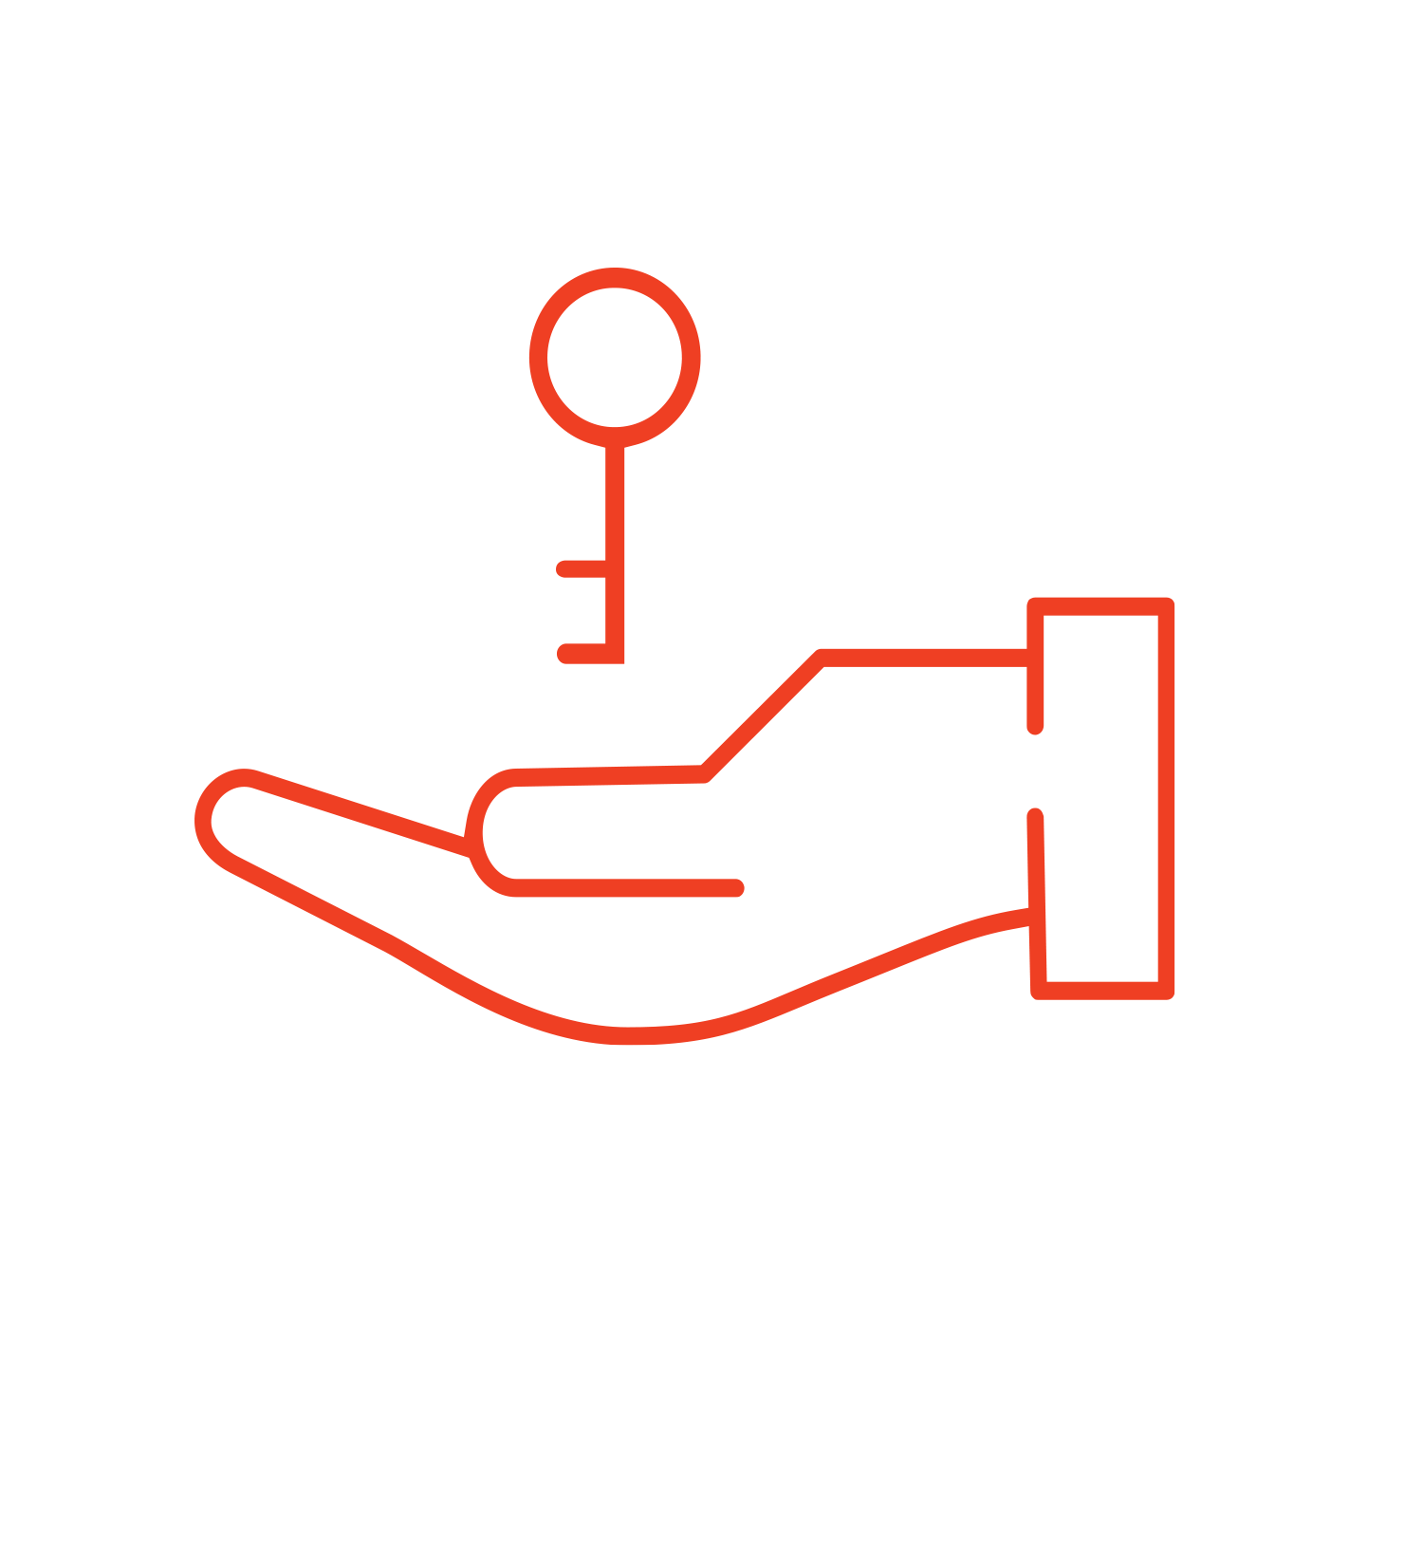
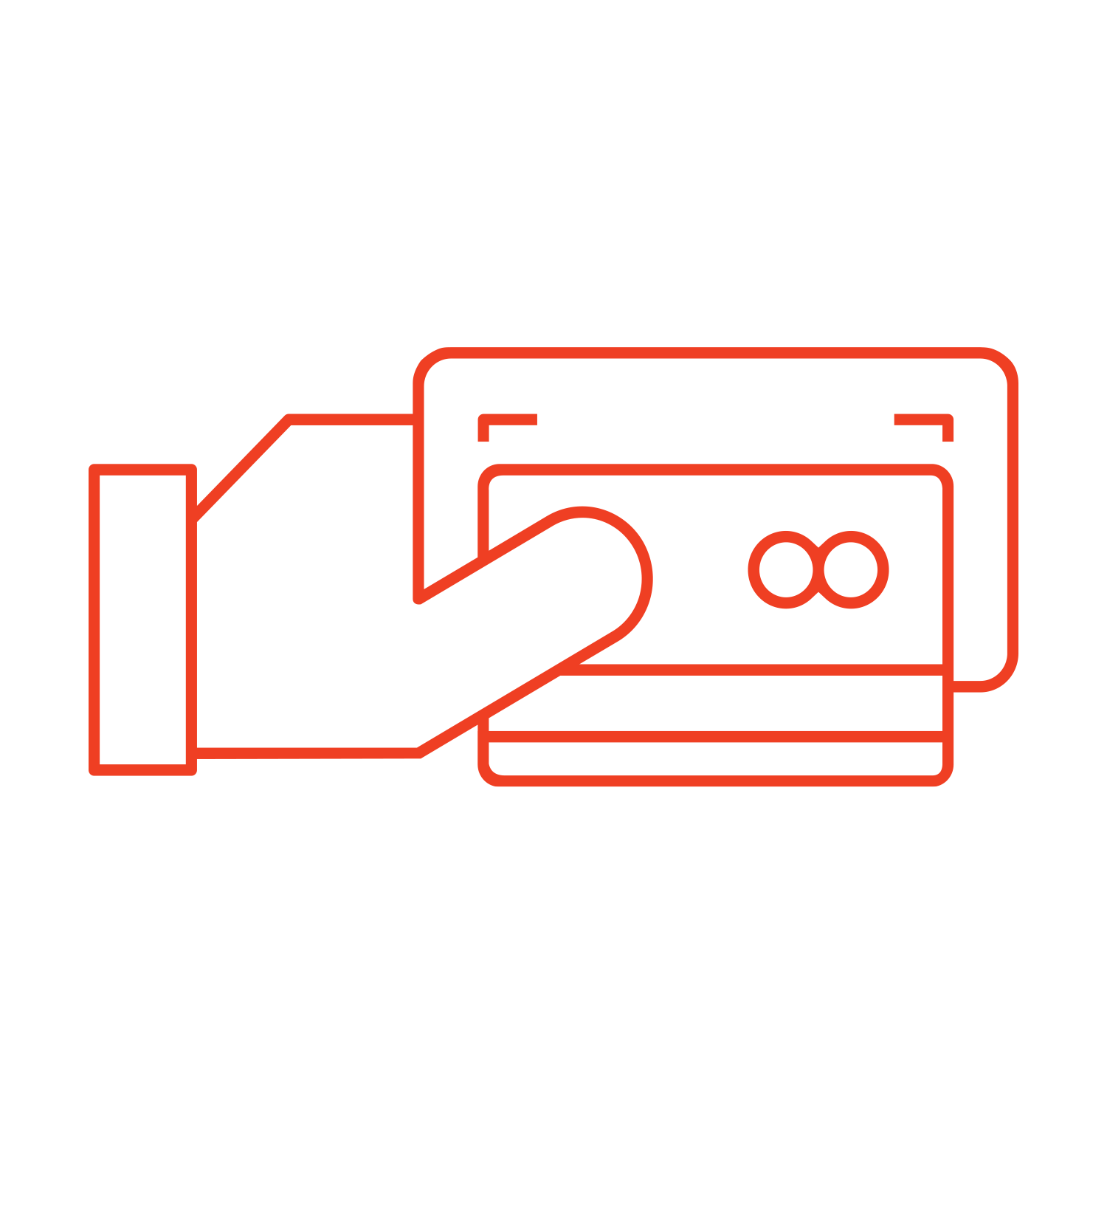


What Access Really Looks Like:
Stolen creds
Mass Scan Exploiters
Targeted Spammers
Initial Access Brokers sell Access
Ransomware Affiliates buy Access
Ransomware as a Service Operators provide tools to launch attacks
Corporate Targets
…and the rising cost of inaction:
$1.1 Billion in Ransom Payments in 2023
Businesses paid over $1.1 billion in ransom payments in 2023, marking the highest annual total to date. (WIRED, 2024)
Average Recovery Cost of $2.73 Million in 2024
The average cost for organizations to recover from a ransomware attack (excluding ransom payments) rose to $2.73 million in 2024, up from $1.82 million in 2023. (Cyberreason.com, 2024) ￼
78% of Organizations Re-Breached After Paying Ransom
Among organizations that paid a ransom, 78% experienced a subsequent breach, with 63% facing higher ransom demands the second time. ￼
$124.2 Billion Annual Cost to U.S. Businesses
Ransomware exposure costs U.S. businesses an estimated $124.2 billion annually, encompassing ransom payments, downtime, recovery, and reputational damage.
Notes:
what is the rising cost of inaction — ransomware payouts, brand damage, delayed detection

Slide 15
Rising Cost of Inaction
$1.1 Billion in Ransom Payments in 2023
Businesses paid over $1.1 billion in ransom payments in 2023, marking the highest annual total to date. (WIRED, 2024)
Average Recovery Cost of $2.73 Million in 2024
The average cost for organizations to recover from a ransomware attack (excluding ransom payments) rose to $2.73 million in 2024, up from $1.82 million in 2023. (Cyberreason.com, 2024) ￼
78% of Organizations Re-Breached After Paying Ransom
Among organizations that paid a ransom, 78% experienced a subsequent breach, with 63% facing higher ransom demands the second time. ￼
$124.2 Billion Annual Cost to U.S. Businesses
Ransomware exposure costs U.S. businesses an estimated $124.2 billion annually, encompassing ransom payments, downtime, recovery, and reputational damage.
Notes:
what is the rising cost of inaction — ransomware payouts, brand damage, delayed detection

Slide 16
Anatomy of Third-Party Exposure
Infostealer logs → Exposed credentials
Logs from malware (RedLine, Raccoon, Vidar) that steal:
Browser-saved passwords
Session cookies
VPN/RMM credentials
Advertised on top tier forums, sold via established relationships in private chats: TOX, Jabber etc
Circulated in private Telegram groups, access marketplaces, and stealer log sites like “RussianMarket”

Slide 17
Anatomy of Third-Party Exposure
Weak segmentation → Pivot path
Segmenting internal networks or vendor access zones to prevent lateral movement
Example: If your HVAC vendor has access to your billing system, you’ve got a segmentation issue

Slide 18
Anatomy of Third-Party Exposure
Overlapping identities → Lateral movement
A vendor using the same password across two client environments
An IT admin using personal email as a backup for corp accounts
Single SSO login shared between vendors and internal users = risk across tenants

Slide 19
Anatomy of Third-Party Exposure
Unnoticed reuse
Credential stolen months ago via infostealer
Password never rotated
New IAB picks it up, sells it again = repeat compromise
Often reused across multiple SaaS platforms (e.g., O365, VPN, Salesforce)

Slide 20
The DWIQ Approach: Focus on the root cause - Initial Access Broker ecosystem
We identify not just the breach, but the brokered access path before it becomes ransomware.
We trace credential lineage back to stealer logs, forums, and sale patterns.
We notify not for noise — but when posture can be changed and can mitigate - actionability is the gold standard of real intelligence
we must ask ourselves, “is this intelligence changing our security posture?” “is it leading us to take action?”
Notes:
explain what we do when we focus on the initial access broker ecosystem

Slide 21
Offensive Intelligence Operations and Collection
Intelligence cycle:
1. Planning
& Direction
5. Dissemination
2. Data
Collection
4. Analysis
& Production
3. Processing
Notes:
what are our gaps? Gaps in 3rd-party visibility:
No insight into vendor credential theft
No understanding of access resale
No early warning on compromise before malware is deployed
Additions to underground op requirements:
Burner infrastructure & opsec (clean VMs, proxies, misattrib cloud usage)
Linguistic mimicry (slang, dialect nuance, underground etiquette)
Temporal commitment (presence, consistency in persona behavior)
Deep community fluency (knowing who’s real vs. bluffing)

Slide 22
Offensive Intelligence Operations and Collection
What it takes to run disciplined, effective intelligence operations in a misattributable underground ecosystem:
Undercover personas: Built with backstory, behavioral consistency, and operational purpose
Reputation seasoning: Time + presence → credibility in hard-to-access forums, gated channels, or encrypted markets
Technical expertise for misattribution
Crypto hygiene, laundering simulation, burner wallet movement
Operational infrastructure: clean VMs, proxies, unmanaged cloud infrastructure
Cultural fluency: Underground etiquette, language, timing, nuance
“Street expertise”: Ability to read deception, navigate actor intent, defend cover challenges, negotiate like a criminal
Notes:
These are not ad hoc excursions. They are deliberate, tradecraft-driven operations — built to surface truth without triggering threat actor defenses.

Slide 23
Impact of Practicing Intelligence
To those managing supply chain security — we offer more than detection. We offer discernment.
- Less noise. More clarity.
- Less reaction. More posture insight.
- Less marketing. More actionability.

Slide 24
What Offensive Intelligence Makes Possible: Outcomes from disciplined, source-facing intelligence operations
DWIQ Intelligence Outcomes (All Clients)
72 access broker interceptions this month — threats stopped before resale
1,627 all-time access broker interceptions — credentials acquired before ransomware groups
80 FBI notifications this month — national-level alerts delivered in real time
2,183 all-time FBI notifications — helping law enforcement intervene early
482 all-time threat actors engaged — real adversaries tracked, disrupted, and denied

Slide 25
Tradecraft Over Alerts
DWIQ take the practice of intelligence in our mission. The sole purpose of our alerts and what we publish…?
Third-party risk intelligence isn’t a product. It’s a pattern of presence and discernment.
Where others issue tickets, we offer insight that shifts posture.

