Slide 1
The Economics of Renewable Energy Figures and Tables
By David Timmons, Jonathan M. Harris, and Brian Roach
Copyright © 2024 Economics in Context Initiative,
Global Development Policy Center, Boston University

Slide 2
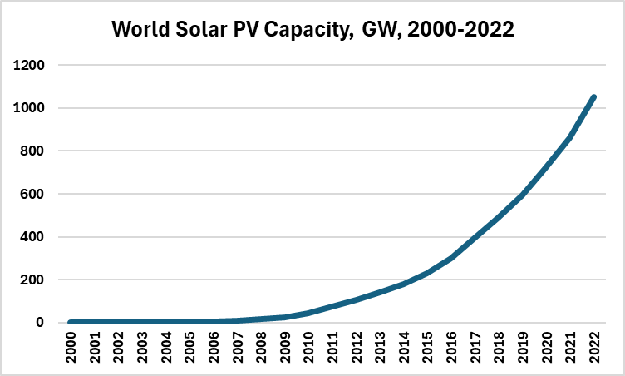
Figure 1. World Solar PV Capacity, GW 2000-2022

Slide 3
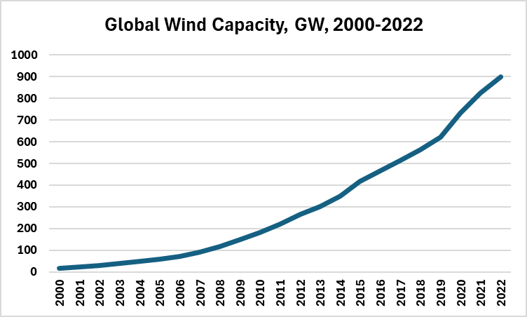
Figure 2. Global Wind Capacity, GW, 2000-2022
Source: Data from International Renewable Energy Agency, 2023.

Slide 4
Table 1. World Energy Optimum Sources and Storage in 2050
Electricity Generation, TWh |  |  | Heat Generation, TWh |  |  | Energy Storage, TWh
Solar | 104,468 | 76.1% | Solar | 3,009 | 5.3% | Batteries | 27,522 | 44%
Wind | 27,307 | 19.9% | Geo- thermal | 791 | 1.4% | Pumped hydro | 668 | 1%
Hydro | 4,192 | 3.1% | Biomass | 5,830 | 10.3% | Compressed air | 2,404 | 4%
Biomass | 330 | 0.2% | Methane | 6,573 | 11.6% | Thermal | 9,300 | 15%
Geo- thermal | 381 | 0.3% | Waste | 665 | 1.2% | Synthetic methane | 9,531 | 15%
Fossil fuels | 37 | 0.0% | Electric | 39,614 | 70.1% | Hydrogen | 13,311 | 21%
Nuclear | 26 | 0.1% | Fossil fuels | - | - | Total | 62,736 | 100%
Other | 436 | 0.3% | Total | 56,482 | 100%
Total | 137,277 | 100%
Source: Bogdanov et al. (2021)

Slide 5
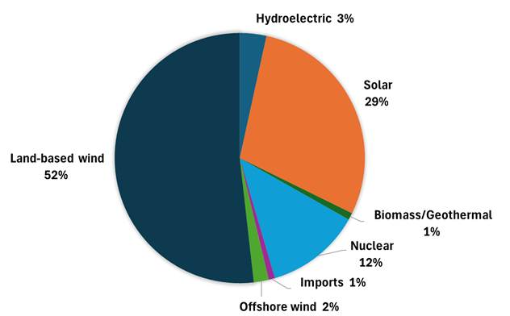
Figure 3. Generation for U.S. Electric Grid in 2035, Without Fossil Fuels
Source: NREL (2022)

