Slide 1
YOLO Training Progress
Ankush Patel – CS494 – Week 5

Slide 2
eGPU
Configured CUDA, enabling training on the RTX 2080 Ti.
Training the old CIFAR 10 model on CPU took approx. 61 seconds per epoch, whereas training on the eGPU took approx. 7 seconds per epoch.

Slide 3

Moving to YOLO

Slide 4
Configuration
This week, I was able to setup YOLO and test some existing pretrained models on images.
The models were pretrained on the COCO dataset, which consists of 80 classes and 330K images with more than 200K labeled images.

Slide 5
Models [Pascal Titan X]
YOLOv3-320
YOLOv3-tiny
mAP – 51.5
FLOPS – 38.97 Bn
FPS – 20
On my CPU – each prediction takes approx. 21-24 seconds so approx. 0.044 FPS
mAP – 33.1
FLOPS – 5.56 Bn
FPS – 220
On my CPU – each prediction takes approx. 0.9-1.2 seconds so approx. 0.952 FPS
Notes:
mAP – mean average precision i.e. how well the prediction matches up to the ground truth.

Slide 6
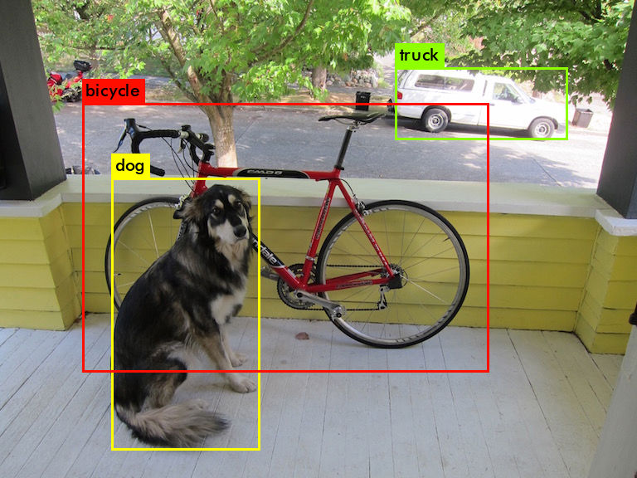
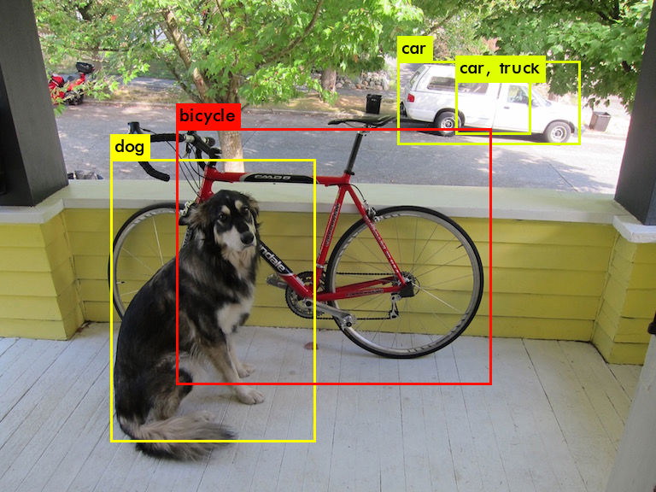
Small Comparison: Dog
YOLOv3-320
YOLOv3-tiny

Slide 7
Small Comparison: Dog
YOLOv3-320
YOLOv3-tiny
dog: 100%
truck: 92%
bicycle: 99%
dog: 57%
car: 52%
truck: 56%
car: 62%
bicycle: 59%

Slide 8
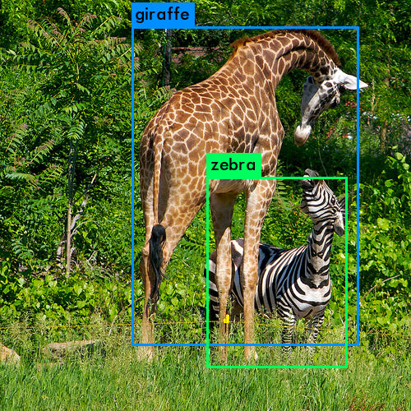
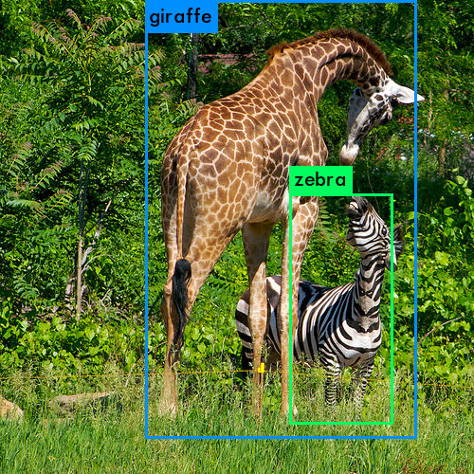
Small Comparison: Giraffe
YOLOv3-320
YOLOv3-tiny

Slide 9
Small Comparison: Giraffe
YOLOv3-320
YOLOv3-tiny
giraffe: 98%
zebra: 98%
giraffe: 53%
zebra: 53%

Slide 10
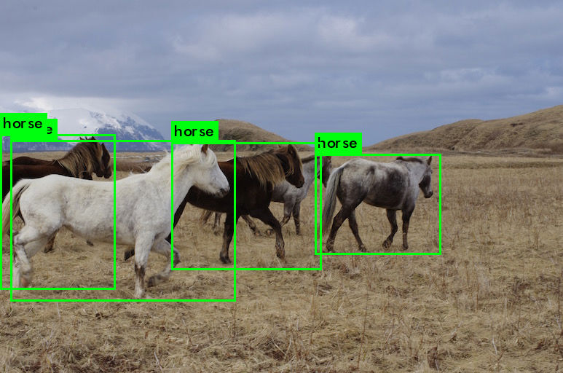
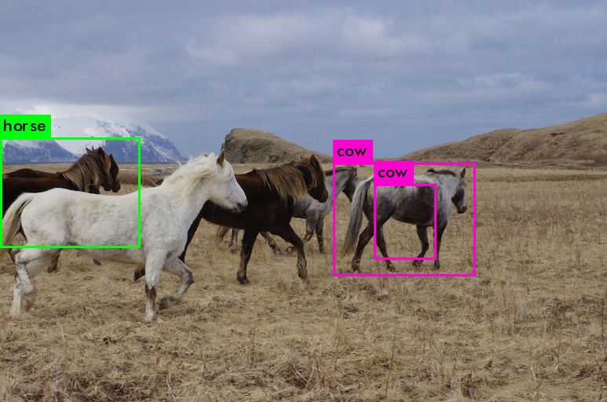
Small Comparison: Horse
YOLOv3-320
YOLOv3-tiny

Slide 11
Small Comparison: Horse
YOLOv3-320
YOLOv3-tiny
horse: 100%
horse: 100%
horse: 96%
horse: 95%
cow: 56%
cow: 54%
horse: 56%

Slide 12
Future
Train my own YOLO network on people (possibly more) using the eGPU
Perform image degradation on the test set
Compute mAP for varying standard deviations of Gaussian Blur

