Slide 1
YOLO Training Progress
Ankush Patel – CS494 – Week 6

Slide 2
Models [Pascal Titan X]
YOLOv3-spp
YOLOv3-tiny
mAP – 60.6
FLOPS – 141.45 Bn
FPS – 20
mAP – 33.1
FLOPS – 5.56 Bn
FPS – 220
Notes:
mAP – mean average precision i.e. how well the prediction matches up to the ground truth.

Slide 3
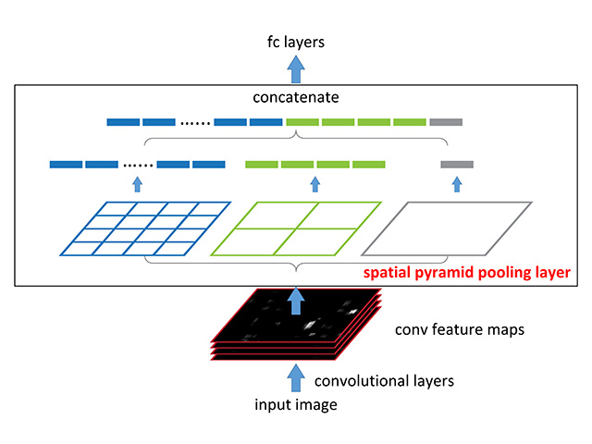
YOLOv3-spp
Spatial Pyramid Pooling
A way to look at images at varying levels of granularity

Slide 4
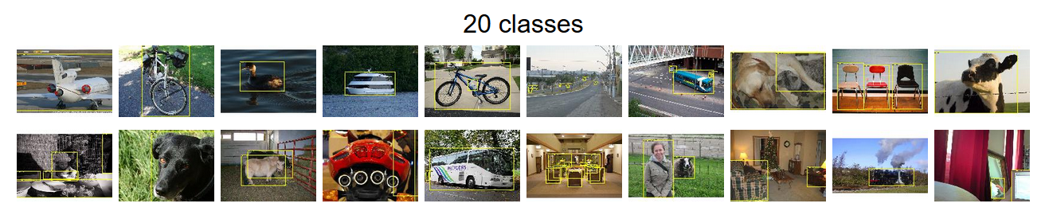
Pascal VOC Dataset
Notes:
12000 images
Person: person
Animal: bird, cat, cow, dog, horse, sheep
Vehicle: aeroplane, bicycle, boat, bus, car, motorbike, train
Indoor: bottle, chair, dining table, potted plant, sofa, tv/monitor

Slide 5
eGPU Training on VOC
YOLOv3-spp
YOLOv3-tiny
mAP – 54.4
FLOPS – 140.57 Bn
FPS – ?
Training time – approx. 13.61 hours
mAP – 66.00
FLOPS – 5.48 Bn
FPS – ?
Training time – approx. 2.78 hours
Notes:
What went wrong – I set the subsampling on 64px on spp, whereas tiny used 16px subdivision

Slide 6
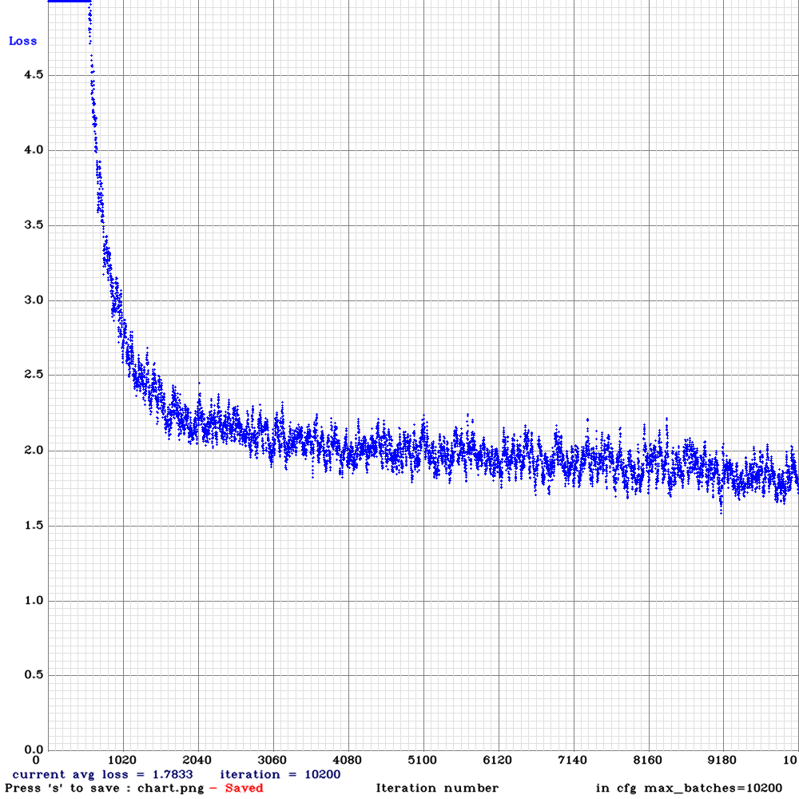
YOLOv3-tiny Loss

Slide 7
Demo YOLOv3-tiny

Slide 8
Future
Retrain YOLO-spp network using the eGPU
CPU comparisons for YOLO-spp and YOLO-tiny*
Figure out why network is not running on 1080p
Perform image degradation on the test set
Compute mAP for varying standard deviations of Gaussian Blur

