Slide 1
ACC 495 Final Project Proposal
By Sam Woodward, Patrick Vlahos, Reagan Henkel, Alex Campbell

Slide 2

Who: US Department of Education
The federal agency that is primarily responsible for overseeing education funding and student aid programs within the United States
  Manages the federal student loan programs which is directly tied into the roughly $1.7 trillion student debt issue
Acts as the main regulator and policymakers influencing how student aid is distributed to students
  Adjusts the rates accordingly for student loans
Provides large scale data on tuition, graduation rates, earnings and debt outcomes post-graduate

Slide 3
Executive Summary
Problem
  Uncontrolled amounts of debt hurt recent graduates and the federal government when debts can’t be paid off
Goals
  Establish reliable ROI estimates based off degree type and debt levels
  Evaluate economic shifts and their effect on the value of higher education
  Develop recommendations for potential students based on analysis
Value proposition
  Reduce the amount of debt that the US Department of Education carries
  Improve quality of life for graduates by reducing carried debt

Slide 4
The Issue
The large rise in student loan debt within the United States has raised the debate of whether or not college is worth the price.
The variability between degree type, location, and institution make it difficult to determine whether higher education will have a positive return on investment
The US Department of Education exists to support the pursuit of education and provide resources for potential students. With the complexity and large impact of student loan debt, improved student advisory information is necessary.

Slide 5
Questions to Answer
Does the cost of higher education result in a positive return on investment, and what factors influence this outcome?
How does job supply/demand affect higher education ROI outcomes?

Slide 6
Analysis Techniques
Main Calculations:
Periodic ROI estimates= Post-Grad Earnings-Total Cost of Education
Payback Period= Total Debt/Annual Salary
Job market structure = jobs by industry/total jobs
Use JMP and Alteryx, Excel
Use regression analysis to determine the most important factors affecting ROI

Slide 7
Common Assumptions Throughout Data
Bachelor’s degree graduates in the United States ranging from 1-40 years post graduate
  Using the starting salary of the graduates up until the end of their career where their return on investment for their degree is the highest
Students across different institution types such as healthcare, finance, architecture, etc.
  Assuming the workers stayed in the same institution their degree gets them into (Finance degree stays in the field of finance)

Slide 8
The Data
JMP
Alteryx
Factors to consider:
Level of education
Degree type
Cost of degree
Periodic ROI
Job market influence (employment rate)
Job market demand
Regional variation
Institution type
Demographic of the recipient

Slide 9
Methodology

Slide 10
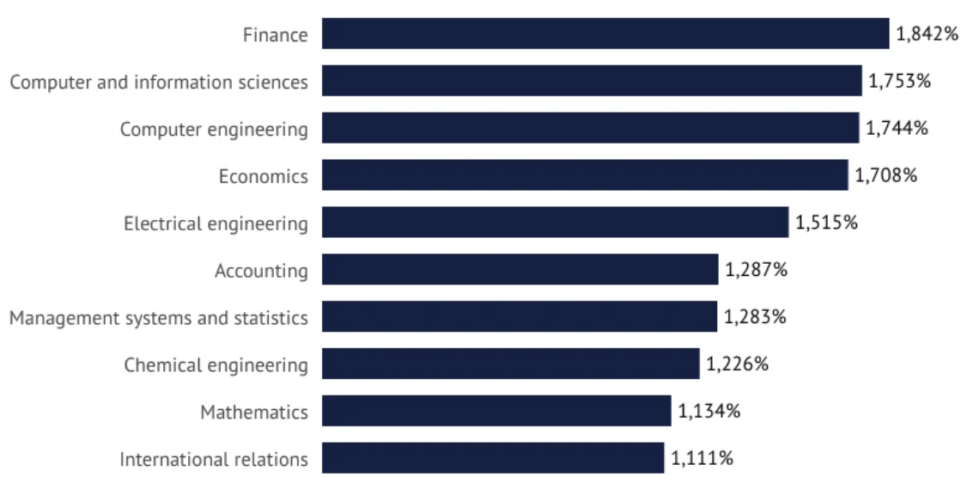

Slide 11
