Slide 1
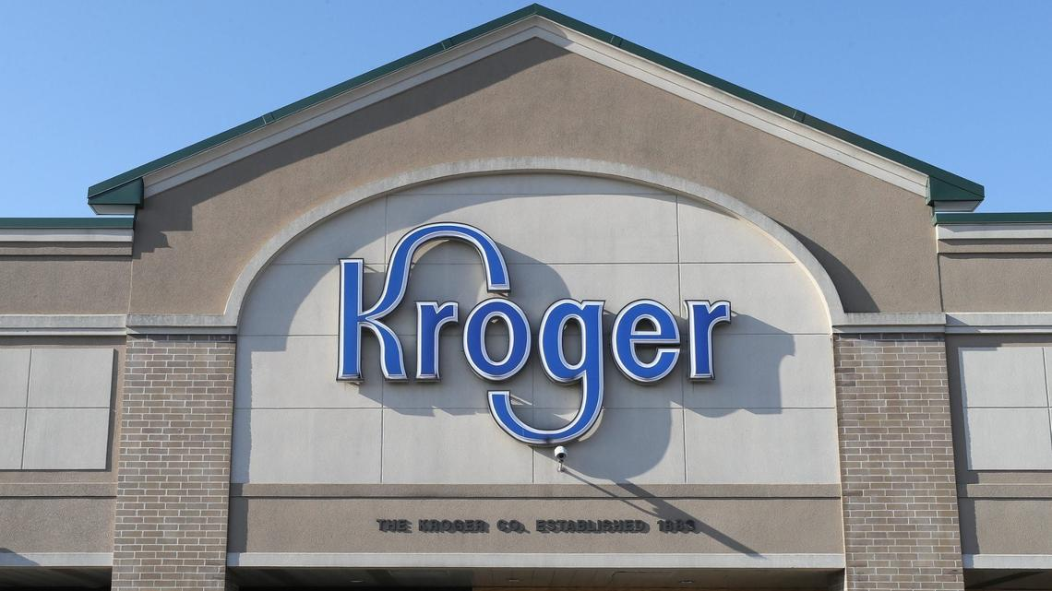
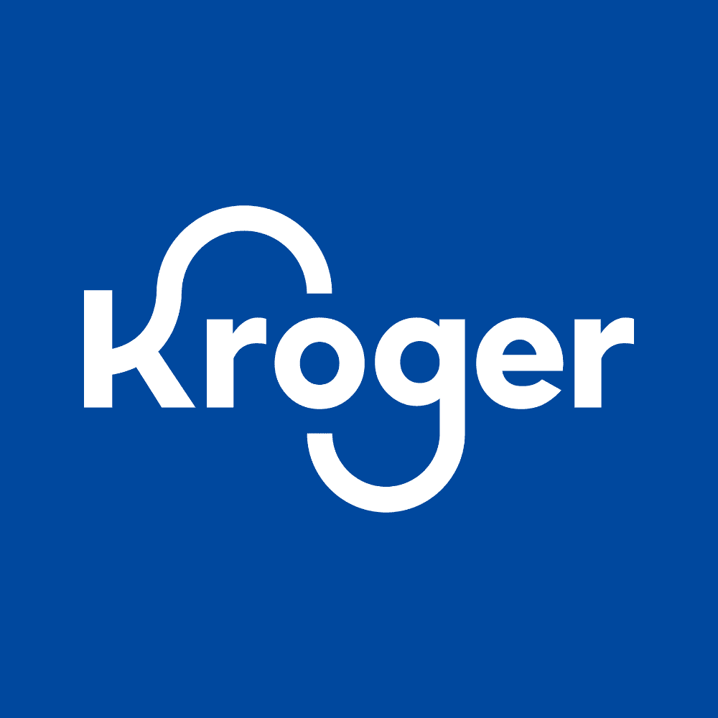
Kroger Co. (KR): Corporate finance Advisory Analysis
FIN 381: Section B Group #8
Rex Whitney, Talon Williamson, Gavin Wright, and Reagan Henkel

Slide 2
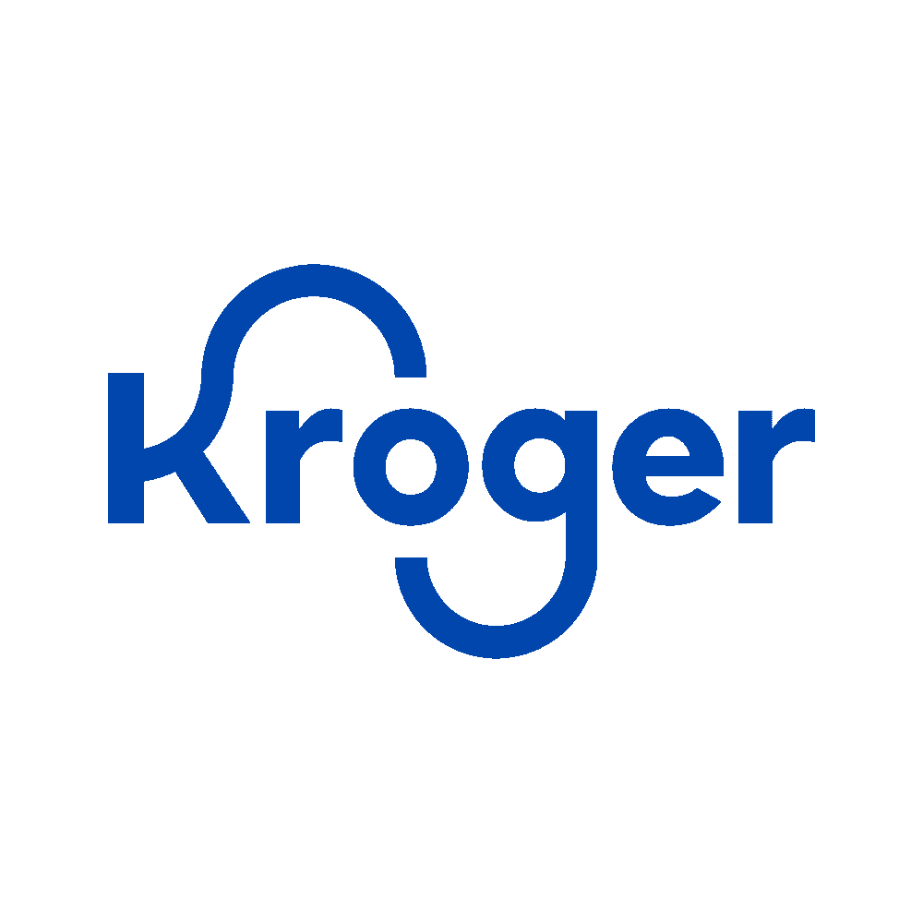
I. Executive Summary
~2,700 Stores
$152.77B
$3.04B
$78.94
35 States
Projected 2025 Sales
Projected Net Income
DCF Intrinsic Value
Company Overview
Financial Snapshot
Valuation Summary
Ticker / Exchange:
KR — NYSE
Current Ratio (2024):
0.96
WACC:
6.14%
HQ:
Cincinnati, Ohio
D/E Ratio (2024):
3.03 (up from 1.66 in 2023)
Beta:
0.469 (5-yr monthly)
Stores:
~2,700 across 35 states
TIE (2024):
10.10
DDM:
$61.94
Segments:
Grocery, Pharmacy, Fuel, Pickup/Delivery
Net Profit Margin:
~1-2% (typical for grocers)
Total Payout:
$63.28
Peers:
Walmart, Target, Albertsons
ROA:
5.2% (projected 2025)
DCF:
$78.94 ★ Most Trusted
Ownership:
86.32% Institutional
ROE:
16.2% (projected 2025)
Peer Multiples Avg.:
$138.96
Top Holders:
Vanguard, Berkshire, BlackRock
FCF Range:
$1.5B – $3.8B annually
Market Price (Jan 25):
~$60 → UNDERVALUED
Notes:
EXECUTIVE SUMMARY — SPEAKER SCRIPT
"Good [morning/afternoon]. Our group analyzed Kroger Co., ticker KR, for our corporate finance advisory project. Let me walk you through our key findings.
Kroger is the second-largest grocery retailer in the United States, with approximately 2,700 stores operating across 35 states. Their primary competitors are Walmart, Target, and Albertsons. Ownership is dominated by institutional investors — 86.32% — with top holders being Vanguard, Berkshire Hathaway, and BlackRock, which signals strong long-term conviction in the business model.
On the financial side, Kroger is in solid shape. They have stable, consistent free cash flow ranging from $1.5 to $3.8 billion annually. Their net profit margins are in the 1-2% range — which is actually normal for grocery stores — and their debt-to-equity ratio jumped to 3.03 in 2024 from 1.66 in 2023, reflecting increased reliance on debt, consistent with pecking order behavior.
For our 2025 pro forma, we projected sales of $152.77 billion and net income of $3.04 billion, based on a 5-year average growth rate.
On valuation, we ran four models: our DDM came in at $61.94, Total Payout at $63.28, DCF at $78.94, and peer multiples averaged $138.96. Our most trusted model — the DCF — gives us an intrinsic value of $78.94, compared to Kroger's January 2025 price of about $60. That tells us Kroger appears modestly undervalued.
We'll go through each section in detail, starting with Firm and Peers."

Slide 3
II. Selection of Peers
Kroger’s Peers
Walmart: Very similar operation model- has a retail grocery store, fuel center, and pharmacy.
Target: Similar aspects with retail grocery and pharmacy. Kroger and Target have market caps is similar ranges.
Albertsons: Close competitor, similar operational model, however, they have less stores and a much smaller market cap.

Slide 4
III. Financial Analysis
Current ratio stayed below 1.0 For over ten years, Current ratio ranges between 0.72 to 1.01
Inventory days decrease from 41.9 days in 2000 to 22.71 days today
Accounts Payable has been high, in 2024 shows 32.97 days. Their cash conversion cycle has remained low.
Kroger has increased their D/E from 2023 at 1.66 and in 2024 reaching 3.03. TIE has be trending up in 2024 it was 10.10
Overall Kroger’s financial position is strong, they have shown consistent profitability and stable revenue despite their increase in debt recently.

Slide 5
IV. Pro Forma
Income Statement (2025)
Balance Sheet (2025)
Key Assumptions
Sales:
$152.77B
Cash (plug):
$8,065M
Sales Growth:
5-yr avg. 2020-2024
COGS incl. D&A:
$121.82B
ST Receivables:
$2,167M
Interest Exp.:
Rate x debt → $0.55B
Gross Income:
$30.95B
Inventories:
$7,598M
Tax Rate:
~21.6% (5-yr avg., post-2018)
SG&A Expense:
$26.51B
Total Current Assets:
$18,613M
Div./Share:
$1.28 (g = 13.24%)
EBIT:
$4.44B
Net PP&E:
$33,212M
LT Debt:
~$15.8B (held constant)
Interest Expense:
$0.55B
Total Assets:
$58,960M
Equity:
Prior RE + NI - Dividends
Pretax Income:
$3.88B
Total Curr. Liab.:
$17,293M
Cash Plug:
$8.06B
Net Income:
$3.04B
Long-Term Debt:
$15,805M
Basis:
Captures post-COVID env.
ROA:
5.16%
Total Equity:
$18,821M
Tax note:
Pre-2018 excluded (TCJA)
ROE:
16.17%
Total Liab. & Eq.:
$58,960M
Result — ROA/ROE:
5.2% / 16.2%
Notes:
PRO FORMA — SPEAKER SCRIPT
"For our pro forma, we forecasted Kroger's 2025 income statement and balance sheet using carefully selected assumptions for each key driver.
Starting with the income statement: we're projecting sales of $152.77 billion. For our sales growth assumption, we used the 5-year average growth rate from 2020 to 2024. We chose this window specifically because it captures Kroger's current operating environment post-COVID, while smoothing out year-to-year volatility. It also excludes older periods where their business looked significantly different.
For interest expense, we applied our assumed rate to total debt, resulting in $0.55 billion — this reflects the current rate environment with debt obligations held stable. For our tax rate, we used a 5-year average effective rate of about 21.6%, excluding pre-2018 data because the Tax Cuts and Jobs Act made those rates incomparable.
For dividends per share, we projected $1.28 by growing the most recent dividend at our constant growth rate of 13.24%.
Looking at the balance sheet: we held long-term debt constant at about $15.8 billion — no major refinancing is expected. We calculated retained earnings as prior-year retained earnings plus net income minus dividends paid. This gave us total equity of about $18.8 billion. Cash serves as our plug at $8.06 billion, which implies Kroger will accumulate modest excess cash in 2025.
Our bottom line results: net income of $3.04 billion, ROA of 5.2%, and ROE of 16.2%."

Slide 6

V. Capital Structure and Cost of Capital
Capital Weights
Beta & CAPM
CDGM & WACC
Market Value of Equity
Method: 5-yr Monthly (60 obs.)
Dividend Growth Model
$41,832.7M 72.40%
Beta: 0.469
Growth Rate: 6.29%
D1 $1.28
Market Value of Debt
Rf: 4.25%
Stock Price $61.64
$15,946.0M 27.60%
MRP: 5.50%
CDGM Cost of Equity 8.22%
WACC Calculation
We x Re 4.94%
Total Firm Value $57,7768.7M
CAPM Cost of Equity 6.82%
Wd x Rd x (1-T) 1.20%
WACC 6.14%
Source: FactSet, Dec 2024 Year End
Sources: U.S. Treasury, Jan 2025. Damodaran (2025)

Slide 7
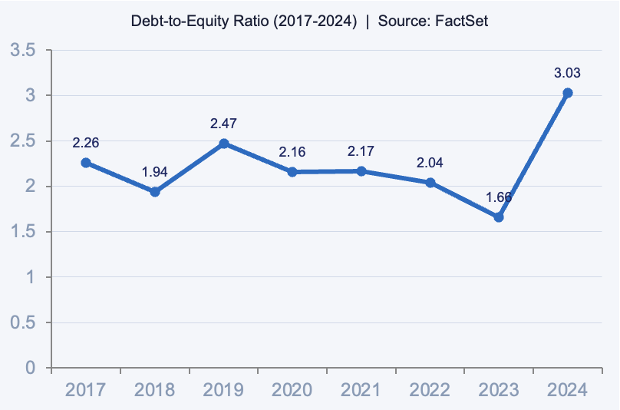
VI. Capital Structure and Debt-to-Equity Trend
Theory Comparison
Trade-Off Theory:
Firms target optimal D/E ratio, balancing tax benefits vs. distress costs. Kroger shows no clear target
Pecking Order Hypothesis:
Internal cash flow first, then debt, then equity. Kroger avoids equity issuance, relies on debt for acquisitions/Capex

Slide 8
VII. Payout Policy
Historical Rates (2017-2024)
Implicit Policy: Hybrid
CFO Recommendation
Maintain Dividend Growth (~13%)
Consistent with historical growth & shareholder expectations
Flexible Repurchases ($1B - $2B)
Preserve flexibility post-Albertsons merger failure
Rationale
Strong FCF supports both commitments. Prioritize financial flexibility while ongoing digital & supply chain investments continue while rewarding shareholders.
Dividend Growth Rate
Dividends
Stable & committed
Grew every year 2017-2024
Signals long-term commitment
Repurchases
Highly discretionary & volatile
Dropped to $60M in 2024
Flexible lever, non committal
13.24% per share, annually
Avg. Annual Repurches
~1,345M excl. 2024 outlier
Repurchase Range
$60M - $2.0B
FCF Range
$1.5B - $3.8B

Slide 9
VII. Firm Valuation
DDM & Total Payout
DCF Model (Preferred)
Comparable Multiples
Dividend Discount Model (DDM)
Discounted Cash Flow (DCF)
Peers: Walmart, Target, Albertsons
Const. Growth Rate (g):
6.29%
WACC:
6.14%
(Costco excluded — membership model distorts multiples)
CDGM Cost of Equity (Ke):
8.22%
Terminal Growth Rate:
2.5%
Peer
P/S
P/E
EV/EBIT
D1 (next yr. dividend):
$1.28
Forecast Period:
5-year FCF
Walmart
1.54
48.22
36.77
Implied Stock Price:
$61.94
Implied Stock Price:
$78.94
Target
0.67
15.85
14.56
Albertsons
0.20
41.83
9.68
Total Payout Model
Why DCF is Most Trusted
Peer Avgs
0.80
35.30
20.34
Forecasted Dividends:
$753.5M
- Grounded in Kroger's actual cash flows
Average Implied Price:
$138.96
Avg. Repurchases:
$1,345M
- Less sensitive to single assumptions
Shares Outstanding:
660M
- Terminal growth 2.5% reflects stable, mature grocery industry
- Not distorted by peer model differences
RECOMMENDATION: DCF Intrinsic Value $78.94 | Market Price ~$60 | Kroger appears UNDERVALUED | Beta = most impactful input on WACC
Implied Stock Price:
$63.28
- Beta is most influential input — drives cost of equity & WACC weight
Notes:
FIRM VALUATION — SPEAKER SCRIPT
"For our firm valuation, we estimated Kroger's intrinsic value using four different methods: the Dividend Discount Model, the Total Payout Model, the DCF Model, and a Comparable Multiples analysis.
Starting with the DDM: We used a constant dividend growth rate of 6.29% — we deliberately made this conservative relative to our historical rate of about 13%, because that historical rate is inflated by share buybacks rather than true dividend growth. Using our CDGM cost of equity of 8.22%, the DDM gives us an implied price of $61.94.
For the Total Payout Model: We added our forecasted dividends of $753.5 million to our average annual repurchases of $1,345 million. Dividing by shares outstanding, this model implies a price of $63.28. Both income models are sensitive to the spread between the cost of equity and the growth rate.
For the DCF: We discounted forecasted free cash flow at our WACC of 6.14%, and used a terminal growth rate of 2.5% — which is conservative and appropriate for a mature, stable grocery business. The DCF produced an implied price of $78.94. This is our most trusted model because it's grounded in Kroger's actual cash flows, less sensitive to individual assumptions, and not distorted by peer differences.
For Multiples: We used Walmart, Target, and Albertsons. We excluded Costco because their membership-based model commands premium multiples that would heavily distort our comparison. Averaging across P/S, P/E, EV/EBIT, and EV/EBITDA ratios, we get an average implied price of $138.96 — though Walmart's premium multiples do inflate this average.
Our final recommendation: using the DCF as our primary model, we estimate Kroger's intrinsic value at $78.94. Compared to the January 2025 market price of approximately $60, Kroger appears modestly undervalued. Of all our inputs, beta has the greatest single influence on valuation — it directly drives our cost of equity and carries the largest weight in our WACC calculation."

Slide 10
Key Takeaways
Our Recommendation
Business Model:
Intrinsic Value Estimate
Defensive, non-cyclical grocery retailer. ~2,700 stores in 35 states. Stable throughout 2008-09 and COVID.
$78.94
Financial Health:
Consistent FCF ($1.5B-$3.8B/yr). Low net margins (~1-2%) are normal for grocery. D/E rose to 3.03 — increasing but manageable.
per share (DCF method)
Market Price (Jan 2025):
Capital Structure:
~$60 / share
Consistent with Pecking Order Hypothesis — internal financing first, then debt. WACC = 6.14%.
VERDICT: UNDERVALUED by ~32%
Payout Policy:
Hybrid policy: stable dividend growth (13.24%/yr avg.) + flexible buybacks. Funded through operating cash flow, not new debt.
CFO Recommendations:
• Maintain ~13% annual dividend growth
Pro Forma:
• Flexible buybacks of $1-2B in 2025
Projected 2025 Sales $152.77B, Net Income $3.04B, ROA 5.2%, ROE 16.2%. Balance sheet balanced with $8.06B cash plug.
• Preserve flexibility post-Albertsons merger uncertainty
• Continue digital & supply chain investment
Notes:
CONCLUSION — SPEAKER SCRIPT
"Let me wrap up our analysis of Kroger.
The key takeaways are: Kroger is a defensive, non-cyclical grocery retailer. With approximately 2,700 stores across 35 states, they remained stable through both the 2008-09 financial crisis and COVID-19 — a strong signal about the durability of their business model.
Financially, Kroger generates consistent free cash flow between $1.5 and $3.8 billion annually. Their net margins are low at 1-2%, but that's completely normal for grocery. Their debt-to-equity ratio rose to 3.03 in 2024 — elevated, but manageable given their cash flows. This is consistent with the Pecking Order Hypothesis — they prioritize internal financing and turn to debt when needed rather than issuing equity.
Their payout policy is a hybrid: stable, committed dividend growth averaging 13.24% annually, combined with flexible, discretionary buybacks. Importantly, these payouts are funded through operating cash flow — not borrowed — which is a healthy sign.
For our 2025 forecast, we project sales of $152.77 billion, net income of $3.04 billion, ROA of 5.2%, and ROE of 16.2%.
Now our final recommendation: using the DCF as our most trusted model, we estimate Kroger's intrinsic value at $78.94 per share. With the January 2025 market price at approximately $60, that implies Kroger is undervalued by roughly 32%.
As CFO, we would recommend maintaining roughly 13% annual dividend growth, keeping buybacks flexible at $1-2 billion, preserving financial flexibility following the failed Albertsons merger, and continuing investment in digital capabilities and supply chain modernization.
In summary — Kroger is a financially sound, cash-generating business trading below our estimated intrinsic value. Thank you."

