Slide 1
MSFT
Microsoft Corporation
Equity Research Pitch · MSFT · BUY
Thomas Sauter · Reagan Henkel · Alex Harrell
April 28, 2026
Miami University | FIN 401

Slide 2
Company Highlights & Business Description
KEY FACTS
Global Software & Cloud Leader
Core platforms: Azure, Microsoft 365, Windows, LinkedIn, GitHub, Xbox
Revenue model: High-margin subscriptions, cloud consumption billing, and enterprise licensing
Founded
1975
Headquarters
Redmond, WA
Segment Revenue Breakdown (FY2025 | Total: $281.7B)
Productivity & Business Processes
43%
Microsoft 365, Teams, LinkedIn, Dynamics
Employees
~228,000
$120.8B (+12%)
Segments
3 Operating
Intelligent Cloud
39%
Azure, Server Products — fastest-growing segment
$109.4B (+19%)
Exchange
NASDAQ: MSFT
More Personal Computing
18%
Windows, Xbox, Search & News advertising
$51.5B (+10%)
Business Model
Land & expand SaaS
Competitive Moat
• 400M+ Microsoft 365 seats — deep enterprise lock-in and very high switching costs
• OpenAI partnership + Azure AI + Copilot = end-to-end AI platform advantage
• $315B+ Remaining Performance Obligation (RPO) = multi-year contracted revenue visibility
Revenue Model
Subscriptions + consumption
Sources: Microsoft FY2025 Annual Report (10-K, filed Jul 2025); Microsoft Investor Relations at microsoft.com/investor; company.newsroom.microsoft.com

Slide 3
Industry Overview & Competitive Positioning
Global Scale
AI Platform Depth
High Switching Costs
Portfolio Resilience
Azure is the #2 cloud platform by revenue (21% share)
Serves virtually every major enterprise IT budget worldwide
Installed base of 400M+ commercial users across 180+ countries
Full-stack AI advantage: cloud infra, OpenAI models, Copilot apps
Copilot is embedded directly into existing Microsoft 365 workflows
GitHub Copilot: 20M+ users; 90% of the Fortune 500 using M365 Copilot
Azure + Teams + M365 + GitHub = tightly integrated enterprise stack
Replacing any piece is expensive, time-consuming, and operationally risky
Data gravity and developer tools reinforce Azure stickiness
Cloud + productivity + software mix smooths revenue through downturns
Recurring subscription and cloud revenue provides high cash flow visibility
AI is a growth layer on top of already profitable, mature product lines
Peer Valuation Comparison (Source: FactSet, as of Apr 28, 2026)
Company | Mkt Cap | Fwd P/E | EV/EBITDA | Rev Growth | Op Margin
Microsoft (MSFT) | $3.2T | ~22x | ~18x | +15% (FY25) | 45.6%
Alphabet (GOOGL) | $1.9T | ~28x | ~26x | +22% | 36%
Amazon (AMZN) | $2.9T | ~32x | ~18x | +14% (AWS) | 11.5%
Oracle (ORCL) | $460B | ~18x | ~18x | +12% | 32%
★ MSFT trades at a 27% discount to its 5-year avg P/E of ~30x while growing faster than peers
Sources: Synergy Research Group Q1 2026 cloud market share; FactSet consensus multiples as of Apr 28, 2026; company 10-K filings (SEC EDGAR)

Slide 4
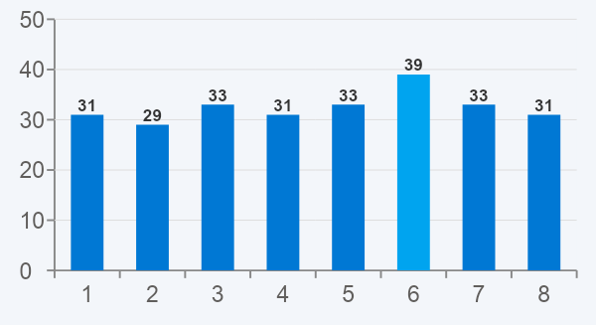
Unique Aspects & Investment Catalysts
01
Azure Reacceleration
Azure Revenue Growth (YoY%) — Microsoft Earnings
Azure grew 35% in FY2025; AI workloads drove over half of incremental growth
Guided 37–38% growth in Q3 FY2026 as committed backlog capacity comes online
02
Copilot Monetization
15M paid seats at $30/user/month — growing 160% YoY
At 10% of the 400M+ seat base → $14B+ in incremental ARR at near-100% margin
03
Valuation Entry Point
MSFT trades at ~22x forward earnings, its lowest in 3 years vs. ~30x historical avg
High-quality AI compounder priced at a meaningful discount to intrinsic value
Copilot Monetization | Microsoft Q2 FY2026
15M
160%
$14B+
04
Commercial Backlog (RPO)
$315B+ in contracted future revenue — rare multi-year revenue floor
Backlog visibility significantly reduces execution risk vs. other AI plays
Paid Copilot Seats
YoY Seat Growth
ARR at 10% penetration
Sources: Microsoft Q2 FY2026 Earnings Release (Jan 29, 2026); Microsoft FY2025 Annual Report (10-K); Microsoft Q4 FY2025 Earnings Call Transcript; FactSet consensus estimates

Slide 5
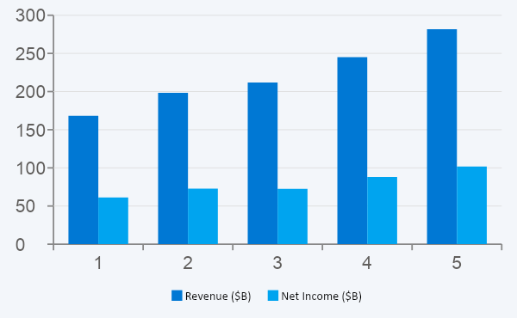
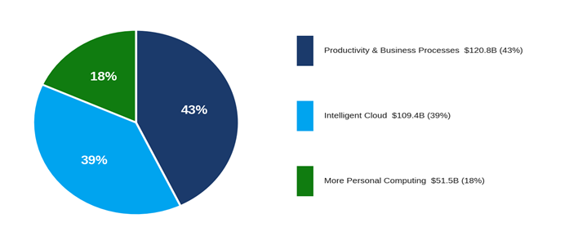
Current Financial Position | FY2025 Full Year
$281.7B
45.6%
$101.8B
$13.64
$107.4B
Revenue (+15% YoY)
Operating Margin
Net Income (+18%)
EPS (Diluted)
Free Cash Flow
Revenue & Net Income | FY2021–FY2025 (Microsoft 10-K)
FY2025 Revenue by Segment | Microsoft 10-K
Balance Sheet | FY2025
Cash: $78.4B | Total Debt: ~$44B | Net Cash: ~$34B
Dividends: $23.3B | Buybacks: $17.4B | AI Capex: $64.6B
ROE: 34% | EBITDA: $162.4B | EBITDA Margin: 57.7%
Sources: Microsoft FY2025 Annual Report (10-K), filed Jul 30, 2025 (sec.gov, CIK: 0000789019); Microsoft Q4 FY2025 Earnings Press Release

Slide 6
Investment Risks | Bull / Base / Bear Scenario Analysis
UPSIDE — Bull Case
BASE CASE — Most Likely
DOWNSIDE — Bear Case
Target Price: ~$550–$610/share
Target Price: ~$490/share
Target Price: ~$340/share
Azure re-accelerates past 40% YoY as committed backlog capacity comes online
Copilot seat adoption beats expectations — penetration reaches double digits
Commercial RPO converts cleanly, supporting sustained double-digit revenue growth
Valuation re-rates toward historical ~30x P/E as growth narrative strengthens
Revenue grows mid-teens as Azure holds above 35% and Copilot scales steadily
Operating margins stabilize as Copilot revenue offsets elevated infrastructure capex
EPS compounds at 15–18% annually; dividend continues to grow
Stock re-rates modestly from current 22x to ~28–30x forward earnings
Copilot enterprise adoption stalls; companies slow AI seat purchases
$64.6B in FY2025 capex does not convert to revenue, compressing free cash flow
AWS and Google Cloud gain cloud market share at Azure's expense
Higher interest rates compress multiples; stock de-rates further from 22x
Key risk: $64.6B in FY2025 capex must convert to revenue — but the $315B RPO backlog confirms demand is already contracted. This is a timing risk, not a demand risk.

Slide 7
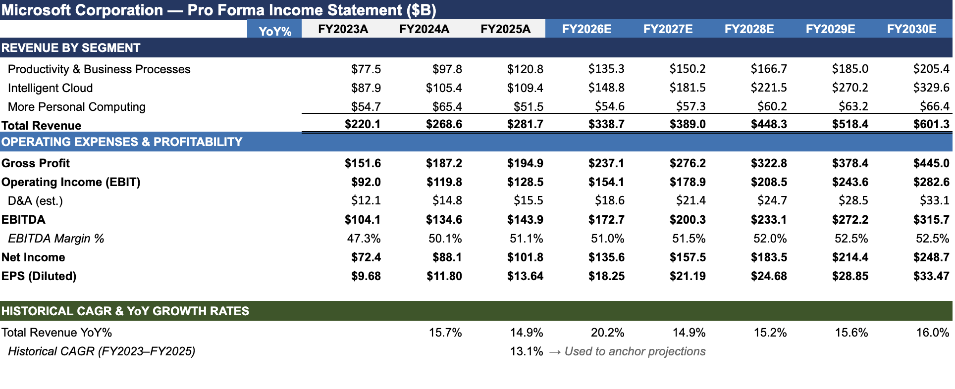
Pro Forma Income Statement | FY2025A – FY2030E

Slide 8
Valuation — DCF & Relative Analysis
DCF Valuation — Key Assumptions
Relative Valuation (Comps) | FactSet, Apr 28, 2026
Input | Value
Revenue CAGR (FY26–30) | 15%
Terminal EBITDA Margin | 57%
WACC | 9.0%
Terminal Growth Rate | 3.5%
Capex / Revenue | 12%
Effective Tax Rate | 18%
Base Case Value | $490 / share
Metric | MSFT (Today) | Implication
Trailing P/E vs. 5Y avg | 24x vs. 33x | 27% discount to history
Forward P/E (NTM) | ~22x | Cheapest in 3 years
EV / EBITDA | ~18x | Reasonable for 57% margin
PEG Ratio | ~1.1x | Paying ~1x per unit of growth
FY2027E EPS × 28x P/E | ~$17 × 28 = $476 | Supports $490 base case
Bull Case Value | $610 | 30x on EPS
Bear Case Value | $340 | 26x on EPS
WACC built using CAPM: Rf = 4.4%, ERP = 5.5%, Beta = 1.0
MSFT Forward P/E — At a 3-Year Low (Source: FactSet/Bloomberg, Apr 2026)
Sources: DCF — author model; WACC via CAPM (Rf 4.4%, ERP 5.5%, Beta 1.0); Comps from FactSet consensus as of Apr 28, 2026; Microsoft FY2025 10-K for base financials

Slide 9
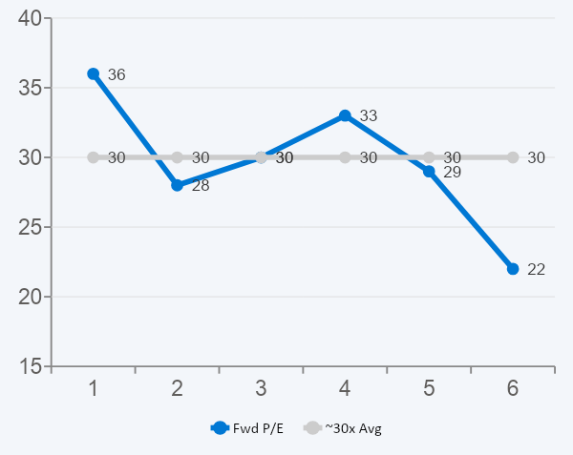
Sensitivity & Scenario Analysis
DCF Sensitivity — WACC vs. Terminal Growth Rate
MSFT Forward P/E History — At a 3-Year Low (Source: FactSet, Apr 2026)
WACC → TGR ↓ | 8.5% | 9.0% | 9.5% | 10.0%
2.5% | $510 | $462 | $420 | $382
3.0% | $528 | $479 | $436 | $397
3.5% ← Base | $540 | $490 ★ | $450 | $415
4.0% | $558 | $506 | $460 | $419
Revenue Scenario Analysis — Azure Growth vs. Copilot Penetration
Scenario | FY26E Rev. | EPS | Target
Bear: Azure 25%, Copilot 3% | $273B | $13.10 | ~$340
Base: Azure 35%, Copilot 7% | $296B | $14.90 | ~$490
Bull: Azure 42%, Copilot 12% | $320B | $17.20 | ~$610
Wall Street Consensus (TipRanks / Benzinga, Apr 28, 2026)
35 of 35 analysts: Strong Buy | Avg 12-mo target: ~$566 | High: $675 | Low: $392
Sensitivities: ±5ppt Azure growth ≈ ±$35/share | ±1ppt margin ≈ ±$15/share | ±1% WACC ≈ ±$45/share
Sources: DCF sensitivity — author model; Scenarios — author estimates; P/E history — FactSet/Bloomberg; Analyst consensus — TipRanks & Benzinga as of Apr 28, 2026

Slide 10
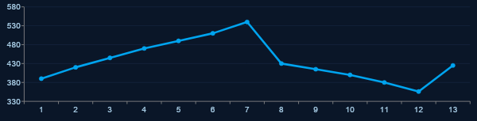
Investment Recommendation
BUY
$414
$490
$472
~$566
NASDAQ: MSFT
Market Price (May 4, 2026)
DCF Base Case Target
Comps-Based Target
(FY2027E EPS × 28x P/E)
Wall St. Avg Target (35 analysts)
MSFT 1-Year Price History | Source: Yahoo Finance / Macrotrends, as of Apr 28, 2026
Why BUY now? (1) Azure growing 40%+ and re-accelerating (2) Copilot at single-digit penetration of 400M+ seats: $14B+ ARR opportunity (3) ~22x forward P/E — a 3-year valuation low for a world-class AI compounder
Source: Yahoo Finance / Macrotrends.net, as of Apr 28, 2026; DDM & DCF — author estimates; analyst targets — TipRanks / Benzinga Apr 2026

Slide 11
APPENDIX
Supporting Analysis
A-1 — DCF Model Detail & FCF Bridge
A-2 — 5-Year Historical Financial Summary
A-3 — Competitive Benchmarking Deep Dive
A-4 — Key Risks & Mitigants Matrix
MSFT | Equity Research Pitch | Miami University FIN 401 | April 2026

Slide 12
A-1 | DCF Model Detail — Microsoft Corporation (MSFT)
DCF Key Assumptions
5-Year Free Cash Flow Bridge ($B)
Input Value
Revenue CAGR (FY26–30E) 13%
Terminal EBITDA Margin 45%
WACC 9.0%
Terminal Growth Rate 3.0%
Capex / Revenue 12%
Effective Tax Rate 18%
Risk-Free Rate (Rf) 4.4%
Equity Risk Premium (ERP) 5.5%
Beta (5-yr vs. S&P 500) 1.0x
Base Case Value: $490 / share
~19% upside from current $425
Year EBITDA FCF PV(FCF)
FY26E $173B $107B $98B
FY27E $200B $125B $105B
FY28E $233B $146B $113B
FY29E $272B $170B $120B
FY30E $316B $198B $129B
Sum PV(FCF): $565B
Terminal Value (PV): $3,082B
Total Enterprise Value: $3,647B
(+) Net Cash: $34B
Equity Value: $3,681B
Diluted Shares: 7.46B
Implied Price: $494/share
WACC vs. Terminal Growth Rate Sensitivity (Implied Price $/share)
TGR ↓ / WACC → 7.5% 8.0% 8.5% 9.0% 9.5%
2.5% $490 $446 $406 $370 $338
3.0% ★ $540 $490 ★ $450 $415 $382
3.5% $600 $545 $499 $459 $424
Sources: DCF — author model; WACC via CAPM (Rf 4.4%, ERP 5.5%, Beta 1.0); base financials from Microsoft FY2025 10-K (SEC EDGAR). Not investment advice.

Slide 13
A-2 | 5-Year Historical Financial Summary — Microsoft Corporation (MSFT)
Metric ($B unless noted) FY2021 FY2022 FY2023 FY2024 FY2025A
Revenue $168.1 $198.3 $211.9 $245.1 $281.7
YoY Growth % — +18% +7% +16% +15%
Gross Profit $115.9 $135.6 $146.1 $171.0 $192.6
Gross Margin % 68.9% 68.4% 68.9% 69.8% 68.4%
Operating Income (EBIT) $69.9 $83.4 $88.5 $109.4 $128.4
Operating Margin % 41.6% 42.1% 41.8% 44.6% 45.6%
EBITDA $96.9 $114.0 $121.0 $141.5 $162.4
EBITDA Margin % 57.6% 57.5% 57.1% 57.7% 57.7%
Net Income $61.3 $72.7 $72.4 $88.1 $101.8
Net Margin % 36.5% 36.7% 34.1% 35.9% 36.2%
EPS — Diluted ($) $8.05 $9.65 $9.72 $11.80 $13.64
Free Cash Flow $56.1 $65.1 $59.5 $74.1 $107.4
R&D Expense $20.7 $24.5 $27.2 $29.5 $31.0
Capital Expenditure $20.6 $23.9 $28.1 $55.7 $64.6
5-Year CAGR (FY21–FY25): Revenue +13.7% | EBITDA +13.8% | Net Income +13.5% | EPS +14.1% | FCF +17.6%
Sources: Microsoft Annual Reports (10-K) FY2021–FY2025, SEC EDGAR CIK 0000789019. FY2023 net income impacted by one-time Activision-related charges.

Slide 14
A-3 | Competitive Benchmarking Deep Dive — Hyperscaler & Software Peer Set
Company Mkt Cap Rev ($B) Rev Gr% Op Mgn% EBITDA Mgn% Fwd P/E EV/EBITDA FCF Yld%
MSFT ★ ~$3.2T $281.7B +15% 45.6% 57.7% ~22x ~18x 3.5%
GOOGL ~$1.9T $350.0B +12% 33.9% 36.5% ~28x ~26x 2.8%
AMZN ~$2.9T $638.0B +11% 11.3% 18.5% ~32x ~18x 2.5%
META ~$1.5T $165.0B +19% 41.6% 50.2% ~24x ~17x 3.2%
ORCL ~$460B $57.0B +12% 32.1% 44.3% ~18x ~18x 2.0%
CRM ~$310B $37.9B +9% 20.9% 35.2% ~28x ~22x 2.1%
SAP ~$280B $38.5B +10% 29.4% 40.1% ~30x ~24x 1.5%
Peer Median — — +11% 31.5% 40.7% ~26x ~21x 2.4%
Key Competitive Takeaways
• MSFT trades at 22x Fwd P/E vs. peer median of ~26x — a rare discount for the highest-margin large-cap in the group (45.6% op margin vs. 31.5% median)
• MSFT grows faster than median peer (+15% vs. +11%) yet trades cheaper on EV/EBITDA (18x vs. 21x) — best-in-class growth at below-median valuation
• Only MSFT + GOOGL operate full-stack AI platforms (cloud infra + model + application layer) — widest moat in the peer set; MSFT priced cheaper than GOOGL despite superior margins
Sources: FactSet consensus estimates; company 10-K filings; market data as of Apr 28, 2026. FCF yield = LTM FCF / market cap. Peer multiples are NTM consensus.

Slide 15
A-4 | Key Risks & Mitigants Matrix — Microsoft Corporation (MSFT)
Risk Factor Likelihood / Impact Mitigant
● Capex ROI Risk ($64.6B FY25 / $85B+ FY26E) Medium / High $315B+ RPO = demand is contracted; timing risk, not demand risk
● Copilot Enterprise Adoption Stalls Medium / High 15M paid seats growing 160% YoY; embedded directly in M365 workflows
● Azure Loses Cloud Share to AWS / Google Cloud Low / High Azure 35% growth FY25; OpenAI exclusivity is a structural cloud advantage
● Antitrust / Regulatory Pressure Low / Medium Activision deal cleared globally; EU AI concerns well-flagged; no near-term catalyst
● Interest Rate / Multiple Compression Low / Medium Already at 22x (3-yr low); strong EPS compounding insulates from further de-rating
● AI Model Commoditization Low / Low MSFT monetizes the platform layer (Azure, M365 Copilot); model-agnostic by design
● High Risk ● Medium Risk ● Low Risk | Likelihood = probability risk materializes; Impact = potential effect on share price
Risk assessment based on author judgment; Microsoft FY2025 10-K risk factors; FactSet consensus; Microsoft Q4 FY2025 Earnings Call Transcript (Jul 2025). Not investment advice.

