Slide 1
# 46
rockeyh

Slide 2
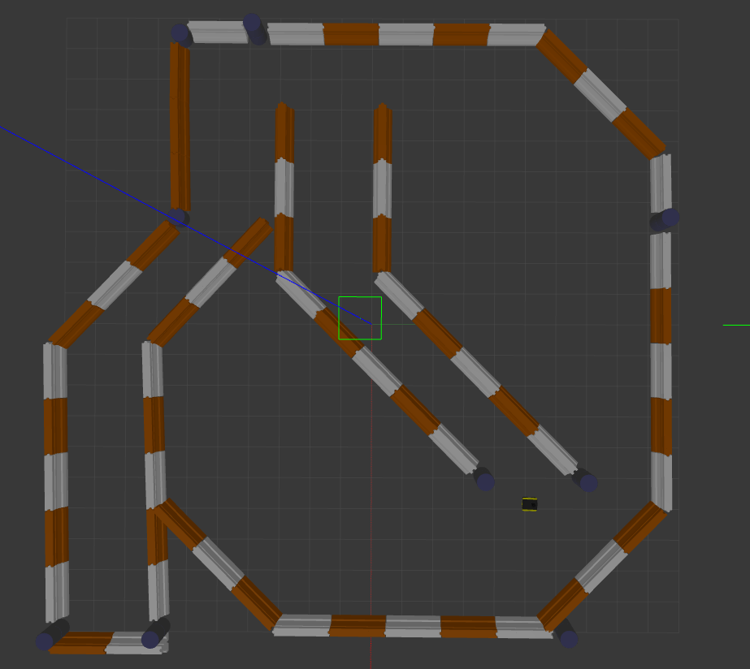

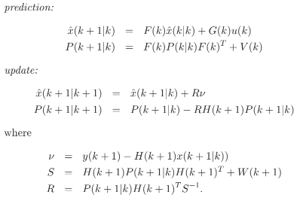

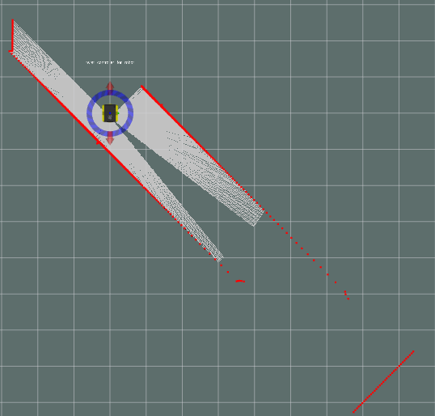
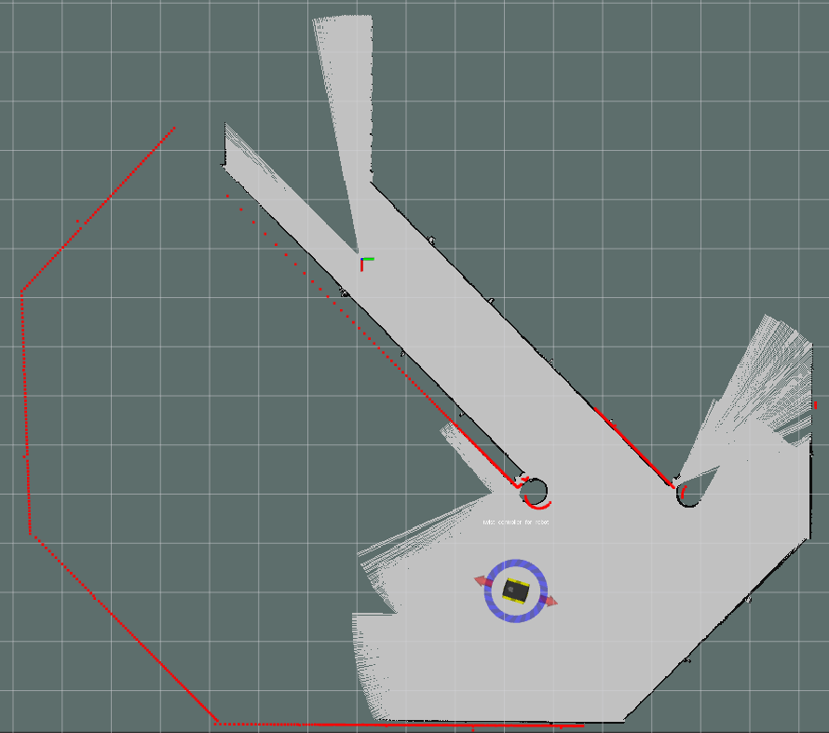
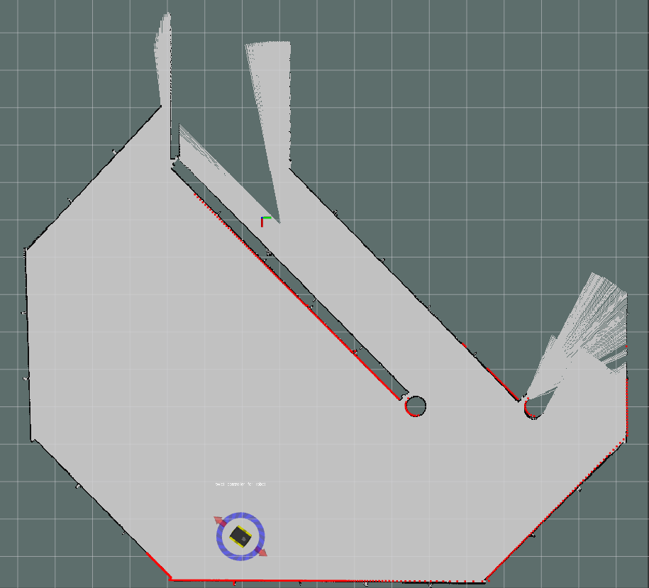

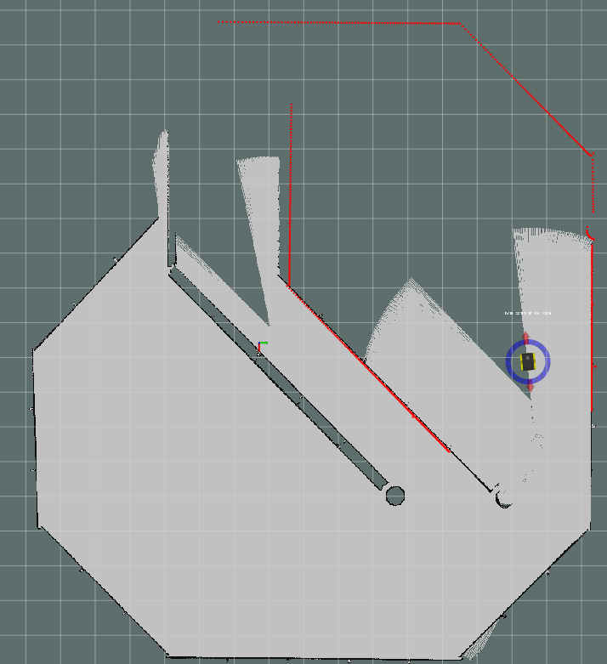
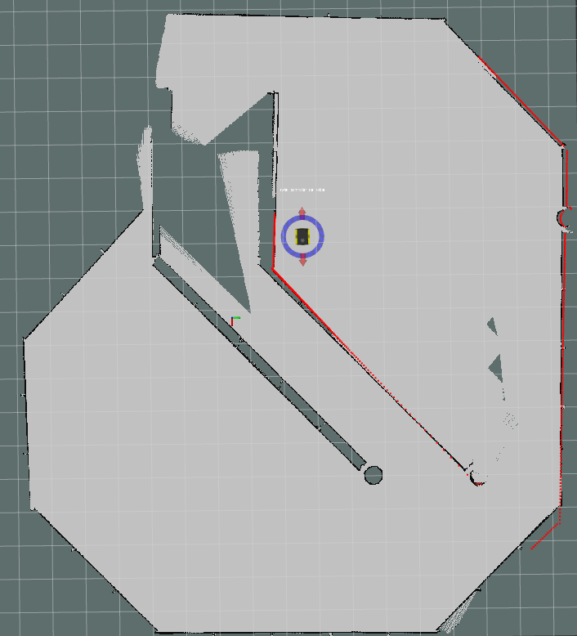
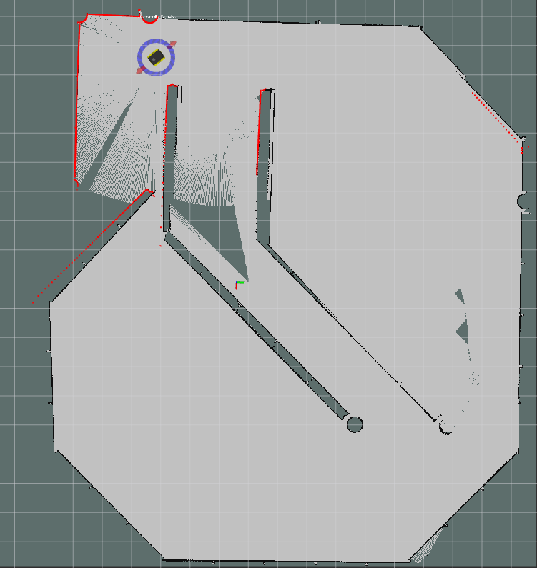


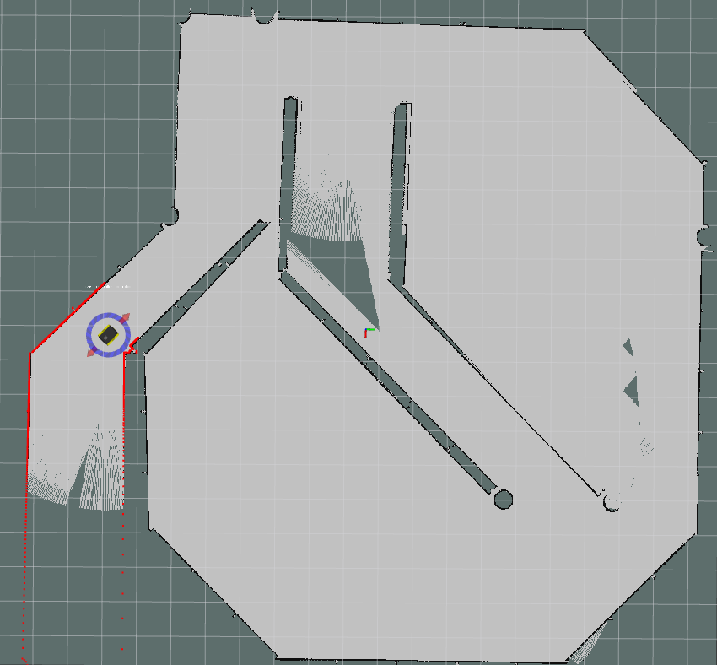
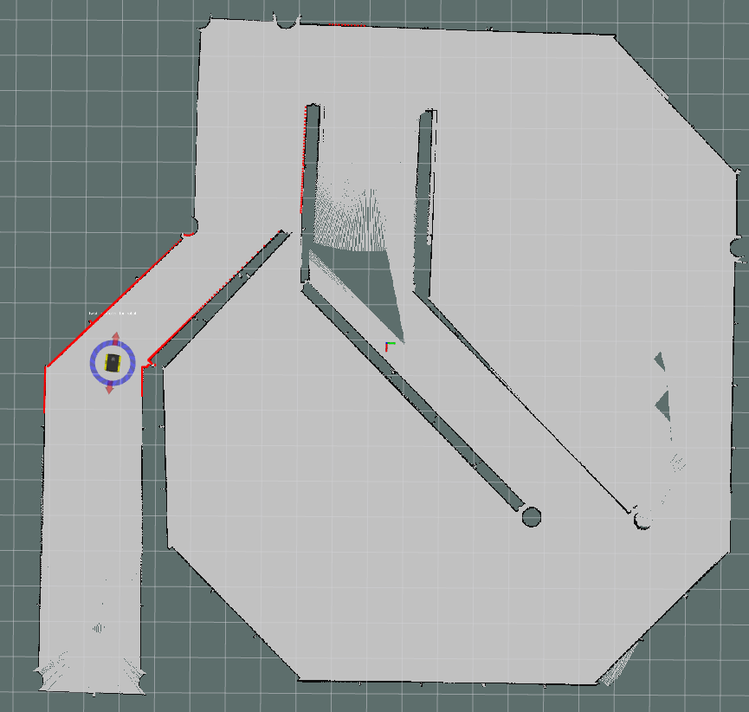
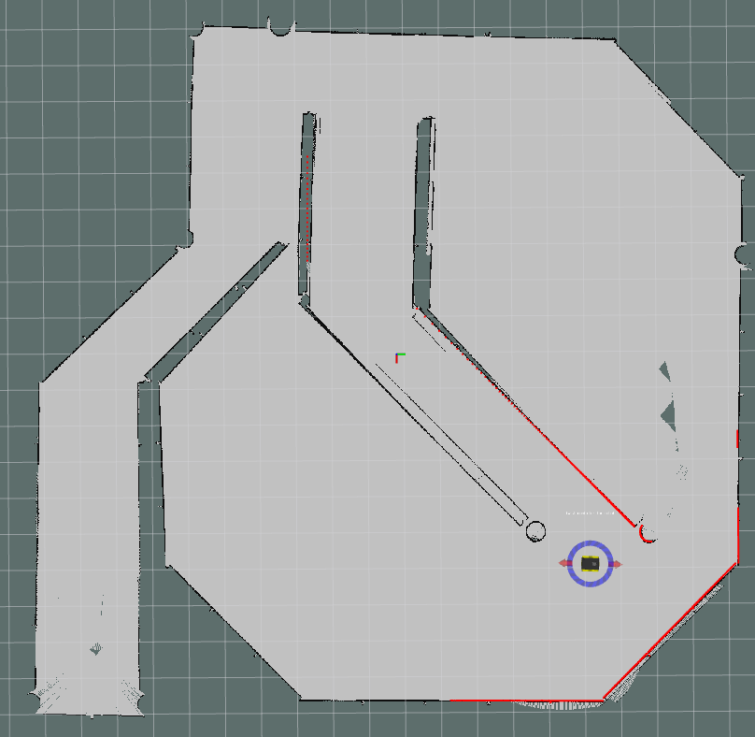
State: x
Input : u
Output: y
Time Step: k
Process Noise: v
Measurement Noise: w
Kalman Filter SLAM
Linear Kalman Filter
Simultaneous Localization and Mapping
Use Kalman Filter to simultaneously estimate position of robot and landmarks in environment
Linear Relative Position Output:
ROS gmapping in Jackal Simulator
Nonlinear Range and Bearing Output:
Extended Kalman Filter
Data Association
Kalman Filter for nonlinear systems where F and H are linearized about the current state estimate
Which landmark is each measurement associated with?
Use Mahalanobis Distance
Source: Principles of Robot Motion: Theory, Algorithms, and Implementations Ch. 8 – Choset et. al.

