Slide 1
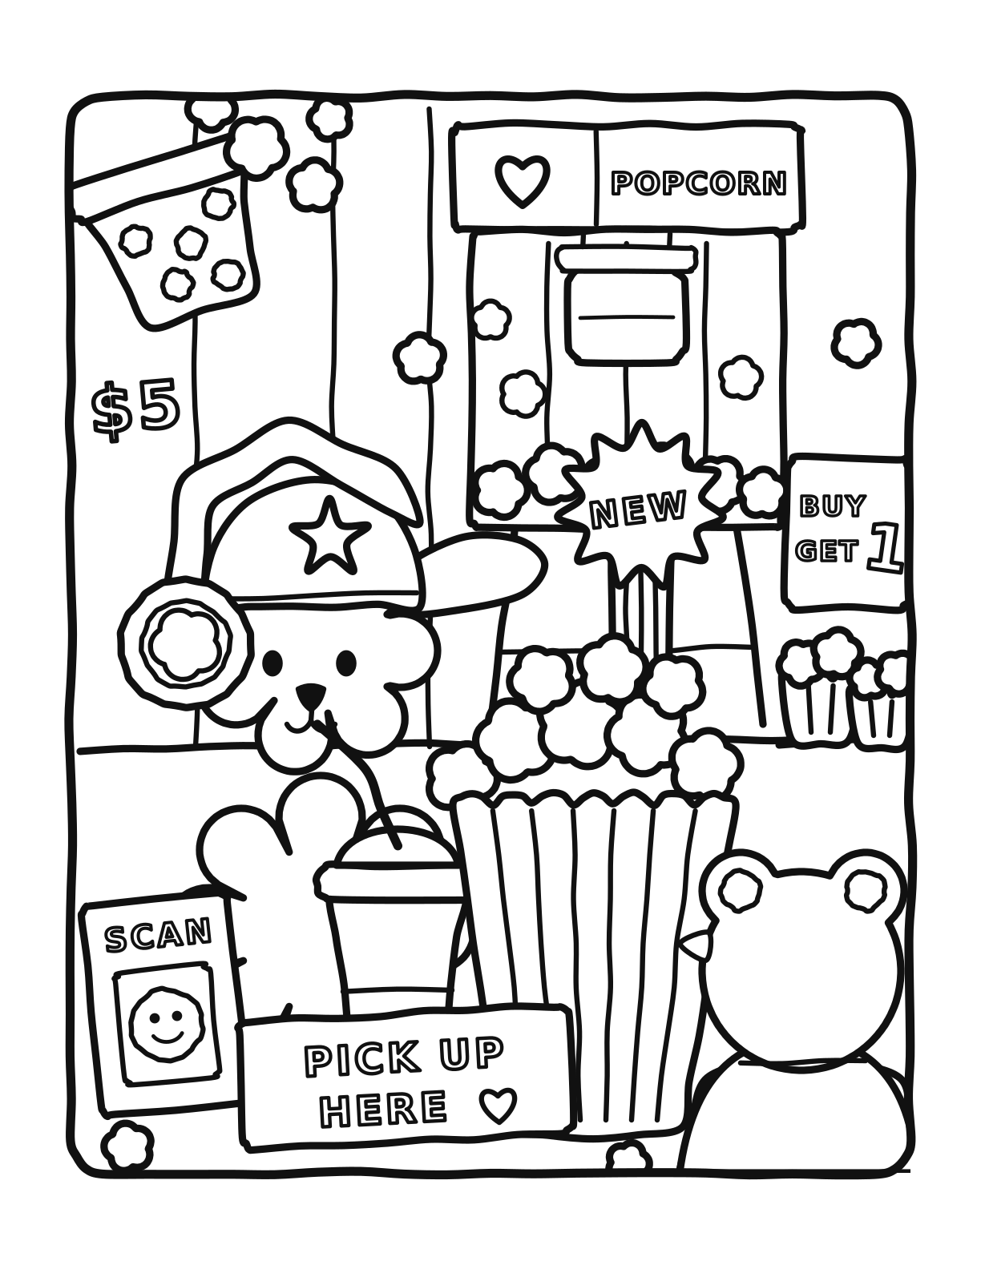
SMALL
WONDERS
A coloring book of twenty-one pages
Every page is generated from Python — no page is traced or clip-art.
US Letter, black line art, print at 100%.
Notes:
Small Wonders: 21 printable coloring pages, generated in code.

Slide 2
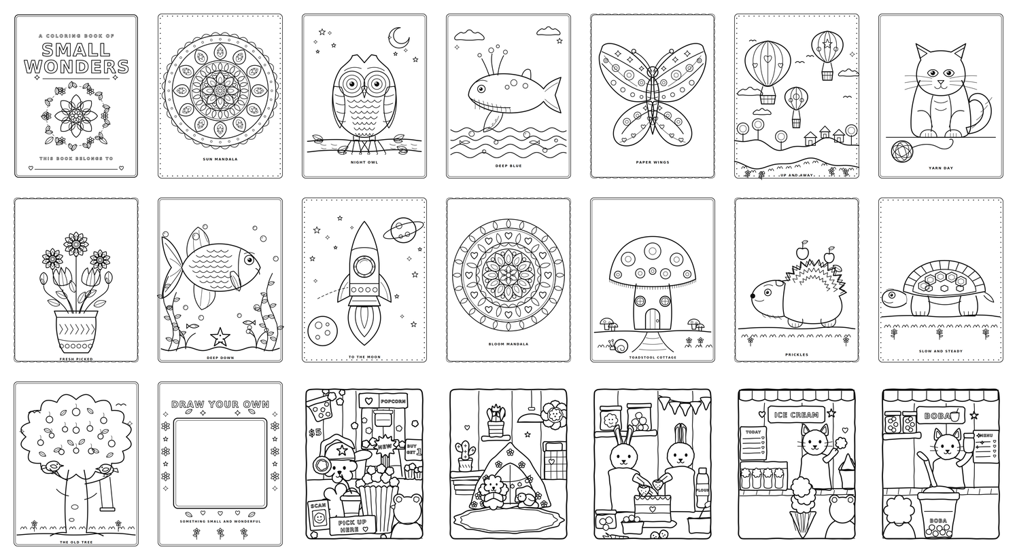
What's inside
5
Inked scenes
Packed shop and room scenes, drawn with a hand tremble and built strictly back to front so objects overlap the way they should.
16
Line-art pages
Clean single subjects — owl, whale, rocket, two mandalas, a tree — with large open areas and nothing fiddly to colour around.
Line weights run 5.2pt on outer silhouettes down to 1.5pt on texture, so nothing closes up at print size.
All twenty-one pages

Slide 3
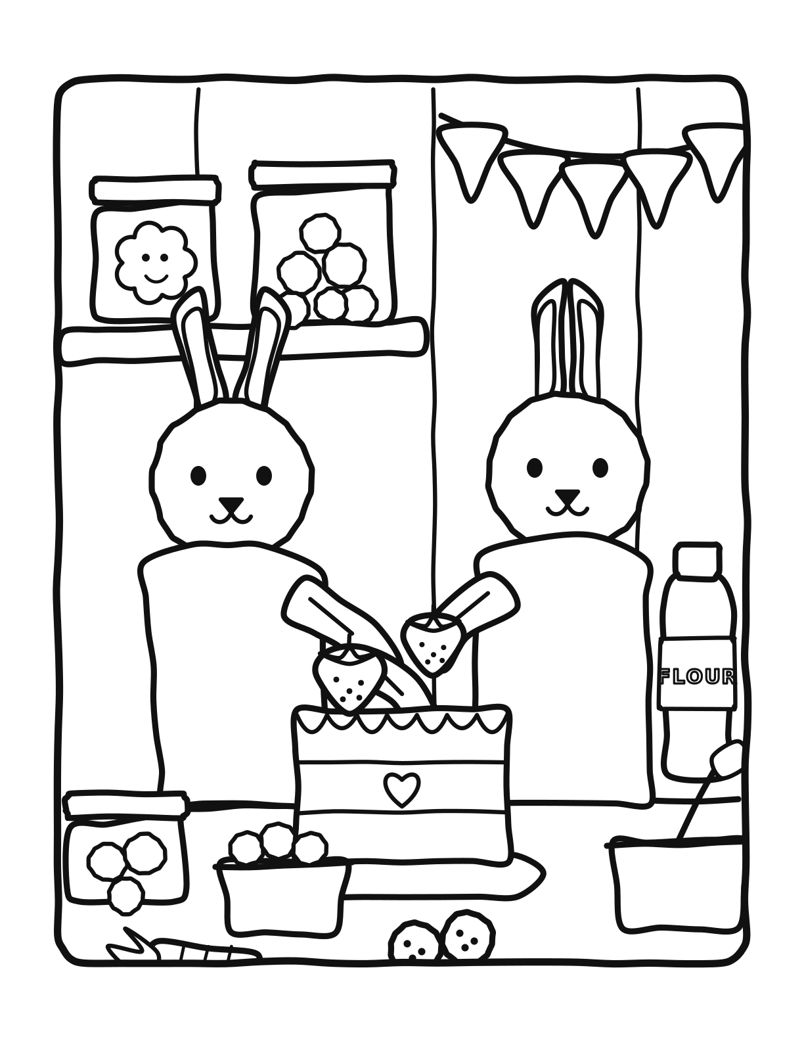
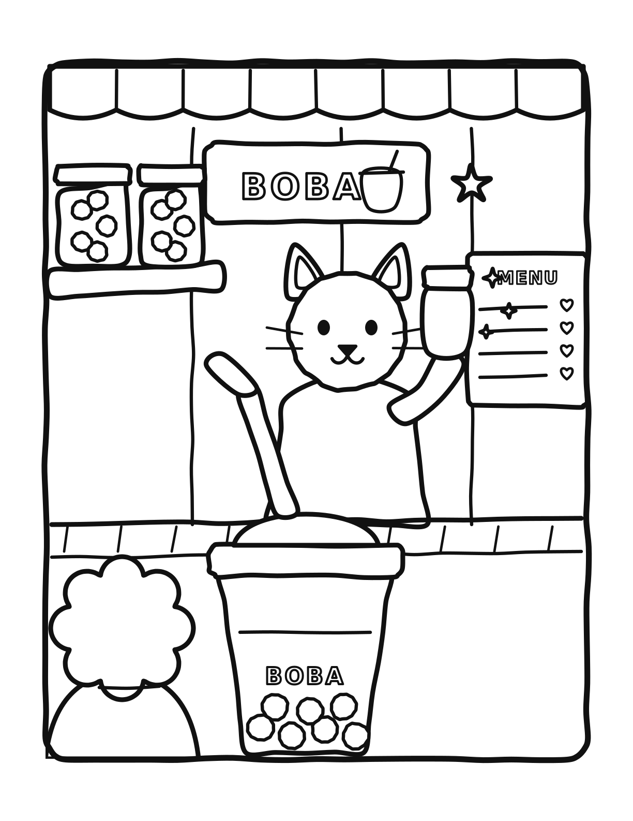
01
Inked scenes
Five busy counters and one quiet bedroom. Every shape is filled white, so the signs sit in front of the machine and the tub sits in front of the counter.

Slide 4
INKED SCENE 1 OF 5
17
Popcorn shop
A fluffy poodle in a star cap works the popcorn counter while a customer waits at the front.
LOOK FOR
A tub spilling over in the foreground
NEW, BUY GET 1, SCAN and PICK UP HERE signs
A kettle machine with a heart panel
Notes:
A fluffy poodle in a star cap works the popcorn counter while a customer waits at the front.

Slide 5
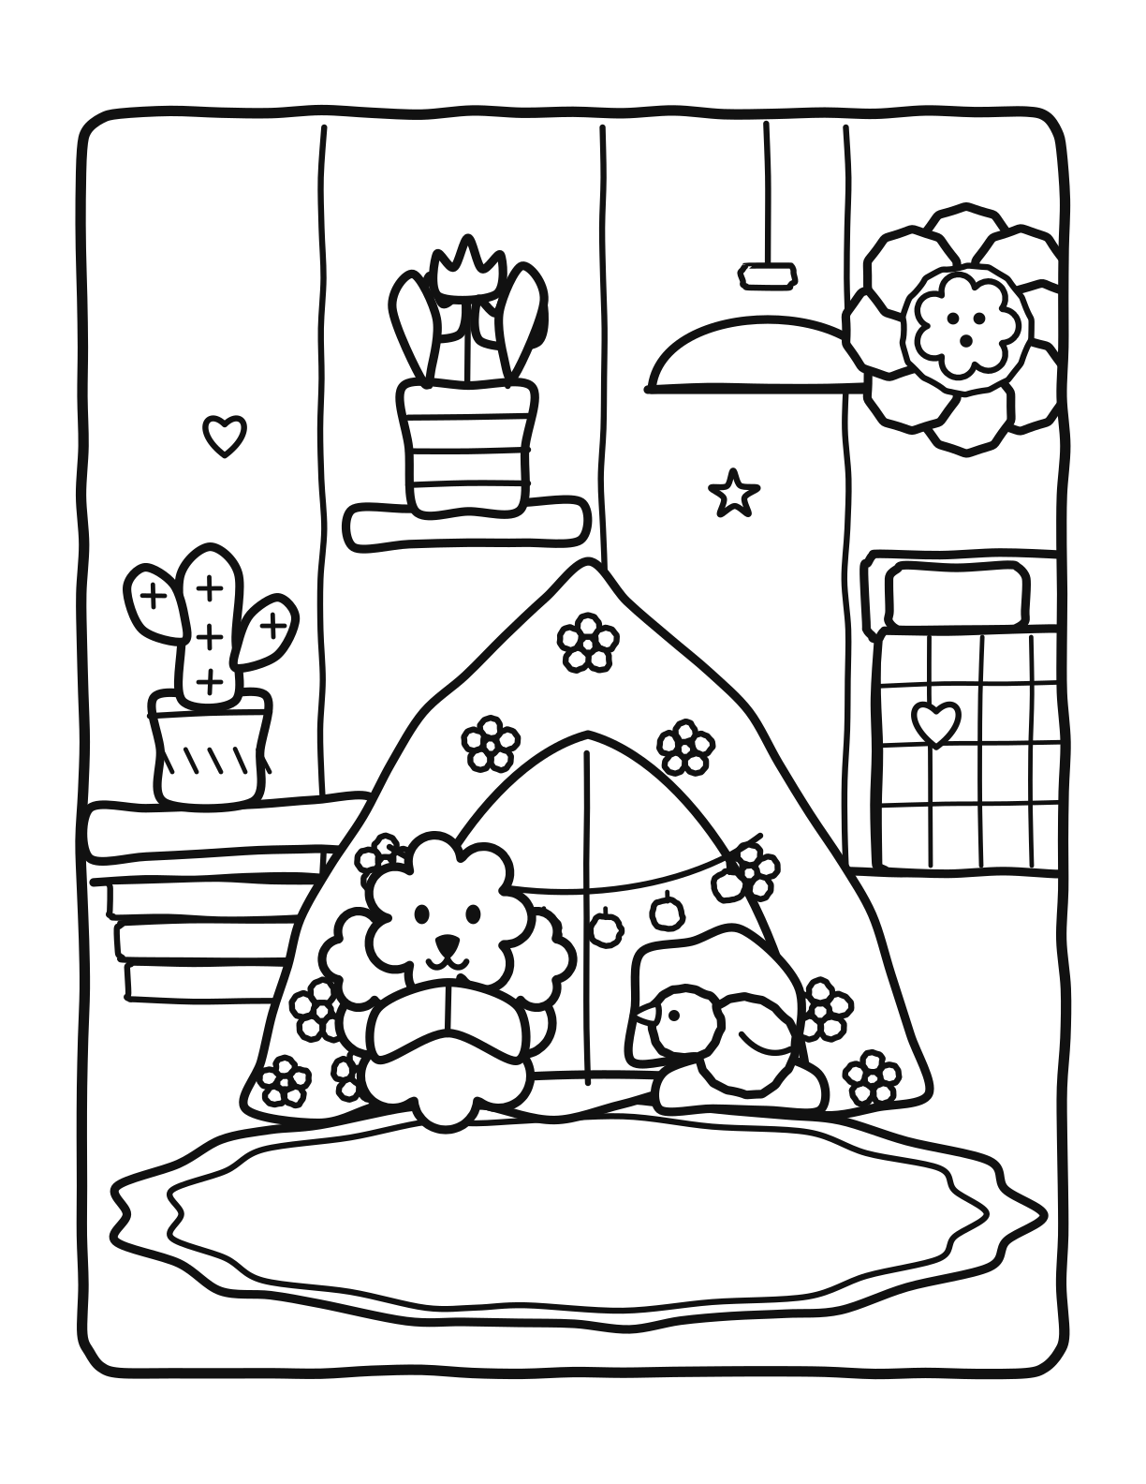
INKED SCENE 2 OF 5
18
Blanket fort
A poodle reads by fairy lights inside a flowered blanket fort while a chick naps on a cushion.
LOOK FOR
Cactus, tulips and a hanging lamp
A flower-shaped portrait frame
A scalloped rug under the whole tent
Notes:
A poodle reads by fairy lights inside a flowered blanket fort while a chick naps on a cushion.

Slide 6
INKED SCENE 3 OF 5
19
Bakery
Two rabbit bakers ice a strawberry cake together, one piping, one placing the fruit.
LOOK FOR
Jars of cookies and sweets on the shelf
Bunting, a flour bottle, a mixing bowl
A carrot and cookies on the counter
Notes:
Two rabbit bakers ice a strawberry cake together, one piping, one placing the fruit.

Slide 7
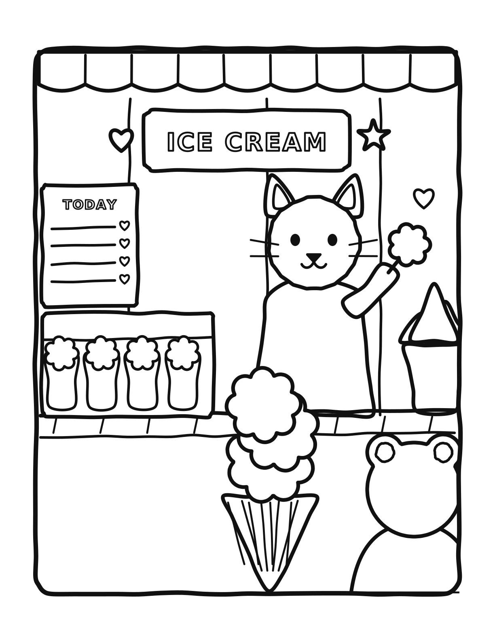
INKED SCENE 4 OF 5
20
Ice cream parlor
A cat lifts a fresh scoop behind the display case while a triple cone waits in front.
LOOK FOR
Four tubs under the counter glass
A scalloped awning and a TODAY board
A stack of spare cones
Notes:
A cat lifts a fresh scoop behind the display case while a triple cone waits in front.

Slide 8
INKED SCENE 5 OF 5
21
Boba tea bar
A cat shakes a drink behind the counter and a giant boba cup fills the foreground.
LOOK FOR
Pearls, a domed lid and a bendy straw
Topping jars on a wall shelf
A menu board with hearts
Notes:
A cat shakes a drink behind the counter and a giant boba cup fills the foreground.

Slide 9
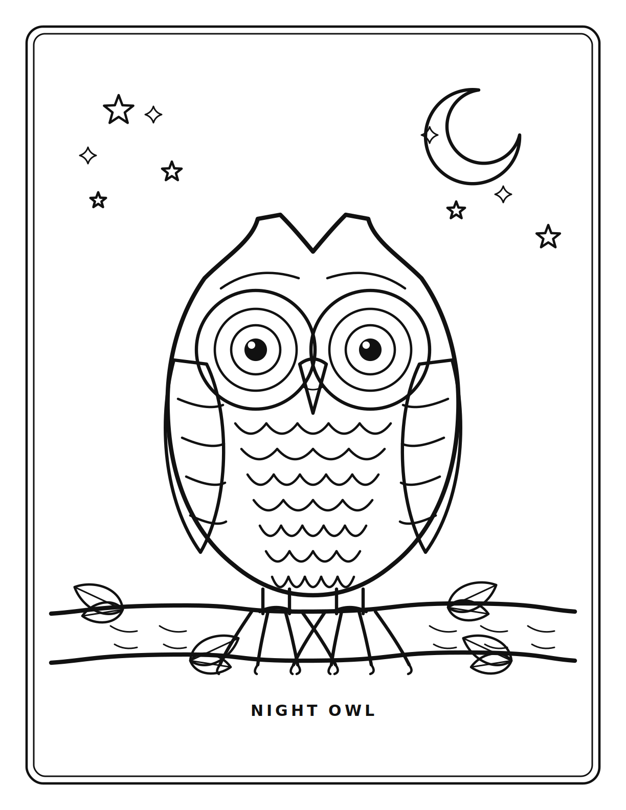
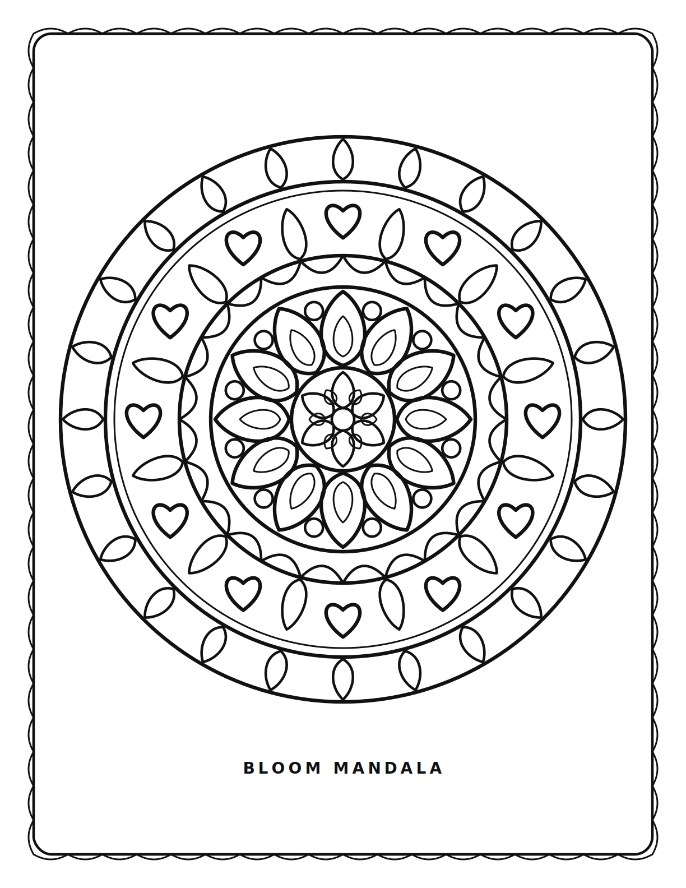
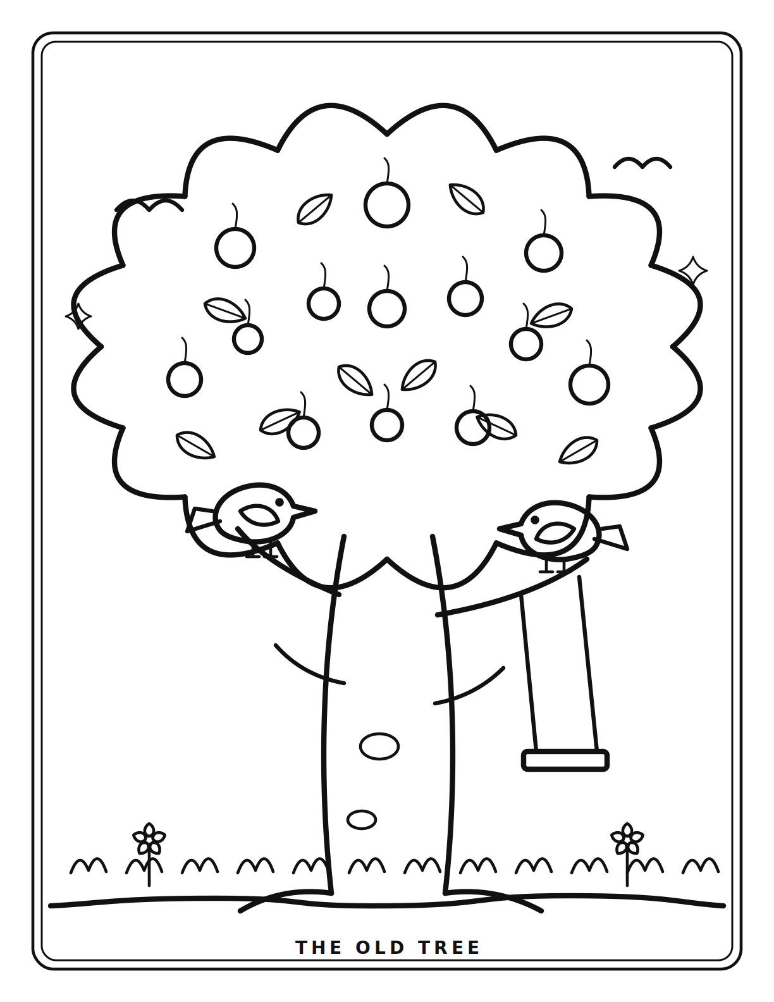
02
Line-art pages
Sixteen single subjects on white. Unfilled outlines, layered line weights, a decorative border and a captioned subject.

Slide 10

PAGE 1 OF 16
1
Cover
A wreath, a big blooming flower and a line for a name.
Notes:
A wreath, a big blooming flower and a line for a name.

Slide 11
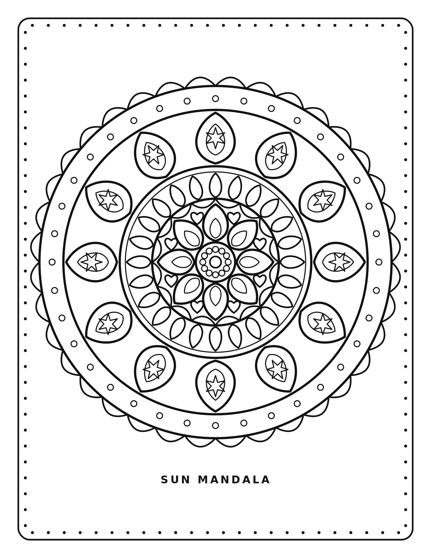
PAGE 2 OF 16
2
Sun mandala
Twelve-fold rings of petals, hearts and scallops.
Notes:
Twelve-fold rings of petals, hearts and scallops.

Slide 12
PAGE 3 OF 16
3
Night owl
A horned owl gripping a branch under a crescent moon.
Notes:
A horned owl gripping a branch under a crescent moon.

Slide 13
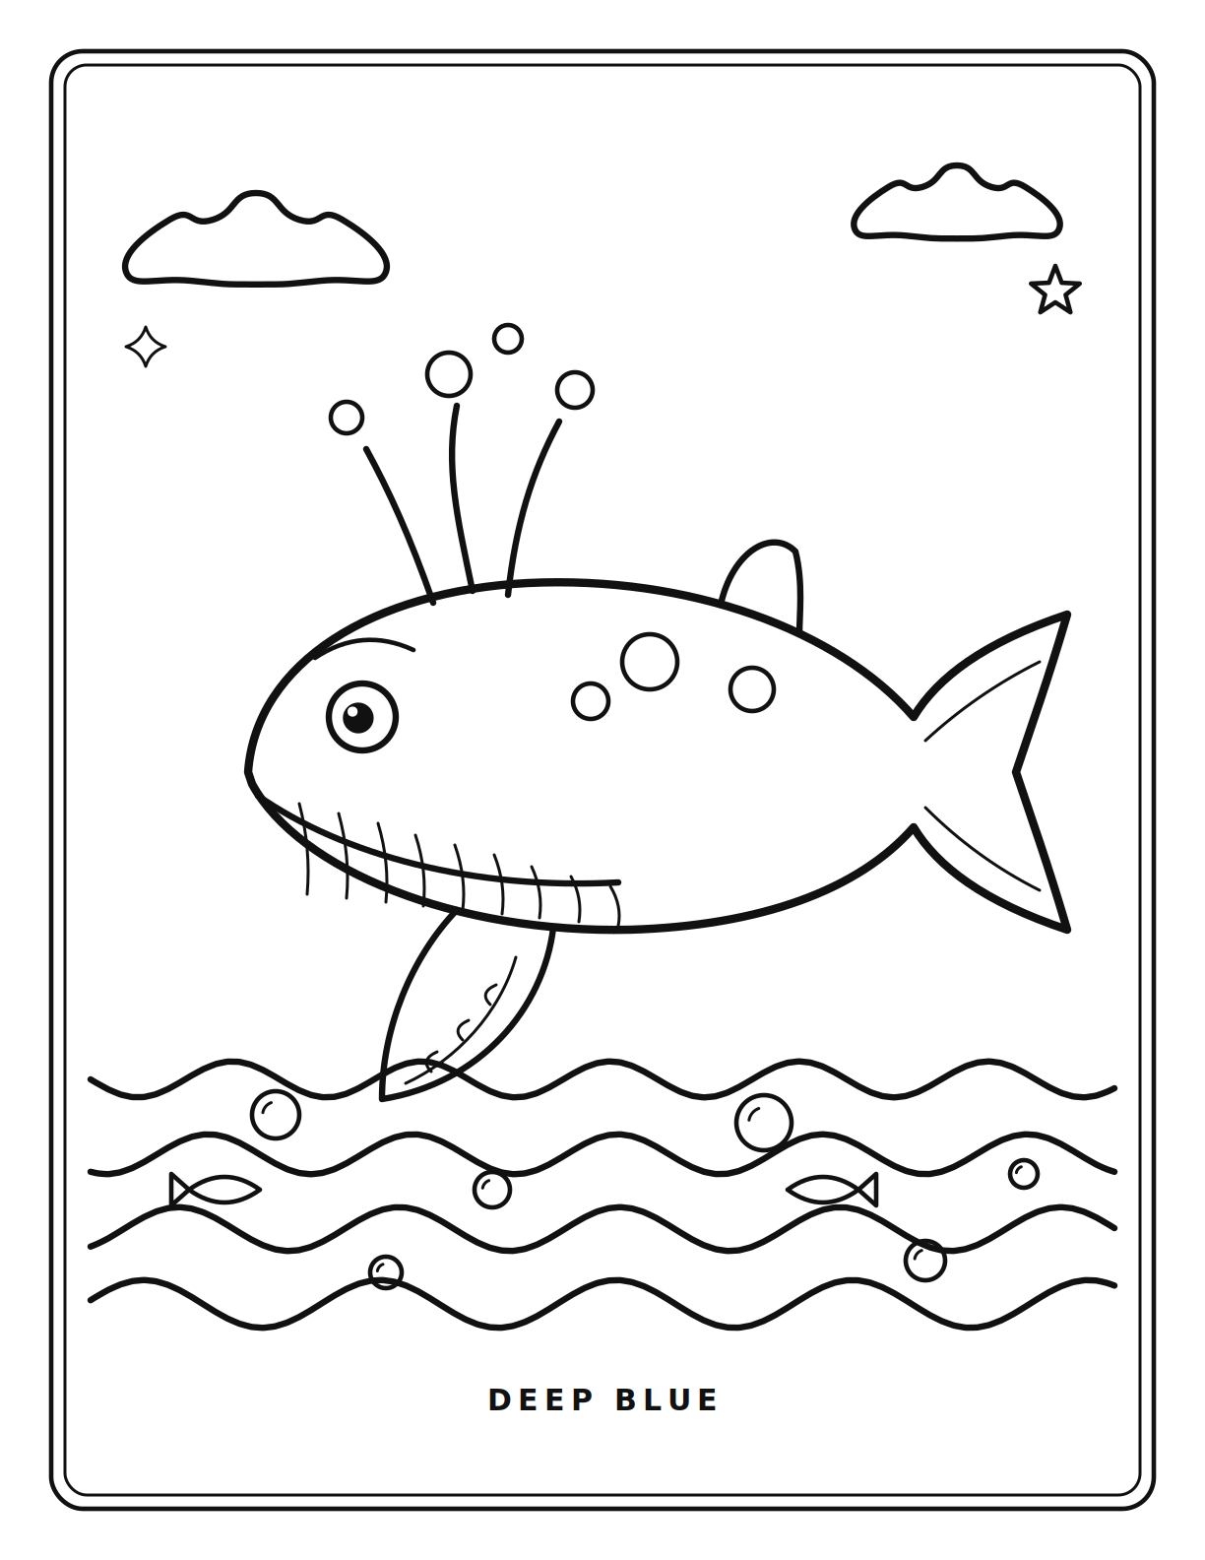
PAGE 4 OF 16
4
Deep blue
A humpback with throat grooves and a long flipper.
Notes:
A humpback with throat grooves and a long flipper.

Slide 14
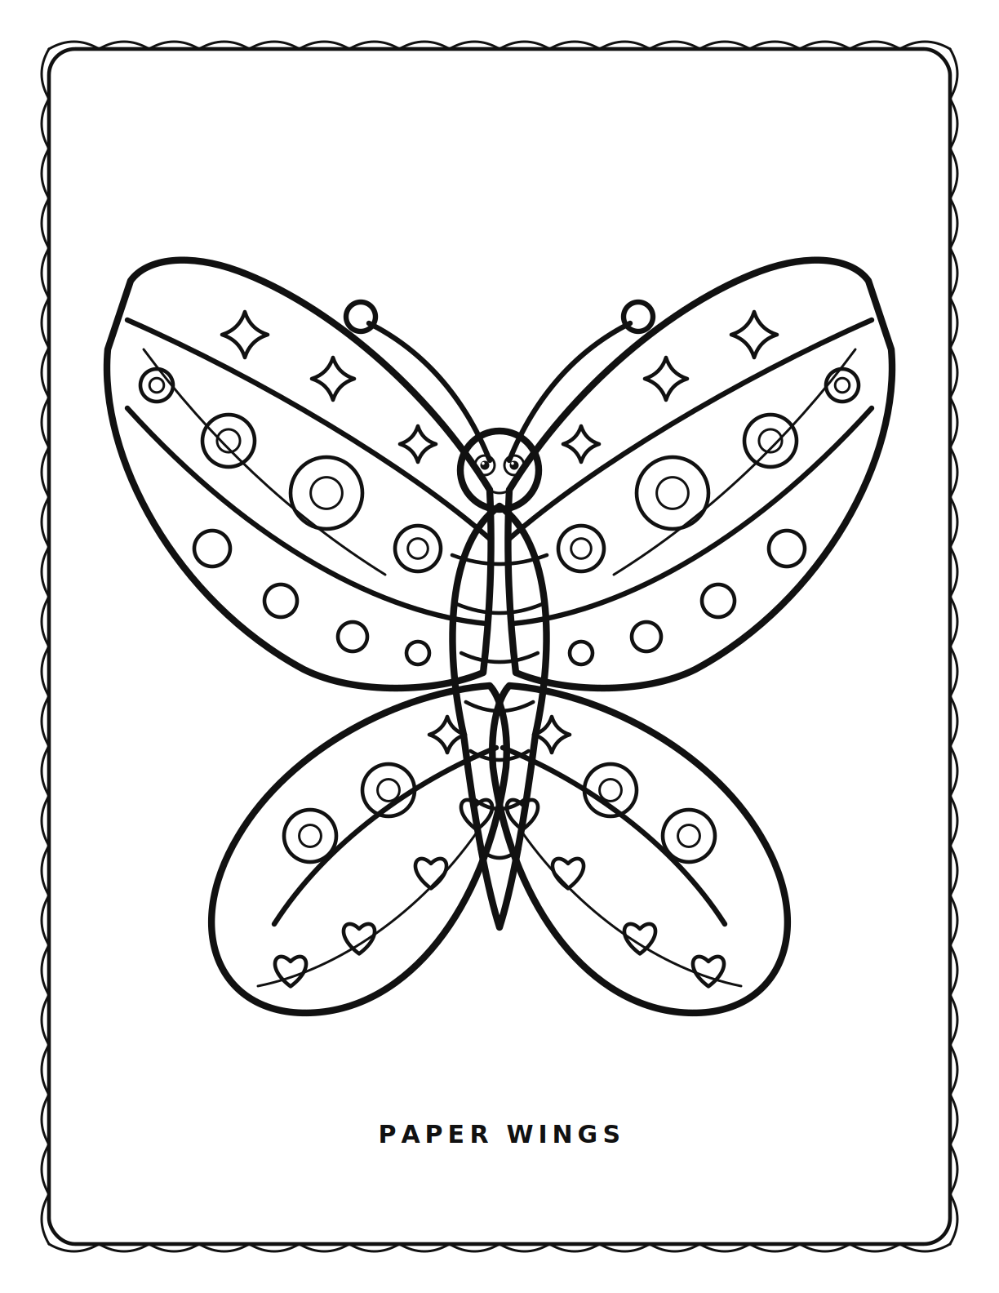
PAGE 5 OF 16
5
Paper wings
Veined wing panels, mirrored exactly down the middle.
Notes:
Veined wing panels, mirrored exactly down the middle.

Slide 15
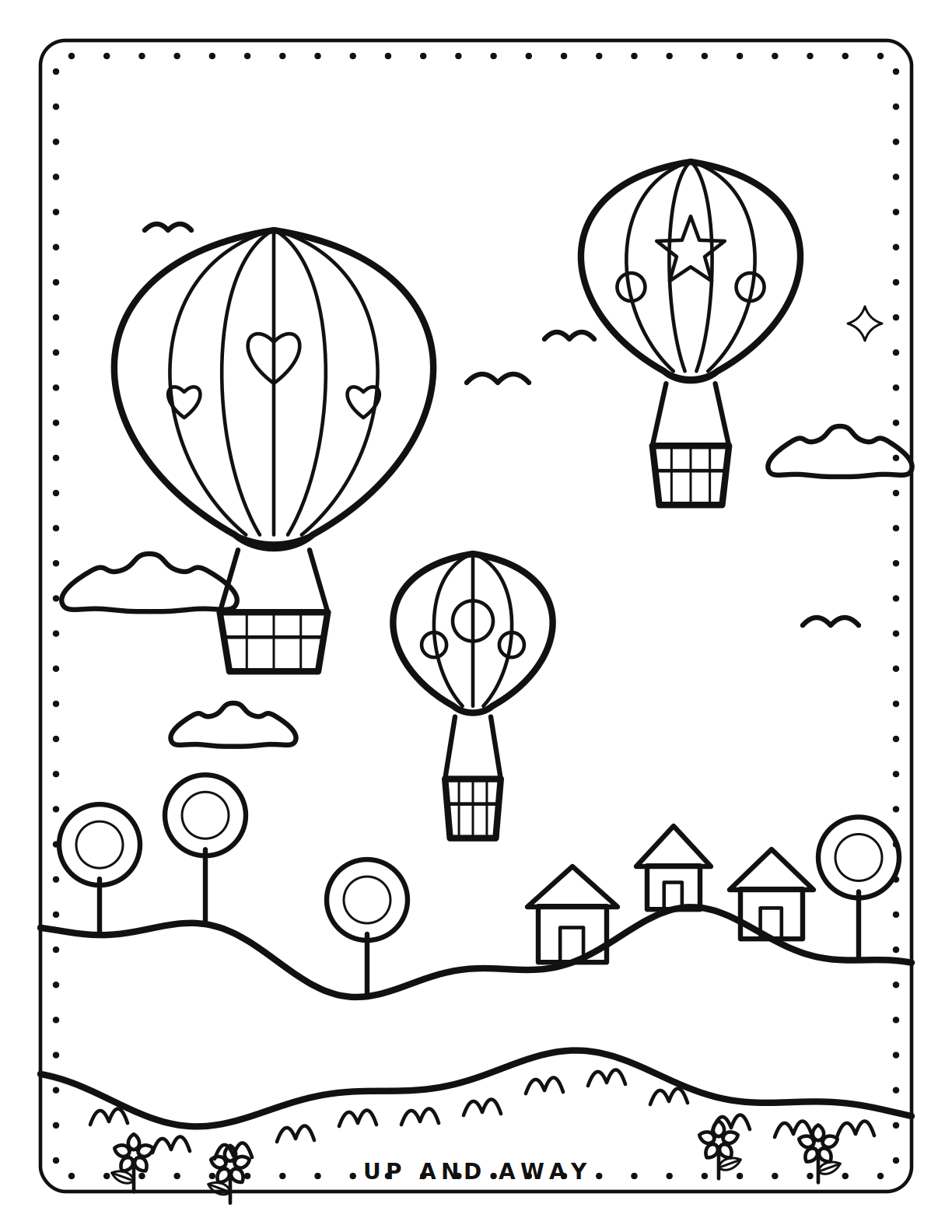
PAGE 6 OF 16
6
Up and away
Three balloons drifting over a village on rolling hills.
Notes:
Three balloons drifting over a village on rolling hills.

Slide 16
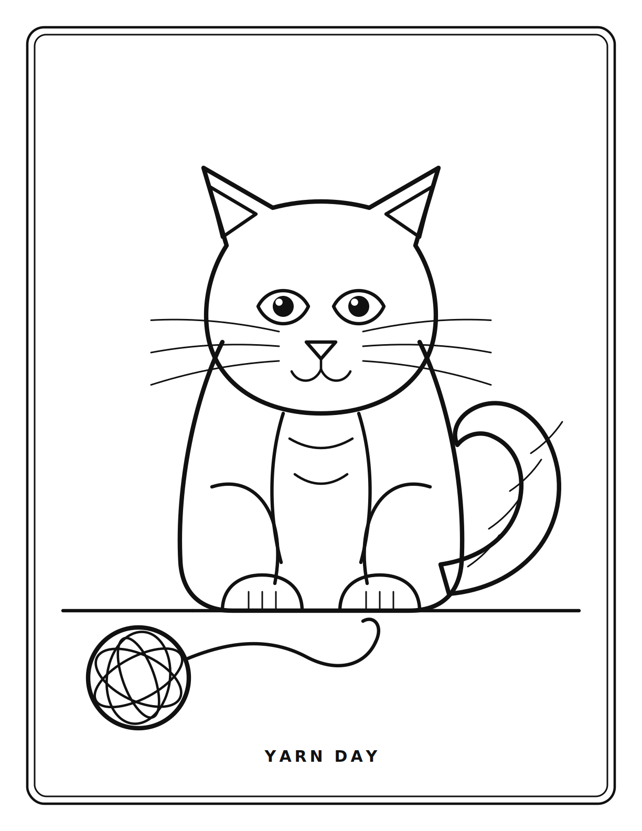
PAGE 7 OF 16
7
Yarn day
A sitting cat with a curled tail and a ball of yarn.
Notes:
A sitting cat with a curled tail and a ball of yarn.

Slide 17
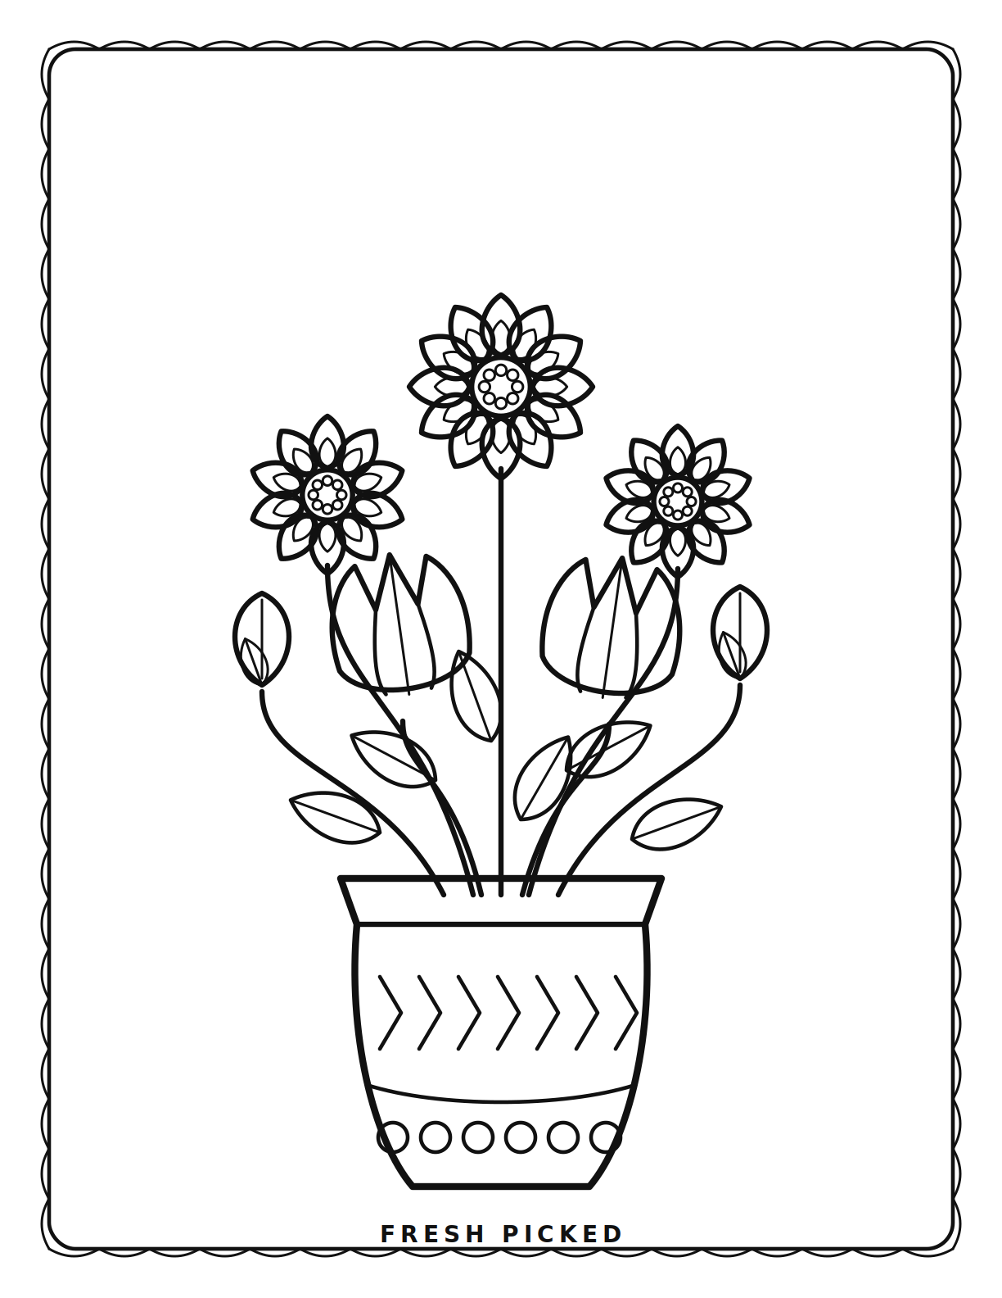
PAGE 8 OF 16
8
Fresh picked
Daisies and tulips gathered in a patterned vase.
Notes:
Daisies and tulips gathered in a patterned vase.

Slide 18
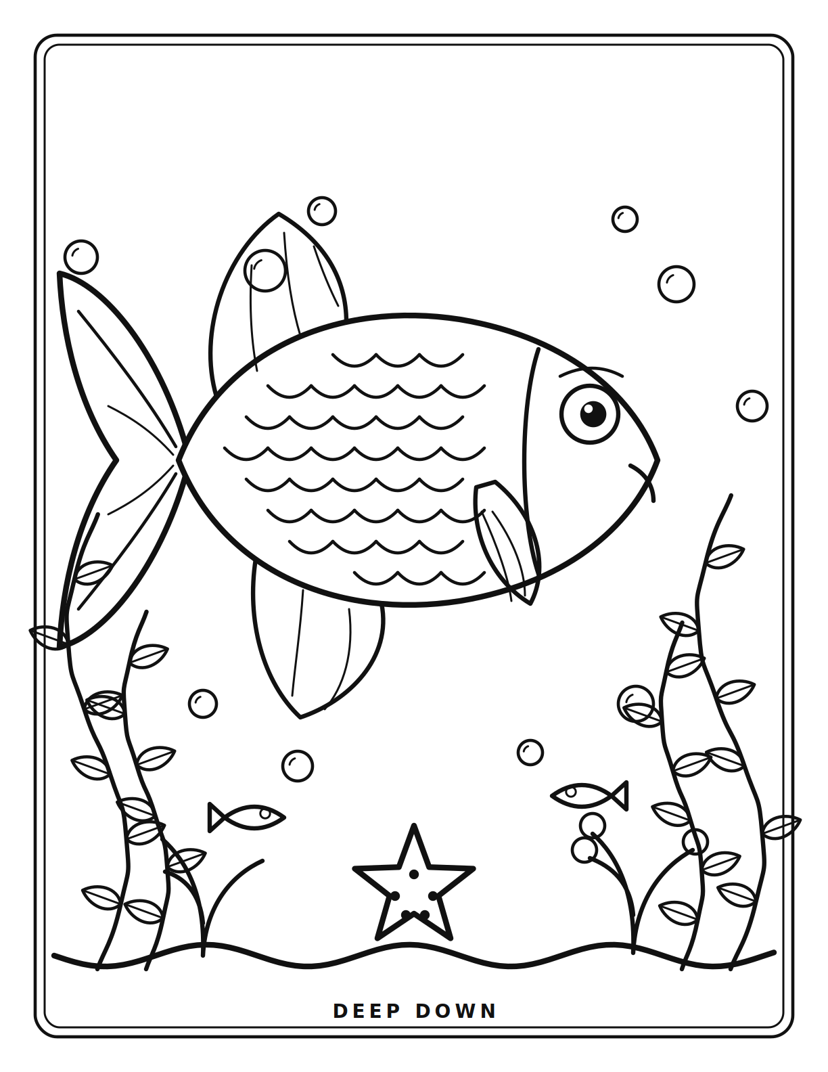
PAGE 9 OF 16
9
Deep down
A scaled fish among seaweed, coral and a starfish.
Notes:
A scaled fish among seaweed, coral and a starfish.

Slide 19
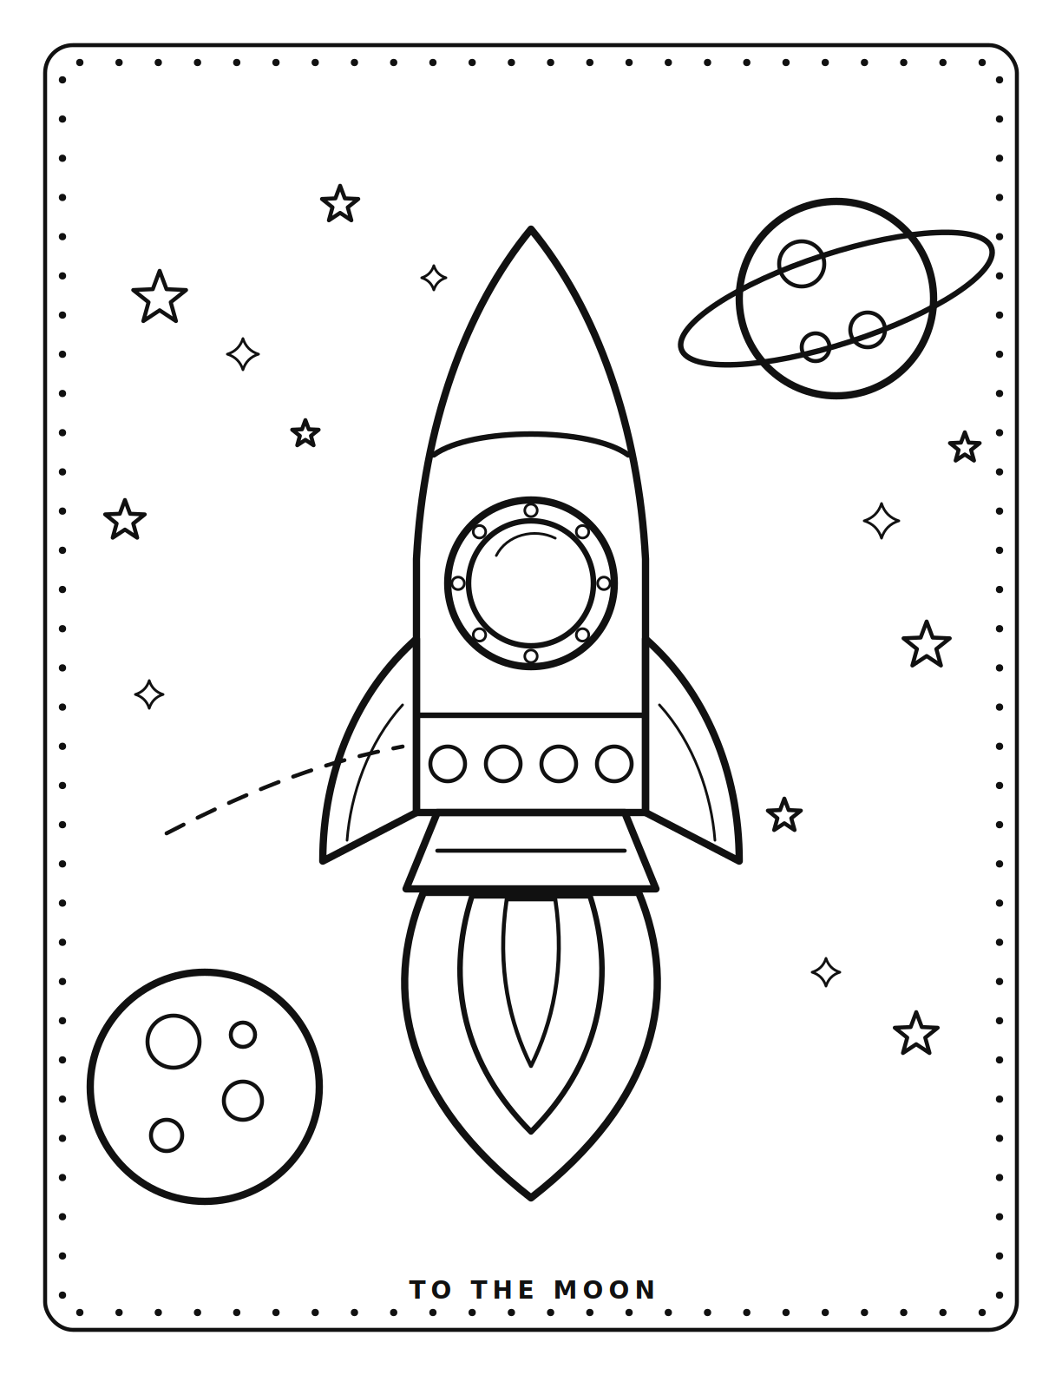
PAGE 10 OF 16
10
To the moon
A rocket climbing past a ringed planet and a cratered moon.
Notes:
A rocket climbing past a ringed planet and a cratered moon.

Slide 20
PAGE 11 OF 16
11
Bloom mandala
Leaves, hearts and petals in twelve-fold symmetry.
Notes:
Leaves, hearts and petals in twelve-fold symmetry.

Slide 21
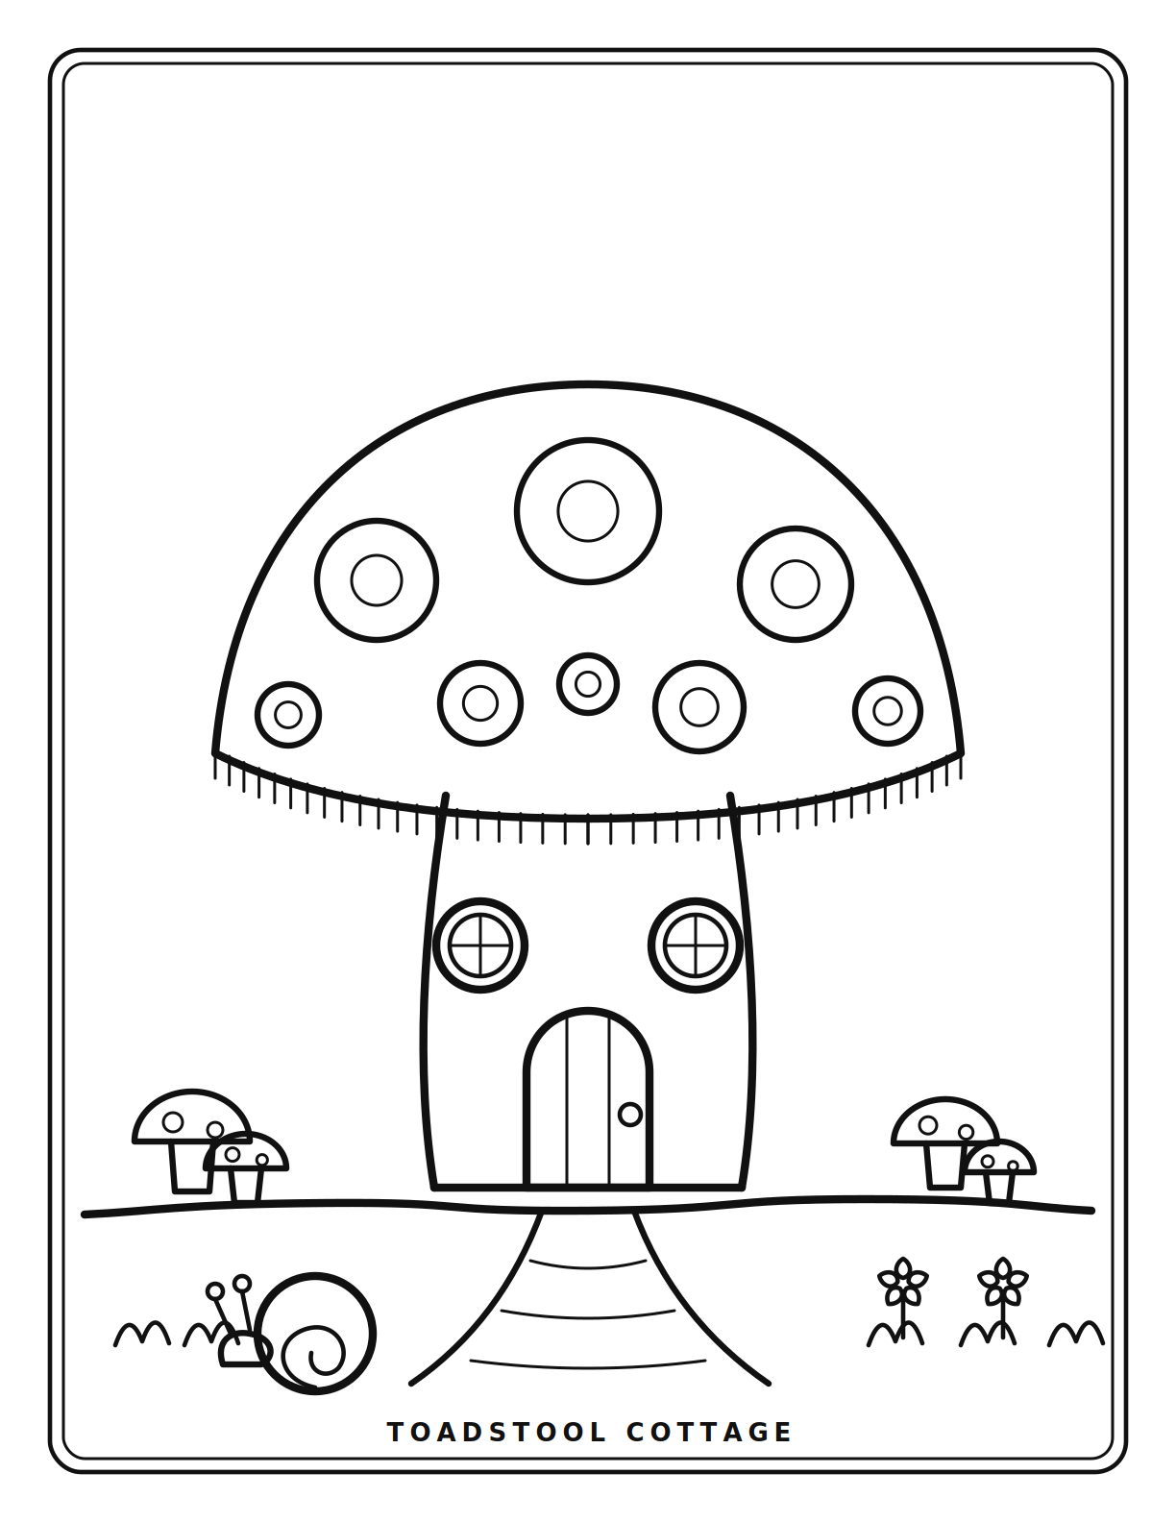
PAGE 12 OF 16
12
Toadstool cottage
A spotted mushroom house with round windows and a snail.
Notes:
A spotted mushroom house with round windows and a snail.

Slide 22
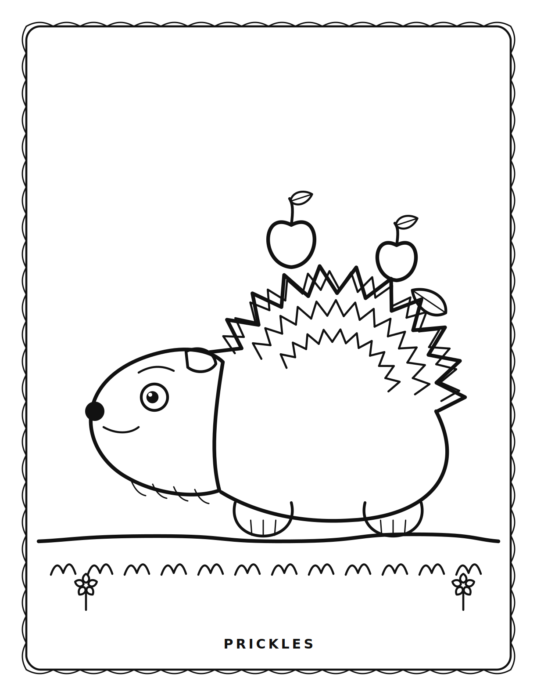
PAGE 13 OF 16
13
Prickles
A hedgehog carrying apples home on its spines.
Notes:
A hedgehog carrying apples home on its spines.

Slide 23
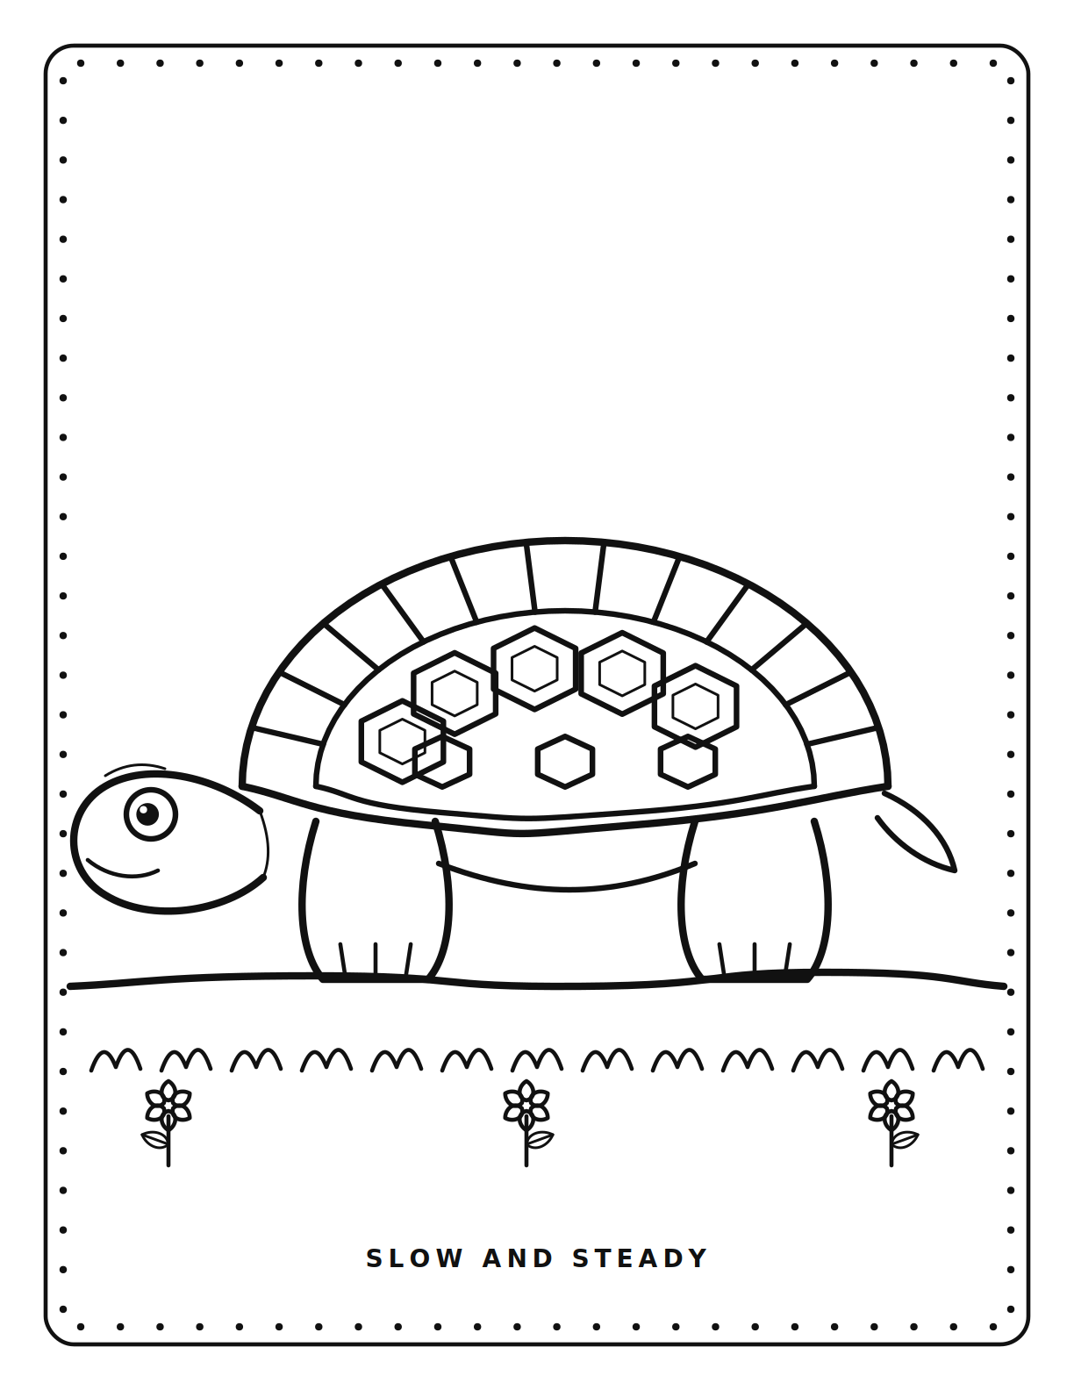
PAGE 14 OF 16
14
Slow and steady
A tortoise with a plated shell, out for a walk.
Notes:
A tortoise with a plated shell, out for a walk.

Slide 24
PAGE 15 OF 16
15
The old tree
A scalloped canopy full of fruit, with birds and a swing.
Notes:
A scalloped canopy full of fruit, with birds and a swing.

Slide 25
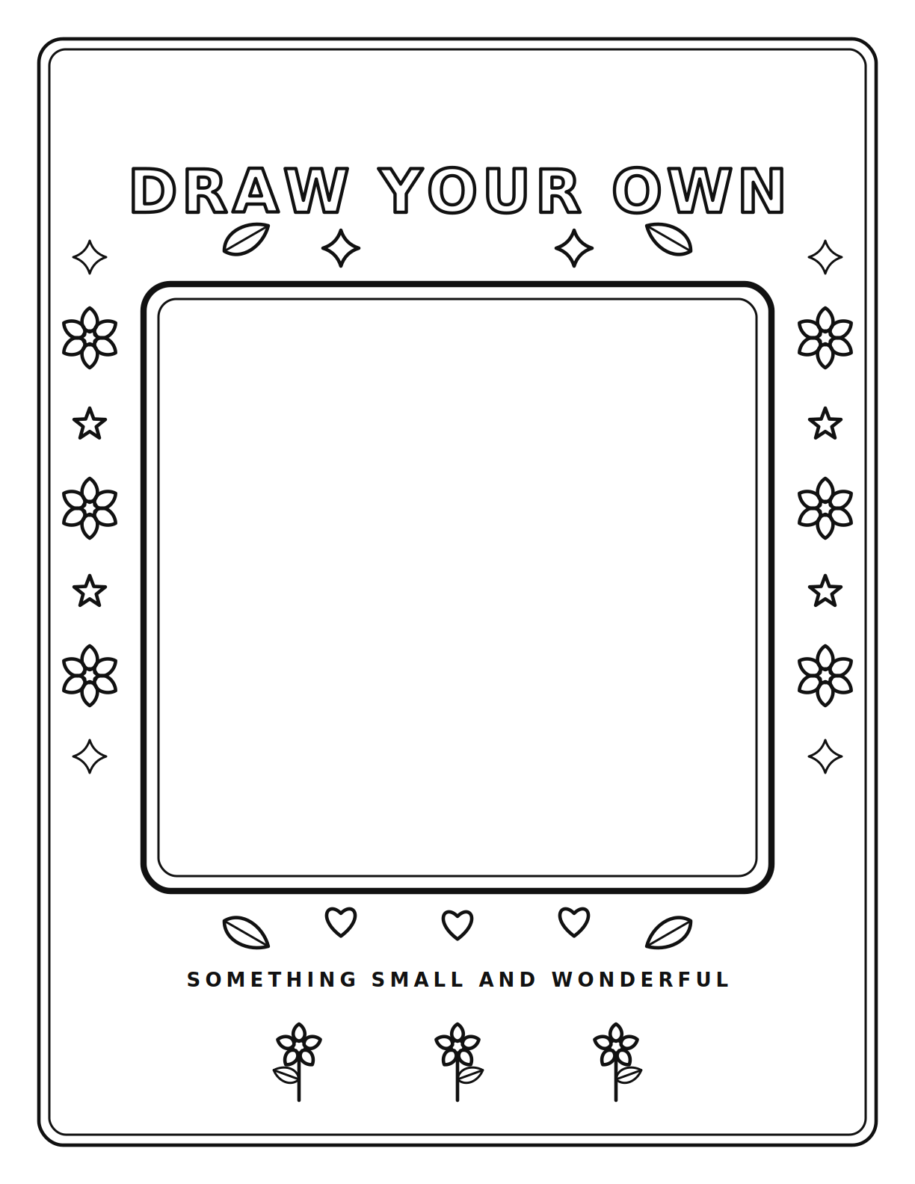
PAGE 16 OF 16
16
Draw your own
An empty frame ringed with flowers, hearts and stars.
Notes:
An empty frame ringed with flowers, hearts and stars.

Slide 26
Print at 100%
1
Actual size
Choose 100% or “actual size”, not “fit to page”, or the margins shift.
2
Vector, not pixels
The PDF holds no rasterised images, so it stays sharp at any size.
3
Any paper
21 pages · 8.5 × 11 in · vector PDF
Pages are true US Letter. A4 works too — print at 100% and lose a little margin.

