Slide 1
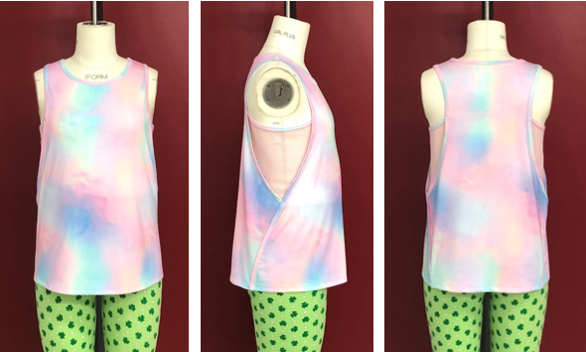
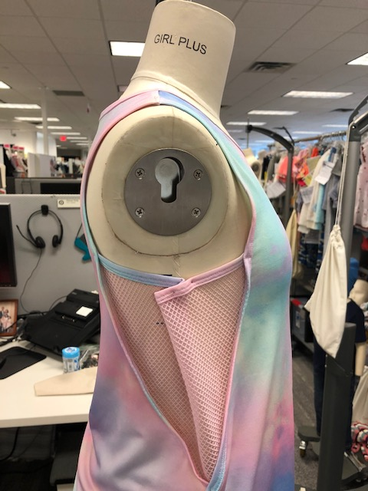
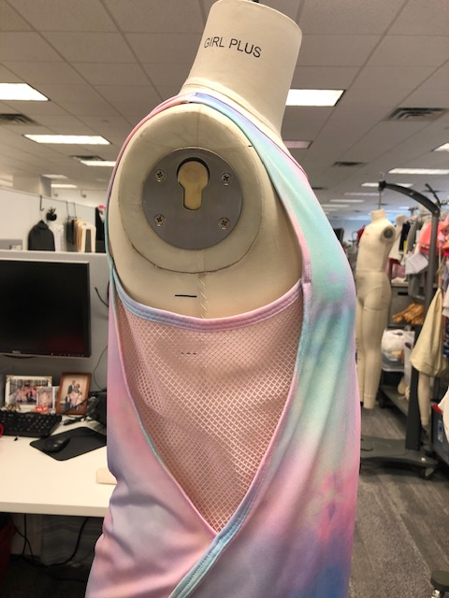
564356 1st Prototype, APC Size LP 1 of 2
Received
Desired
BP digitals
BPFE comments:
Fit and balance are good.
TGT TD digitals
TGT TD Comments:
Modesty concern at front bust due to size of mesh cutout. Revise mesh cutout from 7.25” to 5” for size LP; grade accordingly for all other sizes
BP ensure front panel is curved to ensure better side bust coverage (indicated in red)
BP send image of revision for TGT TD review

Slide 2
564356 1st Prototype, APC Size LP 2 of 2
Reviewed by Yoonie Lee on behalf of Accredited full BPFE Ally Park:
We’ve followed the overall EOF of 564582 M APC sample for LP.
We’ve adjusted the front panel’s side line as following your M APC given cmmts. Pls check and confirm it, if the front panel’s looking at side view is acceptable.
We’ve adjusted the backward width of front bodice to *3.75” at bottom.
TGT-TD Response to BP Comments:
Noted
See TGT TD comments on slide 1
Noted

