Slide 1
Day1

Slide 2
Registration
#3. Course Registration Link The URL to use with the class key is https://linux.thoughtindustries.com/redeem The learner will be prompted to enter or create an LFID, they are then prompted to enter the class key/code: lfd459tcc20220510
**Please make sure all students register at the beginning of the class.
#4. Course Survey Link Here is the custom link to give to the students for the end of class survey: https://www.surveymonkey.com/r/KK7Z3SR?course=LFD459_20220510_PART_VIRT_TCC
**Please make sure all students complete the survey by end of the class.

Slide 3



Exam and Certifications
CKA: Certified Kubernetes Administrator
CKS: Certified Kubernetes Security Specialist
(Must CKA certified first)
CKAD: Certified Kubernetes Application Developer

Slide 4
Lab
Deployment
(control of the application)
kubectl get deployment
Master
nginx
Pod
(application)
kubectl get pod -o wide
nginx
nginx
Service
(how to access your application, ClusterIP, LoadBalacner, NodePort)
Kubectl get svc
SDN:80
SDN:80
service
Pod , virtual network (private)
Host Network:30122
10.98.64.122:80
192.168.233.73
External firewall
http://35.203.121.109:31345/

Slide 5
Lab
Deployment
(control of the application)
kubectl get deployment
Master
Deployment
Replica
Label:a
Secret
configmap
nginx
Pod
(application)
kubectl get pod -o wide
Nginx
Label:b
Nginx
Label:a
Service
(how to access your application, ClusterIP, LoadBalacner, NodePort)
Kubectl get svc
SDN:80
SDN:80
service
Selector : label :a
Pod , virtual network (private)
Host Network:30122
10.98.64.122:80
192.168.233.73
External firewall
http://35.203.121.109:31345/

Slide 6
Lunch time 12:00- 13:30

Slide 7
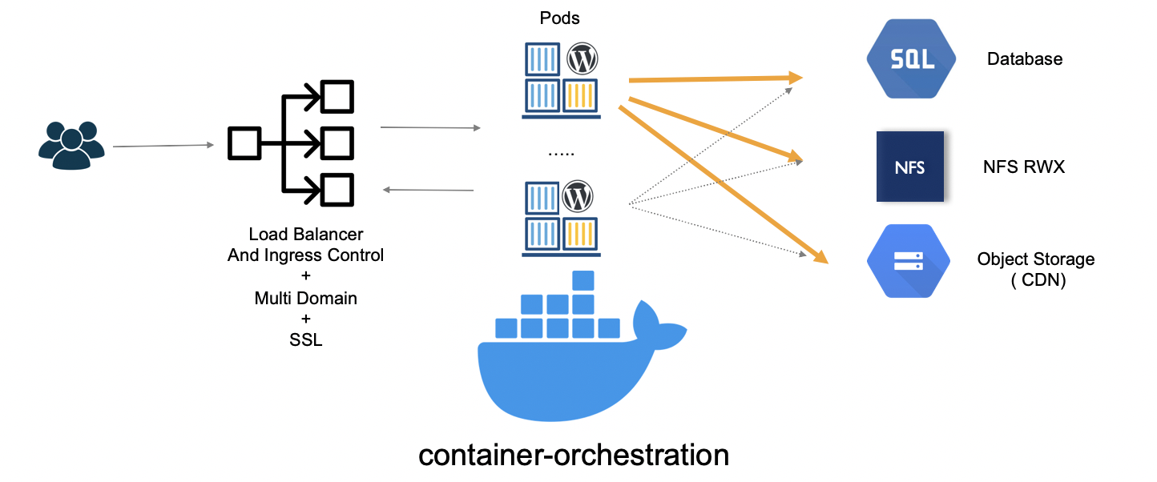
Cloud Native Architecture Characteristics

Slide 8
Day2
https://trainingportal.linuxfoundation.org/redeem
Course Registration Link

Slide 9
Manage yaml file for deployment

Slide 10
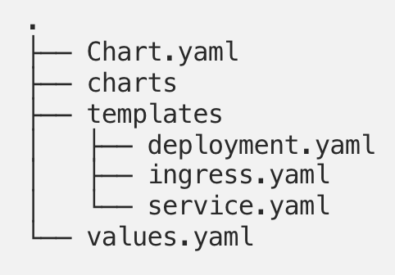
1.Meta
2.Dependency ,指向另一個chart
Helm
Eg:
Wordpress chart
Httpd chart
GO language Injected
To get parameter from values.yaml
Parameters Definition
More example
https://cwhu.medium.com/kubernetes-helm-chart-tutorial-fbdad62a8b61

Slide 11
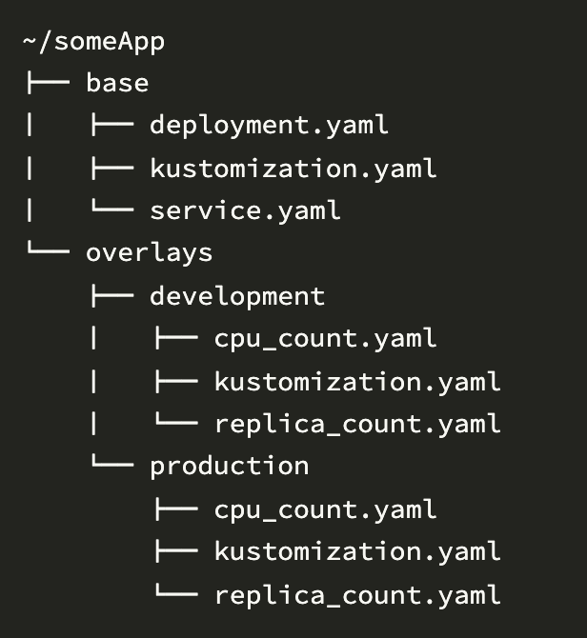
Kustomize
變量？？
kustomize build myapp/base | oc apply -f -
kustomize build myapp/base > /tmp/base.yaml
kubectl apply –f /tmp/base.yaml
More example
https://ellis-wu.github.io/2018/07/26/kustomize-introduction/

Slide 12
配置 Probe
Probe 中有很多精确和详细的配置，通过它们你能准确的控制 liveness 和 readiness 检查：
initialDelaySeconds：容器启动后第一次执行探测是需要等待多少秒。
periodSeconds：执行探测的频率。默认是 10 秒，最小 1 秒。
timeoutSeconds：探测超时时间。默认 1 秒，最小 1 秒。
successThreshold：探测失败后，最少连续探测成功多少次才被认定为成功。默认是 1。对于 liveness 必须是 1。最小值是 1。
failureThreshold：探测成功后，最少连续探测失败多少次才被认定为失败。默认是 3。最小值是 1。

Slide 13
Probes can be configured in many ways based on how often they need to run, the success and failure thresholds, and how long to wait for responses.
initialDelaySeconds (default value 0): If you know your application needs n seconds (for example, 30 seconds) to warm up, you can add delay in seconds until the first check is executed by using initialDelaySeconds.
periodSeconds (default value 10): If you want to specify how often you execute a check, you can define that using periodSeconds.
timeoutSeconds (default value 1): This defines the maximum number of seconds until the probe operation is timed out.
successThreshold (default value 1): This is the number of attempts until the probe is considered successful after the failure.
failureThreshold (default value 3): In case of probe failure, Kubernetes makes multiple attempts before the probe is marked as failed.
Note: By default, the probe will stop if the application is not ready after three attempts. In case of a liveness probe, it will restart the container. In the case of a readiness probe, it will mark pods as unhealthy.

Slide 14
Day4

Slide 15
Cluster Level (namespace)
Project Level(namespace)
1
ClusterRole , Role
>>>
--verb=create --resource=deployments,statefulsets,daemonsets
clusterrolebinding
rolebinding
3
2
System User (service account)
Normal User
DEPLOYMENT

Slide 16
Expose network
https://medium.com/google-cloud/kubernetes-nodeport-vs-loadbalancer-vs-ingress-when-should-i-use-what-922f010849e0

