Slide 1
Wafer-Scale Integration
Measurement Data-Processing Script
Rhiannon Evans

Slide 2
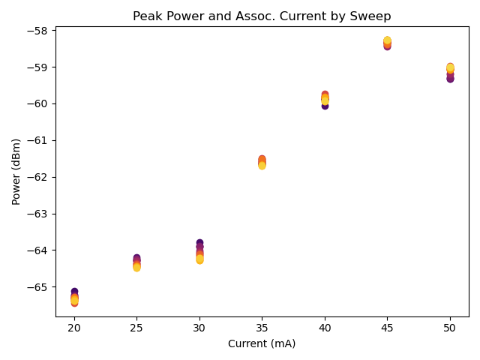
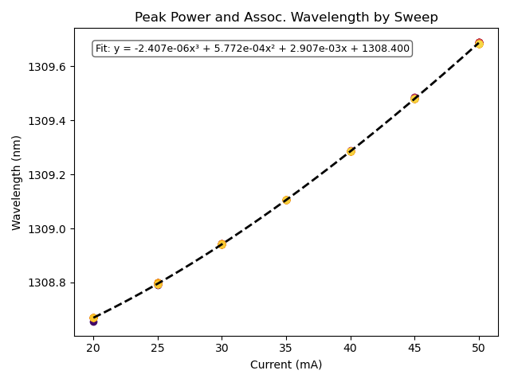
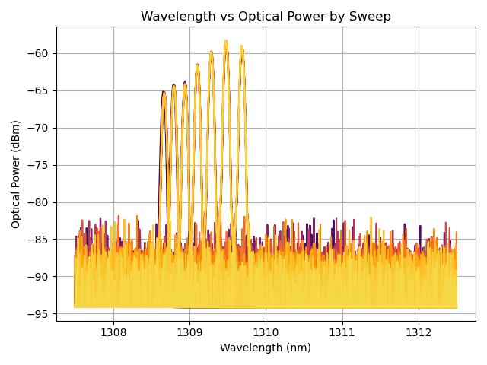
OSA
Data is organized by “sweep”.
Each “sweep” has an associated temperature (C), current (mA), and voltage (V).
Each “sweep” holds one set of Optical Power (mW) measurements and one set of Wavelength (nm) measurements.

Slide 3
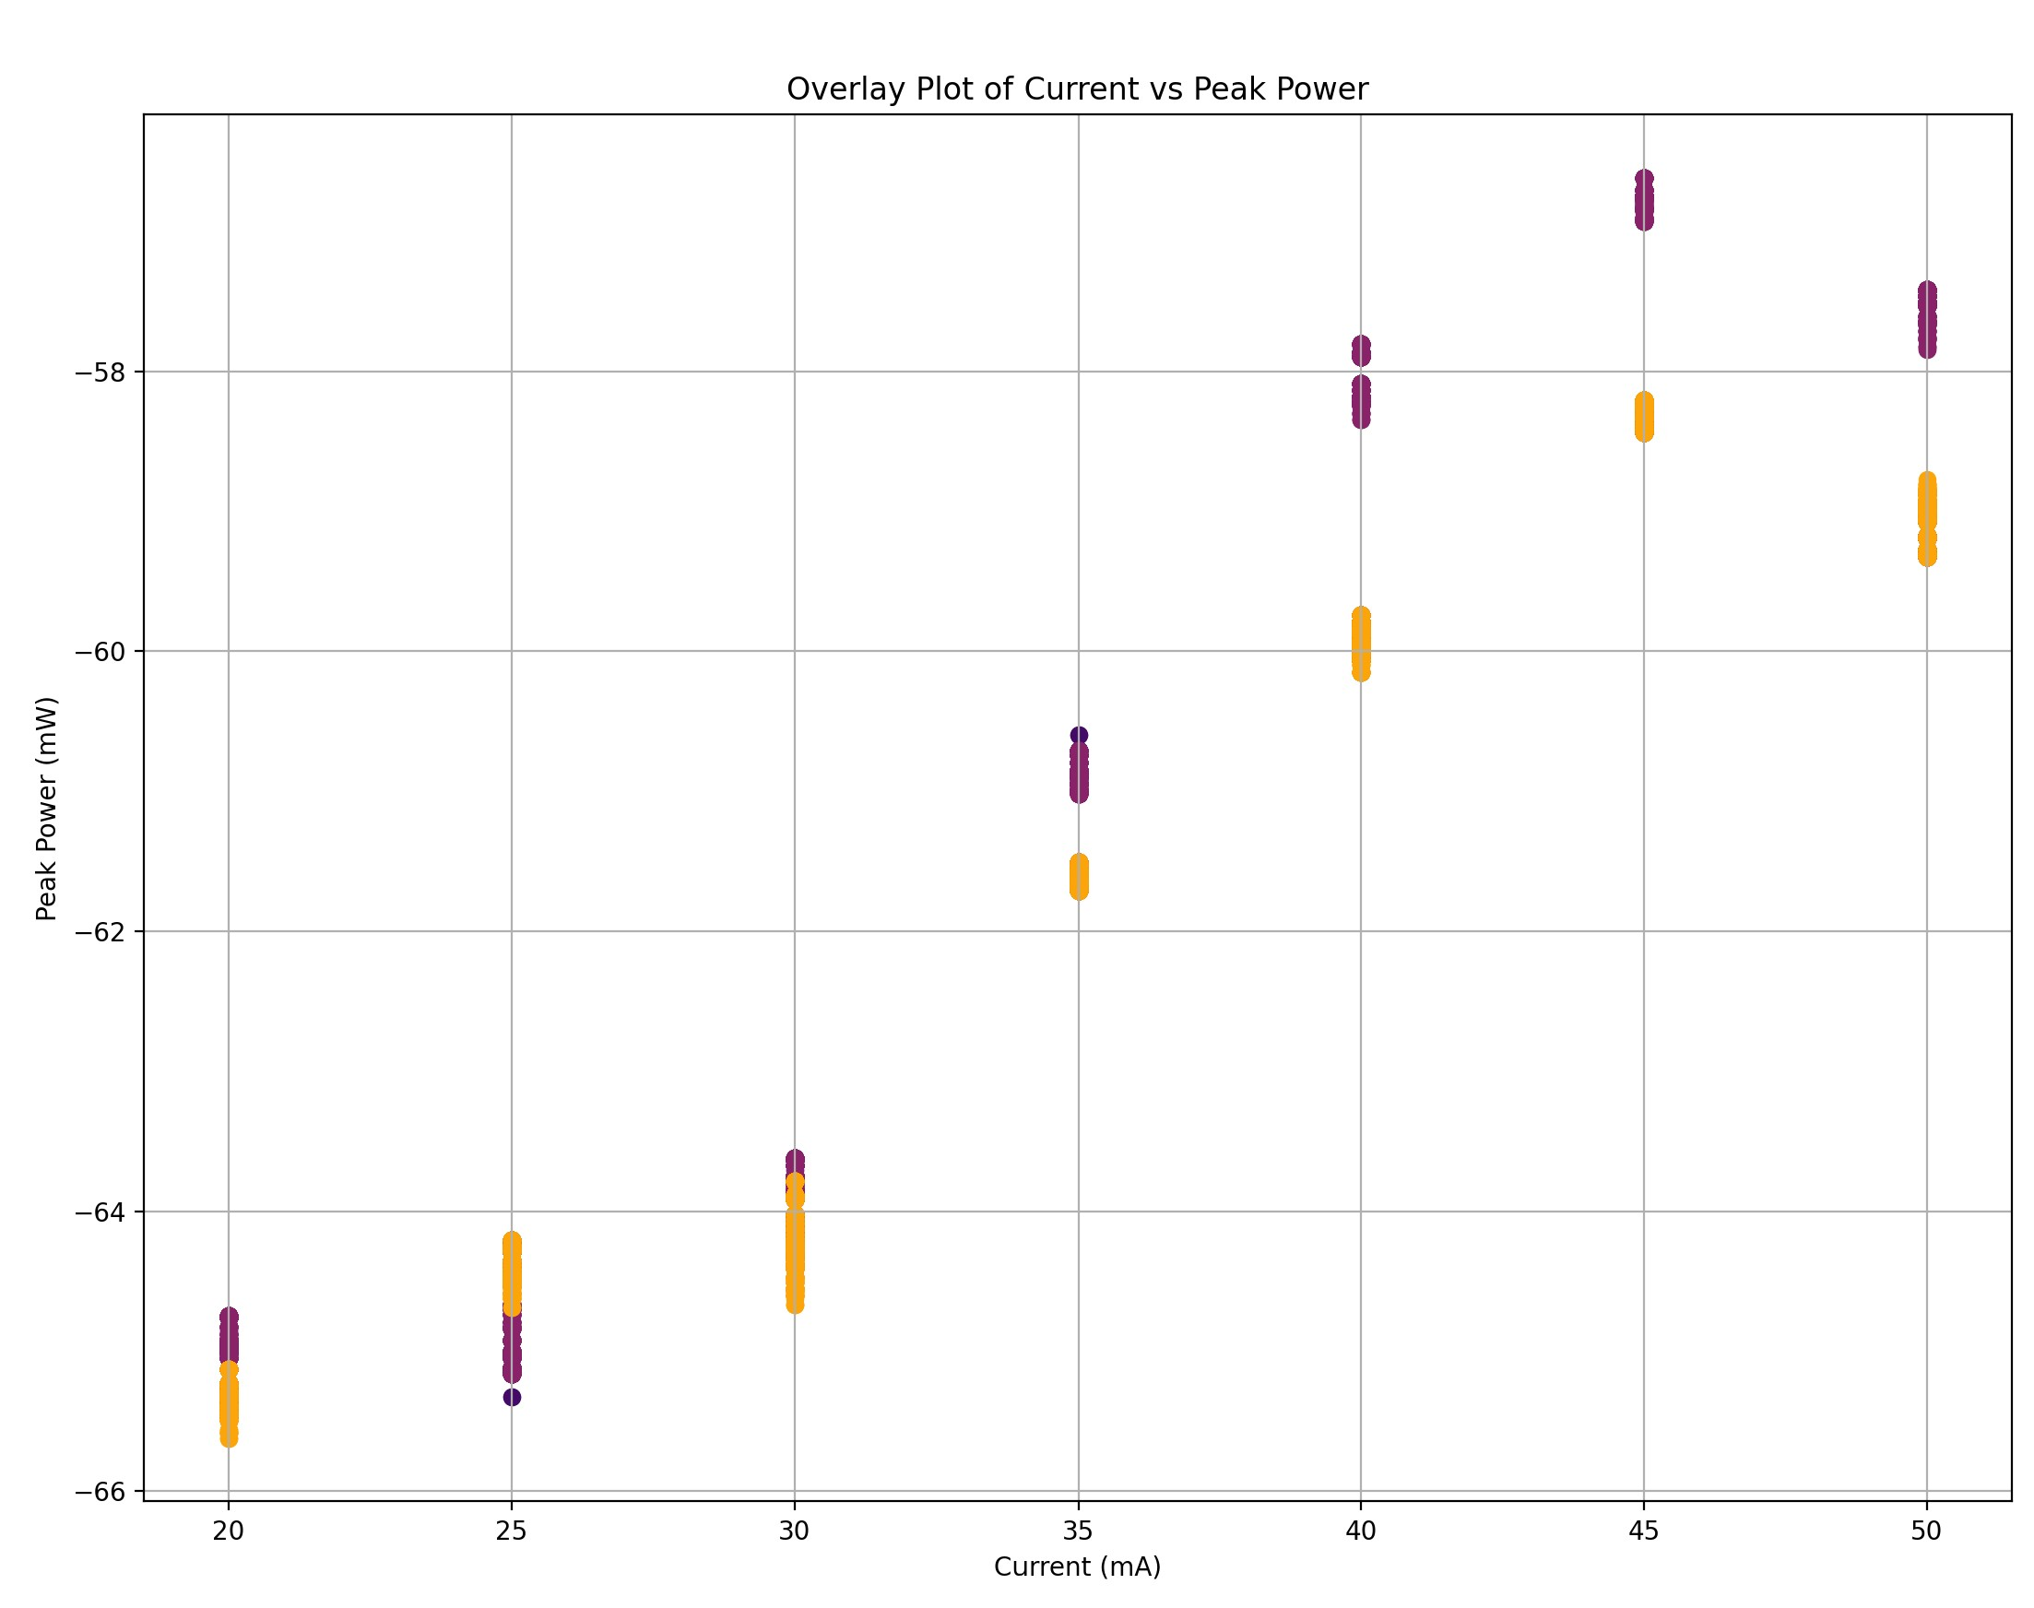
OSA Comparison

Slide 4
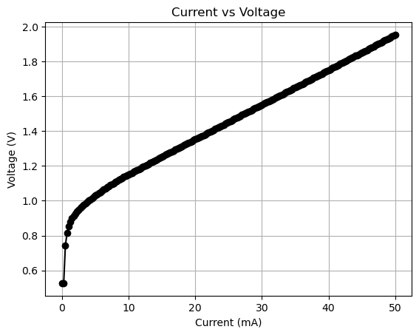
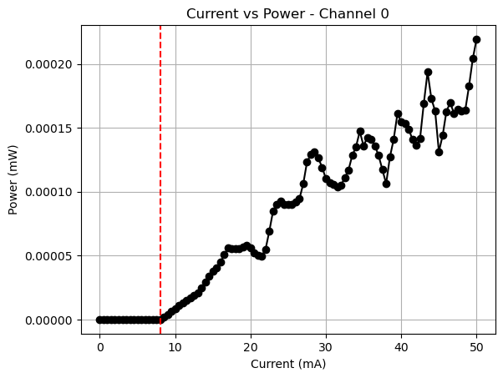
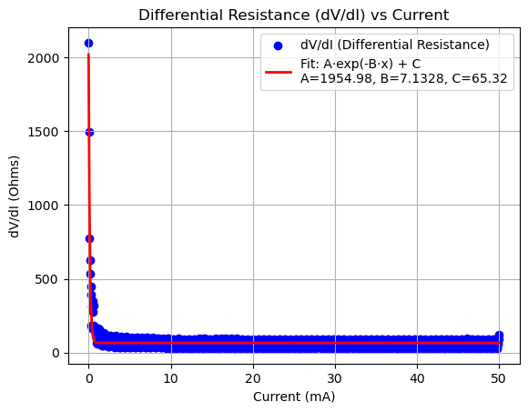
LIV
Data includes up to ten channels of optical power (mW) measurements, current (mA), voltage (V), and temperature (C). Files tagged “wlm” will also include useful wavelength (nm) measurements.
A threshold current is estimated for each channel and shown as a red dashed line on LI plots.
Differential resistance is computed from current and voltage gradients and plotted with a fit.

Slide 5
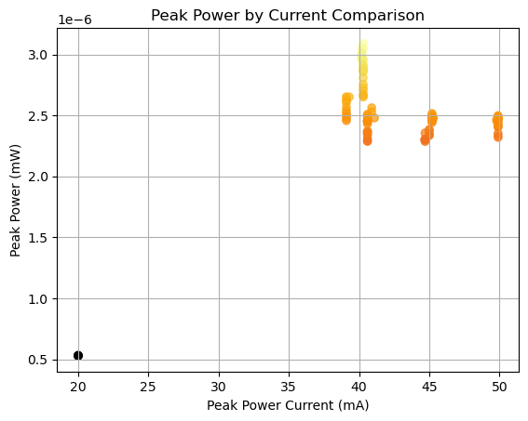
LIV Comparison
Threshold comparison plot in progress..

