Slide 1
Service-Oriented Architecture and Enterprise Service Bus
Rhiannon Kimberlin
WEB 420
11/29/2020

Slide 2
Agenda
What are Service-Oriented Architectures (SOA)?
What are Enterprise Service Buses (ESB)?
The relationship between SOA and ESB
How is data transmitted through a SOA environment?
Why Adopt SOA?
Disadvantages of SOA
How is Software deployed and managed?
How to scale a SOA environment

Slide 3
What are Service-Oriented Architectures?
Service-Oriented Architectures (SOA) is a style of software design where services are provided to other components by application components through communication protocol over a network. During the SOA process, services can communicate with each other one of two ways.
Through passing data
Two or more services coordinating an activity
There are three roles in SOA building blocks
Service Provider – why and how the services are being offered, and determines the service category, and if there need to be any trading agreements.
Service Broker – makes information regarding the service available to those requesting it.
The Service Requester – locates entries in the broker registry and then binds them to the Service Provider. They can also have access to multiple services.

Slide 4
How is data transmitted in SOA?
Typical SOA implementation – information moves between the layers
Enterprise Resource and Operational Systems Layer – Represents existing applications
Integration Layer – Various technologies are utilized to expose existing enterprise resources and operational systems so they can be used by business components.
Business Components Layer – Deployable units of software that provide functionality required by the business services.
Business Services Layer – High level business functionality throughout the enterprise. The layer bridges the “ideal” model and existing assets.
Business Processes Layer – Creation of business solutions through the Business Services Layer.
Customer Facing Layer – Customers can be humans using the we or clients, but this layer allows customers to view and control the execution of enterprise business processes/services.

Slide 5
Why Adopt SOA?
Increased speed – Change impact is able to be isolated while business processes are more easily modified.
Simplicity – Effective management of cooperation by simplifying access to services and value streamlined chains beyond organizational boundaries.
Efficient streamlining – This model reuses existing capacities and eliminates redundancies.
Optimal sharing – Implementation of reusable data exchange, as well as logic interoperability with multiple activities.
Transparency, security and resiliency – The infrastructure was built on performant standards, meaning consolidation, simplification and optimization of the IT infrastructure.

Slide 6
Disadvantages to SOA
Large upfront investment – Long term there are smaller costs associated once built and implemented, however implementation can be pricy.
Greater load and increased response time – Each interaction is followed by full validation, which results in a heavier load and longer response times.
Vast variety of services – With multiple services having to exchange messages while executing tasks, messages can become overwhelming while managing services.
Not every project can use SOA effectively – There are multiple applications that do not need SOA.
Stand alone, non distributed applications that do not need request/response based calls
Short lived applications or applications that are limited in scope
Homogenous application environments
Applications that need GUI based functionality

Slide 7
How is software in SOA is deployed and managed?
SOA composite applications can be deployed via Oracle Enterprise Manager Fusion Middleware Control Console with the Deploy SOA Composite wizard.
This is great for a new SOA composite application.
This can also manage existing deployed SOA composite applications.
Once the application is deployed, tasks can be performed.
Creating instances, configuring properties, monitoring performance, etc.

Slide 8
How to scale a SOA environment
Scalability Cube – This cube has three dimensions that can be thought of as the X, Y, and Z axis. When these axis are thought through and combined, the application will be built to be very scalable.
X-axis – Distribution of the same work or mirroring of data.
Y-axis – Distribution and separation of work responsibilities/data across multiple instances.
Z-axis – Distribution and segmentation of work by customer, customer need, location or value.
No one Axis can scale a SOA implementation alone. These axis are used to combine for the need of the application.
Architecting the SOA is important and can lead to scaling issues if done poorly.

Slide 9
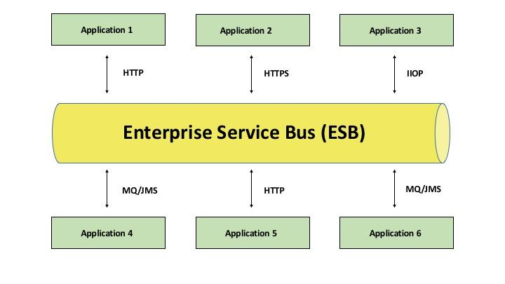
What are Enterprise Service Buses?
Enterprise Service Buses (ESB) are a type of architecture.
ESB is a middleware.
ESB is a set of rules and principles for integrating applications together over a bus-like infrastructure. Each application does not interact directly with one another, rather it interacts with the ‘bus’ that connects them.
This architecture type was born to move away from point-to-point integration which is hard to manage over time.
ESB increases organizational agility, scales well and can utilize existing systems while exposing them to new applications.

Slide 10
Relationship between SOA and ESB
SOA allows services to interact with one another, despite service type.
ESB is a way that allows services to speak with one another (through the ‘bus-like’ structure) in a SOA environment.
The bus-like structure acts as the communication center in the SOA. It ‘picks up’ information and ‘delivers’ it to it’s destination.
ESB is an essential component of SOA, but is also viewed as the bottleneck in SOA deployment.
This is caused by enhancements or changes to one integration which can destabilize other integrations.
SOA’s structure is what gave way to the building of ESB, to overcome it’s limitations.

Slide 11
Resources
Community, S. (2019, February 13). What Is Service-Oriented Architecture? Retrieved November 29, 2020, from https://medium.com/@SoftwareDevelopmentCommunity/what-is-service-oriented-architecture-fa894d11a7ec
Deploying SOA Applications. (n.d.). Retrieved November 29, 2020, from https://tekslate.com/deploying-soa-applications-3
Enterprise Service Bus (ESB). (n.d.). Retrieved November 29, 2020, from https://www.ibm.com/cloud/learn/esb
Exforsys. (n.d.). SOA Disadvantages: IT Training and Consulting. Retrieved November 29, 2020, from http://www.exforsys.com/tutorials/soa/soa-disadvantages.html
Lublinsky, B. (2006, November 22). Incorporating Enterprise Data into SOA. Retrieved November 29, 2020, from https://www.infoq.com/articles/SOA-enterprise-data/
Scaling SOA. (2020, September 21). Retrieved November 29, 2020, from https://doveltech.com/innovation/scaling-soa/
What is an ESB? (2017, July 18). Retrieved November 29, 2020, from https://www.it.ucla.edu/news/what-esb
What is an ESB? (n.d.). Retrieved November 29, 2020, from https://www.mulesoft.com/resources/esb/what-esb
What is SOA?: Uses & Need: Advantages And Disadvantages. (2020, August 01). Retrieved November 29, 2020, from https://www.educba.com/what-is-soa/

