Slide 1

SOAP Assignment 3.3
Rhiannon Kimberlin

Slide 2
What is SOAP
Stands for Simple Object Access Protocol.
SOAP is a lightweight, XML-based protocol for exchanging information in a decentralized, distributed environment.
When SOAP is combined with a transport protocol, such as HTTP it becomes the middle man for applications to publish database-backed Web Services.
SOAP has the following features
Protocol Independence
Language Independence
Platform and operating system independence

Slide 3
What is SOAP (continued)
SOAP is a no-state single-direction message exchange protocol.
SOAP contains the following aspects
Defines a format for the message being sent, as well as how to organize the information into a XML document.
Describes how to transfer the SOAP message via carriers (HTTP protocol and simple mail transfer protocol)
Defines a set of rules and classification of related entities, If the message cannot be parsed, it can assign a particular receiver and handle strategies.
Defines a group contract for calling and SOAP message exchanging.

Slide 4
SOAP Origins
SOAP began development in 1997. The goal was to enable applications to communicate via Remote Procedure Calls (RPCs) on top of HTTP.
Microsoft joined forces with DevelopMentor and Userland, however Userland dropped out and published their own form early on.
SOAP was officially published by W3C in 1999.
The initial creating of SOAP was entirely based upon HTTP protocol.
SOAP 1.1 began to support transport protocols.
The latest version of SOAP is 1.2 and was released in 2007.

Slide 5
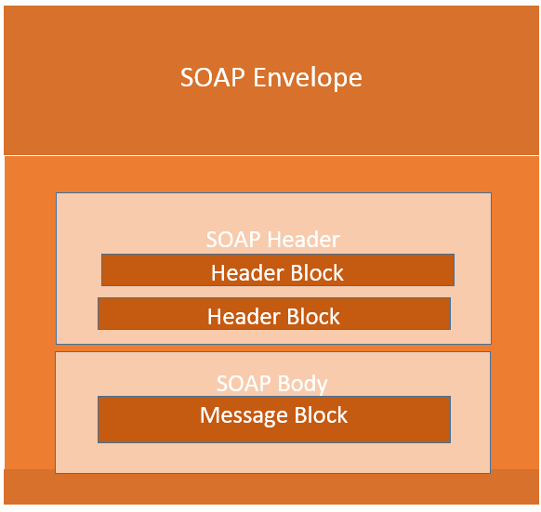
SOAP Envelopes
Envelopes are indicators for the start and end of a message that needs to be communicated.
Headers are optional in a SOAP envelope
If there is one, it becomes the first child element in the envelope.
It is mandatory that every Envelope contains a Body.
The Body contains XML data which is communicated via the internet.
As SOAP versions have evolved, the Envelope changes.

Slide 6
Headers
Header elements contain meta-information, transaction identifier, casualty identfiers or any other out-of-band information.
Intended to add new features or functionality and can be reused multiple times.
SOAP header contains header entries defined in a namespace.
If multiple headers are defined, all immediate child elements of the SOAP header are interpreted as SOAP Header Blocks.
There are two attributes SOAP Headers can have
Actor – There is a defined method of service nodes that process then forward the message to the next node. This is helpful when the recipient should be specified.
MustUnderstand – Indicates whether the Header element is option or mandatory. If this is true the recipient must understand and process the Header attribute according to its defined semantics, or return a fault.

Slide 7
Faults
When an error occurs during processing, a response is created to the SOAP message which is called a fault. The fault is sent back to the original sender.
Faults are pre-defined code and include a description and address of the SOAP processor that generated the fault.
SOAP messages can only carry one fault block. A fault is optional.
Sub Elements of Faults
<faultCode> | Text code utilized to indicate a class of errors.
<faultString> | Text message explaining the error
<faultActor> | Text string that indicates who caused the fault.
<detail> | An element used to carry application-specific error messages

Slide 8
Fault Codes
SOAP-ENV:VersionMismatch
Found an invalid namespace for the SOAP Envelope element
SOAP-ENV:MustUnderstand
An immediate child element in the Header element utilized the MustUnderstand attribute and was set to ‘1’ was not understood
SOAP-ENV:Client
The message was incorrectly formed or contained incorrect information
SOAP-ENV:Server
There was a problem with the server, therefore the message could not proceed.

Slide 9
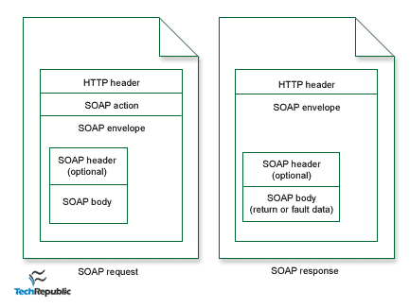
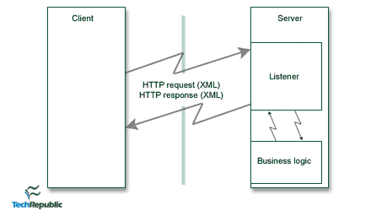
Data Flow of a SOAP API
Client wraps a method call in SOAP/XML, which is posted over HTTP to the Server.
That request is parsed to read method name, parameters passed and delegated for processing.
XML response is sent back to client containing the return value or fault data.
The client is then able to parse the response XML.
The server utilizes a “listener” to process SOAP requests.
The listener is a server code at the specified URL for parsing the XML request, making the procedure call and wrapping the result in XML to send as the response.

Slide 10
Why use SOAP APIs?
SOAP provides the following advantages compared to REST
Language, platform, and transport independent
Works well in distributed enterprise environments
Standardized
Provides significant pre-build extensibility in the form of WS* standards
Built-in error handling
Automation when used with certain language products

Slide 11
Appendix
1 Simple Object Access Protocol Overview. (n.d.). Retrieved November 01, 2020, from https://docs.oracle.com/cd/A97335_02/integrate.102/a90297/overview.htm
Contributor, G. (2001, April 02). An introduction to the Simple Object Access Protocol (SOAP). Retrieved November 01, 2020, from https://www.techrepublic.com/article/an-introduction-to-the-simple-object-access-protocol-soap/
Graham, S., Boubez, T., & Daniels, G. (2002, May 10). Building Web Services with Java: SOAP. Retrieved November 01, 2020, from https://www.informit.com/articles/article.aspx?p=26666
Simple Object Access Protocol. (n.d.). Retrieved November 01, 2020, from https://www.sciencedirect.com/topics/computer-science/simple-object-access-protocol
SOAP - Body. (n.d.). Retrieved November 01, 2020, from https://www.tutorialspoint.com/soap/soap_body.htm
SOAP - Fault. (n.d.). Retrieved November 01, 2020, from https://www.tutorialspoint.com/soap/soap_fault.htm
SOAP vs REST 101: Understand The Differences. (n.d.). Retrieved November 01, 2020, from https://www.soapui.org/learn/api/soap-vs-rest-api/
XML SOAP. (n.d.). Retrieved November 01, 2020, from https://www.w3schools.com/xml/xml_soap.asp

