Slide 1

The Technology Value Stream
Rhiannon Kimberlin
Bellevue University

Slide 2
What is the Technology Value Stream
Technology Value Stream is the process that is required to convert a business hypothesis into a technology-enabled service that delivers value to the customer.
The central concept to any type of value stream is value.
Value is any good, service or product delivered to a customer.
Customers do not know or care about the newest technologies available. The Value Stream focuses on providing the customer what the expect and pay for.
Due to this fact, the number of processes or activities should be evaluated to ensure value is created for the customer.
Value streams can be broken up into three parts:
Creation
Delivery
Capture

Slide 3
Lead Time Versus Processing Time
Lead Time - The amount of time that occurs between when a ticket is created, until the work is completed.
Lead Time interacts with business, as developers do not often engage until a while after the ticket is created.
Lead Time is more associated with the customer experience.
Process Time – The amount of time that occurs between when work is started, until work is completed.
Process Time interacts with the developers and their perspective.
The Proportion of process time to lead time is a measure of efficiency.

Slide 4
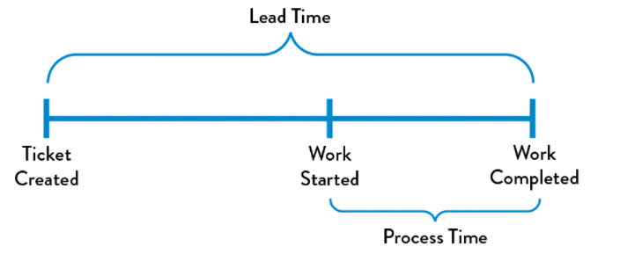
Difference Between Lead and Process Times

Slide 5
The Common Scenario: Deployment Lead Times Requiring Months
Deployment times typically take longer in large, complex environments.
Typically, the work is tightly-coupled, and uses monolithic applications.
Typically, there is less automation in scenarios where Lead Times take months.
Typically, there is rework to be done in situations where the Lead Time takes months, which can be costly.
Fixing problems can take longer because it is not always apparent where something “broke” and why.
Customer Experience is heavily impacted as they have to wait longer, for inferior product, creating low value.

Slide 6
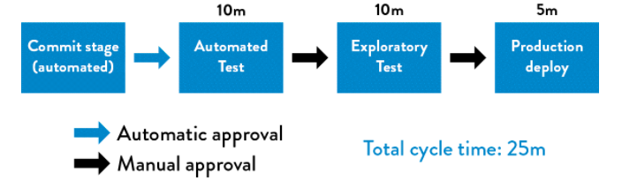
Our DevOps Ideal: Deployment Lead Times of Minutes
Ideally, to produce value we can have work done in minutes to hours, which is where DevOps comes into play.
DevOps supports writing and testing small patches of code to ensure confidence that problems will be quickly detected and fixed.
DevOps supports constant feedback.
The more people looking at a subject, the more likely they are to notice problems before they snowball.
To achieve this, typically it is better when architecture is modular, well encapsulated and loosely-coupled.
The value stream in DevOps looks as follows:

Slide 7
How to Deliver Value – DevOps Style
Making Work Visible – Visual workboards help to deliver an environment to show what everyone is working on, and where they are at in the process.
Limit Work In Process – By limiting multi-tasking, multiple teams have focus on one singular project and mission, which helps to deliver more value.
Reduce Batch Sizes – DevOps supports small code to be written and tested which helps support predictability.
Reduce the Number of Hand offs – Hand offs require communication, which if done too frequently takes time away from the Process Time.
Continually Identify and Elevate our Constraints – Work begins to bottleneck, this methodology may take several attempts to ensure inertia does not cause a constraint.
Eliminate Hardship and Waste – Only do the amount of work the customer is paying for.

Slide 8
How to Deliver Value – DevOps Style continued
Working safely within complex systems – Identify problems in complex systems to help overcome them and have plans in place if something should go wrong.
See Problems as They Occur – Do not let problems snowball. When a problem is identified, tackle it promptly.
Swarm and Solve Problems – As problems arise, get a team together to swarm the issue. The more people involved, the more likely the solution will be best solved.
Keep Pushing Quality Close to the Source – Do not give teams that are not associated with the work the approvals on what to do. Keep the work close to those doing it.
Enable Optimizing for Downstream Work Centers – The most important customer should be whoever is next downstream to ensure quality and value.
Feedback is valuable to quality, reliability and safety.

Slide 9
How to Deliver Value – DevOps Style continued
Enabling Organizational Learning and Safety Culture – Understand why a problem happened to best predict and stop it in the future.
Institutionalize the Improvement of Daily Work – Work Arounds should not be a part of the DevOps system. All staff should focus on how to get better in each of their processes daily to ensure success.
Transform Local Discoveries into Global Discoveries – Share best practices with the team and document work to ensure people can follow whats working well.
Inject Resilience Patterns into our Daily Work – High performers improve daily operation and seek to understand the building tension in effort to elevate performance.
Leaders Reinforce a Learning Culture – Leaders lead, however they are not who is closest to the work. They should create the correct conditions for employees to produce value, and be trained to allow future leaders to do the same,
By understanding why’s, problems can be solved in innovative ways.

Slide 10
The Ways
The First Way: The Principle of Flow
This Principle focuses on the downstream of work and how to prevent defects.
The Second Way: The Principle of Feedback
By obtaining more people to provide feedback, it helps reduce potential defects because the problems that would occur are already solved.
The Third Way: The Principle of Continual Learning and Experimentation
This principle focuses on finding the root of any issue in order to resolve it and to be innovative in ideas for solutions.

Slide 11
Types of Organizations
Pathological Organization
Characterized by fear and threat. Failure is covered up and information is not shared.
Bureaucratic Organization
Characterized by rules and processes. Failure is processed through the system set into place, such as discipline and justice.
Generative Organization
This is the Organization where DevOps can thrive.
Information is actively sought by the employees and shared freely, and failure is met with questions to understand what went wrong so it can be fixed.

Slide 12
Appendix
Kim, G., Debois, P., Willis, J., Humble, J., & Allspaw, J. (2017). The DevOps handbook: How to create world-class agility, reliability, and security in technology organizations. Portland, OR: IT Revolution Press, LLC.
Longest, D. (2020, November 12). Value Streams in Software: A Definition and Detailed Guide. Retrieved December 21, 2020, from https://www.plutora.com/blog/value-streams-in-software-guide

