Slide 1

Open Authentication (Oauth)
Rhiannon Kimberlin WEB-420 Bellevue University

Slide 2
What is OAuth
In the modern world, it is very popular to allow sites and services to connect via use of a password. Providing a password directly to someone else is a danger. OAuth is the answer for that danger.
OAuth is an open-standard authorization protocol or framework that provides the ability for secure designated access.
OAuth doesn’t provide your password to other sites and services.
Instead authorization tokens are generated as a secure identity.
OAuth does allow more security, but not through means of authentication. It uses authorization as a secure means to provide access.
OAuth does not allow full access or all data to a site once authorized.
OAuth is not an API service.

Slide 3
How does Oauth Work?
There are six central components in OAuth 2.0
Scopes and Consent
Actors
Clients
Tokens
Authorization Server
Flows

Slide 4
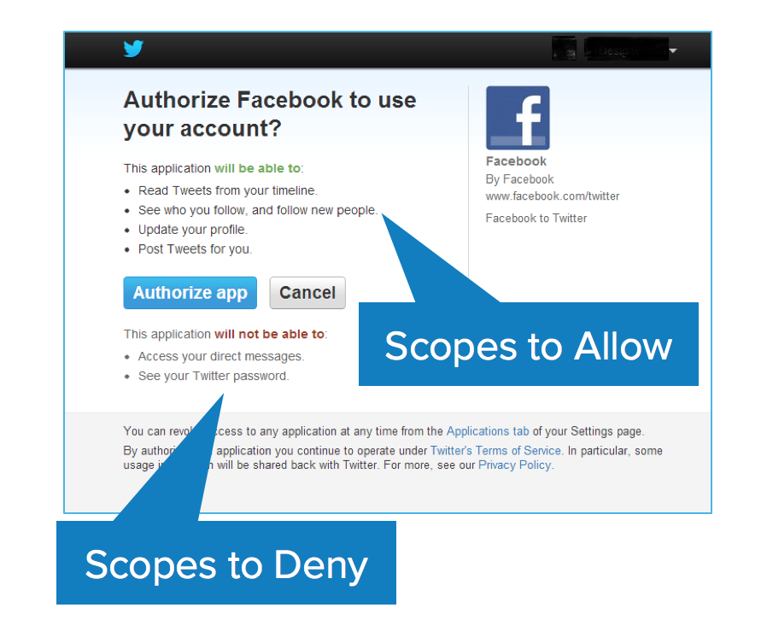
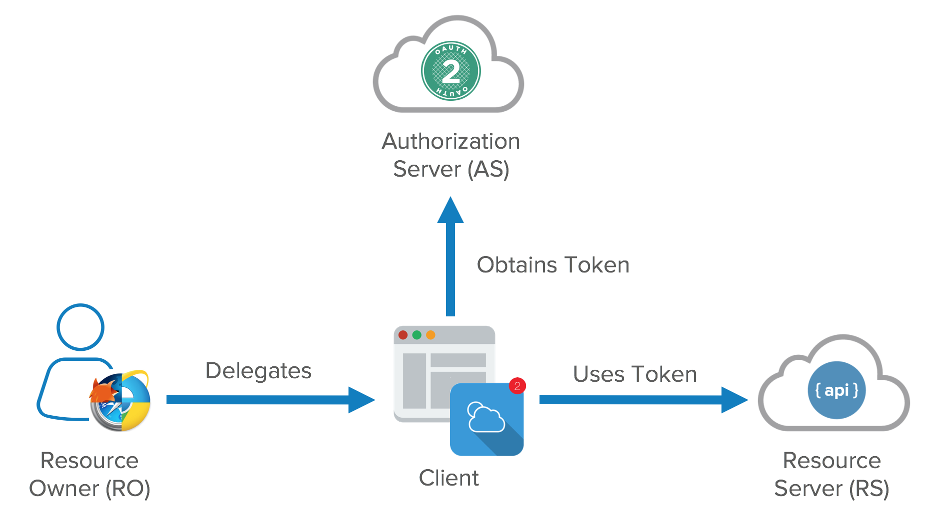
OAuth 2.0 Scopes, Consent & Actors
Scopes are the authorization screens where an app requests permissions.
Scopes are coded by the application developer.
Scopes define what actions an App is allowed to have if given permission. Consent must be gathered in this step.
There are four notable Actors in OAuth
Resource Owner
Resource Server
Client
Authorization Server

Slide 5
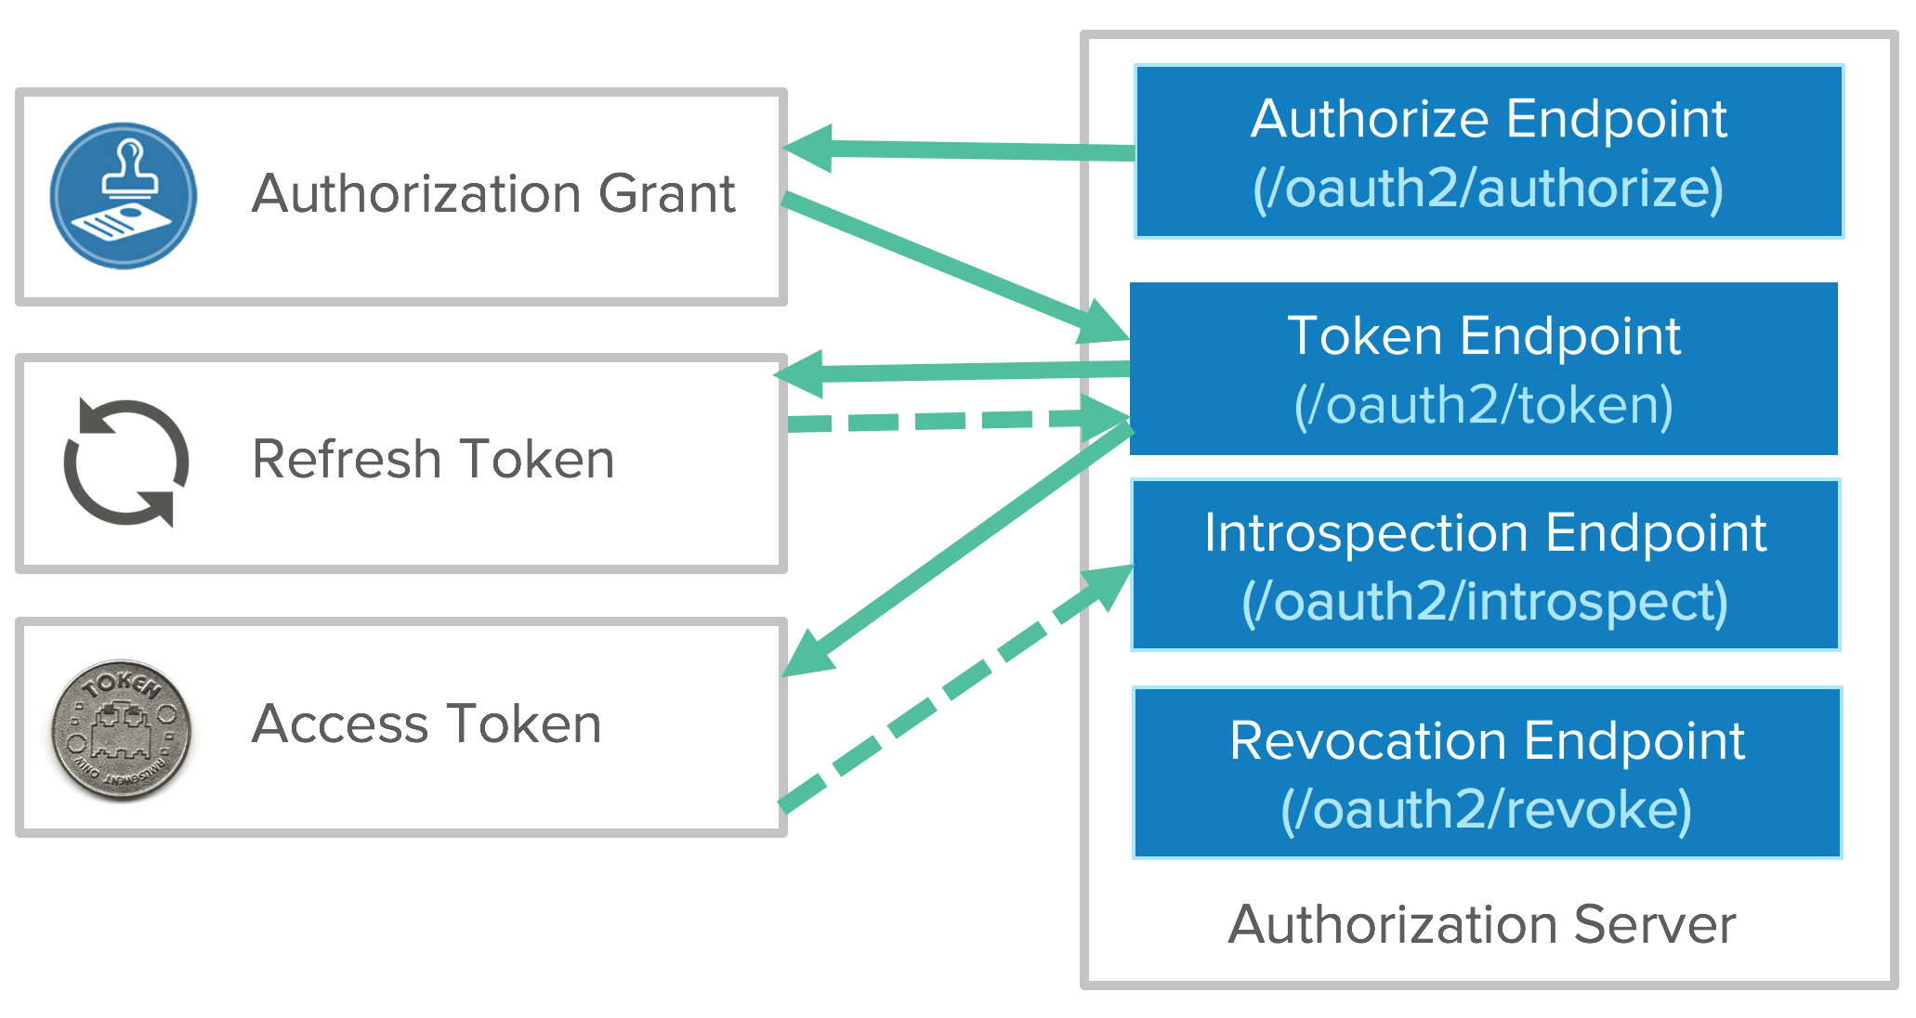
Oauth 2.0 Tokens & Authorization Server
Client uses this to access the Resource Server.
Tokens are short lived, except refresh tokens which can last from days to years.
Refresh Tokens are able to be revoked.
Tokens are retrieved from end points. In the past, they were encrypted at their end points but now are encrypted during transportation between endpoints.
Refresh tokens are harder to manage for developers, which is what makes the API keys so attractive.
API Keys are not as secure as OAuth.

Slide 6
OAuth 2.0 Flows
Implicit Flow – Communication happens through the browser with no back end server.
Can be called a 2 Legged OAuth.
More vulnerable to security threats
Authorization Code Flow – Uses both front channel and back channel for communication. Front end provides authorization and the back end uses the token.
This is generally the standard that most people use, but may not be optimal dependent on the Resource Owner and Public Owner.
Client Credential Flow – Server-to-Server Communication.
Client application acts on it’s own, not on the behalf of a user.

Slide 7
Six Simple steps in Oauth
Step 1: The User shows intent
User wants to give a site permission to do something for them
Step 2: The Consumer gets permission
The Consumer receives a token and a secret
Step 3: User is redirected to the Service Provider
It is important the User validates they have been redirected to the Service Provider. This is where hacking can happen.
Step 4: User gives permission
Now that the user knows it’s the service provider, they provide their username and password give permission to ‘what” the service provider can do.
Step 5: Consumer obtains an access token
Step 6: The consumer accesses the protected resource

Slide 8
History of OAuth
OAuth 1.0 was started around November 2006 while developing Twitter OpenID.
In July 2007 a team released an initial specification, which turned into OAuth Core 1.0 in October 2007.
Limitations in OAuth 1.0 became apparent over the years and underwent substantial revision.
OAuth 2.0 was released in 2012. It did not come without it’s own criticism.
While OAuth 2.0 is more widely used than 1.0, it has limitations of it’s own.
OAuth 2.0 is technically less secure and more complex.
OAuth 2.0 was designed to be more interoperable and flexible between sites and devices, as technology is rapidly advancing.

Slide 9
Differences between Oauth 1.0 & 2.0
OAuth 1.0 and 2.0 are very different from each other and not compatible.
OAuth 2.0 is faster and easier to implement.
OAuth 1.0 used complicated cryptographic requirements and did not scale.
OAuth 1.0 supported 3 flows. OAuth 2.0 has 6 flows.
OAuth 1.0 encrypted tokens on the end points.
OAuth 2.0 encrypts tokens via transit.

Slide 10
Why Oauth?
While there are limitations to OAuth, there is a balance between usability and security.
OAuth prevents hackers from screening passwords or even other sites from saving passwords and usernames that do not belong to them.
The additional layer of security does not interrupt the user experience, so most users do not even realize the extra protection.
Additionally, if a user should lose their mobile they can revoke all OAuth tokens stored on the lost device.
Users are given more control over what actions a third-party may take, such as posting, reviewing information or gaining access to things such as pictures.

Slide 11
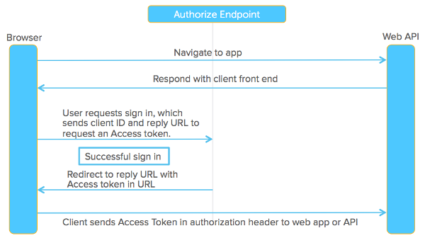
Data Flow of an Oauth API
Browser navigates to Web API
Web API responds with client front end and sends back to browser.
User sign in, which sends client ID and reply URL to request a token.
Upon successful sign in, URL will redirect Access token in URL.
Client sends access token in authorization header to web app or API.

Slide 12
Appendix
8/30/2018, R. (2018, August 31). What is OAuth? Definition and How it Works. Retrieved December 14, 2020, from https://www.varonis.com/blog/what-is-oauth/
Grimes, R. (2019, September 20). What is OAuth? How the open authorization framework works. Retrieved December 14, 2020, from https://www.csoonline.com/article/3216404/what-is-oauth-how-the-open-authorization-framework-works.html
Raible, M. (2017, June 21). What the Heck is OAuth? Retrieved December 14, 2020, from https://developer.okta.com/blog/2017/06/21/what-the-heck-is-oauth

