Slide 1
Microservices
Rhiannon Kimberlin
Bellevue University
WEB 420
Professor Krasso

Slide 2
What are Microservices?
Microservices are an architectural style that uses an application as a collection of multiple services.
These services are defined with the following traits:
Highly maintainable and testable
Loosely coupled
Independently deployable
Organized around business capabilities
Owned by a small team

Slide 3
What is an API gateway?
API gateway is an API management tool that sits between a client and a collection of backend services.
API gateways acts as a reverse proxy to accept API calls, aggregate the services required and return the appropriate result.
API gateways are generally used for common tasks such as user authentication, rate limiting and statistics.
Benefits to an API gateway
Understanding of how clients use your APIs with monitoring.
Clients can find all services even when API services are added or retired.
Authentication services and rate limiting protect APIs.

Slide 4
Advantages of Microservices
Multiple Components – Services can be deployed, tweaked, and redeployed independently, creating strong integrity to the application.
Built for Business – Microservices architecture encourages cross-functional teams versus previous monolithic approaches of the past.
Simple Routing – Microservices receive requests, process them and generate responses accordingly.
Decentralized – Elements are broken into even smaller elements. This makes it easy to change and deploy pieces.
Failure Resistant – If a service should go down, the client still utilizes the remaining services left to function. There are also monitoring microservices to watch and prevent risk of failure.
Evolutionary – Microservices allow potential for growth of new technologies and languages.

Slide 5
Disadvantages of Microservices
Communication between services – Due to multiple independent services, requests must be carefully handled while travelling between modules.
More services require more resources – Maintaining more databases or transactional management can be time consuming.
Global Testing is difficult – Each service must be confirmed before testing which can be time consuming.
Debugging problems – Each service will have logs to go through. This can be time consuming to review.
Deployment challenges – Multiple services must be coordinated which potentially could be complex.
Large versus small product companies – Large product companies do well with microservices but can be too complicated for small companies.

Slide 6
How are Microservices deployed in a production environment?
There are multiple ways to deploy Microservices.
Multiple Service Instances per Host Pattern – One or more physical or virtual hosts is provisioned then ran multiple services instances of each one.
Service Instance per Host Pattern – Each service is run in isolation on it’s own host.
Service Instance per Container Pattern – Service is packaged as a container image then deployed in containers.
Service Instance per Virtual Machine Pattern – Each service is packed as a virtual machine, then launched using Virtual Machine Image.
Serverless Deployment – Microservices are packaged as a ZIP file then uploaded to AWS Lambda.
When Microservices are deployed all at once, we run the risk of defects and errors. Small releases increase predictability.

Slide 7
How are Microservices managed in a production environment?
Tips to manage Microservices:
Keep It Simple – Kong Yang states, “If it works, don’t fix it. Let each Microservice do one thing, and do it terribly well.”
Put management plan into place early – This should be done before deployment and will help make microservices easy to continuously manage.
Orchestration – Each microservice needs to share if its not working, or getting overloaded so it can be quickly replace or replicated.
Develop a minimum set of operation capabilities – Microservices will need a way of telling when other services shut down and how to respond and scale to make up for it.
Continuous integration and continuous delivery – This practice helps to ensure microservices do not become overburdened with manual processes.
Investment – Continue to revisit and reinvest in operations.

Slide 8
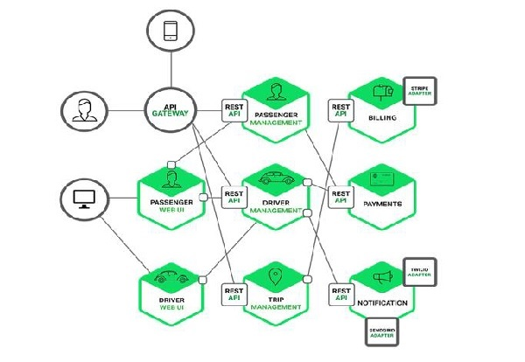
What is Scaling and how it pertains to Microservices
Scaling is the process of breaking down a software into different units which allows potential to implement more advanced features of the application.
Scaling improves security, durability and maintainability of the application.
Scaling Methodologies:
X-Axis Scaling (Horizontal Scaling) – A service can be expanded out. This is the same type of scaling that monolithic applications follow due to it’s ease and minimal time consumption.
Y-Axis Scaling (Vertical Scaling) – Users requests are redirected and restricted by use of logic. This helps ensure load balancing.
Z-Axis Scaling – Scaling at the business level (see attached diagram)

Slide 9
Scaling continued
Vertical scaling increases computing power with a more powerful computer (which can be costly).
Vertical Scaling can only go so far.
Horizontal scaling increases computing power with computers of equal power.
Large scale operations generally choose Horizontal versus Vertical scaling.
Horizontal scaling it not immediate and takes planning and preparation.
Adding servers is always a good way to handle increased traffic, but if the system is not balanced, users may see little to no improvement.

Slide 10
How are Microservices scaled?
Tips to effectively scale Microservices:
Implement Production development units – Set up teams and keep them focused on specific projects to avoid complications.
Encourage Ownership – Make the teams own the software. They should build, test, deploy and run it.
Determine Service Boundaries – It is wise to establish a hard boundary for microservices and be willing to change boundaries if they don’t work when tested.
Timing of service upgrades – Upgrading every service at once is unwise. Services should be upgraded in small manageable batches to ensure reduction of risk.
Embrace multiple ways of testing – More testing makes more dependable containers.
Security is priority – Improper security leads to costly issues.
Documentation – Proper documentation ensures scaling has best practices and intel to ensure services can be rapidly scaled.

Slide 11
Challenges of Scaling Microservices
Prior monolithic approaches do not work with scaling microservices. New approaches had to be created and taken to assist with microservices.
Monolithic approaches to scaling relied on a load balancer and copies of the application.
Microservices are complex. To overcome this, it’s best to visualize microservices as a network.
More microservices adds more complexity. This can cause defects to be hard to locate the origin.
It’s hard to establish baseline of normal activity for every service, however doing so will make it easier to understand how to scale properly.
While communication is a huge benefit to microservices, it can be difficult to create clear contracts of operation and responsibilities.

Slide 12
Resources
Beedgen, C. (2018, May 16). 7 secrets to scaling with microservices. Retrieved December 08, 2020, from https://www.infoworld.com/article/3271785/7-secrets-to-scaling-with-microservices.html
Bohorquez, N. (2018, May 02). The Complexity of Scaling a Microservices Architecture. Retrieved December 08, 2020, from https://thenewstack.io/the-complexity-of-scaling-a-microservices-architecture/
Casey, K. (n.d.). Microservices and containers: 6 management tips for the long haul. Retrieved December 08, 2020, from https://enterprisersproject.com/article/2017/10/microservices-and-containers-6-management-tips-long-haul
Eventuate, C. (2019, July 17). Deploying Microservices: Choosing a Strategy. Retrieved December 08, 2020, from https://www.nginx.com/blog/deploying-microservices/
Qian, A. (2020, May 21). Advantages and Disadvantages of Microservices Architecture. Retrieved December 08, 2020, from https://cloudacademy.com/blog/microservices-architecture-challenge-advantage-drawback/
Scaling Systems. (n.d.). Retrieved December 08, 2020, from https://science.jrank.org/computer-science/Scaling_Systems.html
What does an API gateway do? (n.d.). Retrieved December 08, 2020, from https://www.redhat.com/en/topics/api/what-does-an-api-gateway-do
What is Microservices? (n.d.). Retrieved December 08, 2020, from https://smartbear.com/solutions/microservices/

