Slide 1
CLIC SARGENT: WEB FORUM
Team 10

Slide 2
Our proposed solution
Our web application is targeted at young people with the age of 13 and 18
Being a young person is difficult enough without the added stress of living with cancer
They have questions, and lots of them!
About life in general, cancer and life with cancer
We wanted to provide them a platform for them to be able to ask questions and know that they would be able to speak to someone who understood what they were going through
Notes:
Speech notes: (feel free to improvise)
-The aim of our proposed solution was to target young teens between the ages of 13 and 18 years of age
-Having had a chance to speak to Michael Wilkinson later, we found out that amongst other things that this demographic often faces great difficulty in maintaining friendships due to cancer
-We wanted to provide them a platform for them to be able to ask questions and know that they would be able to speak to someone who understood what they were going through

Slide 3
Our Design
Our design had to be appropriate for the target audience and this has influenced our styling choices
We decided to implement a friendly interface that is easy to use and navigate with no problem
With the use of aesthetically pleasing icons and colours, our design attracts audiences from various ages

Slide 4
Future goals
Anonymous login that allows for the user to protect their information
Up-voting of posts and comments
Vlog page that links to YouTube playlists
Link to a closed Facebook group, to widen the community
Live chat to get in touch with support groups and professionals

Slide 5
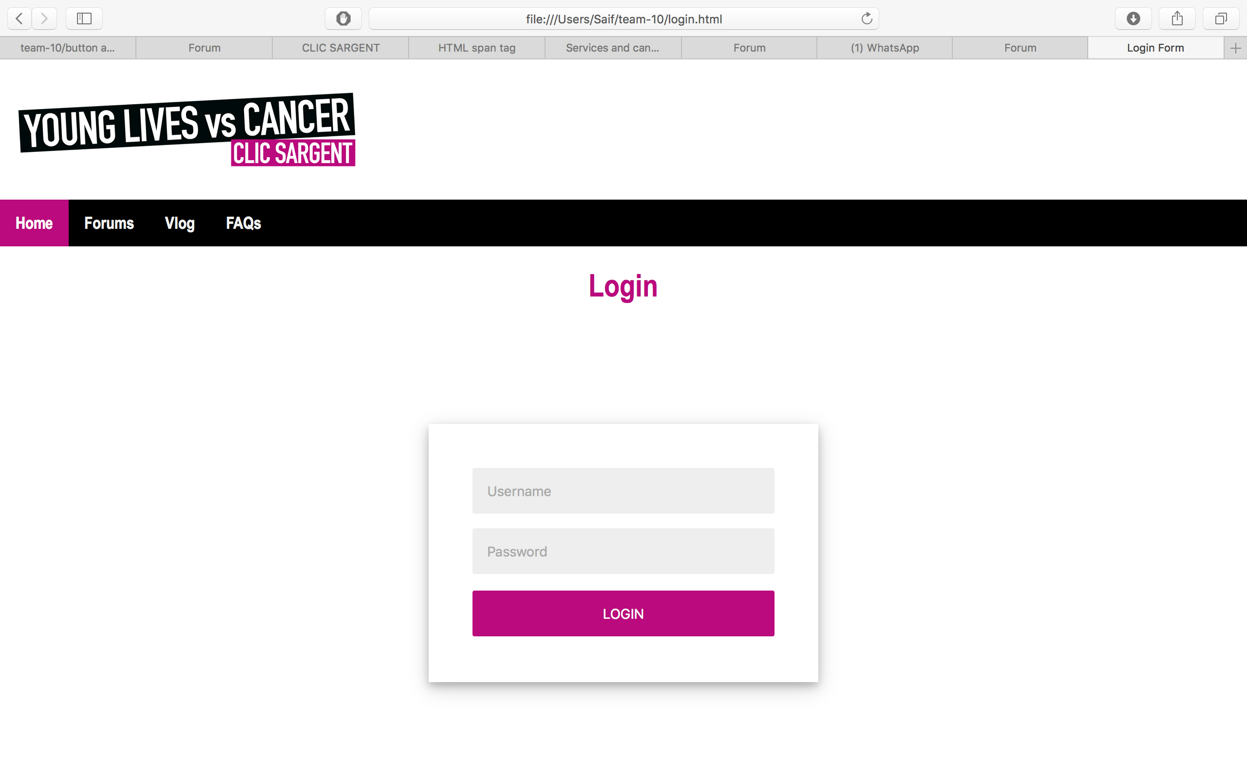

Slide 6
Thank you!
Any Questions?

