Slide 1


Automatic Accident Detection & Rescue Management System
Group Members
Abhishek Fartade 230340130001
Ankita Mishra 230340130009
Gaikwad Atul Jalindar 230340130019
JadhavAbhishek Devidas 230340130020
Riya Soni 230340130043
Guided By
Bhupendra Singh

Slide 2
Contents
Project Introduction
Objectives
Hardware & software used
Block Diagram
Flowchart
Observation
Output
Conclusion
Future Scope

Slide 3
Introduction
The constant improvement of technology leading to civilization in search of better prospects as expected an implosion of transportation system is observed that increment in number of vehicles on road result in increased chance of vehicular accidents . The accidents must be reported immediately in order to provide quick and proper medical assistance because there is also rise in unreported accidents.

Slide 4
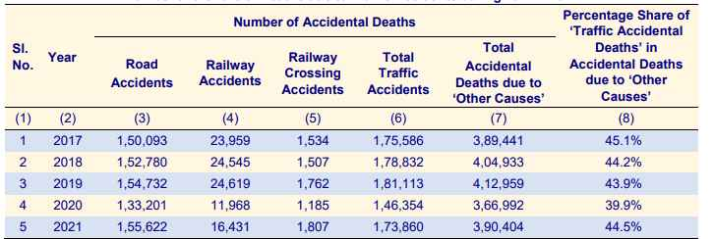

Slide 5
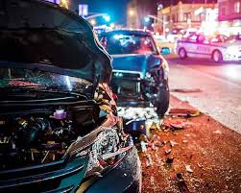
Objectives
Detection of Accident as quickly as possible.
Have minimum false detection.
Immediately messaging current location an call for help.

Slide 6
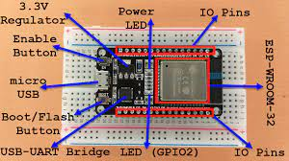
Hardware & Software used
Why ESP32 ?
ESP32 WROOM

Slide 7
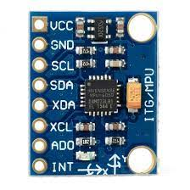
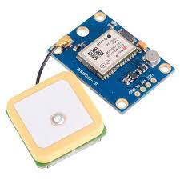
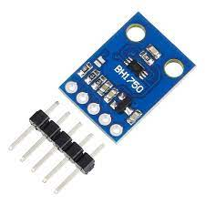
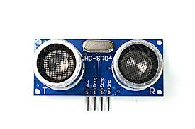
Components
1x ESP32-WROOM-32
1x MPU-6050
1x SIM900A
1x HCSR-04
1x BH1750

Slide 8
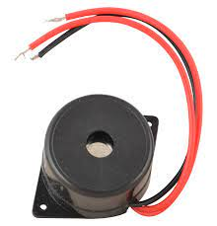

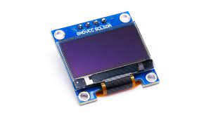
1x Buzzer
1x Display
1x Piezoelectric sensor

Slide 9
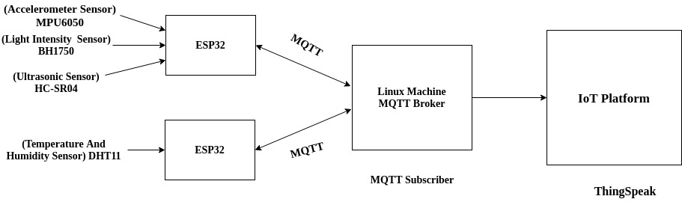
Block digram

Slide 10
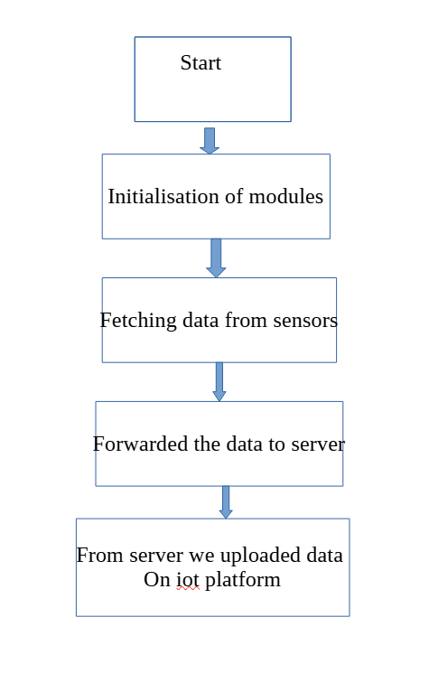
Flow chart

Slide 11

Softwares
IDE
- Aruino IDE
-Espressif IDE
Protocols
- MQTT
- UART
Operating system
- FreeRTOS

Slide 12

Output

Slide 13
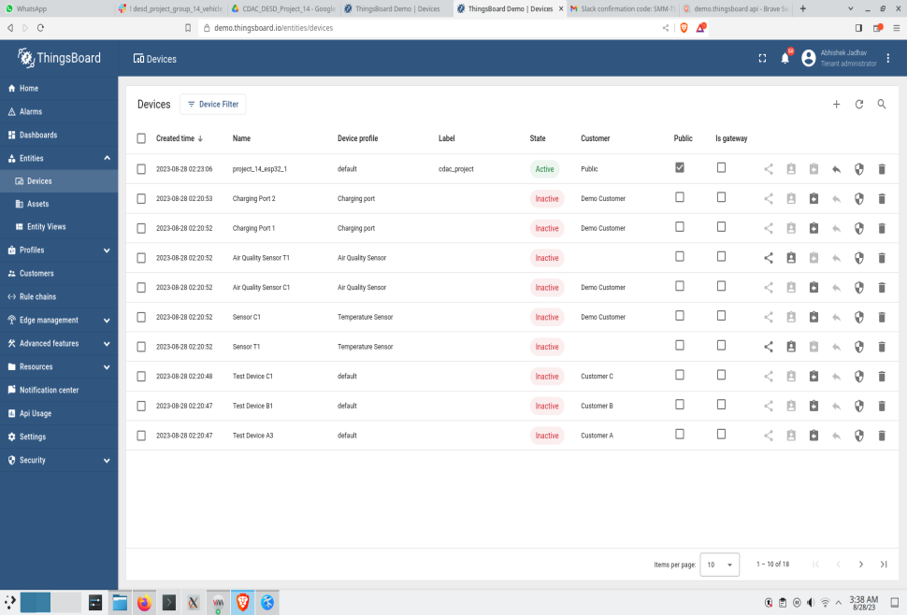
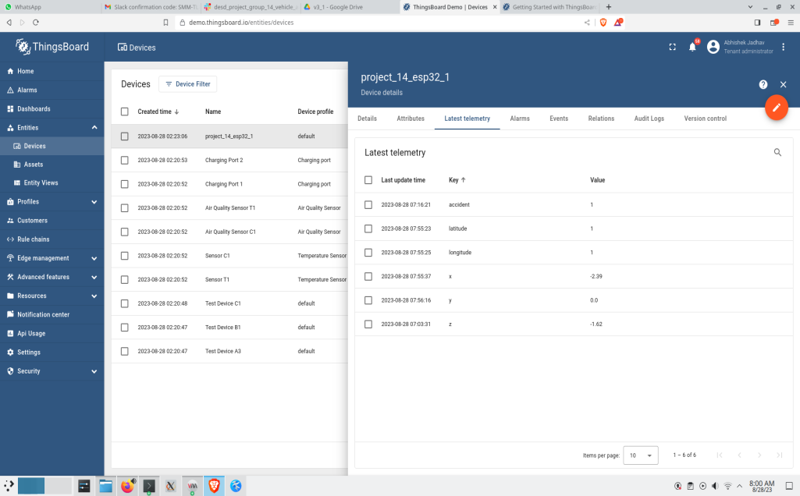

Output

Slide 14
Conclusion
Significant innovation in road safety and emergency response
The AADRMS's capabilities significantly reduce response times, potentially saving lives and minimizing injuries.
The AADRMS is a testament to our commitment to a safer future on the roads, where technology plays a pivotal role in safeguarding lives.

Slide 15
Future Scope
Incorporate machine learning algorithms to enhance the accuracy of accident detection by analyzing complex patterns from sensor data. This can improve the system's ability to differentiate between accidents and false positives.
Develop algorithms that use historical accident data and real-time conditions to predict accident-prone areas. This proactive approach can enable authorities to take preemptive measures.
Combine data from multiple sensors for more comprehensive accident detection. For instance, fusing accelerometer, GPS, and camera data can provide a holistic view of accidents.

Slide 16
Thank you !

