Slide 1
Observability

Slide 2
Agenda
Introduce the Challenge/Activity
Theory to support learning outcomes and the Activity
Initial demo of activity
Note: See chapter 1 and 2 from the text

Slide 3
The Challenge
Create a codespace from the github template and run:
ansible-playbook toaster.yml
Observe the running system and use the umlet vscode plugin to document it with a deployment diagram. Submit the deployment diagram with the uploader at the end of the presentation.

Slide 4
Unit Learning Objectives
Explain the advantages tracing has over plain logging for root cause analysis of an issue.
Consider metrics like utilization, saturation and errors for system health.
Give reasons for REDS/Google golden metrics being an improvement for understanding how happy users will be with a system.
Consider logs, log levels and log models as a way of understanding software issues.

Slide 5
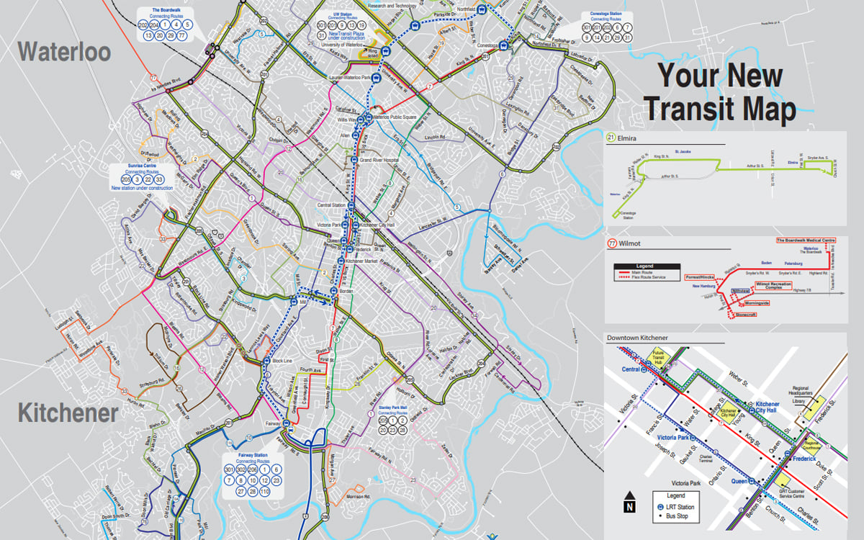
Who came by bus today?
GRT Map

Slide 6
Bus observers
Do they all observe the same things?
riders
municipality
the garage
drivers
staffing coordinators

