Slide 1
Monolith (instrumenting)

Slide 2
Agenda
Review database lab
Introduce the Challenge/Activity
Theory to support learning outcomes and the Activity
Initial demo of activity
Chapter 3 and 5 in the book

Slide 3
Otel Collector for Database (R)
queries: - sql: "SELECT sum(xact_commit+xact_rollback) as count_test FROM pg_stat_database; " metrics: - metric_name: query_requests # R from REDS value_column: count_test

Slide 4
Otel Collector for Database (E)
- sql: "SELECT sum(xact_rollback) as count_test FROM pg_stat_database; " metrics: - metric_name: query_errors # E from REDS value_column: count_test

Slide 5
Monolithic white box Challenge
Create a codespace from this github template.
Start with, “Create and launch an HTTP Server,” in the open telemetry python docs
When you are done submit the output from the docker-compose up window

Slide 6
Learning Outcomes
Support traces in a monolithic app by instrumenting so that code traces are available for troubleshooting.
Measure REDS metrics in monolithic app by adding and incrementing the appropriate counters.
Integrate language logs by turning them into open telemetry loggers.

Slide 7
Observability Pipelines
push data from a process to an instance of the OpenTelemetry Collector. Filtering, batching, and creating metric views are all accomplished at the Collector rather than in the process itself.
having said that the semantics of what we push are important
chapter 3 covers this in some depth

Slide 8
Pipeline Semantics
signals are logs, traces and metrics
add new signals like sessions in the Future
signals have attributes

Slide 9
Attributes (from the sqlquery)
- sql: "SELECT sum(xact_rollback) as count_test FROM pg_stat_database; " metrics: - metric_name: query_errors # E from REDS value_column: count_test
the value_column is count_test but other columns will be stored as attributes

Slide 10
Attributes (from today’s lab)
# Now create a counter instrument to make measurements with roll_counter = meter.create_counter( "dice.rolls", description="The number of rolls by roll value", ) roll_counter.add(1, {"roll.value": result})
roll.value is an attribute

Slide 11
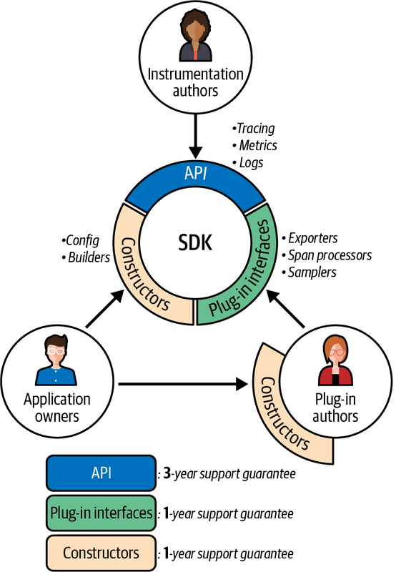
Future of Open Telemetry
OpenTelemetry’s long-term support guarantees

Slide 12
Foundation of OpenTelemetry is built on two points:
standards-based context and conventions,
alongside a universal data format.
the telemetry pipeline includes attributes that meet stakeholder needs for observability

Slide 13
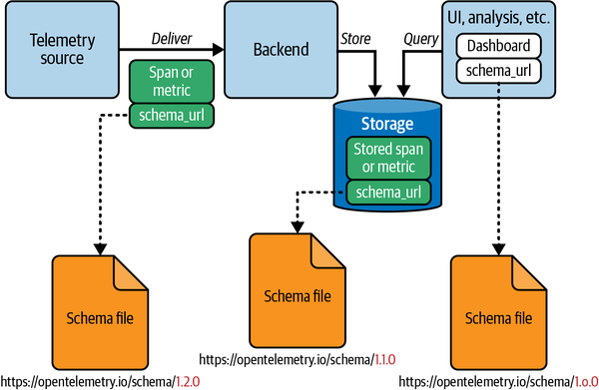
Telemetry Schemas
An example of a schema-aware telemetry system

Slide 14
Open Telemetry Collector
can provide schema transformations
support changes in semantic conventions (and their associated support in analysis tools)
without having to reinstrument or redefine output from existing services

Slide 15
setting up OpenTelemetry is twofold
installing the software development kit (SDK)
for python we do this with pip packages
installing instrumentation
some instrumentation is automatic with the SDK, some is custom

Slide 16
requirements.txt
opentelemetry-distro opentelemetry-exporter-otlp
then run opentelemetry-bootstrap -a install

Slide 17
logs
import logging logging.basicConfig(level=logging.INFO) logger = logging.getLogger(__name__) logger.warn("{} is rolling the dice: {}", "Rich", "6")
built in to python

Slide 18
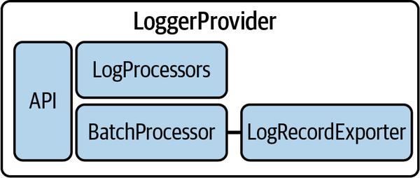
Logger Provider
The LoggerProvider framework

Slide 19
custom traces
from opentelemetry import trace # Acquire a tracer tracer = trace.get_tracer("diceroller.tracer") with tracer.start_as_current_span("roll") as rollspan: rollspan.set_attribute("roll.value", 6)

Slide 20
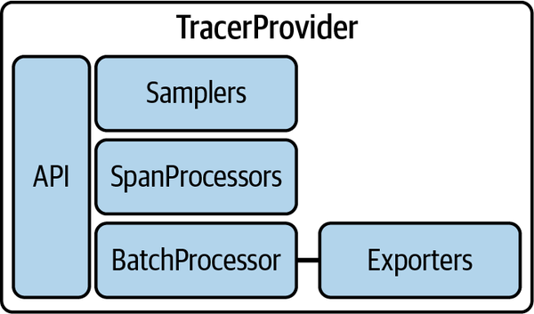
Tracer Provider
The TracerProvider framework

Slide 21
custom metrics
from opentelemetry import metrics meter = metrics.get_meter("diceroller.meter") # Now create a counter instrument to make measurements with roll_counter = meter.create_counter( "dice.rolls", description="The number of rolls by roll value", ) roll_counter.add(1, {"roll.value": "6"})

Slide 22
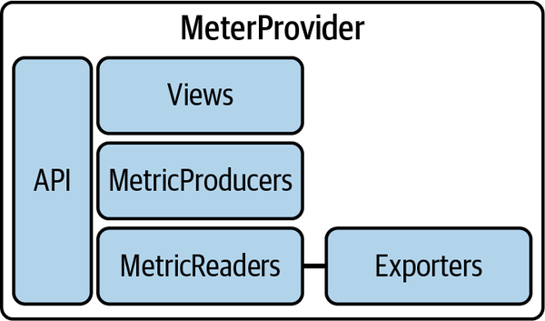
Meter Provider
The MeterProvider framework

Slide 23
Conclusion
work required to reinstrument a large system a form of vendor lock-in
advantage of OpenTelemetry is that once it’s done
OpenTelemetry is a standard that works with every observability system.

