Slide 1
Telemetry

Slide 2
Agenda
Review observability Challenge/Activity
Introduce the Challenge/Activity for telemetry
Theory to support telemetry learning outcomes and activity
Initial demo of activity
Note: See chapter 3 and 4 from the text

Slide 3
Observability (activity review)
We installed the kubernetes dashboard. From their github:
Kubernetes Dashboard is a general purpose, web-based UI for Kubernetes clusters. It allows users to manage applications running in the cluster and troubleshoot them, as well as manage the cluster itself.
essentially this was a “hello world” for a distributed system using kubernetes ansible and helm
a pod is the unit of deployment in our case … see the next slides

Slide 4
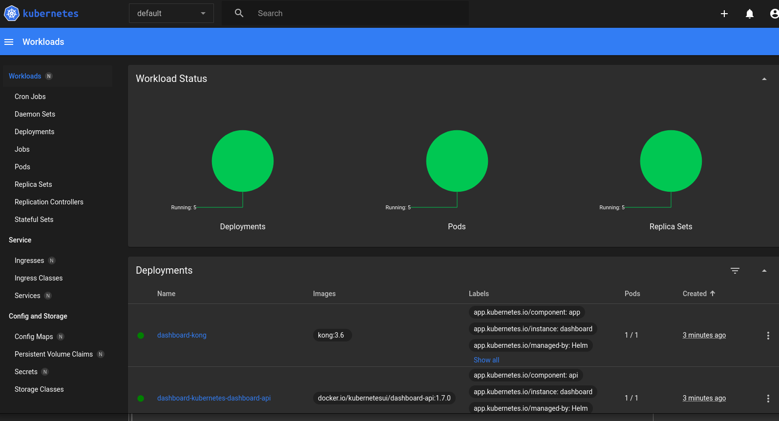
Kubernetes dashboard
kubernetes dashboard

Slide 5
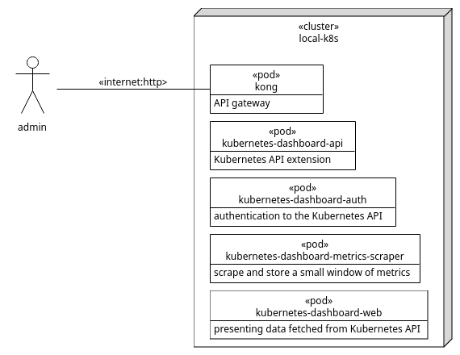
Deployment diagram
deployment diagram

Slide 6
Telemetry Lab
Create a codespace from the github template and run:
pip install -r requirements.txt ansible-playbook playbook.yml
Follow instructions in chapter 4 of the text and make notes in README.md. Submit the README.md file with the uploader at the end of the presentation.

