Slide 1
Telemetry

Slide 2
Agenda
Review observability Challenge/Activity
Introduce the Challenge/Activity for telemetry
Theory to support telemetry learning outcomes and activity
Initial demo of activity
Note: See chapter 3 and 4 from the text

Slide 3
Observability (activity review)
We installed the kubernetes dashboard. From their github:
Kubernetes Dashboard is a general purpose, web-based UI for Kubernetes clusters. It allows users to manage applications running in the cluster and troubleshoot them, as well as manage the cluster itself.
essentially this was a “hello world” for a distributed system using kubernetes ansible and helm
a pod is the unit of deployment in our case … see the next slides

Slide 4
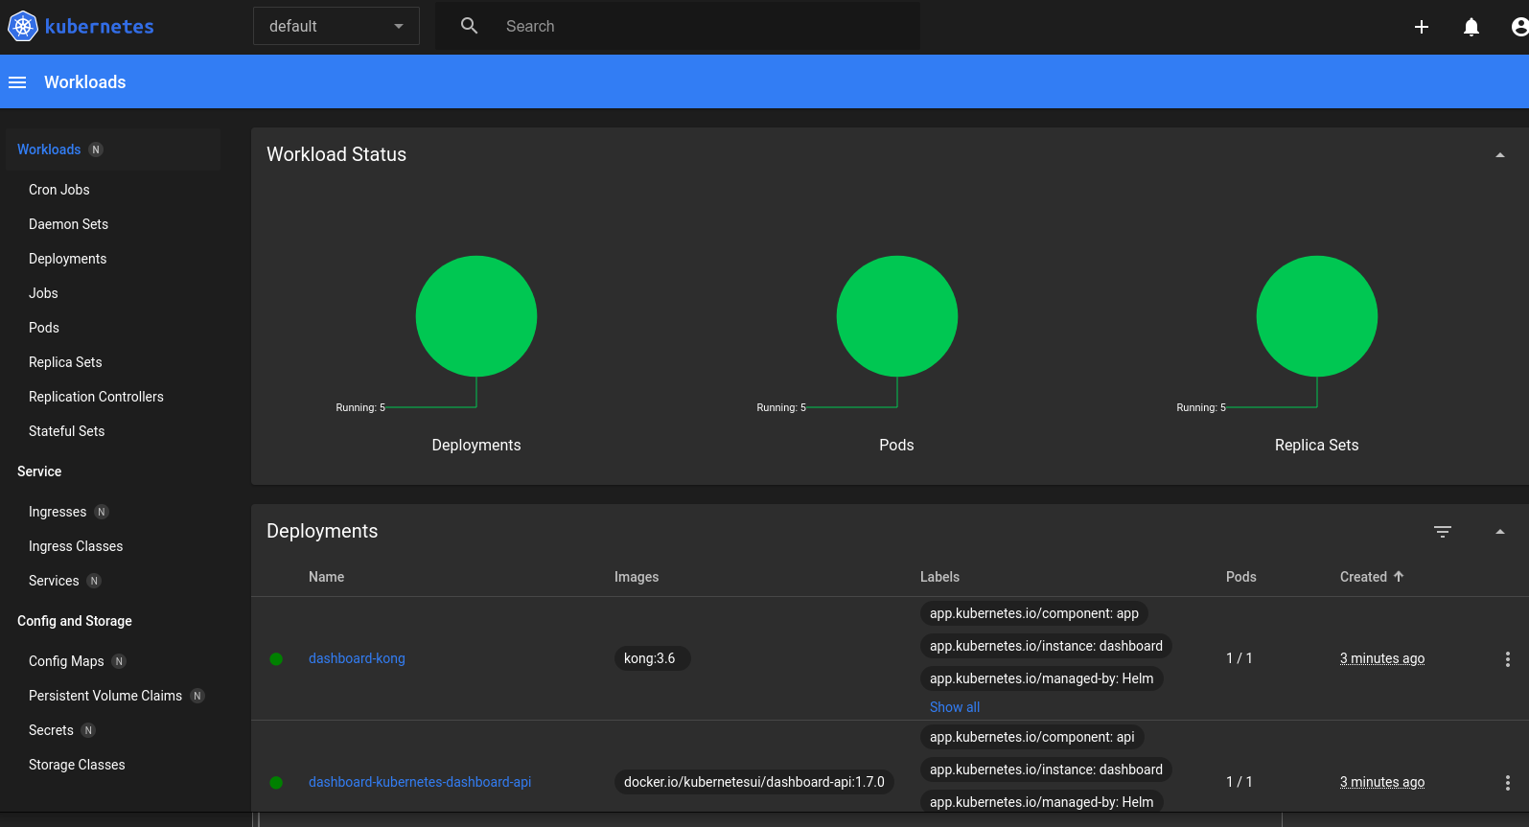
Kubernetes dashboard
kubernetes dashboard

Slide 5
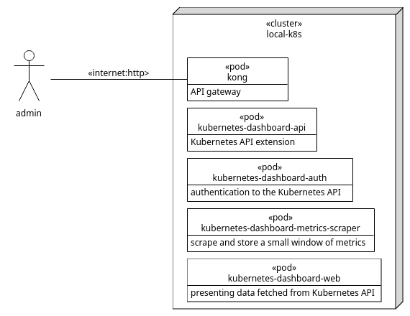
Deployment diagram
deployment diagram

Slide 6
Telemetry Lab
Create a codespace from the github template and run:
pip install -r requirements.txt ansible-playbook playbook.yml
Follow instructions in chapter 4 of the text and make notes in README.md. Submit the README.md file with the uploader at the end of the presentation.

Slide 7
Learning outcomes
Explain how historical applications of telemetry for things like predictive maintenance apply to software.
Compare alternatives for software telemetry within the observability ecosystem.
Justify the storage needs for telemetry, based on information needs for operational success.
Validate and configure collectors to collect logs and/or metrics for observability and troubleshooting.

Slide 8
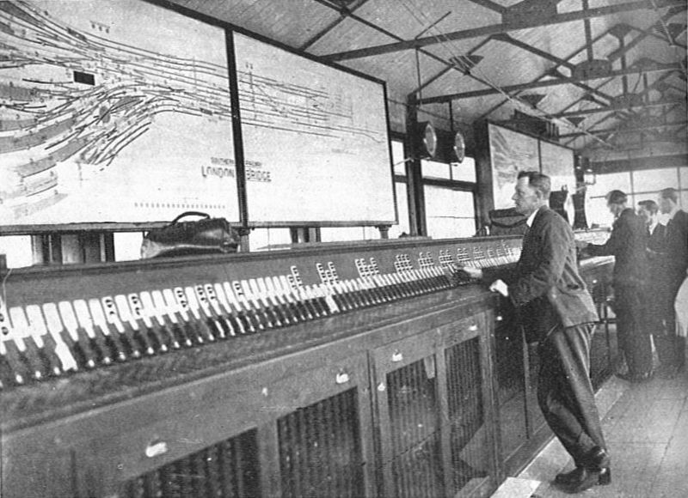
A Brief History of Telemetry
Southern Railway, 1928

Slide 9
“Telemetry” sent over telegraph lines
used to control switches on train tracks, power plants and public power grids
early but important distributed systems!
moved onto trains to prevent bearing overheating and fires
further expanded to predictive maintenance to keep broken trains from blocking the tracks
logging esentially built into Unix software with system activity reporting and system logging service

Slide 10
computer telemetry on network
first logs … to tell you about individual events and moments within a system
metrics … to see how system performance changes over time
then tracing … look at entire operations and how they combined to form transactions

Slide 11
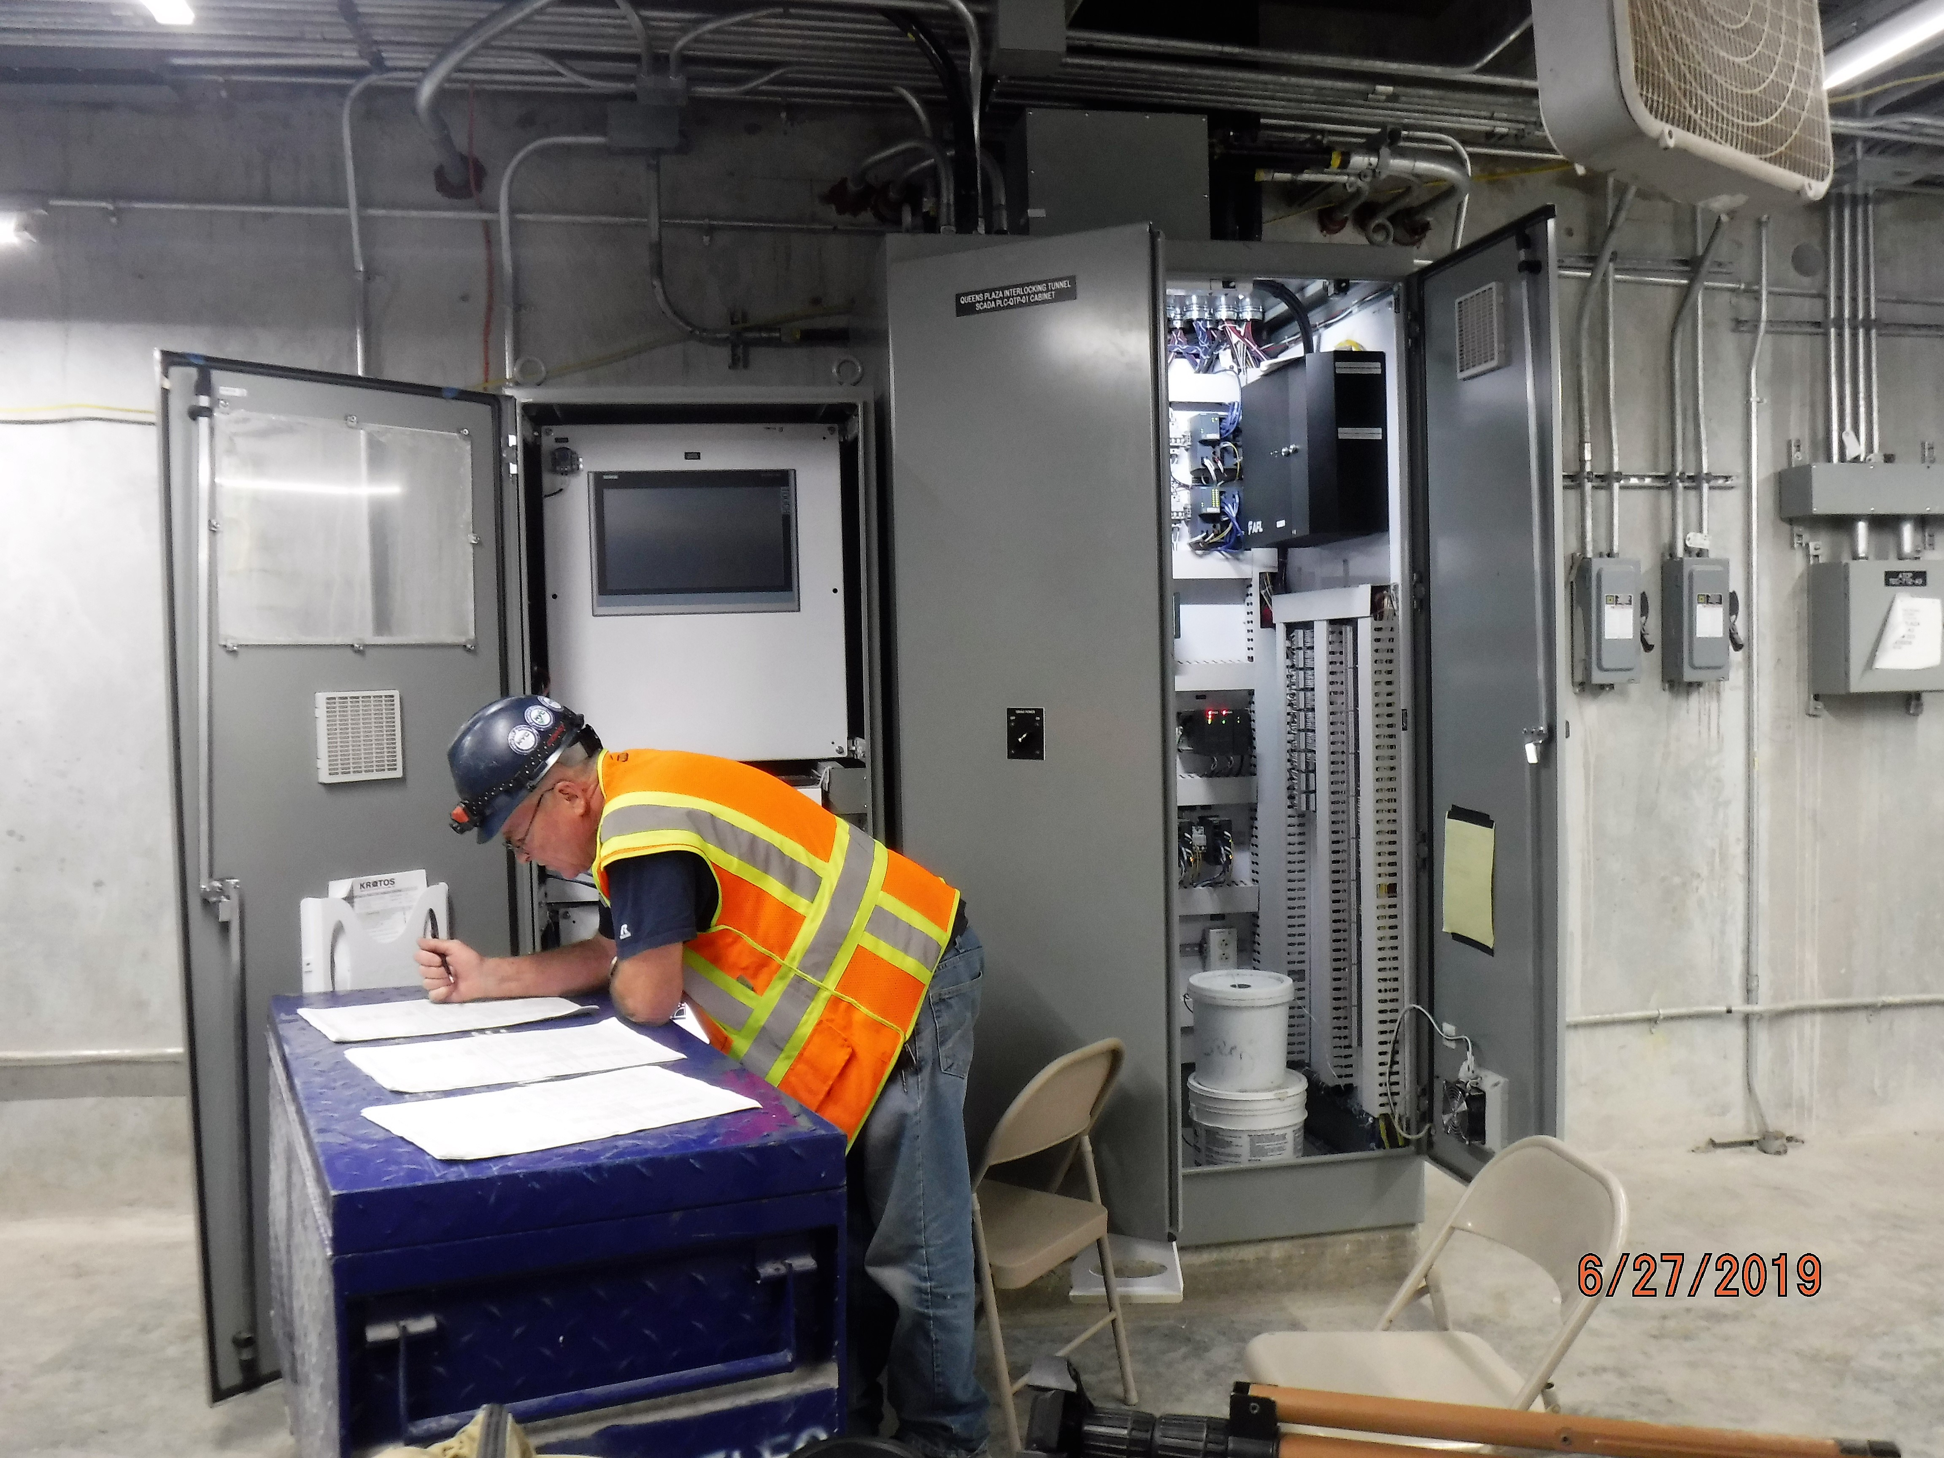
SCADA
MTA Capital Construction Mega Projects, CC BY 2.0 https://creativecommons.org/licenses/by/2.0, via Wikimedia Commons

Slide 12
Uses
Industrial include manufacturing, process control, power generation, fabrication, and refining
Infrastructure … include water treatment and distribution, wastewater collection and treatment, oil and gas pipelines, electric power transmission, and wind farms.
Facility , including buildings, airports, ships, and space stations … monitor and control heating, ventilation, and air conditioning systems (HVAC), access, and energy consumption.

Slide 13
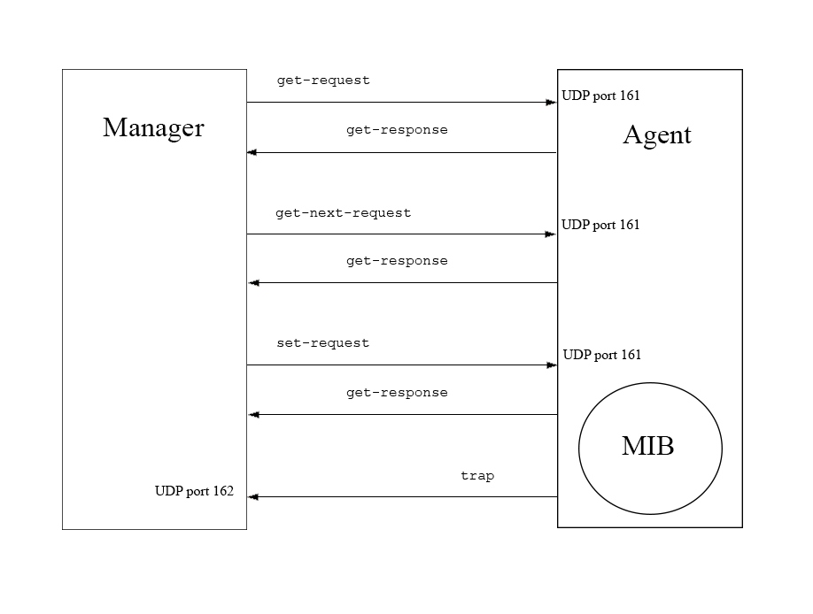
SNMP
An.bellizzi, CC BY-SA 4.0 https://creativecommons.org/licenses/by-sa/4.0, via Wikimedia Commons

Slide 14
consists of three key components
Managed devices
Agent - software that runs on managed devices
Network management station (NMS) - software that runs on the manager
Uses
SNMP used by IT to monitor and update networked devices
SCADA used by operations to control processes

Slide 15
Open Telemetry
used to monitor distributed software systems
similar to SCADA and SNMP in that it monitors and generates alerts
different in that it is read only, where SCADA and SNMP can also manipulate systems
tracing, look at entire operations as they span services
absence of auditable tracking in SCADA … opportunity for DevOps??????

Slide 16
Time Series Database (TSDB) Storage
need to store enough history to meet stakeholder needs
Thanos provides a global query view, high availability, data backup with historical, cheap data access as its core features in a single binary.
Thanos supports S3, GCS, Azure, OpenStack Swift, Tencent COS, AliYun OSS, Baidu BOS, Oracle Cloud Infrastructure Object Storage object stores
storage format is object based with a block defined by a prefix and a series of blobs

Slide 17
Storage Configuration
focusing on Thanos, there is documentation here.
the storage is controlled by the values.yaml file in the helm chart
in open telemetry demo for today’s lab the helm chart is here.
there is a lot to these values, but focus on the components (starting on line 47)

Slide 18
Otel collectors
each component has an otel collector to make it observable
for instance the emailService has:
- name: OTEL_EXPORTER_OTLP_TRACES_ENDPOINT value: http://$(OTEL_COLLECTOR_NAME):4318/v1/traces
many more examples to follow when we talk about instrumenting

Slide 19
Manual testing for observability
the lab uses feature flags, described in chapter 4, to manipulate the open telemetry demo
note your observations in the README file and submit it below

Slide 20
Telemetry
Without telemetry, your system is just a big black box filled with mystery.
this is especially a problem with distributed systems
part of the system runs on a sensor, appliance or even a phone
telemetry lets operators and other stakeholders see inside the box and help the system reach it’s goals.

