Slide 1
Monolith (instrumenting)

Slide 2
Agenda
Review database lab
Introduce the Challenge/Activity
Theory to support learning outcomes and the Activity
Initial demo of activity
Chapter 3 and 5 in the book

Slide 3
Otel Collector for Database (R)
queries: - sql: "SELECT sum(xact_commit+xact_rollback) as count_test FROM pg_stat_database; " metrics: - metric_name: query_requests # R from REDS value_column: count_test

Slide 4
Otel Collector for Database (E)
- sql: "SELECT sum(xact_rollback) as count_test FROM pg_stat_database; " metrics: - metric_name: query_errors # E from REDS value_column: count_test

Slide 5
Monolithic white box Challenge
Create a codespace from this github template.
Start with, “Create and launch an HTTP Server,” in the open telemetry python docs
When you are done submit the output from the docker-compose up window

Slide 6
Learning Outcomes
Support traces in a monolithic app by instrumenting so that code traces are available for troubleshooting.
Measure REDS metrics in monolithic app by adding and incrementing the appropriate counters.
Integrate language logs by turning them into open telemetry loggers.

Slide 7
Observability Pipelines
push data from a process to an instance of the OpenTelemetry Collector. Filtering, batching, and creating metric views are all accomplished at the Collector rather than in the process itself.
having said that the semantics of what we push are important
chapter 3 covers this in some depth

Slide 8
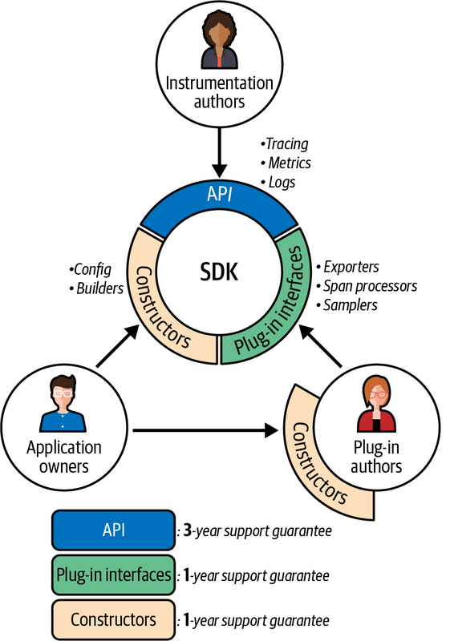
Pipeline Semantics
OpenTelemetry’s long-term support guarantees

Slide 9
Foundation of OpenTelemetry is built on two points:
standards-based context and conventions,
alongside a universal data format.
the telemetry pipeline includes attributes that meet stakeholder needs for observability

Slide 10
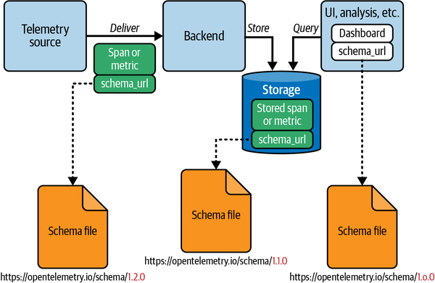
Telemetry Schemas
An example of a schema-aware telemetry system

Slide 11
Open Telemetry Collector
can provide schema transformations
support changes in semantic conventions (and their associated support in analysis tools)
without having to reinstrument or redefine output from existing services

