Slide 1
Microservice (analysis)

Slide 2
Agenda
Introduce the Challenge/Activity
Theory to support learning outcomes and the Activity
Initial demo of activity

Slide 3
Microservice white box Challenge
Create a codespace from this github template.
follow the instructions in the README.md
make sure to add metrics and a dashboard

Slide 4
First things First
I should have covered long ago
logger.info(f"{__name__} started")
This produces a log line, main started. Very important for preserving your sanity on what you are looking at.

Slide 5
Then add the commit hash
or other version information in the startup
OTEL_RESOURCE_ATTRIBUTES=service.name=fastapiApp,service.version=<commit hash>
saves sanity when degugging

Slide 6
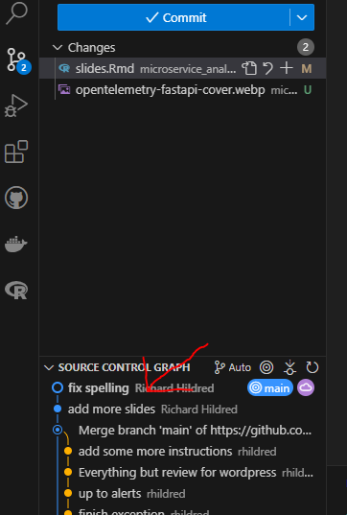
Get the commit hash by right clicking
Commit Hash

Slide 7
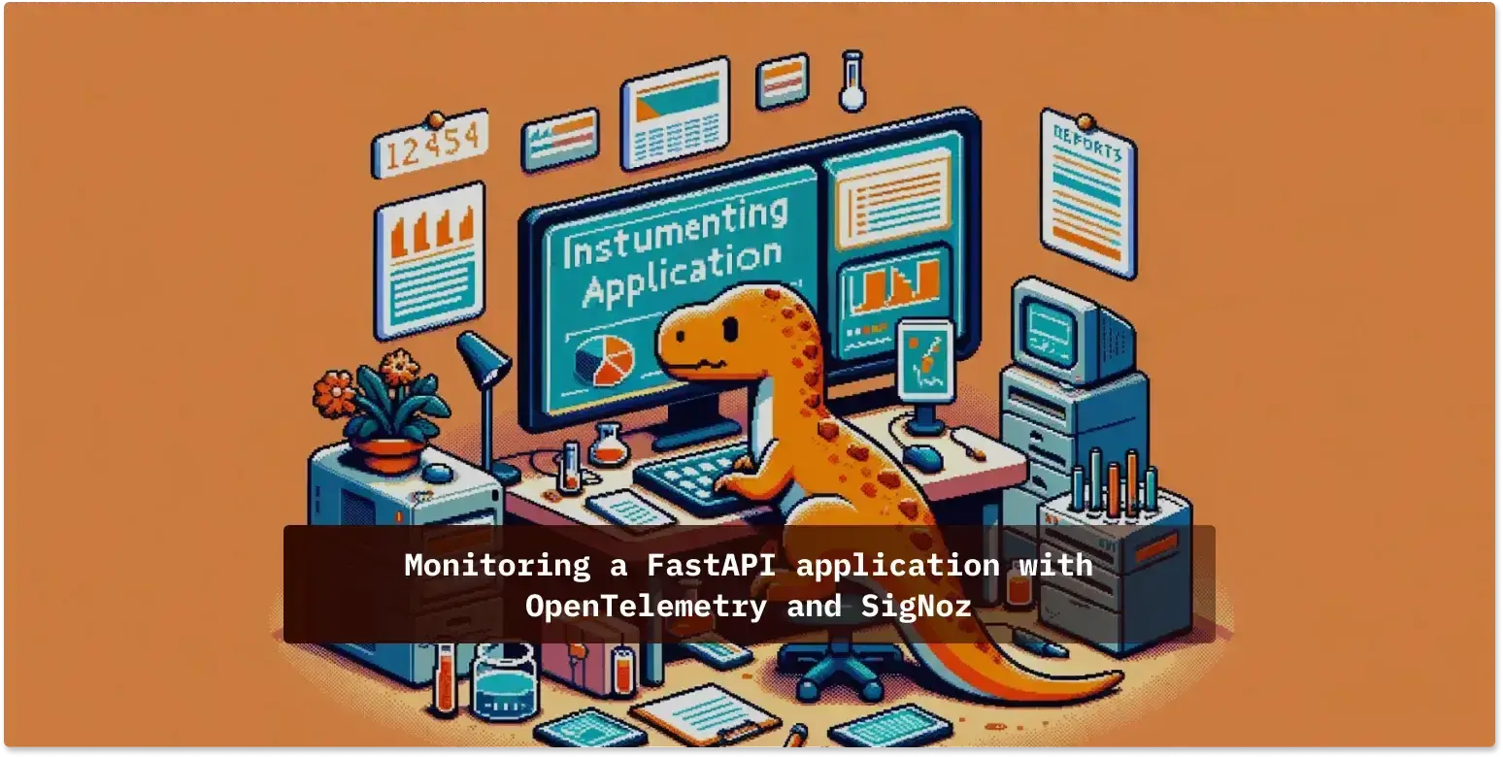
Please follow this article to practice with analysis
Excellent article

Slide 8
Look for
Clicking on a trendline in the metric view to go to trace or log
adding a metric per the last lab and creating a dashboard to see it

Slide 9
I changed my view a bit
I needed to develop a Microservice framework for another course
Last week, I was thinking of a Microservice as a function
this week I am thinking of a Microservice as a collection of endpoints
produced by an autonomous team

Slide 10
This approach is supported
by flask or fastapi in python
hono in ts/js
spark framework in Java
Carter in dotnet

Slide 11
On Infrastructure like
AWS Lambda
knative
cloudflare functions
Azure functions

Slide 12
Next week
We will start with Microservices

