Slide 1
Observability

Slide 2
Agenda
Introduce the Challenge/Activity
Theory to support learning outcomes and the Activity
Initial demo of activity
Note: See chapter 1 and 2 from the text

Slide 3
The Challenge
Create a codespace from the github template and run:
ansible-playbook toaster.yml
Observe the running system and use the umlet vscode plugin to document it with a deployment diagram. Submit the deployment diagram with the uploader at the end of the presentation.

Slide 4
Unit Learning Objectives
Explain the advantages tracing has over plain logging for root cause analysis of an issue.
Consider metrics like utilization, saturation and errors for system health.
Give reasons for REDS/Google golden metrics being an improvement for understanding how happy users will be with a system.
Consider logs, log levels and log models as a way of understanding software issues.

Slide 5
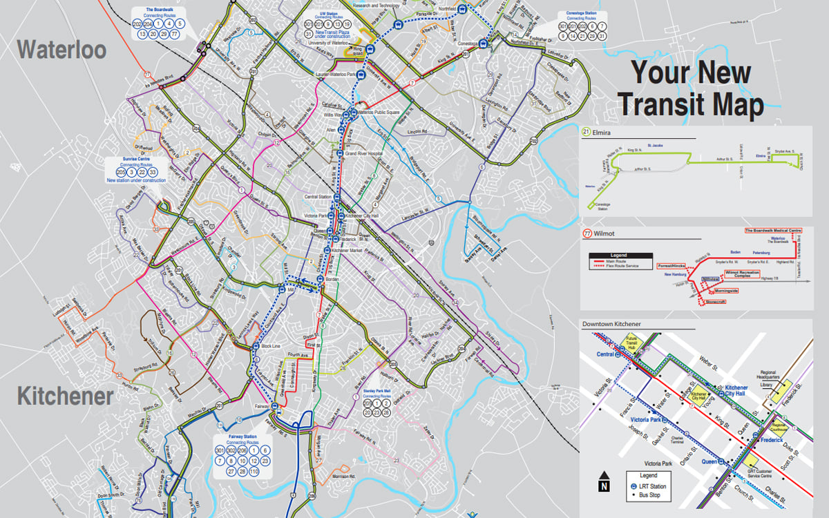
Who came by bus today?
GRT Map

Slide 6
Bus Stakeholders
Do they all care about observing the same things?
riders
municipality
the garage
drivers
staffing coordinators
A complete view of observability integrates the needs of all Stakeholders

Slide 7
Riders (users of the system)
care about the current location of the bus they wish to get on
a metric with attributes of bus: 1234, route: 201, lat: 43.48171410601913, long: -80.51813393653605 timestamp: 1725052424
the eta of the bus at their location
projection from a time series of the last 4 stops and the time it took last time

Slide 8
Municipality
care about how riders use the system, which buses they take, how many transfers, what time of day
tracing a rider from when they get on their first bus to when they get off their last
care about how many riders are on each bus at any time and place
a metric with attributes of bus: 1234, route: 201, lat: 43.48171410601913, long: -80.51813393653605 timestamp: 1725052424, riders: 42

Slide 9
Garage
care about logs for the particular bus that they have in front of them
they may do inspections, but will rely on logs to know any problems with the bus
need sensor data for other things like predictive maintenance
this could also be from logs on the bus or from metrics reported directly by sensors
metrics would allow them to get the bus in for predictive maintenance

Slide 10
Drivers
care about their own schedules
a customized report produced from the database for them
care about the scheduled arrival times at each stop
could add another difference from schedule attribute to the stop arrival metric in the previous slide with an alert when the metric is greater than 90 seconds in either direction

Slide 11
Staffing Coordinators
care about ridership metrics somewhat for the rare occasions they could schedule an extra bus
care about stop arrival metrics that also include the drivers
drivers can’t be early or late at stops

Slide 12
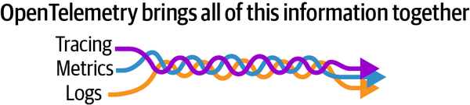
Different Observers Have Different Interests
The braid of open telemetry

