Slide 1
Microfrontend (instrumenting)

Slide 2
Agenda
Review Analysis with signoz and fastapi
Look at javascript otel
Microfrontend talk
Initial demo of activity

Slide 3
Learning Outcomes
Interpret information from logs to reproduce and resolve problems.
Measure REDS metrics in a microservice by adding and incrementing the appropriate counters.
Determine metrics from the point of view of the customer from a micro-frontend

Slide 4
Analysis with signoz and fastapi
today’s microfrontend is based on fastapi as on last week
Hopefully you are comfortable with viewing metrics, logs and traces in signoz
the app last week was in the /app folder
this week the app is /app.py
please instrument it and run as in the other lab once you are comfortable with what it does.

Slide 5
Instrumenting front end code
while preparing, I did this javascript example.
this is based on a javascript example.
the javascript code for this project is in /index.js
please instrument it and run as in the other lab once you are comfortable with what it does.

Slide 6
Microfrontends
for autonomous teams to develop software that can then be composed in to an application
reduce coupling!
Martin Fowler wrote about this is this excellent article
the holy grail of distributed systems
not as well adopted as one would hope for

Slide 7
Composition
micro frontends have custom elements for their autonomous user interfaces
a custom element extends a HTMLElement to implement a particular new tag
class Year extends HTMLElement { connectedCallback() { this.innerHTML = new Date().getFullYear(); } }

Slide 8
The custom element is pulled in by
customElements.define("x-date", Year);
and
<script src="index.js" type="module"></script>

Slide 9
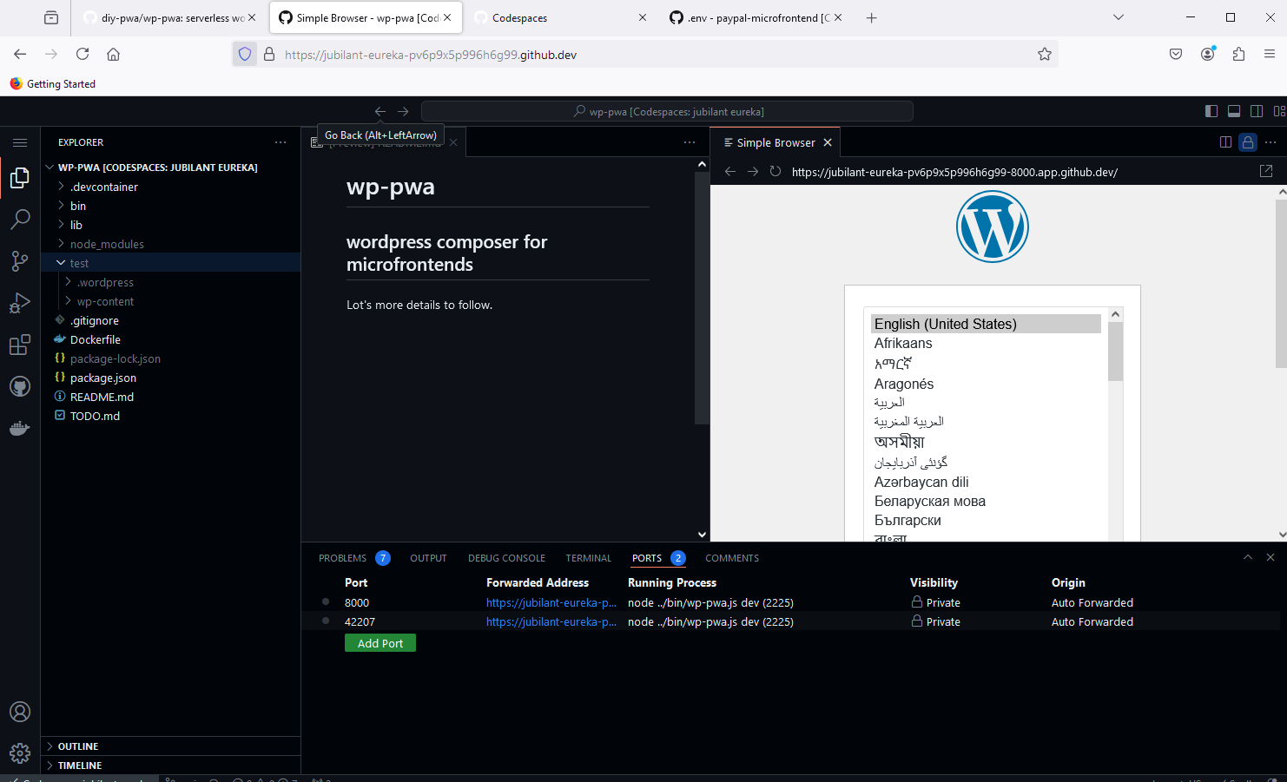
The script brings the custom tag in anywhere
in wordpress

Slide 10
Even into legacy apps
retrieve with wget -r
build with figma and TeleportHQ
or with something like Rails, Django or Symphony

Slide 11
Monitoring and Logging
so important with autonomous teams
the devOps group may be the only ones who see the whole application
important to get the repository path as the service.name
very important to get the commit hash
monitoring and logging can take away some of the passion about what code belongs to which autonomous team

Slide 12
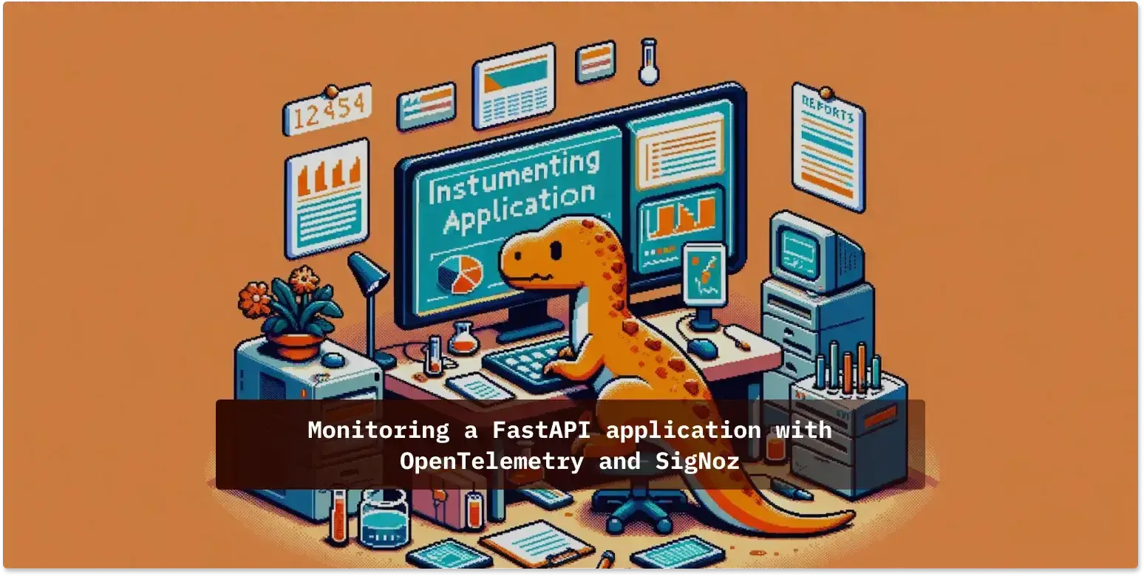
The article last week
had something on distributed tracing

Slide 13
Correlating Traces Across Microservices
also important with Microfrontends
from opentelemetry.propagate import extract, inject ctx = extract(request.headers) with tracer.start_as_current_span("get_user", context=ctx): inject(headers)

Slide 14
strace
traces system calls of a particular process
with autonomous teams and microfrontends we need to trace across processes
opentelemetry lets us do that in a way that we can really add value beyond predictability to our companies

Slide 15
This week’s activity
to instrument the code in the lab.
add signoz to your project like in last week’s lab
you do not need to worry about logging on the javascript side
that’s what next week’s activity will be about

