Slide 1
Database (collecting)

Slide 2
Agenda
Review last week’s lesson on Telemetry
Introduce the Challenge/Activity
Theory to support learning outcomes and the Activity
Initial demo of activity
Based on The New Observability model (end of chapter 4)

Slide 3
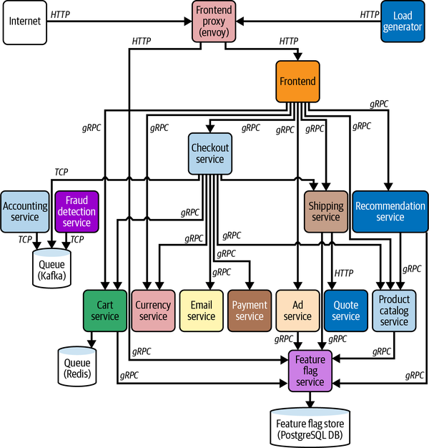
Finding Needles in Haystacks
Open Telemetry Demo

Slide 4
Probably a bit more complex
… than what you will see at work
more languages
each service has a single responsibilty
microservices and microfrontends allow autonomus teams

Slide 5
Database Observability Challenge
Create a codespace from this github template. Use the article at to instrument. If this ends up a struggle try to understand the runSQLQuery part with the theory about the system of record.

