Slide 1
Database (analysis)

Slide 2
Agenda
More from last week’s lesson on collecting
Introduce the Challenge/Activity
Theory to support learning outcomes and the Activity
Initial demo of activity

Slide 3
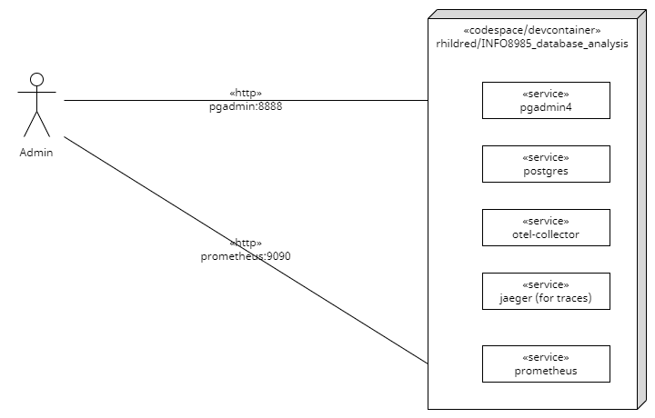
More Complete Example
Deployment Diagram

Slide 4
Bounty for Kubernetes
notice that I have used docker-compose for this
couldn’t get the otel-collector to send metrics to prometheus
would be very interested if you could compare templates/otel-collector-cm0-configmap.yaml to the opentelemetry demo values.yaml and get it working.

Slide 5
Database Analysis Challenge
Create a codespace from this github template.
Use the pg_stat_database table to receive RED metrics.
test with pgadmin
you can trigger a rollback/error by making a syntax error in your sql
submit the otel-collector yaml that logs RED metrics

Slide 6
Unit Learning Objectives
Measure baseline metrics for the database of a system.
Select thresholds for logging long running queries.
Infer causes of system issues by finding exceptions from baseline behaviour and drawing correlation to logs and other database events.
Justify metric thresholds for generating alerts so that they can be responded to appropriately.
Support management overview of data running through the system by generating daily reports.

Slide 7
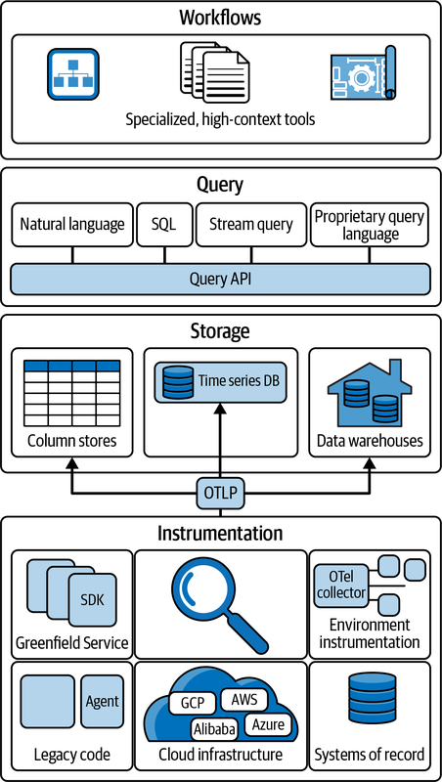
Many sources of Observability
Open Telemetry Protocol

Slide 8
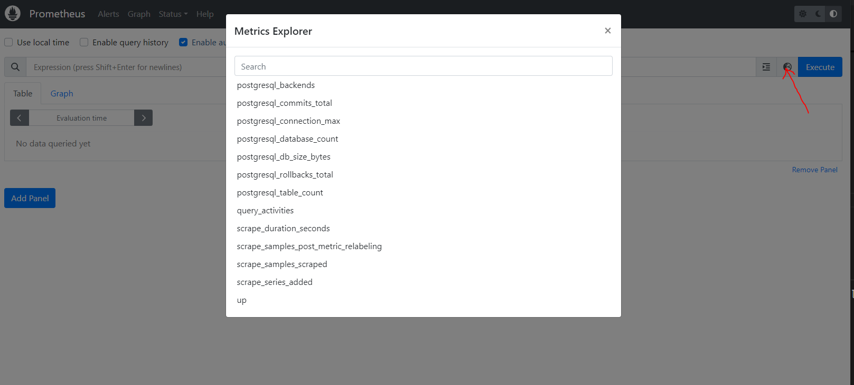
View in Prometheus
available metrics

Slide 9
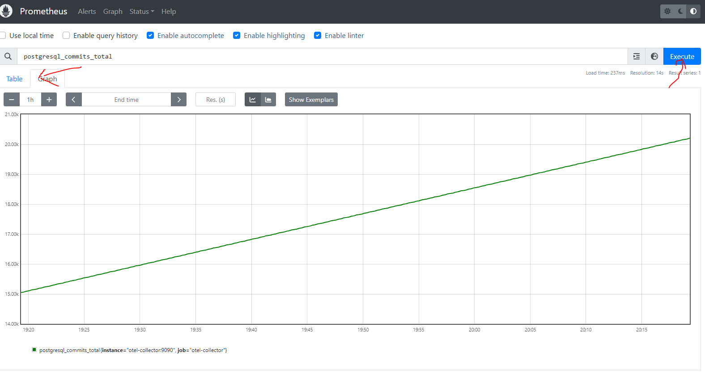
See on a graph
total commits

Slide 10
Baseline metrics
REDS is a good start
for instance to get total number of transactions
SELECT sum(xact_commit+xact_rollback) FROM pg_stat_database;
read more at https://signoz.io/blog/postgresql-monitoring/

Slide 11
Errors
SELECT sum(xact_rollback) FROM pg_stat_database;
for testing you can trigger a rollback by making a SQL error like SELECT * FROM pg_stats_database
you can also try out the pg_stat_database queries in pgadmin

Slide 12
Duration
SELECT SUM(active_time) FROM pg_stat_database;
the average duration is this, divided by the number of requests

Slide 13
Saturation
ran out of time to get the Saturation
thinking that this could be obtained from kubernetes or docker by looking at %cpu for the postgres service

Slide 14
Long running queries
a query is a problem when the request rate is greater than the duration
if it takes 2 seconds to run a query and the average request rate is 2 per minute, there is no problem
if the request rate is greater than 30 per minute there is a big problem

Slide 15
To find long running queries
SELECT pid, now() - pg_stat_activity.query_start AS duration, query FROM pg_stat_activity WHERE (now() - pg_stat_activity.query_start) > interval '2 minutes';

Slide 16
Log rather than metric
queries: - sql: <from above> logs: - structured_body: true

Slide 17
User problems …
can sometimes be traced back to database problems
the system becoming bogged down can be caused by duration > arrival rate and fixed by adding indexes
exceptions from database logs can relate to gateway timeouts from unhandled exceptions in the

Slide 18
Alerts can be generated
… when metrics collected from pg_stat??? are out of range
read more in https://prometheus.io/docs/alerting/latest/overview/

Slide 19
Reporting for management
management is driven by metrics too
Key performance indicators relate to business goals/ effectiveness
Metrics track the status of business processes
a SMART KPI is Specific, Measurable, Achievable, Relevant, and Time-bound

Slide 20
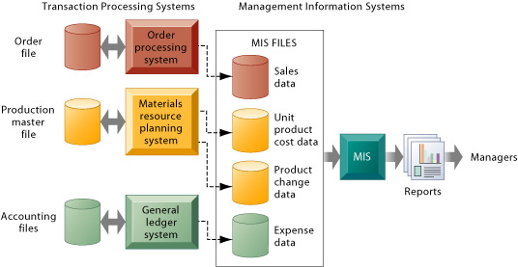
Metrics from the system of record
Management Information Systems

Slide 21
Collecting from the database
produce systems information to meet the needs of different stakeholders
this week for the lab follow the given links looking especially at SQL queries for different stakeholders

