Slide 1
Microservice (instrumenting)

Slide 2
Agenda
Introduce the Challenge/Activity
Theory to support learning outcomes and the Activity
Initial demo of activity

Slide 3
Microservice white box Challenge
Create a codespace from this github template.
follow the instructions in the README.md

Slide 4
Learning Outcomes
Support traces in a microservice by setting up custom spans so that code traces are available for troubleshooting.
Measure REDS metrics in a microservice by adding and incrementing the appropriate counters.
Integrate language logs by centralizing as open telemetry loggers.

Slide 5
Micro services
separate deployable
meant to be provided by an autonomous team
this is a great way to get things done in parallel
continuous integration and deployment
internal and external apis are done this way
scale to 0 when not being used to not incur billing

Slide 6
Micro Service Platforms
AWS Lambda
Google Cloud Functions
Azure Functions
knative functions
Cloudflare pages and functions or workers

Slide 7
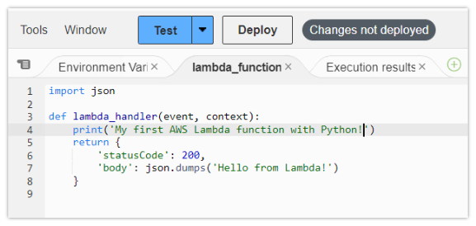
AWS Lambda
python code

Slide 8
Google Cloud Functions
import functions_framework from markupsafe import escape @functions_framework.http def hello_http(request): name = "World" return f"Hello {escape(name)}!" # escape as could be from request

Slide 9
Azure functions
uses a func cli to scaffold and developer adds code to implement (and instrument)
The generated function_app.py project file contains your functions.
End-to-end development tools are available for all stages of the development cycle.
Numerous programming languages are supported, and hosting alternatives are available.

Slide 10
Example function_app.py
import azure.functions as func app = func.FunctionApp() @app.function_name(name="HttpTrigger1") @app.route(route="req") def main(req: func.HttpRequest) -> str: user = req.params.get("user") return f"Hello, {user}!"

Slide 11
Knative functions
also uses a func cli to scaffold and developer adds code to implement (and instrument)
adapter to run azure function on kubernetes … Kubernetes-based Event Driven Autoscaling (KEDA)
essentially anything that can be a docker image can be run in knative
a little more boilerplate code than the previous examples

Slide 12
Instrumenting
instrumenting a python microservice is like instrumenting a flask app
example from a couple of weeks ago is included in the lab so that you can start with working code
I got a lot further during the break by using signoz
made signoz work with kubernetes cluster in a codespace

Slide 13
Always remember to re-raise Exceptions
except ValueError as exc: ... raise
otel and signoz handle exceptions as traces
appear separately

Slide 14
Signoz has good presentation of exceptions
from opentelemetry import trace span = trace.get_current_span() except ValueError as exc: # Record the exception and update the span status. span.record_exception(exc) span.set_status(trace.Status(trace.StatusCode.ERROR, str(exc))) raise

Slide 15
Separate logging from handling
import traceback import logging logging.basicConfig(level=logging.INFO) logger = logging.getLogger(__name__) try: do_something_that_might_error() except Exception as error: logger.debug(traceback.format_exc()) raise

Slide 16
Separate Metric from handling
try: do_something_that_might_error() except: error_counter.add(1, {"error.module": __name__}) raise

Slide 17
I am a lot happier
got otel collector working with kubernetes and app.py
signoz built for opentelemetry from the ground up
super easy to create dashboards for metrics
logs, traces, exceptions and metrics all in the same place

Slide 18
In the next few weeks
complete instrumentation of knative python function
look in depth at analysis with signoz
get metrics, log, trace and get exceptions from javascript micro-frontends
instrument and analyze a complete open source app

