Slide 1
Database (collecting)

Slide 2
Agenda
Review last week’s lesson on Telemetry
Introduce the Challenge/Activity
Theory to support learning outcomes and the Activity
Initial demo of activity
Based on The New Observability model (end of chapter 4)

Slide 3
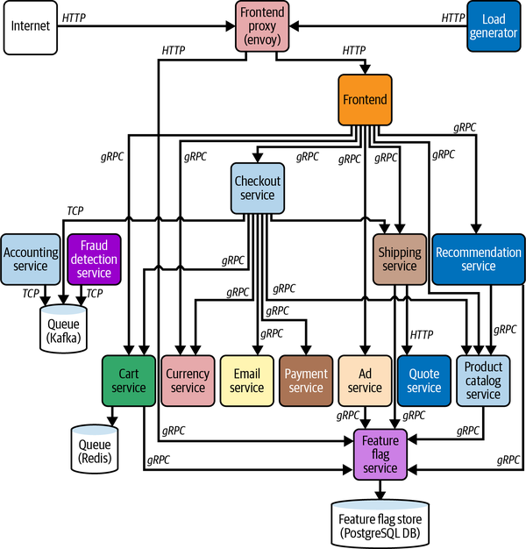
Finding Needles in Haystacks
Open Telemetry Demo

Slide 4
Probably a bit more complex
… than what you will see at work
more languages
each service has a single responsibilty
microservices and microfrontends allow autonomus teams

Slide 5
Database Observability Challenge
Create a codespace from this github template. Use the article at to instrument. If this ends up a struggle try to understand the runSQLQuery part with the theory about the system of record.

Slide 6
Unit Learning Objectives
Measure baseline metrics for the database of a system.
Select thresholds for logging long running queries.
Infer causes of system issues by finding exceptions from baseline behaviour and drawing correlation to logs and other database events.
Justify metric thresholds for generating alerts so that they can be responded to appropriately.
Support management overview of data running through the system by generating daily reports.

Slide 7
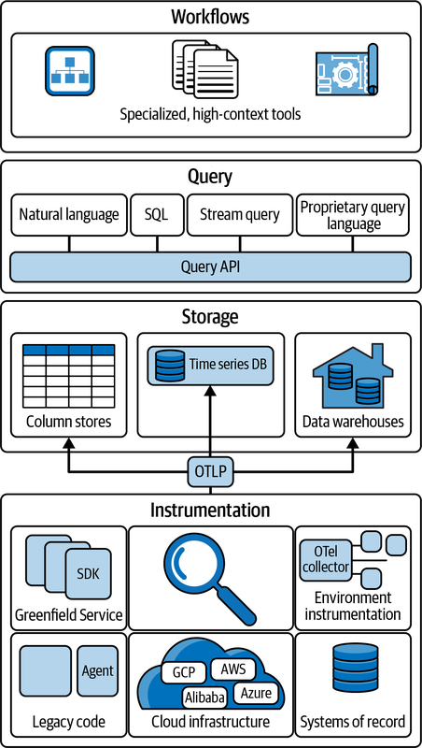
Many sources of Observability
Open Telemetry Protocol

Slide 8
Baseline metrics
REDS is a good start
for instance to get total number of transactions
SELECT sum(xact_commit+xact_rollback) FROM pg_stat_database;
read more at https://signoz.io/blog/postgresql-monitoring/

Slide 9
Long running queries
a query is a problem when the request rate is greater than the duration
if it takes 2 seconds to run a query and the average request rate is 2 per minute, there is no problem
if the request rate is greater than 30 per minute there is a big problem
SELECT pid, now() - pg_stat_activity.query_start AS duration, query FROM pg_stat_activity WHERE (now() - pg_stat_activity.query_start) > interval '2 minutes';

Slide 10
User problems …
can sometimes be traced back to database problems
the system becoming bogged down can be caused by duration > arrival rate and fixed by adding
exceptions from database logs can relate to gateway timeouts from unhandled exceptions in the

Slide 11
Alerts can be generated
… when metrics collected from pg_stat??? are out of range
read more in https://prometheus.io/docs/alerting/latest/overview/

Slide 12
Reporting for management
management is driven by metrics too
Key performance indicators relate to business goals/ effectiveness
Metrics track the status of business processes
a SMART KPI is Specific, Measurable, Achievable, Relevant, and Time-bound

Slide 13
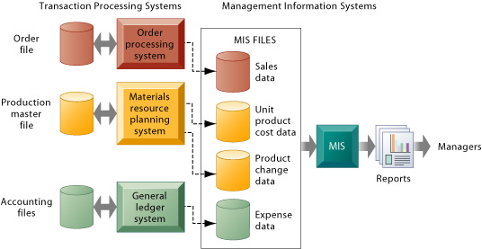
Metrics from the system of record
Management Information Systems

Slide 14
Collecting from the database
produce systems information to meet the needs of different stakeholders
this week for the lab follow the given links looking especially at SQL queries for different stakeholders

