Slide 1
Observability

Slide 2
Agenda
Introduce the Challenge/Activity
Theory to support learning outcomes and the Activity
Initial demo of activity
Note: See chapter 1 and 2 from the text

Slide 3
The Challenge
Create a codespace from the github template and run:
pip install -r requirements.txt ansible-playbook playbook.yml
Follow instructions to observe the running system and use umlet to document it with a deployment diagram. Submit the deployment diagram with the uploader at the end of the presentation.

Slide 4
Unit Learning Objectives
Explain the advantages tracing has over plain logging for root cause analysis of an issue.
Consider metrics like utilization, saturation and errors for system health.
Give reasons for REDS/Google golden metrics being an improvement for understanding how happy users will be with a system.
Consider logs, log levels and log models as a way of understanding software issues.

Slide 5
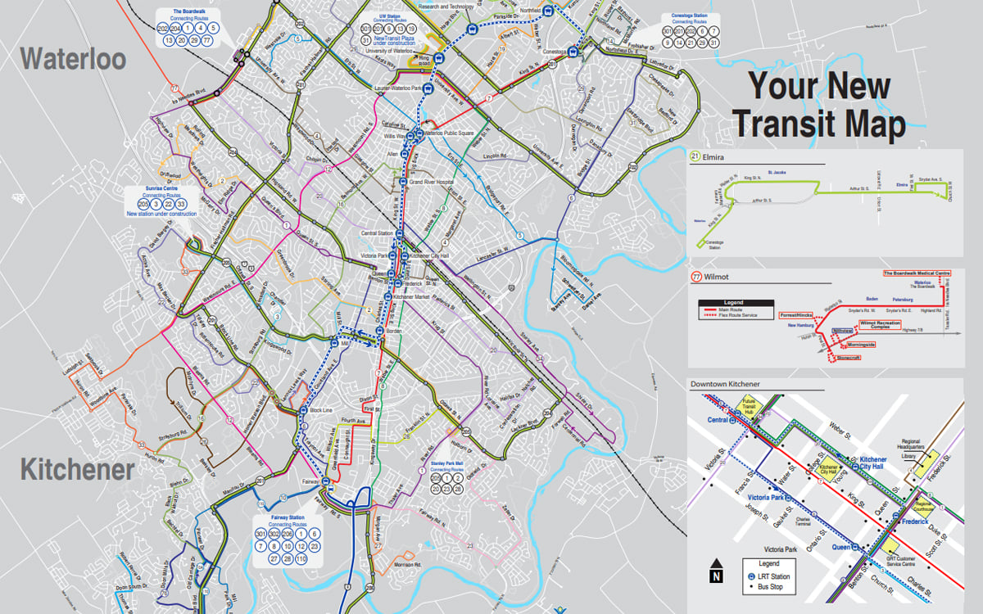
Who came by bus today?
GRT Map

Slide 6
Bus Stakeholders
Do they all care about observing the same things?
riders
municipality
the garage
drivers
staffing coordinators
Complete observability integrates the needs of all Stakeholders

Slide 7
Riders (users of the system)
care about the current location of the bus they wish to get on
a metric with attributes of bus: 1234, route: 201, lat: 43.48171410601913, long: -80.51813393653605 timestamp: 1725052424
the eta of the bus at their location
projection from a time series of the last 4 stops and the time it took last time

Slide 8
Municipality
care about which buses riders take, how many transfers, what time of day, how many riders are on each bus at any time and place
tracing a rider from when they get on their first bus to when they get off their last
a metric with attributes of bus: 1234, route: 201, lat: 43.48171410601913, long: -80.51813393653605 timestamp: 1725052424, riders: 42

Slide 9
Garage
care about problem logs for the particular bus that they have in front of them
need sensor data for other things like predictive maintenance
this could also be from logs on the bus or from metrics reported directly by sensors
metrics would allow them to get the bus in for predictive maintenance

Slide 10
Drivers
care about their own schedules
a customized report produced from the database for them
care about the scheduled arrival times at each stop
could add another difference from schedule attribute to the stop arrival metric in the previous slide with an alert when the metric is greater than 90 seconds in either direction

Slide 11
Staffing Coordinators
rely on logs to know any problems with the bus
care about ridership metrics somewhat for the rare occasions they could schedule an extra bus
care about stop arrival metrics that also include whether the drivers are early or late at stops

Slide 12
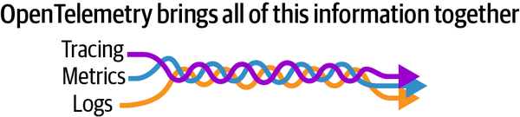
Different Observers Have Different Interests
Learning Open Telemetry

Slide 13
Tracing
bus example traces a particular rider spanning their entire trip.
the advantage of tracing is that it provides observability of an actor as they go through multiple services
in contrast, logging is from the perspective of the system rather than the actor

Slide 14
Metrics
key performance indicators for the different stakeholders of the system
in the bus example utilization would be riders
saturation is the riders divided by capacity of the bus
errors are drivers being 90 seconds or more early or late at stops

Slide 15
REDS
Requests
Errors
Duration
Saturation

Slide 16
REDS adds
requests, for instance the number of riders that start trips
duration, the time they spend on the bus system
in the GRT we don’t tap off so this one is tricky
if we narrow focus to the ticket purchasing app see that errors, requests, and duration tell us something about our user experience

Slide 17
Google Golden Signals
The four golden signals of monitoring are latency, traffic, errors, and saturation. If you can only measure four metrics of your user-facing system, focus on these four.
Latency
The time it takes to service a request.

Slide 18
Google Golden Signals (cont.)
Traffic
A measure of how much demand is being placed on your system.
Errors
The rate of requests that fail.
Saturation
How “full” your service is.

Slide 19

Logs
Thinkstock

Slide 20
Logs … topic by themselves
text-based messages meant for human consumption that describe the state of a system or service
for instance, that a file couldn’t be written because the storage device was out of space
full observability, by contrast, track available storage capacity
leading indicators to prevent a failure that can be logged

Slide 21
Log levels
Level | What it means / When to use it
logging.NOTSET | When set on a logger, indicates that ancestor loggers are to be consulted to determine the effective level. If that still resolves to NOTSET, then all events are logged. When set on a handler, all events are handled.
logging.DEBUG | Detailed information, typically only of interest to a developer trying to diagnose a problem.
logging.INFO | Confirmation that things are working as expected.

Slide 22
Log levels (cont)
Level | What it means / When to use it
logging.WARNING | An indication that something unexpected happened, or that a problem might occur in the near future (e.g. ‘disk space low’). The software is still working as expected.
logging.ERROR | Due to a more serious problem, the software has not been able to perform some function.
logging.CRITICAL | A serious error, indicating that the program itself may be unable to continue running.

Slide 23
Log models
models semi structure the data in the logs
import logging logging.basicConfig(format='%(asctime)s %(clientip)-15s %(user)-8s %(message)s') logger = logging.getLogger('tcpserver') logger.warning('Protocol problem: %s', 'connection reset', extra={'clientip': '192.168.0.1', 'user': 'fbloggs'})

Slide 24
Something went wrong
Our engineers have been notified and are working on the problem
observability, yes (if the devops engineers actually have been notified)
messages like this are shown to users in the case of unhandled exceptions

Slide 25
Please don’t
… make an exception observable and then swallow it
exception handling is different then making the exception observable
always re-throw the exception at the point of writing a metric or logging

Slide 26
Observability
observability is in the process of changing for the better
the heart of that change will be a newfound ability to correlate across all forms of telemetry: traces, metrics, logs
correlation is the key to unlocking the workflows and automation that we desperately need to keep up with this world of ever expanding complex systems.

