Slide 1
Microservice (instrumenting)

Slide 2
Agenda
… Going to seem a lot like the flask app
Introduce the Challenge/Activity
Theory to support learning outcomes and the Activity
Initial demo of activity

Slide 3
Monolithic white box Challenge
Create a codespace from this github template.
follow the instructions in the README.md

Slide 4
Learning Outcomes
Support traces in a microservice by setting up custom spans so that code traces are available for troubleshooting.
Measure REDS metrics in a microservice by adding and incrementing the appropriate counters.
Integrate language logs by centralizing as open telemetry loggers.

Slide 5
Micro Services
AWS Lambda
Google Cloud Functions
Azure Functions
Cloudflare pages and functions or workers

Slide 6
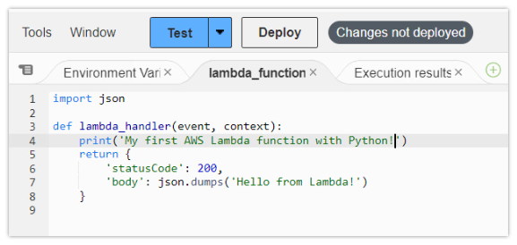
AWS Lambda
python code

Slide 7
Google Cloud Functions
import functions_framework from markupsafe import escape @functions_framework.http def hello_http(request): name = "World" return f"Hello {escape(name)}!" # escape as could be from request

Slide 8
Azure/Knative Functions
both use a func cli with somewhat different parameters and output
there is also a kn cli for knative
kn cli makes services from a regular docker image/ Dockerfile

