Slide 1
Active Record
(PROG1730 #1 (12F) Database Design)
Rich Hildred
rhildred@conestogac.on.ca
519-594-0900
2D04 (Waterloo Campus)

Slide 2
Objectives
Introduce the idea of design patterns
  Adaptor
  Factory Method
  Domain Model
  Active Record
  Approval
  Oauth
Notes:
Kathryn

Slide 3
Objectives (continued)
Object to Relational Mapping
  Semantics
  ObjectID
Security
  7 Functional Users

Slide 4

Design Patterns
Christopher Alexander 1977-1979
Ward Cunningham 1987
Martin Fowler – 2002
Structural
Creational
Behavioral

Slide 5
Adaptor
Type: Structural
What it is:
  Convert the interface of a class into another interface that clients expect. Lets classes work together that otherwise couldn’t because of incompatible interfaces.

Slide 6

Factory Method
Type: Creational
What it is:
  Define an interface for creating an object, but let subclasses decide which class to instantiate. Lets a class defer instantiation to subclass.

Slide 7
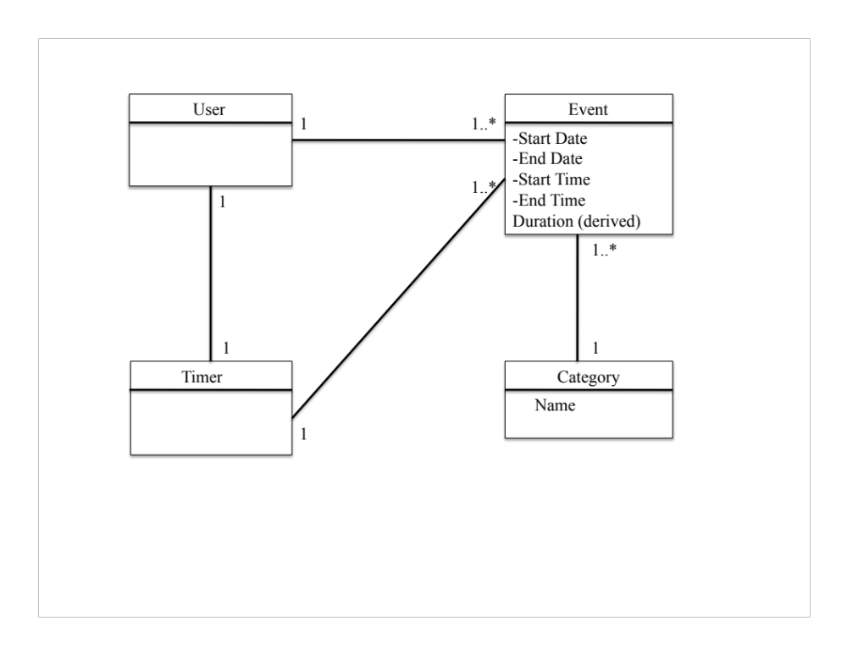
Domain Model
Type: Structural
What It is:
  Define the pattern between entities in the customer’s language. Lets programmers understand the customer’s language using abstraction.

Slide 8
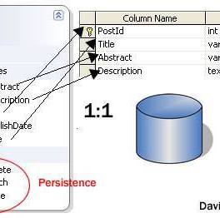
Active Record
Type: Behavioral
What it is:
  An object that wraps a row in a database table or view, encapsulates the database access, and adds domain logic on that data.

Slide 9

Approval
Type: Behavioral
What It is:
  When someone adds you as a friend, Facebook sends you a notification prompting you to confirm or deny the request. If you approve the request, that person is added.

Slide 10

Oauth
Type: Behavioral
What It is:
  Specifies a protocol for establishing system-to-system authorization. It allows you to approve access to your data on one system to another system acting on your behalf.

Slide 11
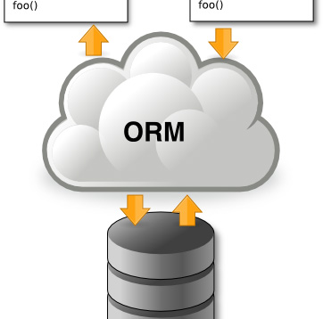
Object To Relational Mapping
bind an object to its data in the database
Productivity
Application Design
Code Reuse
Application Maintainability

Slide 12
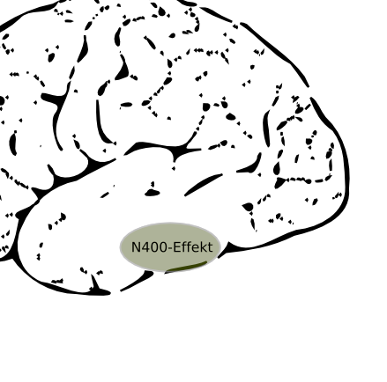
Semantics
A class is named Singularly – Person
A collection of objects of a single class is named in the plural – People
A table is viewed as a collection of objects of the same class - People

Slide 13
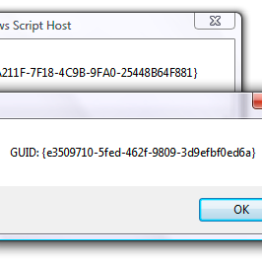
ObjectId
Characteristic of an Object Oriented Database
Can even be a GUID
Often implemented as a primary key auto incrementing
By Convention “id”

Slide 14
In Addition to Domain Methods
 | var oPerson = ActiveRecord::create(‘person’);
C | oPerson.fname = “Richard”; oPerson.lname = “Hildred”; oPerson.save(fComplete); // fComplete is a function that gets called on completion
R | oPerson.find(‘lname = ?’, array(‘Hildred’), fComplete); //fComplete is a function that gets called on completion oPerson.load(‘lname = ?’, array(‘Hildred’), fComplete); // like find but only loads 1 object
U | oPerson.fname = “Rich”; oPerson.save(fComplete); // fComplete is a function that gets called on completion
D | oPerson.delete(fComplete); //fComplete is a function that gets called on completion

Slide 15

Security
All security has to come from database
Attackers can make your javascript do anything

Slide 16
7 functional users
CREATE USER | GRANT
ReadOnly | GRANT SELECT on tables that anyone should be able to see
LoggedInReadOnly | GRANT SELECT on tables that a logged in user can see
AdminReadOnly | GRANT SELECT on tables that an admin user can see
LoggedInUpdate | GRANT INSERT and UPDATE to tables that anyone that is logged in can update
AdminUpdate | GRANT INSERT and UPDATE to tables that only an admin can update

Slide 17
7 functional users (continued)
CREATE USER | GRANT
LoggedInDelete | GRANT DELETE on tables that a logged in user can delete from
AdminDelete | GRANT DELETE on tables that only an admin user can delete from

Slide 18

Views
Views create an object in the database that a USER can be GRANTed privileges to.

Slide 19

Entity Integrity
Extended by Active Record pattern to say that each object must have a unique id that is also the PRIMARY KEY in the database
By convention called “id”

Slide 20
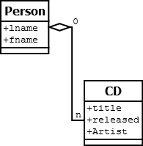
Relational Integrity
Pretty much guaranteed that bad data will be attempted
Relational Integrity is an important protection against a cd belonging to someone who doesn’t exist

Slide 21

Legal Values Integrity
SQL
  CHECK clause enforces legal-values integrity
  Example:
  CHECK (CreditLimit IN (5000, 7500, 10000, 15000))

