Slide 1
Agent UML
Stefano Lorenzelli e-mail: 1999s024@educ.disi.unige.it

Slide 2
Summary
Introduction to agents
Agent-oriented programming
Introduction to Agent UML
Class Diagram
Interaction Diagram

Slide 3
What is an agent
An agent is an hardware or software system placed in an environment that enjoys the following properties:
    Autonomy
    Social ability
    Reactivity
    Proactivity
    [Wooldridge et al, 1995]

Slide 4
A stronger notion of agent
Another stronger notion assigns to the agent also the following properties:
  Mentalistic notions:
    Beliefs
    Desires
    Intentions
  Emotional notions:
    Trust
    Friendship
    Suspiciousness
    [Wooldridge et al, 1995]

Slide 5
When agent notion is useful
The agent notion is adaptable to many HW and SW systems but it is particularly useful in such contexts where complexity is high enough to make the simple notion of object insufficient to describe the system.
The focus is on the behaviour of agents and not on the content of objects (attributes and methods).
Agent-oriented programming is at an abstraction level higher than object-oriented programming.

Slide 6
Agent-oriented programming (1)
Agent-oriented programming (AOP) is a specialisation of object-oriented programming (OOP) in the way the computational system is conceived:
“The computational system is seen as composed of communicating modules, each with its own way of handling messages.” [Shoham, 1993]
The (mental) state of modules (agents) consists of components such as beliefs, capabilities and intentions.

Slide 7
Agent-oriented programming (2)
A computation consists of agents that:
  Inform other agents about facts
  Offer and request services
  Accept or refuse proposals
  Compete for accessing shared resources
  Collaborate for achieving common goals
 | OOP | AOP
Basic unit | Object | Agent
Parameters defining state of basic unit | Unconstrained | Belief, commitments, chioces, …
Process of computation | Message passing and response methods | Message passing and response methods
Types of messages | Unconstrained | Inform, request, offer, promise, decline
Constraints on methods | None | Honesty, consistency, …

Slide 8
What is Agent UML
Agent UML is a support notation for agent-oriented systems development.
It consists in using the UML modeling language and extending it in order to represent agents, their behaviour and interactions among them.
AUML is not restricted to using UML. Other approaches should be used wherever it makes sense.

Slide 9
Who is interested in AUML
OMG Special Interest Group: recommends standards for agent technology where appropriate (www.omg.org)
FIPA Modeling Technical Commitee: tasked with developing an AUML standard (www.auml.org)
Other methodologies: MESSAGE, Gaia, Tropos, Prometheus, MaSE, ...

Slide 10
Common features of agents
Agents share some common characteristics:
  Identifier
      identifies each agent in a multiagent system
  Role
      defines the behaviour of an agent into the society (es. Seller, Buyer)
  Organization
      defines the relationships between the roles (similar to human or animal organizations such as hierarchies, markets, groups of interest or herds)
  Capability
      specifies what an agent is able to do and under what conditions
  Service
      describes an activity that an agent can perform and is provided to other agents

Slide 11
Representation of agents
UML Class Diagrams can be used to represent the static view of agents.
<<agent>> agent-name
Role role 1, role 2, …, role n role dynamic 1, role dynamic 2, …, role dynamic n
Organization organization 1, organization 2, …, organization n org dynamic 1, org dynamic 2, …, org dynamic n

Slide 12
Capabilities representation (1)
A capability is composed of the following parts:
  Input
    What the agent must receive in input to achieve his task
  Output
    What the capability generates as a result of the work
  Input constraints
    Constraints that are expected to hold in the situation before the action specified by the capability can be performed
  Output constraints
    Constraints hat are expected to hold in the situation after the action specified by the capability has been performed
  Input-output constraints
    Constraints that must hold across input and output situations
  Description
    A description in natural language of the capability

Slide 13
Capabilities representation (2)
<<agent>> sum
Role addition, subtraction rd 1
Organization calculator
Protocol enter-society, exit-society compute
Example of capability representation:
  The agent ‘sum’ has two capabilities expressing the fact that he is able to make additions and subtractions
<<capability>> subtraction
Input x,y:Integer
Output d:Integer
Input Constraint x>=0, y>=0
Input-Output Constraint x-y >=0
Description This capability makes the difference of two integers and returns an integer
<<capability>> addition
Input x,y:Integer
Output s:Integer
Description This capability makes the sum of two integers and returns an integer
They can be defined
using OCL or simple
logic expressions

Slide 14
Service representation (1)
A service is composed of the following parts:
  Name
      The name of the service
  Description
      A description in natural language of the service
  Type
      The type of the service
  Protocol
      A list of interaction protocols supported by the service
  Agent communication language
      The communication languages used in this service
  Ontology
      A list of ontologies supported by the service
  Content language
      A list of content languages supported by the service
  Properties
      A list of properties that discriminate the service

Slide 15
Service representation (2)
<<service>> computation
Description This service makes an addition when requested by the request addition protocol and makes a subtraction when requested by the request-subtraction protocol
Type computation
Protocol request-addition request-subtraction
Agent Communication Language FIPA ACL
Ontology computation ontology
Content Language FIPA SL
<<agent>> sum
Role addition, subtraction rd 1
Organization calculator
Protocol enter-society, exit-society compute
Example of service representation:
  The agent ‘sum’ exports a service that makes additions and subtractions on demand

Slide 16
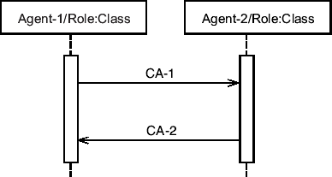
Representing interactions
Agent interactions can be represented in UML standard using sequence diagrams

Slide 17
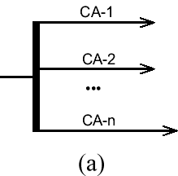
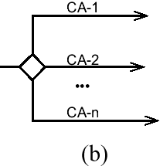
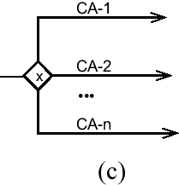
Concurrent interactions (1)
UML has been extended in order to represent concurrent communication acts sent from the sender agent to the receiver.
  a) Concurrent communication acts from CA-1 to CA-n are sent in parallel.
  b) A selection of the n acts is sent in parallel (zero or more).
  c) Exclusive choice: only one of the communication acts is sent.

Slide 18
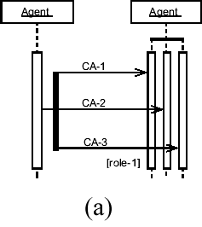
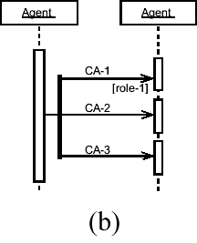
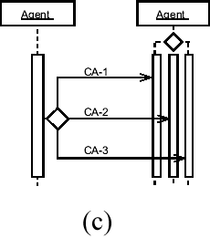
Concurrent interactions (2)
a) An agent sends 3 concurrent CA to another agent. The diagram can be interpreted in two different ways:
  Every CA is processed from the same agent/role by a different thread of execution
  Every CA is processed by a different role of the agent (in this case mesages can be annotated specifying the role)
b) The same semantic of (a) but with a simpler notation
c) Choice from three different communication act received by three different threads (or roles)
NOTE: each concurrent CA can be sent to different agents

Slide 19
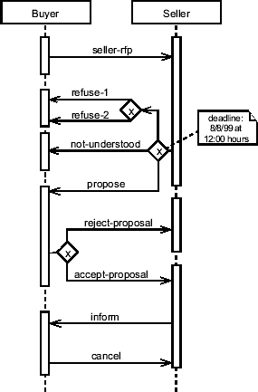
Example of interaction
The Buyer sends a request-for-proposal to the Seller
The Seller has three options to choose within the deadline:
  make a proposal
  refuse (with different reasons)
  say he did not understand
If the Seller has made a proposal, the Buyer has the choice to reject or to accept it
If the last is the case, the Seller schedules the proposal informing the Buyer about its the state
The Buyer can cancel the proposal execution at any time

Slide 20
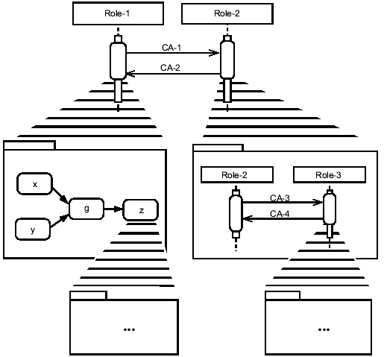
Detailing interaction messages
Any interaction process can be expressed in more detail.
The “leveling” can continue down until the problem has been specified adequately to generate code.
Also activity diagrams and statecharts can be used.

Slide 21
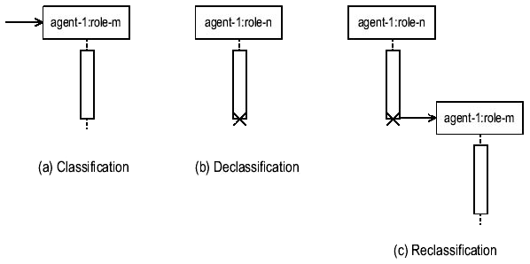
Roles management
UML sequence diagrams can be used to represent changes in agents’ role.

Slide 22
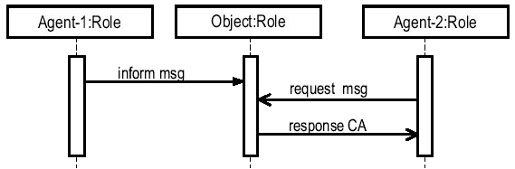
Object role in AOP
Objects may always be included in an agent-oriented system and can communicate with agents using message passing methods.

Slide 23
References (1)
Agents
  [Wooldridge et al, 1995]
  Wooldridge and Jennings
  Intelligent Agents: Theory and Practice
  Knowledge Engineering Review
  Volume 10 No 2, June 1995
  Cambridge University Press
  (www.csc.liv.ac.uk/~mjw/pubs/ker95/ker95-html.html)
  [Shoham, 1993]
  Y. Shoham
  Agent-oriented programming
  Artificial Intelligence
  60(1):51-92
  (http://www.ncat.edu/~esterlin/c7902s02/Notes/Shoham.pdf)

Slide 24
References (2)
Agent UML
  http://www.auml.org/
  http://www.jamesodell.com/
  http://aot.ce.unipr.it/auml/

